Slide 1
A Collaborative Approach to the Convergence of Housing & Tourism
A Case Study by Spencer Wetmore & Brumby McLeod

Slide 2
Situation Analysis
The City of Folly Beach, South Carolina
Notes:
Spencer Wetmore introduction.

Slide 3
City Council Concerns around STR Compliance
Revenue about collecting appropriate taxes;
Fairness concerns that properties were operating on a level playing field as it relates to business license and nightly rental registration requirements
Resident concerns that owners were appropriately advertising and monitoring rentals.

Slide 4
Zoning
The City allows short term rentals in all zoning districts, with the goal of regulating their potential externalities (noise, trash, events, turtle lighting) rather than limiting their scope

Slide 5
Short-term Rental Operating Requirements
All rentals (short and long term) must have a business license: City contracts with Charleston County to renew; first license must be done in City Hall, renewals online through the County;
Short term rentals must complete rental registration form – local contact, fee, info about the rental (parking, bedrooms, manager, etc);
Must post rules and occupancy in the home

Slide 6
College of Charleston
Riley Center for Livable Communities and the Office of Tourism Analysis
Notes:
In the fall of 2016, Spencer and her Director of Zoning, approached me about some concerns they had around short-term rental compliance. Those concerns were similar to what she listed in an earlier slide. At the time of their inquiry, I was preparing for an upcoming research sabbatical in the mountain west to benchmark vacation rental operating requirements across ski resort towns. The choice of these communities was related to their decades of experience with residential nightly rental accommodations and seemed like a natural expansion from the beach communities. Despite the timing and the limiedt budget, I agreed to conduct a quick audit of the Folly Beach short-term rental situation to see if there was evidence of non-compliance.

Slide 7
Office of Tourism Analysis
Existing Relationship
New Project
Vacation Rental Report
Economic Impact Study
Vacation Rental Summit
Short-term Rental Forum
Phase I:
Nightly Rental Compliance Audit
Results
Phase II:
Grant Proposal for Compliance

Slide 8
The Convergence of Housing & Tourism
Sources of Transient Inventory
Notes:
Simply put, where does an overnight guest sleep?

Slide 9
Sources of Transient Inventory
Sources of Transient Inventory
Residential housing (single family homes, condominiums and apartments) represent the largest and most dynamic source of transient inventory in a destination.
Hotels
Other
Condominiums and Apartments
Interval
Single Family Homes
Notes:
Transient inventory refers to accommodation that is available on a short-term basis, most often defined by a stay of less then 30 days. More importantly, these short stays, or transients stays, require the collection of a transient room or occupancy tax in addition to other taxes such as sales tax and local options taxes on the nightly rental charges.
So, what are the sources of transient inventory? When we examine a community for overnight accommodations, hotels are typically the easiest to identify. An additional source of transient inventory, particularly in leisure destinations includes interval accommodations such as timeshare and fractionals. Other types of commercial accommodation are also present such as small inns, bed and breakfast and hostels; these are grouped into other in this diagram. Today, the largest source of transient inventory by property count has become residential housing…here in lies the short-term rental dilemma that we are facing as communities. This transient stay has penetrated beyond the traditional second-home beach community, lake community, or lake community, right into our traditional neighborhoods, the urban core, and historic districts.

Slide 10
Sources of Transient Housing Inventory
Hotels
Other
Condominiums and Apartments
Interval
Single Family Homes
Notes:
So, what are the sources of transient inventory? When we examine a community for overnight accommodations, hotels are typically the easiest to identify. And additional source of transient inventory, particularly in leisure destinations includes interval accommodations such as timeshare and fractionals. Other types of commercial accommodation such as small inns, bed and breakfast and hostels are grouped into other. Today, the largest source of transient inventory by property count has become residential housing. If we take a community and segregate the potential overnight accommodation inventory by product type, such as hotels, interval, other and residential units. Of course, not all condominiums, apartments, and single family homes are in the residential short-term rental pool. From here, we can begin to isolate the residential housing units and determine a destinations housing mix. This was the strategy for our part of the project…to understand the broader bed base context and usage.

Slide 11
Sources of Transient Housing Inventory
Blocks represent the total housing inventory in a destination, jurisdiction, neighborhood, or zone.
Notes:
Of course, not all condos, apartments, and single family homes are in the residential short-term rental pool. Let’s evaluate each of these product types for a few minutes.
This inventory is also highly flexible in its usage and provides a community with residential short-term rentals, seasonal rentals, and long-term rentals. A portion of this inventory is also considered a second-home or vacation home for ownership use only.

Slide 12
What is the housing mix for your community?
Owner Occupied
Long-term Tenant Occupied
Seasonal Second Homes
Owner Occupied
Long-Term Tenant Occupied
Second-home Owner
Notes:
Under a broader bed-base context, there are four usage categories of residential housing. These include owner long-term occupied, long-term rentals, and vacant homes. This set of definitions and parameters is used by the US Census Bureau and the American Community Survey. The forth usage of homes is the short-term rental, and these units come from the three usages identified in this slide.

Slide 13
Where do short-term rentals come from in the housing mix?
x
x
x
x
x
x
x
x
x
x
Owner Occupied
Long-Term Tenant Occupied
Second home Owner
Short-Term Rental
Notes:
The solid red might represent rent-by-owner and the red patterned cubes represent professionally managed or multi-unit operators. The white x might represent non-compliant properties.

Slide 14
Sabbatical Research Study

Slide 15
Primary Goals of the Research
Comparative study of benchmark mountain destinations
Document requirements for operating residential nightly rentals;
Identify the current housing mix usage for these jurisdictions;
Develop a housing fact-base for the Town of Vail, CO using existing data sources.
Notes:
In the winter/spring of 2017, my host sabbatical organization and a third party research team conducted a benchmark study related to the processes for operating residential nightly rentals in a collection of peer mountain jurisdictions.

Slide 16
Municipality | Zoning | Life Safety | Public Notice | HOA | Tax | Business License | Permit | Education | Quality | Fees
City of Aspen |  |  |  | X | X | X | X | X |  | $150 +
Town of Breckenridge | X |  |  |  | X | X | X |  |  | $75 +
Town of Crested Butte | X |  |  |  | X | X |  |  |  | $10 +
City of Durango | X | X | X |  | X | X | X | X |  | $750 +
Town of Jackson | X | X | X | X | X | X |  | X |  | $37 +
Park City Municipal Corporation | X | X |  |  | X | X |  | X |  | $149 +
City of South Lake Tahoe | X | X | X |  | X | X | X | X |  | $545 +
City of Steamboat Springs | X |  |  | X | X | X | X |  |  | $500 +
Town of Telluride | X |  |  |  | X | X |  |  |  | $187 +
Town of Vail |  |  |  |  | X | X |  |  | X | $162 +
Notes:
Municipal licensing and related compliance of short term rentals is evolving rapidly and very significantly among tax collecting entities. When aggressively pursued, the licensing/compliance process successfully measures not just the supply but the use and related revenue stream from related units and has collateral value by encouraging compliance and increasing associated revenues. In addition, it creates barriers and hurdles to entering into the short-term rental business.
The Town of Vail began licensing at the onset of 2016 (and at end of Q3 2016) had about 300 so called, rent-by-owner units licensed. More aggressive licensing/compliance have multiple benefits including better understanding and compliance from existing units. Considerations related to the mechanics of licensing, compliance and enforcement along with related costs are a major consideration, thus the assessment of similar mountain towns and their short-term rental requirements.
The following table summarizes each town assessed by whether or not there were elements of a particular requirement included in the town requirements. The categories of assessment included zoning, life safety, public notice, HOA, tax, Business licensing, permitting, education, quality rating, and fees.

Slide 17
Municipality | Total Housing Units | Owner Occupied Units | Renter Occupied Units | Vacant Housing Units | Percentage of Vacant Units
Town of Breckenridge | 7,146 | 1,017 | 937 | 5,128 | 71.7%
Park City Municipal Corporation | 10,715 | 1,835 | 1,274 | 7,607 | 71.0%
Town of Vail | 7,366 | 1,223 | 1,493 | 4,649 | 63.1%
Town of Telluride | 2,145 | 464 | 616 | 1,065 | 49.6%
City of Steamboat Springs | 10,308 | 3,386 | 2,036 | 4,886 | 47.4%
City of Aspen | 6,364 | 1,899 | 1,816 | 2,649 | 41.6%
City of South Lake Tahoe | 16,602 | 3,722 | 6,091 | 6,789 | 40.9%
Town of Crested Butte | 1,090 | 372 | 353 | 344 | 31.6%
Town of Jackson | 4,758 | 1,526 | 2,370 | 862 | 18.1%
City of Durango | 8,482 | 3,560 | 4,046 | 876 | 10.3%
Notes:
The following table provides a summary of housing units in 2016 from ESRI based projections on US Census Bureau housing profile data for these municipalities. The first column represents the number of housing units in the jurisdiction. The next two columns represent the long-term occupied units by owners and tenants. The final column represents the seasonally or partially occupied housing units. This category is primarily made up of short-term rentals and second-home owners that do not rent their home. Ordering these by vacant housing units, we see that Breckenridge, Park City, and Vail have the highest number of vacant housing units.

Slide 18
The most important need is to create a fact-based understanding of the housing mix usage in a market. This fact-based program could then be used to inform policy, ordinances and the desired use of housing while protecting and enforcing zoning, ordinances, and the unique vision of of the communities that make up a market.
Notes:
Municipal licensing and related compliance of short term rentals is evolving rapidly and very significantly among tax collecting entities. When aggressively pursued, the licensing/compliance process successfully measures not just the supply but the use and related revenue stream from related units and has collateral value by encouraging compliance and increasing associated revenues.
The Town of Vail began licensing at the onset of 2016 (and at end of Q3 2016) had about 300 RBO units licensed.
More aggressive licensing/compliance have multiple benefits including better understanding and compliance from existing units. Considerations related to the mechanics of licensing, compliance and enforcement along with related costs are a major consideration, thus the assessment of similar mountain towns and their short-term rental requirements.
The rent-by-owner market is best thought of as a subset of the broader short term rental market which is a subset of the larger bed base. While the actual physical supply of available units has been relatively static, the use of those units appears to vary widely between short term, monthly, long term and owner occupied units. When unit usage changes there is an impact both where it comes from and goes.
The full impact and consequence of the RBO market is best contemplated and understood in a broader context where the (relatively) fixed supply of units is carefully estimated, primarily using County tax records but augmented with other crosschecks such as business licenses.

Slide 19
A Collaborative Approach
The theoretical framework for addressing the convergence of housing and tourism.
Notes:
In May 2017, I began discussions with the City of Folly Beach, Charleston County, the Charleston Area Convention and Visitors Bureau and the Riley Center for Livable Communities to beta test ”the Collaborative Approach” for improving compliance and understanding the housing mix usage in Folly Beach. In August 2017, we initiate

Slide 20
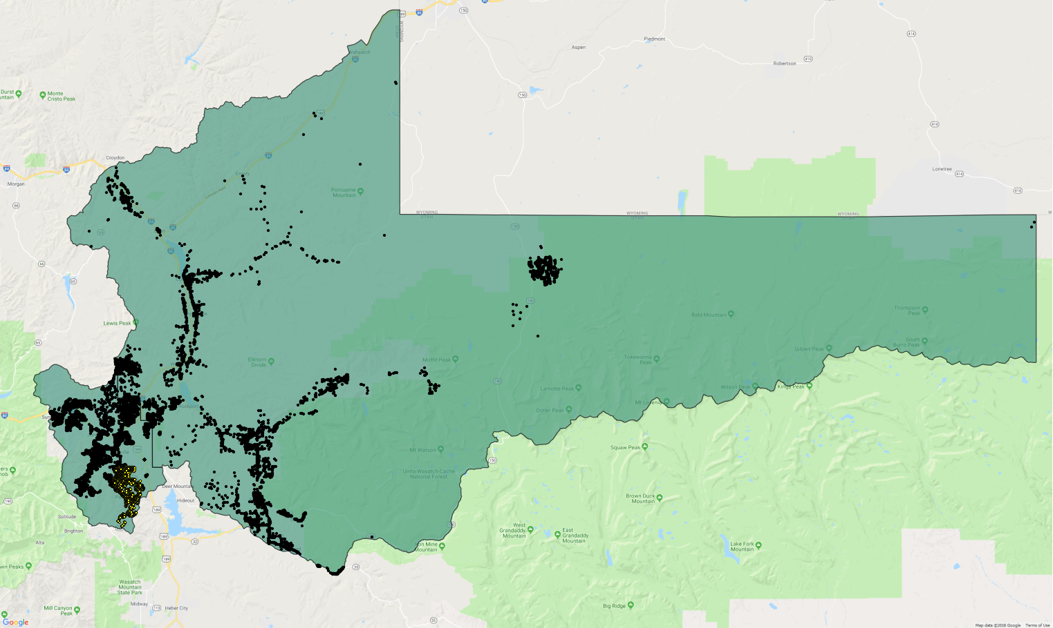
Notes:
I am always looking for ways to explain ”the Collaborative Approach” to

Slide 21
Housing Mix Usage
Cities
Counties
Lodging Operators
Vendors & Attractions
HOA
DMO
State
Residents
Shared Interest in the Convergence of Housing & Tourism
Notes:
For the DMO, lodging has always played an important role for the overnight guest. Today, more and more of this bed-base is coming from the housing stock. Residential units have always played a role, but it has reached a tipping point to which the role of the DMO must change to collaborate to create a level business playing field for lodging operators and balance the impact of tourism on a community.

Slide 22
The Case of Folly Beach
An application of the Collaborative Approach
Notes:
In April of 2017, I was able to present my sabbatical research findings to the Town of Vail. In May 2017, Spencer and Aaron of Folly Beach had secured partial funding for the proposed grant with the Riley Center for Livable Communities. In June 2017, we had additional support to move forward with the project. This was our chance to test the Collaborative Approach. The findings from the December 2016 audit revealed the following…

Slide 23
Overview of the Project
Collaboration between City | County | Destination Marketing Office
City of Folly Beach
Charleston County
Charleston Area Convention & Visitors Bureau (CACVB)
Administered as a grant with College of Charleston’s
Riley Center for Livable Communities
Office of Tourism Analysis
Focused on
Identification of all nightly rentals in the City (software solution called STR Helper)
Reconciliation of City registrations with County licenses
Assist in annual renewal process
Bring properties into compliance

Slide 24
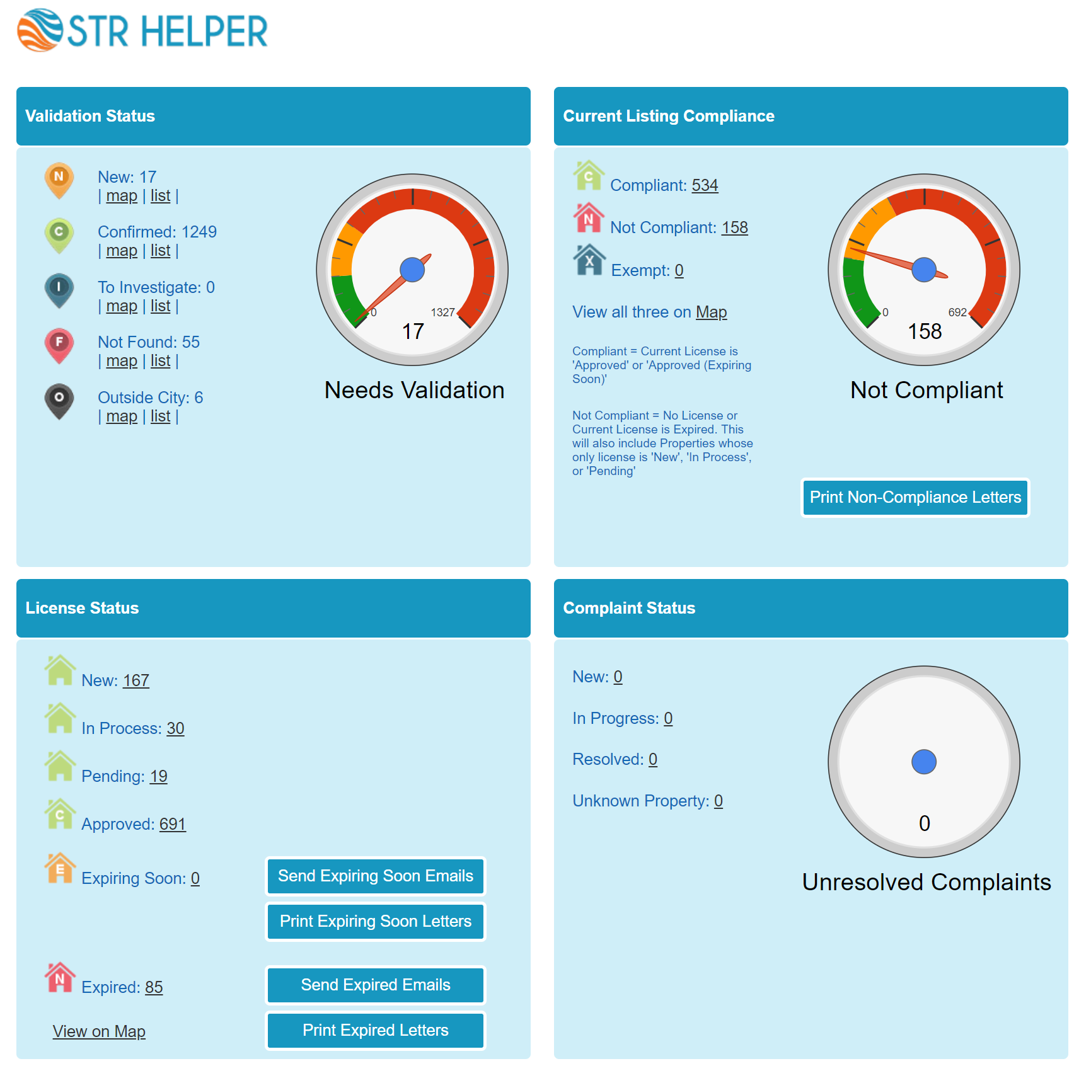
STR Helper
Dashboard

Slide 25
2017 Year End License Status
License Status | Count
Fully Compliant | 576
Missing Folly Beach Registration | 114
Missing Charleston County Business License | 68
No Compliance | 117
Total Properties | 875

Slide 26
2018 License Status
License Status |  | Count
Fully Compliant |  | 691
Missing Folly Beach Registration |  | 124
Missing Charleston County Business License |  | 42
Outdated Compliance (Expired 12/31/17) | Expired BL & Reg. | 39
 | Expired Reg, No BL | 30
 | Expired BL, No Reg. | 19
No Compliance (2017 or 2018) |  | 67
Total Properties |  | 1,012
As of May 4, 2018

Slide 27
2018 License Status & Listing Activity
License Status |  | No Active Listings | Active Listings | Total
Fully Compliant |  | 111 | 560 | 691
Missing Folly Beach Registration |  | 82 | 42 | 124
Missing Charleston County Business License |  | 9 | 33 | 42
Outdated Compliance (Expired 12/31/17) | Expired BL & Reg. | 21 | 18 | 39
 | Expired Reg, No BL | 22 | 8 | 30
 | Expired BL, No Reg. | 13 | 6 | 19
No Compliance (2017 or 2018) |  | 0 | 67 | 67
Total Properties |  | 258 | 754 | 1,012
As of May 4, 2018

Slide 28
Example Properties
Fully Compliant
1021 E Arctic Ave
Missing Active Folly Beach Registration
122 E Arctic Ave Unit 1
Missing Active Charleston County Business License
308 W Ashley Ave
Outdated Compliance
212 E Erie Ave
No Compliance
219 E Huron Ave

Slide 29
Future Project Focus
City of Folly Beach
Riley Center for Livable Communities
Continue monitoring compliance
Move to Online Registrations and Renewals
Streamline Business Processes
Incorporate new ordinance requirements
Monitor the online ads
Prohibit Events
Occupancy Limits (2 per bed +2)
Listings with business license number
Open validation to full county
Expand to other jurisdictions within the county
Engage Other States and Communities
Utah
Colorado
California
North Carolina
Florida

Slide 30
Thoughts & Discussion

