Slide 1
Managing The New Workforce
* * * * * * * * * * * * * * * * * * * * *
It Takes A Whole New Set of Skills!!!
Presenter -- Martha N. Bryan
Bryan & Bryan Associates
marthabryan@bryanandbryanassoc.com

Slide 2
Today’s Workforce . . . It’s Changing
Old Versus New
“The single most significant future trend facing our society is the increasing life expectancy. People are not only living longer, but are staying more active and wanting to work.”
Notes:
Instructor Notes:
Have participants work in small groups and identify things they noticed about today’s employees – their work ethic, their interest, their values. All employees are alike in some ways, but there are general tendencies among various age groups.
It’s Changing . . . OLDER WORKERS
Some of the participant’s comments might include . . .
Positive Consistent, uniformity, conformers, disciplined, past oriented,
history absorbed, high work ethic, believe in logic
Down side Dictator, rigid, inhibited, inflexible, set in old ways, technological
dinosaurs, too serious
It’s Changing . . . NEWER WORKERS
Some of the participant’s comments might include . . .
Positive Self-reliant, want balance, attracted to the edge, approach to authority is casual, computer literate, searching their souls to find themselves
Down side Talks too much about private stuff, no street smarts, slackers, rude, lack social skills, won’t wait their turn, self-absorbed, loyalty not important
Wrap up by saying that there is truth to their list – but remember that there is always some individual differences in your employees. Treat them as individuals

Slide 3
The New Workforce – It’s Changing . . . Labels Include
Older Workers Versus New Workers
Positive
Consistent, uniformity, conformers Disciplined, past oriented
History absorbed, high work ethic
Believe in logic
Clear – not complex
Down Side
Decisions made at top
Dictator, rigid, command & control
Inhibited, inflexible
Set in old ways
Technologically slower
Too serious
Positive
Self-reliant, want balance
Attracted to the edge
Approach to authority is casual Computer literate
Down Side
Talks too much about private stuff
No street smarts, can be slackers
Rude, lack social skills
Won’t wait their turn
Self-absorbed
Loyalty not important
Extra
Notes:
Instructor Notes:
Have participants work in small groups and identify things they noticed about today’s employees – their work ethic, their interest, their values. All employees are alike in some ways, but there are general tendencies among various age groups.
It’s Changing . . . OLDER WORKERS
Some of the participant’s comments might include . . .
Positive Consistent, uniformity, conformers, disciplined, past oriented,
history absorbed, high work ethic, believe in logic
Down side Dictator, rigid, inhibited, inflexible, set in old ways, technological
dinosaurs, too serious
It’s Changing . . . NEWER WORKERS
Some of the participant’s comments might include . . .
Positive Self-reliant, want balance, attracted to the edge, approach to authority is casual, computer literate, searching their souls to find themselves
Down side Talks too much about private stuff, no street smarts, slackers, rude, lack social skills, won’t wait their turn, self-absorbed, loyalty not important
Wrap up by saying that there is truth to their list – but remember that there is always some individual differences in your employees. Treat them as individuals

Slide 4
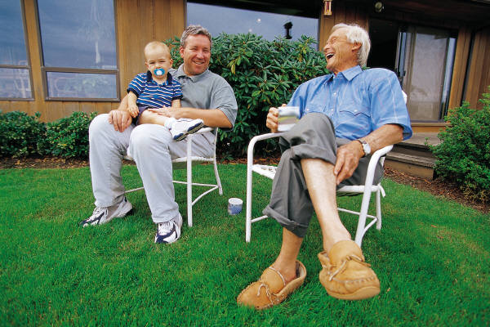
A Generation . . . is a body of individuals born approximately the same time period who generally share
similar behaviors and attitudes.
A generation’s identity is a state of mind shaped by . . .
Family Life Religion
Gender Roles Culture
Politics Lifestyle
View Of The Future Experiences

Slide 5
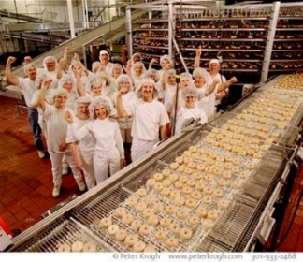
Four / Five Generations At Work
Traditionalists (born approximately 1922-1945)
Baby Boomers (born approximately 1946-1964)
Generation - X (born approximately 1965-1980)
Millenials - Y (born approximately 1981-2000)
Linksters - Z (born after 2000)
Generation Gap - a difference of opinions between one
generation and another regarding beliefs, politics, or values.
(Note -- Research Statistics Vary On The Dates.)

Slide 6
National
Events
Values
Music
What Shaped You?
Relationships
Technology
Parental
Expectations

Slide 7
Appreciating Many Aspects of Diversity
Generational differences may influence behavior; however, this does not mean that generational differences determine adult interactions. There are a host of other variables which come into play that impact behavior and outcomes.
Generational differences represent only one of these factors.
Points to Keep in Mind!
Common experiences of each generation
frequently define their assumptions and perspectives.
BUT
Never generalize from a few to the whole
. . . there are ALWAYS exceptions.

Slide 8
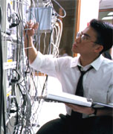
Why Are Things Different?
In the past, relatively stable organizational model for career
advancement.
Today, organizations come in many sizes, types, and shapes.
Career paths vary (average 25 year old is expected to
experience anywhere from 5-8 careers in lifetime).
Work-life expectations have changed with the generations.

Slide 9
Every Generation Says . .
The Same Things About The Next Generation.
# 1 They Don’t Get It!
# 2 They Have It So Much Easier Than We Did.
And, Every New Generation Resists
(And Often Hates) The Previous Generation.

Slide 10
In the Next Cubicle
It’s 9:00 o’clock. Where is he?
Did you see what she had on today?
I don’t understand all the initials in this email!
Kids these days . . .
Why do I have to meet in person? Can’t I just send an
e-mail, text, or instant message?
These rules are driving me crazy!
I have finished my work so I’m going home.
They’re set in their ways!
Extra

Slide 11
Differences We Hear In The Workplace
Conflicts frequently have generational issues as their cause
“He is not committed to his job.”
“She has a poor work ethic.”
“He does not follow direction.”
“I can’t believe the way he / she dresses.”
“What do you mean I can’t work from home on Friday’s?”
Extra

Slide 12
Sounds Of Conflict . . .
Heard Around The Water Cooler
"They are just a bunch of slackers."
"So I told my boss, ‘If you are looking for loyalty, buy a dog’."
"A hiring bonus? Wet behind the ears and he wants a hiring bonus?
At his age, I was just grateful I had a job!"
"I have a new rule: I will not attend meetings that start after 5:00 p.m.
I have a life."
"He's been out of training and in the field for six months, and he wants a
promotion! A promotion!"
,
"She wants a 'career map'? Wow! I don't even know if there will be a
customer relations department this time next year."
"He asks me, 'Do you have an e-mail address?'
I felt like telling him, ‘Since you were in diapers, buddy'!"
"If I hear 'We tried that in '87' one more time, I'll throw up."
Extra

Slide 13
“Old Story” Managers
Their style of leading . . .
“New Story” Managers
How they will need to
change . . .
“We need the wisdom and experience of the older workers, the fresh ideas and the fearlessness of the younger workers, and the reflection of the market place.”
Notes:
Instructor Notes:
Discussion (Depending on time -- small or large group work) -- then summarize
It’s Changing . . . OLD
Old story bosses
Were typically direct, decisions made at top, dictatorial, command and control leadership style, clear (knew where they stood),
not complex
New style bosses
Will need to be . . .
Less controlling
More collaborative
More strategic
More flexible, more tolerant
More focused on outcomes

Slide 14
Leadership Style
“Old Story" Managers . . . Their style of leading
They Were Typically , , ,
Direct & Dictatorial
Decisions Made At Top Command & Control Leadership Style
Clear, Not Complex (Knew Where They Stood)
“New Story“ Managers . . . How they will need to change
They Will Need To Be . . .
Less Controlling
More Collaborative
More Strategic
More Flexible
More Tolerant
More Focused On Outcomes
Extra
Notes:
Instructor Notes:
It’s Changing . . . OLD
Old story bosses
Were typically direct, decisions made at top, dictatorial, command and control leadership style, clear (knew where they stood),
not complex
New style bosses
Will need to be . . .
Less controlling
More collaborative
More strategic
More flexible, more tolerant
More focused on outcomes

Slide 15
The Evils of Youth
“Our youth now love luxury. They have
bad manners and contempt for authority.
Children are now tyrants.”
Extra
Socrates, Greek philosopher 500 BC

Slide 16
Generational Profiling Is It A New Phenomena?
~
“The young people of today think of nothing but themselves. They have no reverence for parents or old age. They are impatient of all restraint. They talk as if they alone knew everything and what passes for wisdom with us is foolishness with them. As for girls, they are forward, immodest and unwomanly in speech, behavior and dress.“
Extra
Socrates, Greek philosopher 500 BC

Slide 17
“I see no hope for the future of our people if they are dependent on the frivolous youth of today, for certainly all youth are reckless beyond words. When I was a boy, we were taught to be discreet and respectful of elders, but the present youth are exceedingly wise and impatient of restraint.”
~ Author Unknown
Extra

Slide 18
Why Shift Our Leadership Approach?
Today Four Generations In Workplace
Today Technology Links People
Business Complexity (Need Collective Resources Of All)
Failure To Satisfy Customers
Employees Want To Know Why
Employees Want Ownership In Their Work
People Closest To The Work Know Best How To Improve It
"I have been in this business 36 years. I've learned
a lot . . . and most of it doesn't apply anymore.“
~ Charles Exley, Chief Executive Officer
NCR Corporation
Notes:
Instructor Notes:
Fill in the blanks with discussion
Today there are four generations in the workplace
Technology links information to people
Business complexity - need collective resources of all
Failure to satisfy customers -- too long to get management’s response
Employees closest to the work know best how to improve it
Employees want ownership in their work - they want to know why
Teams provide greater possibility for empowerment
Flattening of the organization
Issues that have helped create increased generational conflict are the worldwide economy; rapid changes in the workplace; downsizing of companies/organizations; mergers, acquisitions and consolidations of companies; elimination of many middle management positions; seniority as only one element of promotion; and technology.

Slide 19
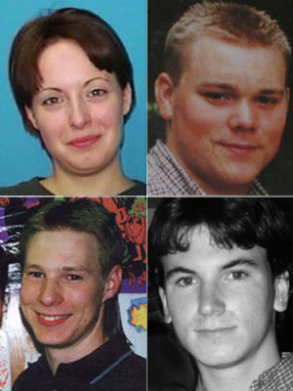
All Employees Want To . . .
benefit society,
engage in satisfying leisure,
exercise leadership,
have friendly and congenial associates,
have a high salary, high prestige, and status,
make contributions to important decisions,
have a stable and secure future,
variety in work assignments, and
work as part of a team.

Slide 20
Keep In Mind
There is more diversity than just generational diversity.
We are all more similar than different.
We can learn from each other.
Everyone brings something to the table.
Everyone wants to succeed.

Slide 21
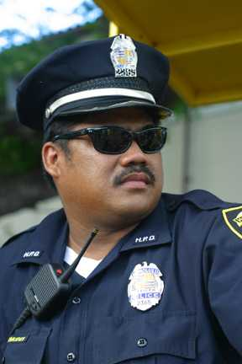
Embracing Diversity
Golden Rule
Treat others the way you would like to be treated.
(assumes similarities)
Platinum Rule
Treat others the way they would like to be treated.
(accepts diversity)
“Let the refinement and improving of your own life keep you so busy that you don’t have time to criticize others.”

Slide 22
Working with all Employees
Accommodate individual differences.
Create workplace choices for all employees.
Use a situational / flexible management style.
Respect competence and initiative.
Nourish retention and mentor.
Focus on outcomes.
Assess Team Dynamics
Identify Employee Differences.
Identify Values And Motivators.
Identify Potential Team Issues.
Develop Solutions.

Slide 23
Guiding Values & Principles . . . Keep Them Simple
Quality Comes First
Customer Focus
Continuous Improvement
Employee Involvement
Integrity Never Compromised
Notes:
Instructor Notes:
The benefit of having a few core values.
Go over the slide -- elaborating on these key vaues
Ask question – Could you run your organization on these few key values?
Why don’t we manage by values instead of so many rules?
Large group discussion

Slide 24
Managing The New Workforce Takes a New Philosophy
An uncompromising belief that people are the most valuable resource.
Commitment by management and employees to organization's mission and goals.
Controls based on loyalty and support.
Commitment to producing goods and services that have distinctive value.
Seeks information -- both bad and good.
(continued)
Notes:
Instructor Notes:
There are two slides on this topic.
Have participants read the two slides covering “Leadership Excellence Means a New Philosophy” and put checkmarks by any bullet they would like to talk about in more detail.
They will probably question the bullet . . .
Controls based on loyalty and support.
When things go wrong most organizations will attempt to
solve the problem by creating a blizzard of new rules.
Suggest they control the workplace by gaining support
and living the values and ethics.

Slide 25
Managing The New Workforce Takes a New Philosophy
(continued)
Open lines of communication.
An obsession with continual learning.
Rewards people who help achieve the mission.
A top management commitment to respecting / instilling pride in all employees.
An environment that rewards calculated risk taking.
Notes:
Instructor Notes:
There are two slides on this topic. This is the 2nd of 2 slides.
See notes on previous slide.
They will probably question the bullet . . .
Rewards people who help achieve the mission
They will likely comment that “the misfits / slackers” get rewarded and that they seem to get all the attention and less workload, while good employees get the work dumped on them. They get all the work.
Any of the bullets can create good discussion topics.

Slide 26
Dear Annie:
A couple of months ago, my boss abruptly left the company, and I was promoted to his job as leader of a 16-person product-development team. This was somewhat surprising, since I am the youngest team member (I'm 27) and have been here for the shortest period of time (two and a half years).
It's a great job and I'm delighted to have it, but several of my direct reports, who are twice my age or older, are not so thrilled. I'm trying not to let their wisecracks about my age get to me, but I am having a hard time getting them to take me seriously as their boss. So far, we've managed to get the work done despite the friction, but it's tough. Do you (and your readers) have any suggestions for me on how to win them over?
~ Nobody's Baby
Fortune Magazine
Case
Study

Slide 27
Traditional
Organizations
control
win / lose
command
competition
hierarchical
authority, rules
results focused
centralized decision
information hoarding
Notes:
Instructor Notes:
These are characteristics that describe the traditional organization – the demand and control organization.
It worked better when information flowed from the top and remained in the hands of the few. It doesn’t work well in a knowledge society where employees are often brighter and smarter than bosses and where information systems are available to all employees.
This style of leadership is still needed in crisis situations, but it is not effective for daily business activities. People tire quickly of the old “command and control” style of leadership.

Slide 28
information sharing
relationship focused
values based
collaboration
partnerships
consensus
inclusion
win-win
teams
New Workforce
Organizations
Notes:
Instructor Notes:
The new organization is a more collaborative workplace where knowledge and skills rely on many people and the complexity of running any organization.
In module I of the program, there was discussion about how the new workforce was changing and how different it is from the “old” workforce. Some of characteristics including . . .
Today there are four generations in the workplace
Technology links information to people
Business complexity - need collective resources of all
Failure to satisfy customers -- too long to get management’s response
Employees closest to the work know best how to improve it
Employees want ownership in their work - they want to know why
Teams provide greater possibility for empowerment
Flattening of the organization
The futuristic organization described on this slide will better meet the challenges of today’s workforce.
This structure also supports the theories of employee motivation to be covered later in the program.

Slide 29
Most Organizations’ Work Environments
Tenured Leaders
Straight Lines Structure
Policies, Rules & Regulations
Answers From Top
Hoards Information
Risk Avoiders – Consistency Important
Yearly Reviews – Manage By Exception
One Size Fits All
Loyalty Very Important
Privacy & Security

Slide 30
Desirable Work Environments For Millennials
Trustworthy Leaders
Competent & Responsive Leaders
Reasonable Structure
Open Flow Of Information
Embraces Technology
Work Customization
Ease & Speed
Trusts Them To Get The Work Done
Organized & Flexible
Encourages Them / Lots Of Feedback
Instills A Sense Of Fun And Play

Slide 31
Work Performance Expectations
Every employee should be held to the same standard.
No adaptation should be made that compromises the integrity of the job or diminishes the effectiveness of your department to carry out its mission.
All employees should comply with policies and procedures set forth by their organization.

Slide 32
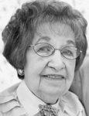
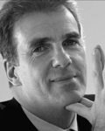
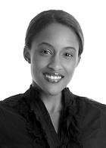
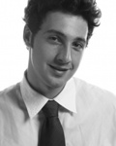
Being Successful With The New Workforce
Do’s & Don'ts
+
+
+

Slide 33
Being Successful With All The Workforce
DO solicit feedback on your employees' challenges and frustrations.
DO work harder on understanding culture-based causes of conflict.
DO anticipate scenarios in which perspectives may collide.
DON’T be rigid on how job is to be done. (Focus on the goal and
outcomes – not how the tasks gets done.)
DO listen to your team. (Collaborate on creative solutions.)
DON’T overreact to negative feedback. (It's not always an indictment on your management style or personal beliefs.)
DO remember, the workplace is not one big melting pot. (It is
individuals with varying viewpoints, which can benefit the workplace.)

Slide 34
Being Successful With The New Workforce
DO be aware of your own age biases.
DO change your world view.
DO take time to learn about all of your employees.
DON'T give in to stereotypes around age.
DO respect your employees, even if you don't understand their way
of doing things.
DO take the time to understand the "why" behind your employee's
actions or thought process.
DON'T shield yourself from people from different cultures.
DON'T condemn different viewpoints as always wrong.
DON’T think you can do it alone. Ask for help.

Slide 35
A Focus On Millennials In The Workplace . . .
80,000,000 Strong
Their Strengths . . .
Multi-Taskers
Technologically Savvy
Purpose & Achievement-Oriented
Team Players & Collaborative
Resourceful
Innovative / Change Agents
Embraces Diversity
Civic-Minded
Optimistic
The Largest Generation In Today’s Workplace
Younger
Workers

Slide 36
Millennials Prefer Workplaces That . . . (1 of 3 slides)
Lets them make it on their own
Allows them to multitask (it prevents boredom)
Allows them to collaborate and problem solve with others
Encourages networking
Doesn’t take away their technology
Takes advantage of their technology savvy
Focuses on outcomes
Challenges them while teaching them new things
Surrounds them with impeccably honest, trustworthy,
ethical & open bosses and employees
Under-promises & over-delivers

Slide 37
Millennials Prefer Workplaces That . . . (2 of 3 slides)
Are approachable, responsive & present
Listen to them & doesn’t ignore their thoughts
Has an open flow of information
Builds relationships with them
Engages with them
Demonstrates interest in them & their success
Makes them feel like superstars
Tells them how they are doing
Focuses on their strengths
Focuses on the positive & frequent reinforcement
Gives them trophies

Slide 38
Millennials Prefer Workplaces That . . . (3 of 3 slides)
Offers flexibility
(i.e., flexible & seasonal hours, work from home)
Plugs in to their parents (they are part of the package)
Communicates their way (blogs, text, instant messaging, etc.)
Limits the long sit-down meetings
Gets the work done with ease & speed
Lets employees give back to the community
Allows for work-life balance
Instills a fun-centered workplace
Entertains them
These Millennials are here to stay!!!

Slide 39
A Focus On Older Workers
Their Strengths . . .
Stability, Punctual & Disciplined
High Work Ethic - Pride In A Job Well Done
Enhanced Knowledge, Wisdom & Confidence
Organized & Efficient
Writing & Problem Solving
Mature - Not Easily Rattled
Professional & Patient
Knows When, Where & How To Communicate
Great Loyalty To The Organization
Older
Workers

Slide 40
Older Workers Prefer Workplaces That . . . (1 of 3 slides)
Desires To Know Their Employees (Their History, Their Challenges
& Their Work Preferences . . .)
Promotes & Supports Continuous Learning
Offers Opportunities For Challenge & Meaningful Work
Offers Opportunities To Make A Difference
Provides Job Security & Predictability
Provides Flexible Benefit Packages & Work Arrangements
Supports A Balanced Work / Life Approach.
Creates Constructive Workplace Relationships
Is Concerned About employee’s Health & Well Being
Models An Open, Contribution-Based Environment
Aging Workers Are One Of Your Most Valuable Resources. Manage Them Well.

Slide 41
Older Workers Prefer Workplaces . . . (2 of 3 slides)
Provides An Environments Where Opinions Are Valued
Where Managers & Supervisors Are Skilled In People Management
Where Bosses Become Their Colleague / Their Partner
When Needed, The Boss Can Act As The Boss
Values The Employee’s Strength, And Shows It (Validates Them)
Creates Mentoring Positions (Lets Them Mentor New Employees)
Are Not Arrogant Or Dismissive
Is Clear About Expectations With Respect To Outcomes &
Participation
Elicits Feedback (Values Employees Lifetime Experiences)
Are Not Intimated By Employee’s Age
Have Bosses Who Can Find Commonality

Slide 42
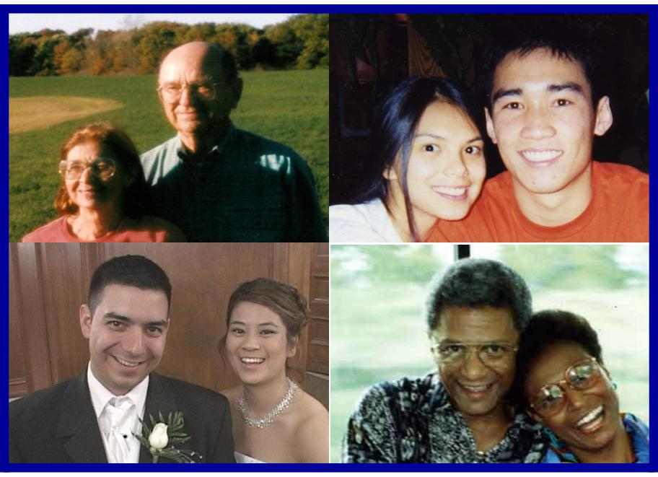
Older Workers Prefer Workplaces That . . . (3 Of 3 Slides)
Where Bosses Debates With Employees & Then Welcomes The
Best Ideas
Through Words & Action, Shows Care For Employees
Asks Them For Help (Can You Show Me . . .)
Makes Changes When Necessary, But Respects Tradition
Handles Conflicts Openly
Works Together For A Win-win Solution
When Needed, Becomes “The Boss”
Communicates Frequently & Transparently
Focuses On The Future & Outcomes

Slide 43
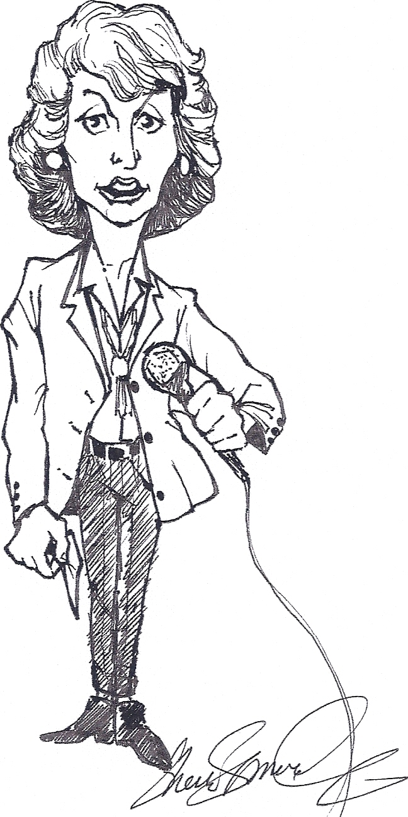
The End . . .
Thank You!
Martha N. Bryan
425-337-1838 Office – 425-330-8418 Cell
marthabryan@bryanandbryanassoc.com
Notes:
Instructor Notes:
Wrap-up the program
43

