Slide 1
Opportunity Zones:
A Local Perspective
Justin Powell
South Carolina City/County Management Association
June 1, 2018

Slide 2

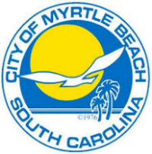
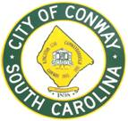
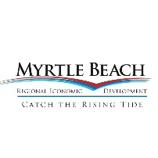
Opportunity Zones in the Grand Strand
Elected to pursue a regional approach to Opportunity Zones
  Outgrowth of long-standing CDBG partnership between Horry County, City of Conway, and City of Myrtle Beach
  Myrtle Beach Regional Economic Development Corporation joined effort
Proposed 13 Opportunity Zones across Horry County

Slide 3
Guiding Philosophy
Focused on census tracts that met one or more of the following criteria:
  State and local incentives are available to complement Opportunity Zone tax incentives
  Large development tracts are available or in process of being developed
  Near recent or anticipated rail or road investments
  Grow and protect the tourism industry
  Revitalization of central cities
  Potential to diversify away from tourism

Slide 4
Horry County Opportunity Zones

Slide 5
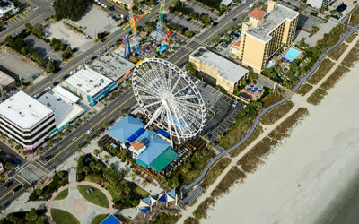
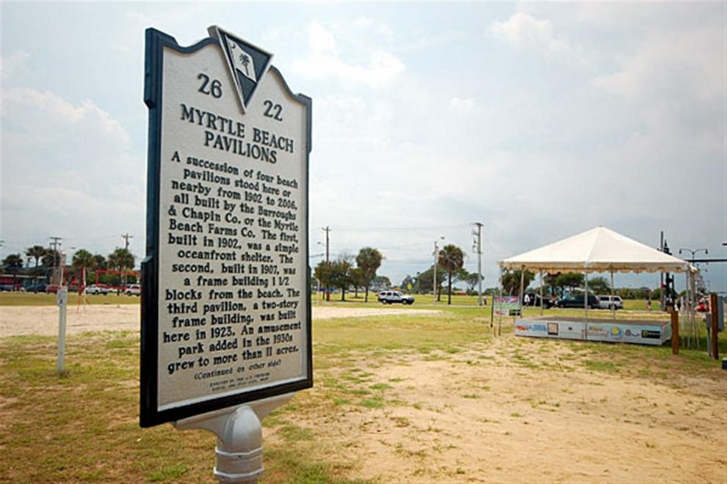
Downtown Myrtle Beach
Two Census tracts (506/507)
  506 Poverty Rate: 37%
  506 MHI: $25,972
  507 Poverty Rate: 28%
  507 MHI: $29,391
Core of state’s tourism industry
Some investment occurring along beaches, but not on second row with an aging hotel stock and downtown core
Opportunities for redevelopment with former Pavilion and Superblock
Source: 2015 ACS

Slide 6
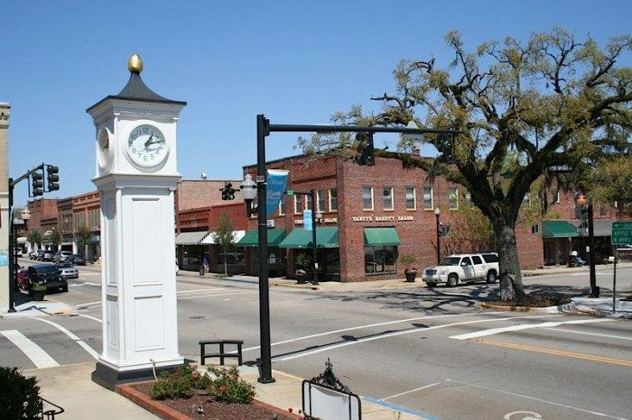
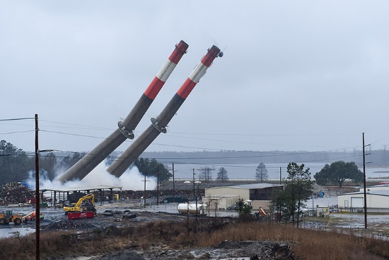
Downtown Conway
Two Census tracts (506/507)
  702 Poverty Rate: 21%
  702 MHI: $38,375
  703 Poverty Rate: 29%
  703 MHI: $32,097
Historic center to Horry County
Opportunities for infill in downtown and new development redevelopment along river, as well as redevelopment of Santee Cooper’s Grainger Plant site
Source: 2015 ACS

Slide 7
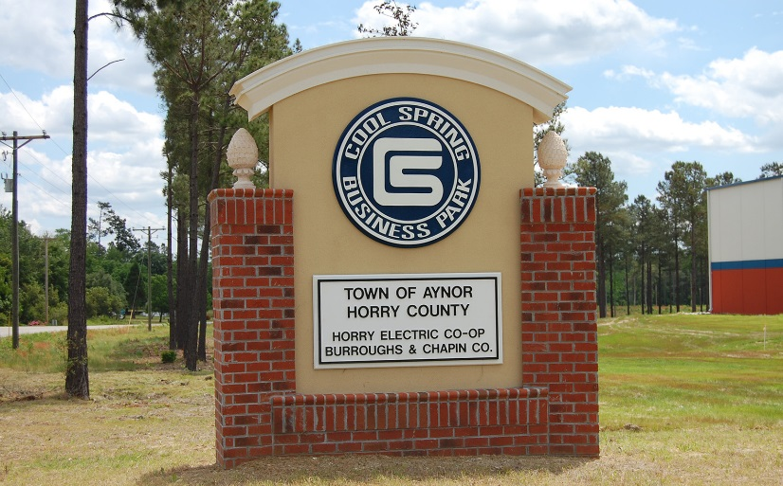
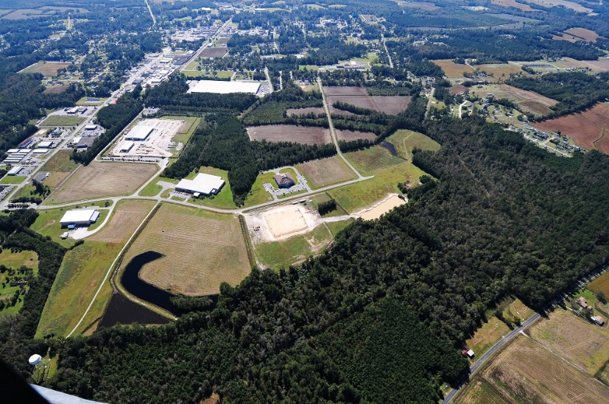
Rural Industrial Sites (Aynor/Loris)
Two Census tracts (202/Loris and 801/Aynor)
  202 Poverty Rate: 23%
  202 MHI: $38,099
  703 Poverty Rate: 23%
  703 MHI: $41,029
Loris and Aynor are historic agricultural communities that have been affected by loss of tobacco.
Two most “development ready” industrial parks within the Census tracts and are near future I-73 corridor
Source: 2015 ACS

Slide 8
How Do Opportunity Zones Work?
Investor
Realized Capital Gains
Opportunity
Fund
Project in Opportunity Zone
Project Investment
ROI
ROI
Tax Benefits

Slide 9
Opportunity Funds
Must make 90% of investments in Opportunity Zones
Substantive shape, form, and allowed investments TBD – guidance from Treasury expected end of 2018/beginning of 2019 on who, what, and how investments can flow through the Opportunity Funds.
Investments allowed either as stock, partnership, or direct ownership of projects within an Opportunity Zone.
    Source: A Primer on the New Federal Qualified Opportunity Zone Provisions; Butler Snow; Alveno Castilla and Ashley Wicks; https://www.butlersnow.com/2018/02/primer-new-federal-qualified-opportunity-zone-provisions/

Slide 10
Project Opportunities
Opportunity Funds can invest in a variety of projects:
  Office
  Residential (Single and Multi)
  Retail
  Adaptive Reuse
  Mixed use
  Start-ups/R&D
  Tangible Property/FFE
Investment must be in Opportunity Zone with 50% of gross income derived from property in Opportunity Zone.
Limitations on “Sin Businesses”: no golf courses, massage parlors, liquor stores, casinos, and racetracks
    Source: A Primer on the New Federal Qualified Opportunity Zone Provisions; Butler Snow; Alveno Castilla and Ashley Wicks; https://www.butlersnow.com/2018/02/primer-new-federal-qualified-opportunity-zone-provisions/

Slide 11
Advantages for Projects
Potential for low tax-advantaged financing because of Opportunity Zone capital gain tax incentive.
Encourages long-term investment by Opportunity Funds.
Provides ability to complete and realize projects with lower than market cash flows.
Source: Qualified Opportunity Zones and Tax Credit Incentives under the Tax Cuts and Jobs Act
Introduction to Qualified Opportunity Zones, GreenburgTraurig, James Lang and Justin Mayor, https://www.gtlaw.com/en/insights/2018/1/qualified-opportunity-zones-and-tax-credit-incentives- under-the-tax-cuts-and-jobs-act?utm_content=buffer8b274&utm_medium=social&utm_source=
twitter.com&utm_campaign=buffer

Slide 12
Combinations with Other Incentives
Flexible design allows for combining with other tax credits and incentives:
  Federal Income Tax Credits: Existing incentives (HTC, NMTC, LIHTC) are typically income tax credits and subject to allocation caps. Opportunity Zone provides capital gains incentives that can be paired with income tax credits.
  State Incentives: Bailey Bill/Historic Tax Credits, Abandoned Buildings, Textile Revitalization
  Local Incentives: Rebate Programs, FILOT, MCBP, TIF
Source: Qualified Opportunity Zones and Tax Credit Incentives under the Tax Cuts and Jobs Act Introduction to Qualified Opportunity Zones, GreenburgTraurig, James Lang and Justin Mayor, January https://www.gtlaw.com/en/insights/2018/1/qualified-opportunity-zones-and-tax-credit-incentives- under-the-tax-cuts-and-jobsact?utm_content=buffer8b274&utm_medium=social&utm_source
=twitter.com&utm_campaign=buffer

Slide 13
Potential Application in Horry County
DOWNTOWN MYRTLE BEACH
Hospitality Projects: Redevelopment and development of hotels and accompanying facilities to upgrade product available in combination with City’s incentives
Mixed-Use: Pavilion tract ideal for mixed use project
Historic Rehabilitation: Combination with Bailey Bill, HTC’s, and City incentives for rehabilitation and adaptive re-use of properties in Superblock and Broadway
Affordable Housing: Significant number of affordable housing projects already going on, could be combined with LIHTC, HOME, and CDBG funding.

Slide 14
Potential Application in Horry County
DOWNTOWN CONWAY
Riverfront Investment: Large landowner looking to divest substantial riverfront holdings and could add to financing in mixed use projects coming out of those sales
Historic Rehabilitation: Combination with Bailey Bill, HTC’s, and City incentives for rehabilitation and adaptive re-use of properties in downtown Conway

Slide 15
Potential Application in Horry County
RURAL INDUSTRIAL PARKS (LORIS/AYNOR)
Industrial Development: Added tool for encouraging manufacturing along with state and county incentives (FILOT, MCP).
Affordable Housing: significant number of affordable housing projects already going on, could be combined with LIHTC, HOME, and CDBG funding.

Slide 16
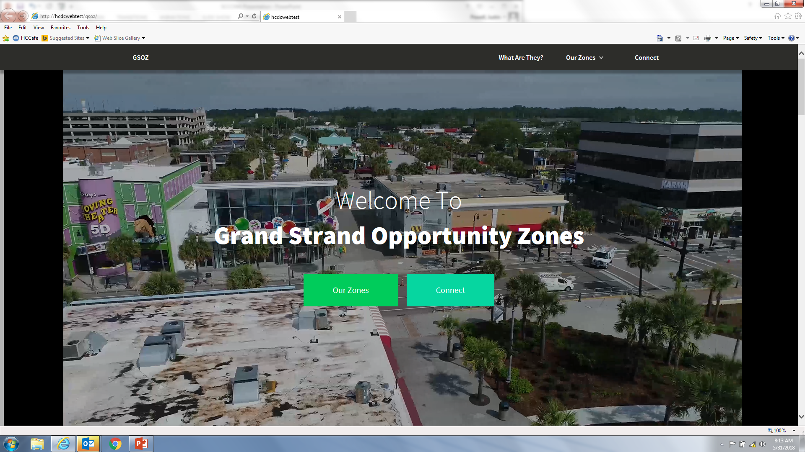
What’s Next While Waiting for the IRS?
Local Governments
  Created working group with MBREDC, MBACC
  Building website (www.grandstrandopportunityzones.com)
Development Community
  Identify potential projects
  Build awareness (charrette)
Grand Strand Opportunity Fund?

Slide 17
Questions?

