Slide 1
SOUTH CAROLINA UPDATE Economic and Other Trends
PRESENTED TO
January 25, 2019
Frank A. Rainwater
Executive Director
South Carolina Revenue and Fiscal Affairs Office
1000 Assembly Street
Rembert Dennis Building, Suite 421
Columbia, SC 29201
(803) 734-2265
www.rfa.sc.gov

Slide 2
Source: SC Revenue and Fiscal Affairs Office – 211A – lpw/7/12/18

Slide 3
Source: U.S. Census Bureau, Population Estimates; RFA - 224 - LPW-10/4/18

Slide 4
Source: S.C. Revenue and Fiscal Affairs Office - 211E - lpw/7/12/18

Slide 6
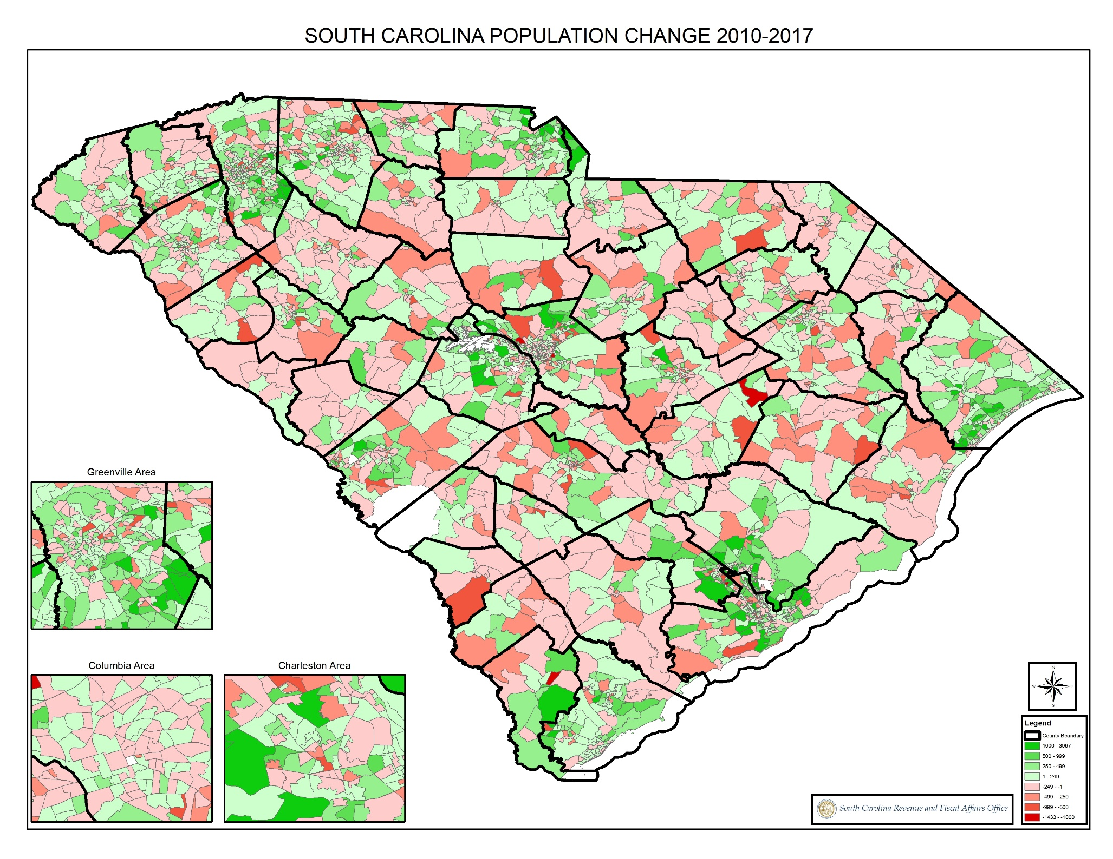

Slide 7
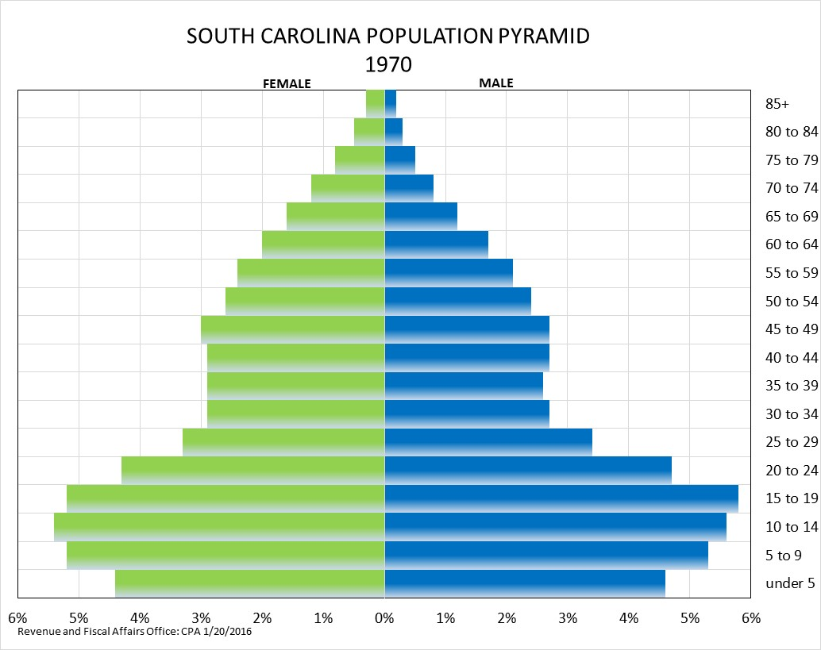

Slide 9
SC Revenue and Fiscal Affairs Office - 209 - lpw/1/2/19

Slide 10
Source: U.S. Census Bureau, Population Estimates 1990-2017; Revenue and Fiscal Affairs Population Projections 2018-2035 RFA 209 01/08/19

Slide 11
Source: US Department of Commerce, Bureau of Economic Analysis RFA-173 EM/10/10/18

Slide 12
Source: U.S. Department of Commerce, Bureau of Economic Analysis, Washington, D.C.
222/BEA/EMM/010/04/18

Slide 13
Source: U.S. Department of Labor, Bureau of Labor Statistics, SCBEA, RWM, 1-17-19

Slide 14
Source: Department of Revenue Annual Report and Index of Taxpaying Ability
rfa/mkm/12/17/2018

Slide 15
Source: Department of Revenue Annual Report and Index of Taxpaying Ability
rfa/mkm/12/17/2018

Slide 16
Source: DOR Index of Taxpaying Ability Report
RFA/mkm/12/19/2018

Slide 17
Source: DOR Annual Report and Index of Taxpaying Ability Report 234-RFA/mkm/12/19/2018

