Slide 1


Revolutionizing Government in the 21st Century
Patrick Ibarra
The Mejorando Group

Slide 2

2

Slide 3
“Revolution:
a sudden, complete or marked change in something.
3

Slide 4
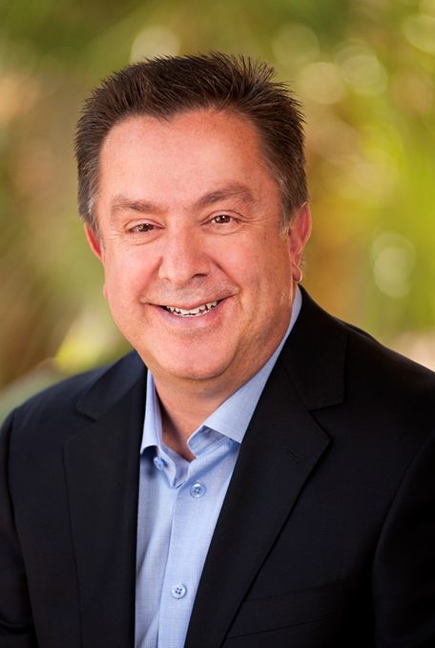



Today’s Presenter
Patrick Ibarra
Former City Manager
Founder of The Mejorando Group
(925)518-0187
patrick@gettingbetterallthetime.com

Slide 5
Future Factors
Politics and Citizen Activism
Social Media
Mistrust of Institutions
Legislation
& Legal
Government
VUCA
Economy
Service
Delivery
Demographics

Slide 6
“Leadership is about Plumbing and Poetry.”
6

Slide 7
Role of Government
To serve as the Protagonist for a Better Quality
of Life
7

Slide 8
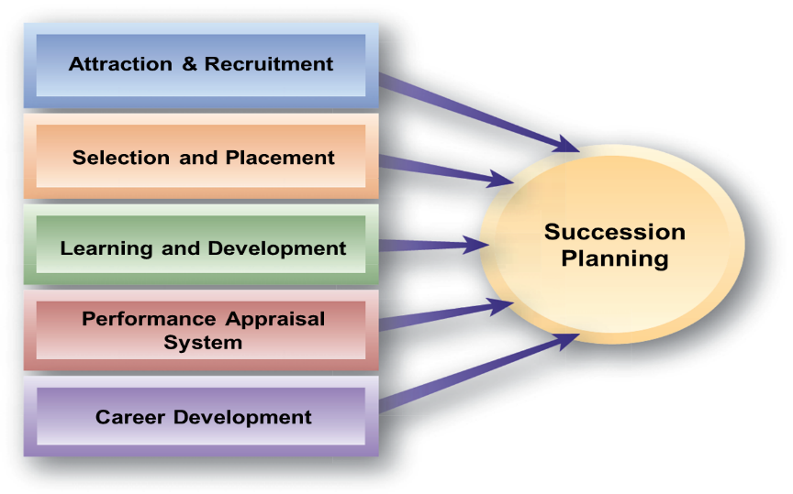
Values-Based
Principles Led
Successful
Purpose Driven
Performance Focused
Results/Market Centric
8
8

Slide 9
Every organization is perfectly designed to get the results it gets.
9

Slide 10
Must
Need
Nice
10

Slide 11
WADITW
11

Slide 12
12

Slide 13
“Playing it Safe is no longer Playing it Smart.”
13

Slide 14
Moon Shot
Wild Shot
Roof Shot
14

Slide 15
Progress
Predictability
15
15

Slide 16
Culture
Service Delivery
Community Building
Strategy
Talent
Innovation
Change
Leadership
8 Steps to Revolutionizing
16

Slide 17
“Culture eats Strategy for Breakfast”
- Peter Drucker
17

Slide 18
“At Apple, we never invented anything. We just happened to find it.”
Steve Jobs
18
18

Slide 19
“Growth and Comfort Don’t
Co-Exist”
19

Slide 20
Typical Change
20

Slide 21
Four Key Roles for Executives
Envisioning
“Adjust the
Thermostat”
Engaging
“Experiment”
Driving Culture Change
Energizing
“Raise the
Speed Limit”
Enabling
“Fuel Up”
21

Slide 22

Cost
Value

Slide 23
Strategy
What business
are you in?

Slide 24














Utility vs. Experience
24

Slide 25
Traditional Approach
Strategy
People
Systems
Customer
25

Slide 26
Empathic Mindset
“The key is starting with customers, and working backwards.”
-Jeff Bezos

Slide 27
Design Thinking Approach
Strategy
People
Customer/
Consumer
Systems
27

Slide 28
Are you seeking Compliance or Commitment?
28

Slide 29
Rocks  | Rock Solid  ? | Rock Stars 
29

Slide 30
Chief
Experience
Officer

Slide 31
Chief
Example
Officer

Slide 32
Adventurers
Wanted!
We help you realize your potential.

Slide 33
Stop tightening your belts and instead, change your pants!
-Me

Slide 34
The Mejorando Group
Who are we? A Change and Organizational Effectiveness consulting practice
What do we do? Partner with government leaders and implement solutions to improve organizational performance.
How do we do that? We provide expertise in:
  Organizational Effectiveness Strategies
  Strategic Planning
  Succession Planning
  Talent Management
  Leadership and Management Skills Training
How do you contact us? Patrick Ibarra, 925-518-0187 or patrick@gettingbetterallthetime.com
Web address: www.gettingbetterallthetime.com
Our mission is to help organizations and
their members “get better all the time”

