Slide 1



COVID-19 Teleconference
Economic Recovery

Slide 2
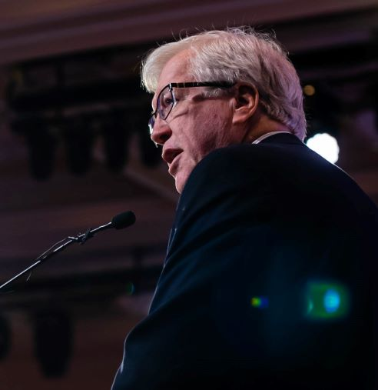
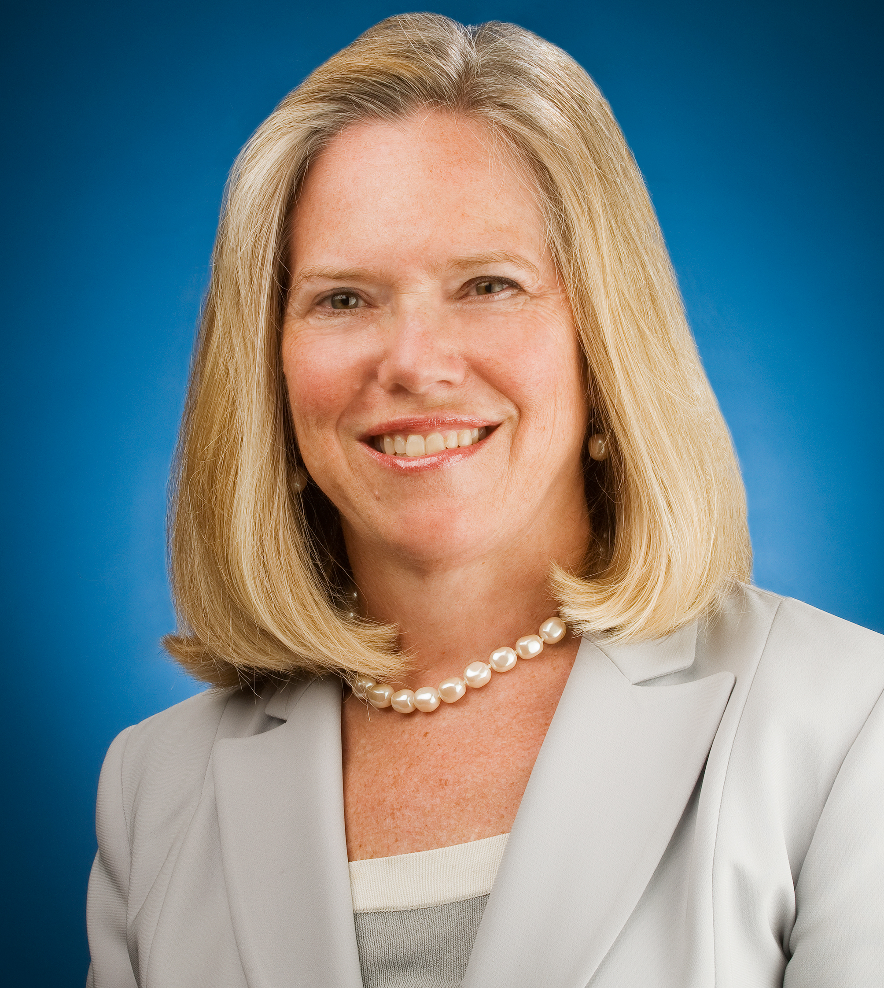
Today’s Presenters
Jeff Finkle
IEDC
jfinkle@iedconline.org
Elizabeth Kellar
ICMA
ekellar@icma.org

Slide 3

Economic Recovery in Times of COVID-19
Jeff Finkle, President & CEO
International Economic Development Council
March 27, 2020

Slide 4

About the International Economic Development Council (IEDC)
Nonprofit based in Washington, DC
The world’s largest association for economic development professionals
  5,000+ members and network of 30,000+
Our Mission: Provide leadership and excellence in economic development for our communities, members, and partners
When we succeed, economic developers help improve the quality of life in their communities

Slide 5
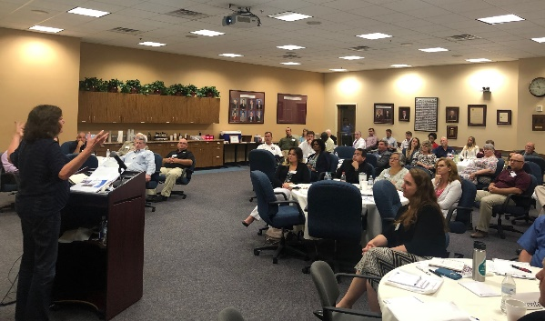
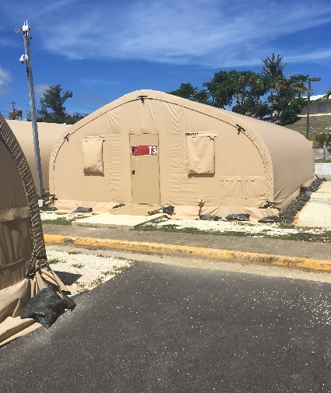
IEDC Economic Recovery Programs
Grants from U.S. Economic Development Administration
Disaster recovery since Hurricane Katrina
Work in U.S. states and territories affected by hurricanes, typhoons, flooding, volcanic eruptions, and other disasters
Deploy volunteers and panels to provide technical assistance on a wide range of economic development projects
Develop courses, workshops, and other resources

Slide 6
The Phases of Economic Recovery
Short-Term: 6 months to 1 year
Long-Term: years to decades
Priorities:
  Restore basic services
  Business re-entry
  Access financial resources
  Communications
Priorities:
  Strategic planning
  Rebuilding resilient infrastructure
  Financial resource development
  Economic diversification
  Resilience
Notes:
Factors that slow recovery
Lack of resources (funding, expertise, etc.)
Lack of access to insurance
Poor planning/ unclear communication
Limitations of existing infrastructure
Factors that enhance recovery
Investment in mitigation and planning
Strong relationships
Strong communication
Access to financial resources

Slide 7
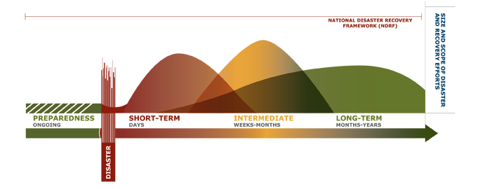
The Phases of Economic Recovery
Source: Leadership in Times of Crisis
Notes:
Source: Leadership in Times of Crisis Toolkit

Slide 8
Challenges: COVID-19
Rapidly changing and unpredictable situation, timeline unknown
Unclear guidance for individuals and businesses, varying across many locations
Local and state government revenue shortfalls
Undercapitalized businesses; closures and employee layoffs
Supply chains disrupted
Some jobs cannot be done remotely and/or high-speed internet and telework resources are not available
Morale: fear and uncertainty

Slide 9
Responsibilities of Local Governments After a Disaster
Implement recovery and mitigation plans
Coordinate efforts across government offices, NGOs, and private sector
Lead efforts to restore critical infrastructure, essential services, business retention and support
Establish metrics to evaluate and communicate progress
Notes:
Local government often takes the following response actions:
• Develop and implement recovery and mitigation plans.
• Ensure integrated efforts across government offices, the private sector and nongovernmental
organizations (NGOs) during the formulation and implementation phase of recovery projects.
• Lead efforts to restore all sectors of the community, including critical infrastructure, essential services,
business retention and the redevelopment of damaged housing units.
• Manage rebuilding to reduce risk reduction and comply with standards for accessible design.
• Undertake an appropriate community planning process.
• Establish metrics to evaluate and communicate progress.

Slide 10
City of Toronto: Economic Support & Recovery Task Force
Established by City of Toronto Mayor’s Office
City working with partners from business community to identify specific actions to support businesses, workers, and residents
Immediate measures include:
  Extending grace periods for tax/utility payments
  Establishing a contingency fund to support businesses
  Expanding small business advisory services
  Exempting businesses from delivery hour restrictions
Notes:
https://www.toronto.ca/home/covid-19/economic-support-recovery/

Slide 11
Role of Economic Development Professionals
Facilitating communication between government and businesses
Identifying resources at the local, state and federal level
Assessing economic impacts
Strengthening partnerships among local, regional and state organizations
Updating economic development strategic plans
Establishing or supporting business recovery centers
Notes:
A key focus for EDOs in the response and recovery is to help facilitate effective communication between government and businesses. Communication on such essential subjects as the availability of power; access to transportation networks and facilities; the availability of temporary facility space for displaced businesses, and government resources to help is a critical activity in the initial days and weeks after a disaster. EDOs also can help advise businesses on ways to communicate that they are “open for business” after a disaster – an
important but often overlooked activity in restoring commerce. (For more information, see Chapter VII on Crisis Communications.)
In recent experience, EDO representatives have found it important to work very closely with the EOC or even to hold office at the center in order to help facilitate critical recovery communications to area businesses.
The EDO also may choose to form an economic recovery team (as in the case of Polk County, Fla., in 2004 or Cedar Rapids, Iowa, in 2008) for information-sharing among emergency management personnel, corporate leaders and local business owners. These economic recovery teams not only help aggregate information on damage assessment of businesses and the local economy, but also help to develop long-term strategies for economic recovery.
Generally, people who are engaged in economic development activities should prepare for any or all of these activities to help support recovery:
• Identifying support resources at the local, state and federal level and assisting in disseminating this information to businesses;
• Documenting the economic impact of disasters and/or continuing to gather statistics that demonstrate key trends;
• Strengthening collaboration and partnerships among local, regional and state organizations;
• Building working relationships with federal officials and their consultants;
• Contributing input to their community’s comprehensive plans and giving feedback regarding
infrastructure and other public services needed to improve commerce;
• Updating economic development strategic plans;
• Project management to ensure implementation of those plans;
• Taking the lead or becoming a key partner in establishing a business recovery center to serve impacted
local businesses; and
• Marketing to attract new investment and facilitating industry diversification, particularly when existing
industries have sustained damage.

Slide 12
Post-Disaster Small Business Assistance:
Financial Programs
Access to financial resources is essential for impacted small businesses – many have lost revenue streams, supply chains, and ability to pay employees
Types of assistance:
  Revolving loan funds (RLFs) – self-replenishing lending tools
  Bridge loans – gap funding for businesses waiting on insurance or other resources
  Grant programs – usually funded from state or federal sources
  CDFIs – can deploy funds to higher risk recipients
Federal resources: SBA Economic Injury Disaster Loans serving businesses affected by COVID-19
Notes:
Revolving loan funds (RLFs) are self-replenishing lending tools. Built upon an initial capitalization, RLF funding is recycled as loan recipients make payments. As loans are repaid, the returns to the loan pool can be lent out again to another recipient. Most RLFs provide small to mid-sized loans. RLFs can be established using federal funds (EDA and HUD provide RLF funds) or state/local funds (such as the Louisiana Revolving Capital Fund). The EDA Revolving Loan Fund Program awards competitive grants to local and state governments and other development organizations to establish RLFs. HUD’s CDBG program can also be used to fund RLFs.
Bridge loan programs provide working capital to businesses after a disaster, before the business can access funds from other sources like insurance claims, renewed profits, and federal financing assistance. The idea is that the bridge loan can be paid back after the business has received these other sources of funding.
Business grant programs target particularly devastated businesses. A grant or forgivable loan can help speed recovery when a business is uncertain about incurring more debt. Funding for this program typically comes from state and local resources. For example, the State of Iowa created the Jumpstart Iowa Small Business Assistance Program to provide short-term financing to small businesses before an anticipated $85 million CDBG grant was scheduled to be disbursed.
Private and nonprofit community development financial institutions (CDFIs) and other small business assistance providers can play a critical role in nimbly and quickly deploying funds, but they have limited resources with which to do so. With the appropriate capital, loan loss and operating support, these private financial partners can assist small businesses through the lingering effects of a catastrophic event, particularly at a time when the market is unwilling to invest with so many unknowns.

Slide 13
Galveston: COVID-19 Business Recovery Loan Program
Originally implemented after Hurricanes Ike and Harvey, has been reinstated to serve businesses affected by COVID-19
Partnership of three local banks to provide low-interest loans
Short-term gap financing
  Short-term (180 day) low interest (fixed rate – 3.25% APR) single-pay note
  APR (Annual Percentage Rate) offered through June 30, 2020
Assistance coordinated by the Galveston Economic Development Partnership
Notes:
https://www.galvestontx.gov/CivicAlerts.aspx?AID=986
HomeTown Bank, Moody National Bank and Texas First Bank will provide low-interest loans to help impacted businesses responding and/or recovering from economic damages that are in dire need of available gap financing.
Following the devastation of Hurricanes Ike and Harvey, these Banks came together in creating a program that could provide low-interest, short-term - gap financing to businesses negatively impacted by the disaster. This program evolved into a national model for business recovery and today, these lenders are pleased to announce that they stand united to once again assist businesses impacted by the Coronavirus – COVID 19.

Slide 14
Post-Disaster Small Business Assistance: Support Strategies
Resource identification: Share information and assist access
Virtual and telecommunications: Resources for online opportunities/telework
Worker assistance: Unemployment benefits, child care services, health/mental health care access, mortgage assistance
Shared work: Employers cut back hours, and state funds (where available) make up the difference
Buy local: Remind customers/ launch campaign
Restaurants: Take-out and delivery options

Slide 15
New Orleans Business Alliance: Gig Economy Relief Fund
Gig economy workers represent 8% of Orleans Parish workforce
Cancellations of events = millions in lost income for gig workers
$100,000 committed by NOLABA for initial fund, up to $500,000
Individual award sizes: $500-1000, depending on need
Reapplication if eligible after 45 days
Notes:
https://www.nolaba.org/relief-fund/?mc_cid=4a1428d94a&mc_eid=ea108d1693

Slide 16
Visit Stockton: #dinestockton
Led by Visit Stockton, tourism arm of the City of Stockton, CA
Promoting restaurants offering takeout and delivery options (and following recommended safety guidelines)
Goal is to lessen impact of closures on local businesses
Visit Stockton also maintains a list of open restaurants and provides a Dine Stockton media toolkit
Notes:
https://www.visitstockton.org/restaurants/dine-stockton/

Slide 17
Crisis Communications
Audiences: the business community, the media, state/federal governments, economic development stakeholders
Ways to communicate: websites, social media, texting services, email
  Many organizations and governments have created COVID-19 response webpages
  IEDC’s RestoreYourEconomy.org
Important information:
  Available resources
  Updates on restrictions/closures
  Your recovery plan and response activities
#COVID19

Slide 18
Las Vegas Global Economic Alliance: Responding to COVID-19 Webpage
LVGEA, like many organizations, created a webpage to keep its business community informed of major updates and available resources
Includes:
  COVID-19 Economic Impact Survey
  Clarification on Essential vs. Nonessential businesses
  Statement on LVGEA’s response
  List of business resources from local, state, and federal sources
  Updates for Vegas Chamber members
  CDC and Nevada Health Link information

Slide 19
The Way Forward
Information is key: communicate clearly and provide access to resources
Work together: coordinate efforts across organizations and leaders
Be adaptable: this situation is constantly changing, we need to adapt very quickly

Slide 20
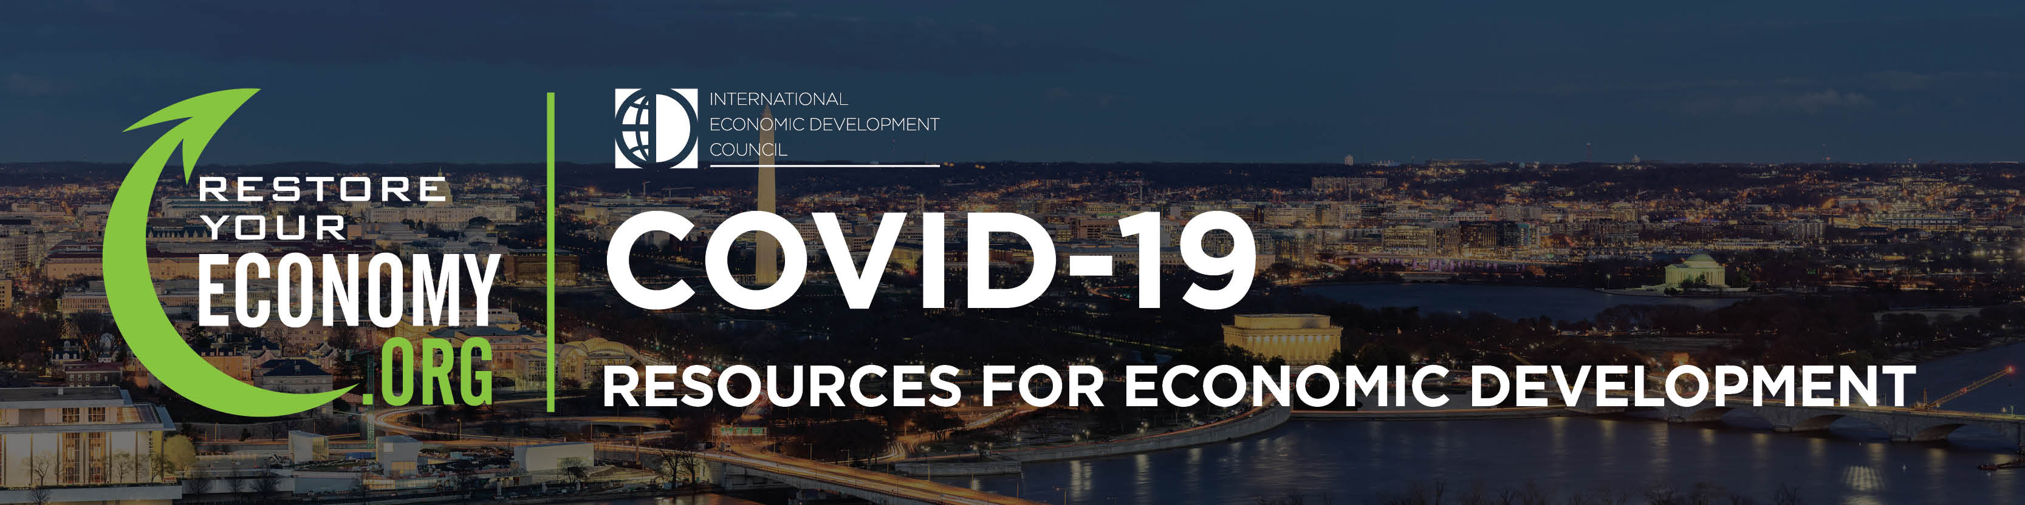
RestoreYourEconomy.org

Slide 21
IEDC Webinars: COVID-19
COVID-19: Demystifying Financial Programs & Resources During This Crisis
Monday, March 30, 2020, 3:00 – 4:30pm ET Visit iedconline.org to sign up (Free!)
Moderator: The Honorable Jane Campbell, Senior Fellow, IEDC, Washington, DC
Speakers:
• Robin Barnes, Principal, Resilience Resolutions; New Orleans, LA
• Alex Contreras, U.S. Small Business Administration’s Office of Disaster Advocacy; Washington, DC
• Vincent DiCara, Founder, DiCara Training and Consulting; Brunswick, ME
• Brett Doney, CEcD, FM, President & CEO, Great Falls Montana Development Authority; Great Falls, MT
• John Zakian, National Disaster Resilience Grant Program Manager, City of Minot; Minot, ND

Slide 22
IEDC Webinars: COVID-19
COVID-19: Preparing for What’s Next
aired Monday, March 23, 2020
Available for free download on iedconline.org and restoreyoureconomy.org

Slide 23
Questions?
Please use THE Q/A FUNCTION TO SUBMIT YOUR QUESTION
Content

Slide 24


