Slide 1
Mid-Atlantic
StatNet:
A Regional Approach
Dave Gottesman
CountyStat Manager, Montgomery County, Maryland
ICMA Conference Presenter

Slide 2
AGENDA:
1. Performance Measurement and Management
& “Data-Smart” Government: A Brief Review
2. Montgomery County, MD’s CountyStat Office
3. Mid-Atlantic StatNet
4. Exercise: Your Region’s StatNet Opportunity

Slide 3

“Data-Smart Government” ?

Slide 4
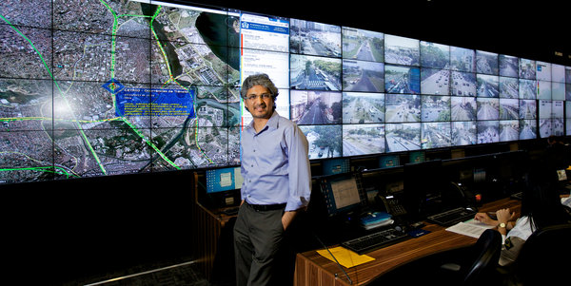
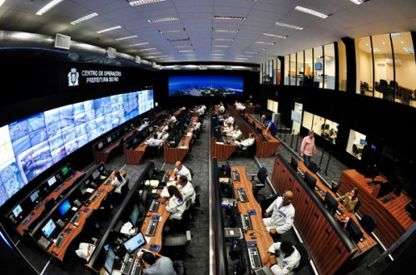
Rio Intelligent
Operations Center

Slide 5
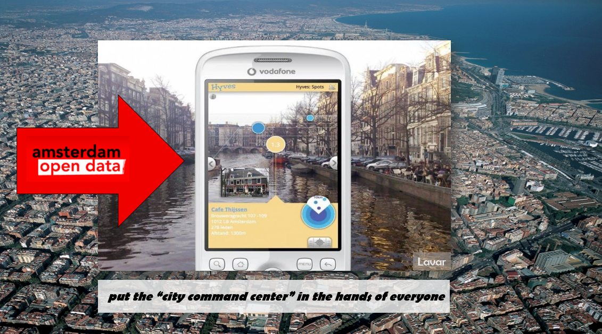

Slide 6
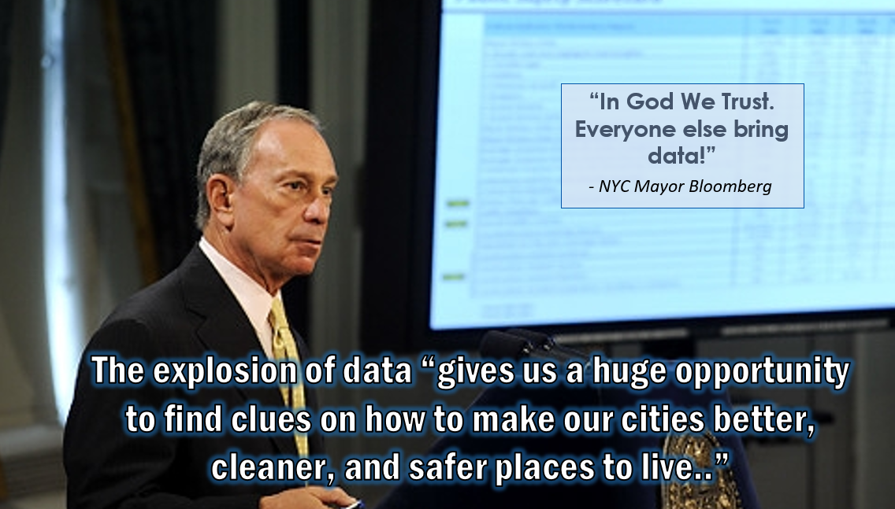

Slide 7
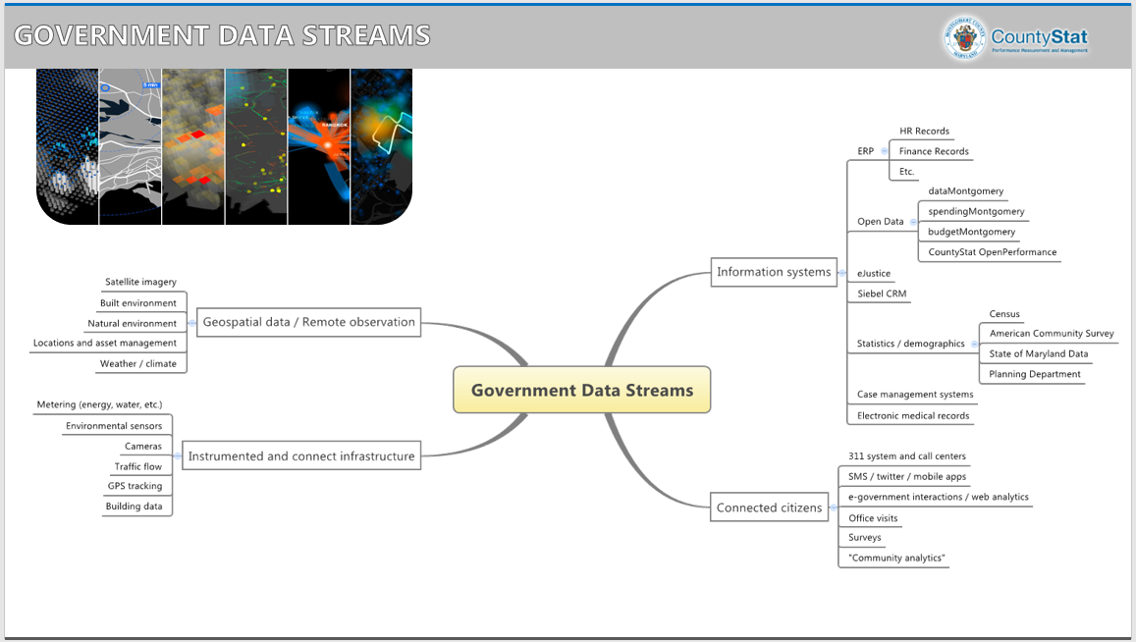

Slide 8
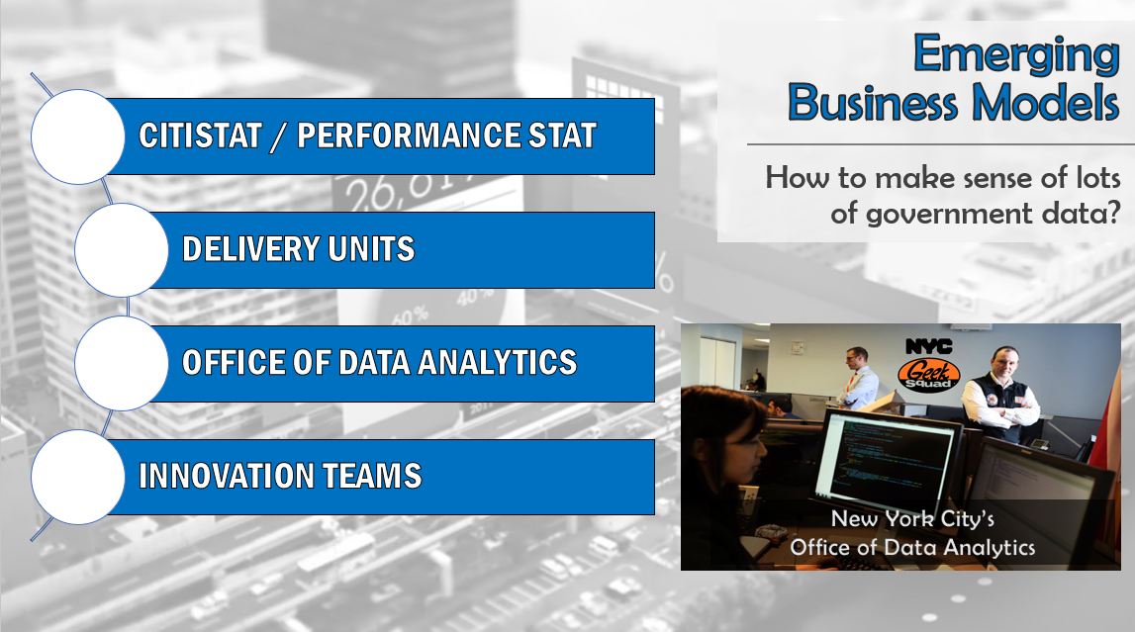

Slide 9
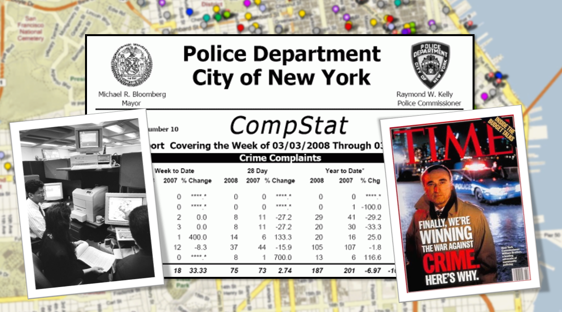

Slide 10
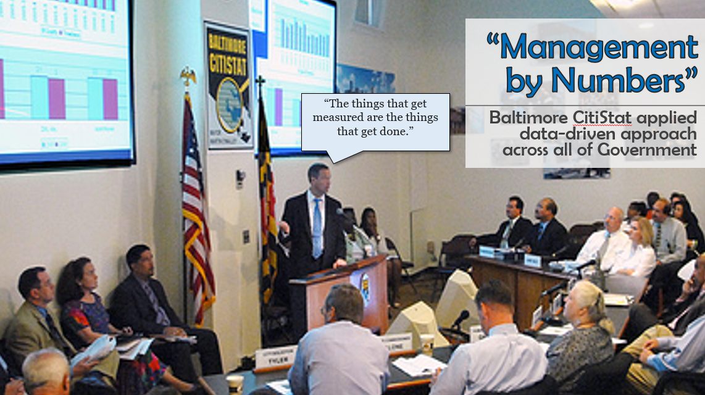

Slide 11
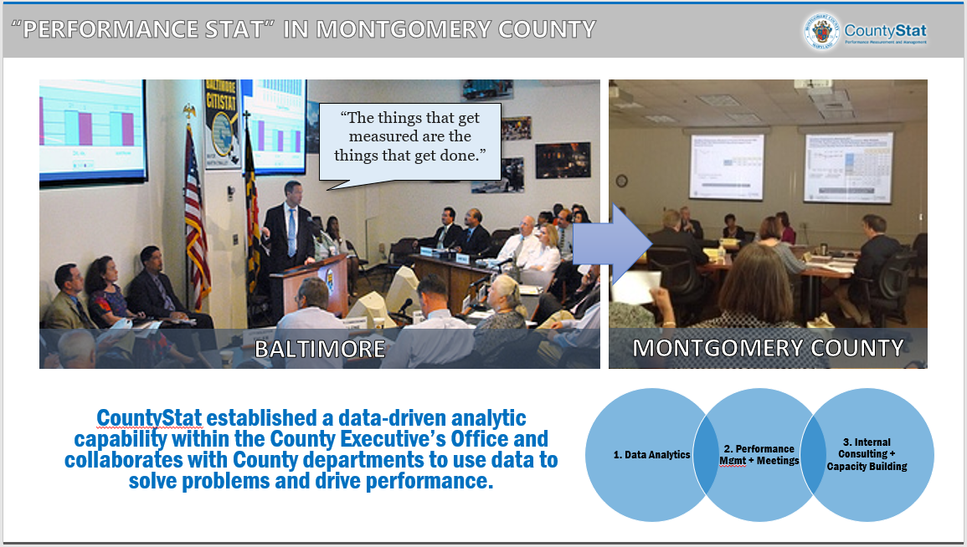
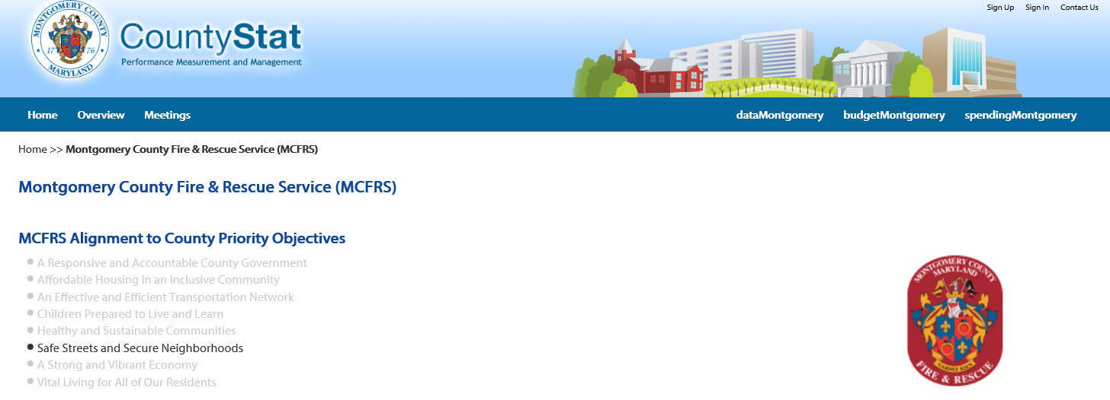
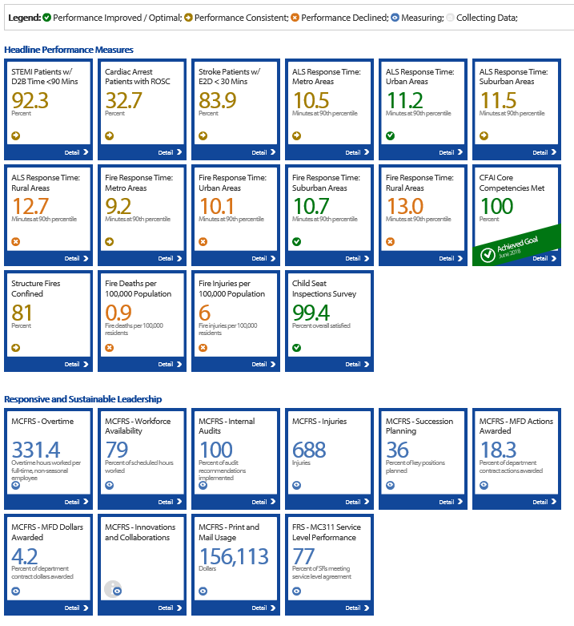

Slide 12
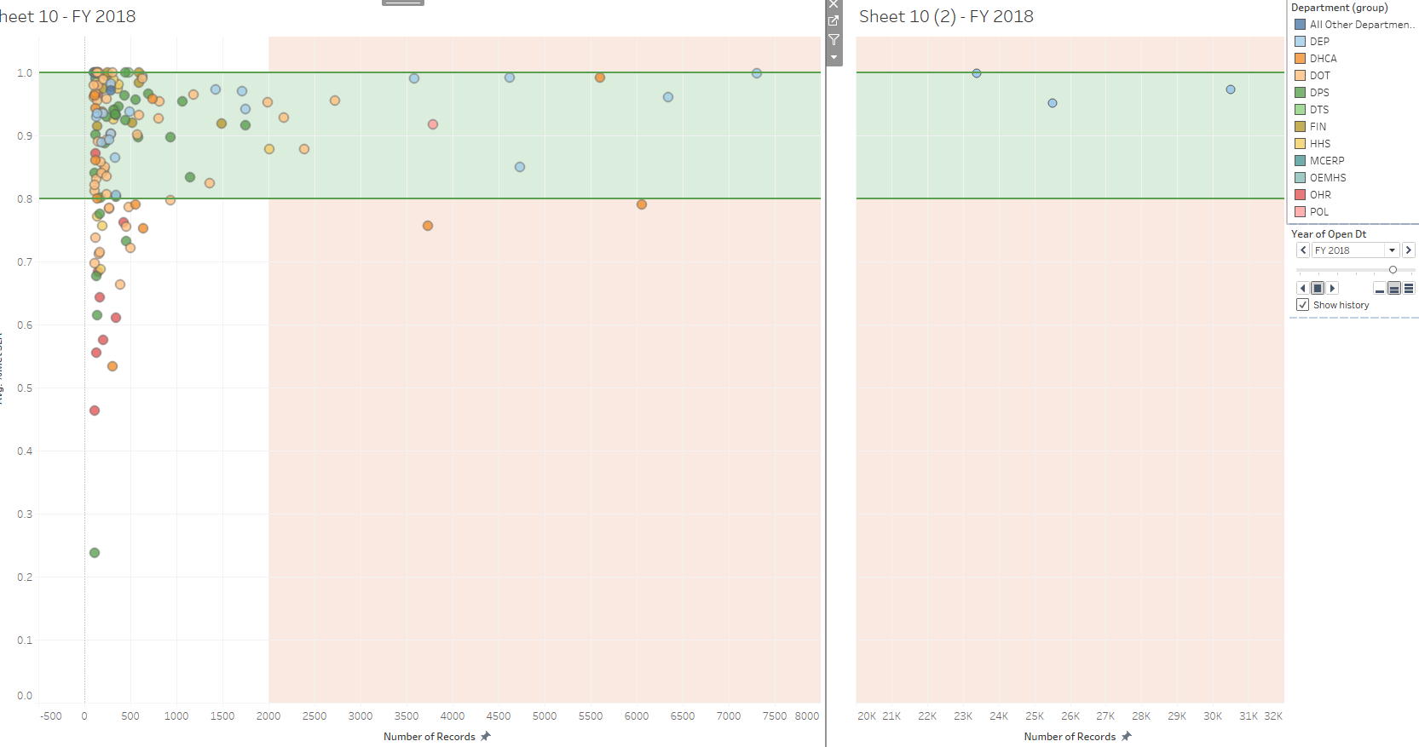
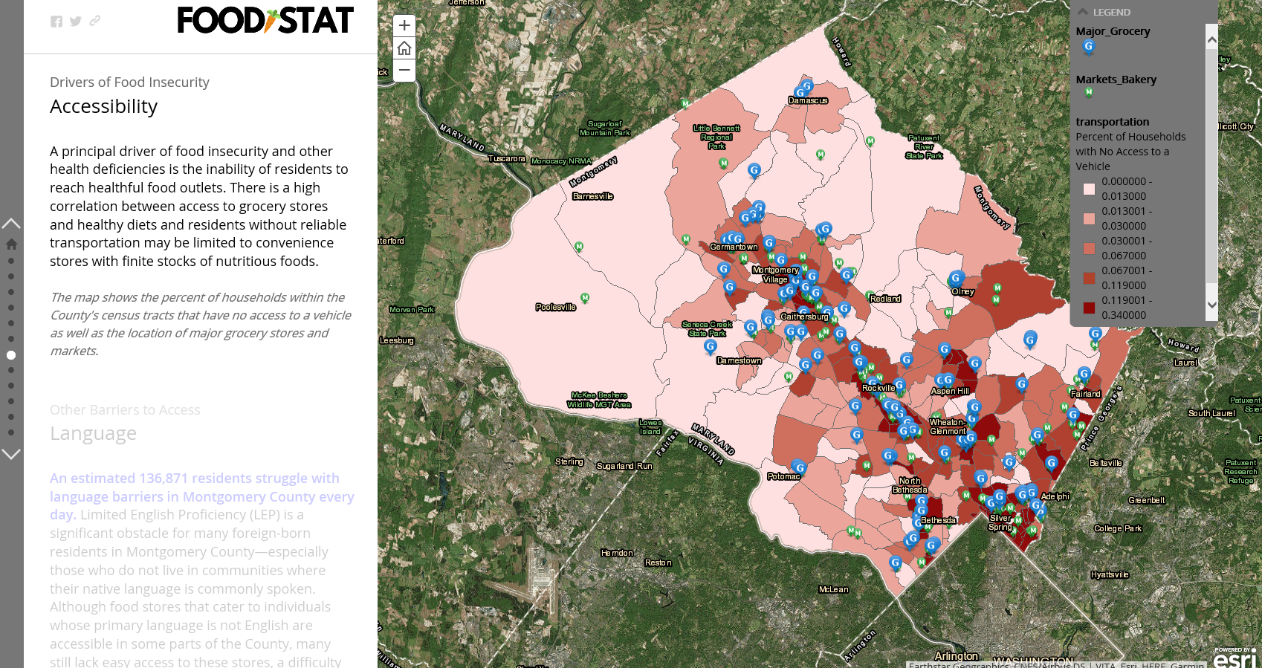
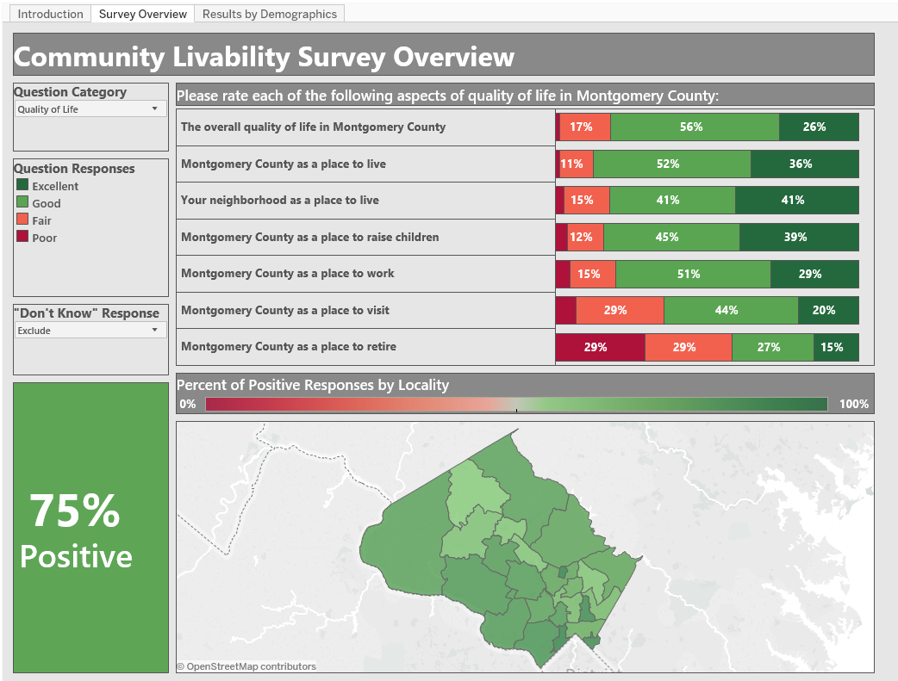
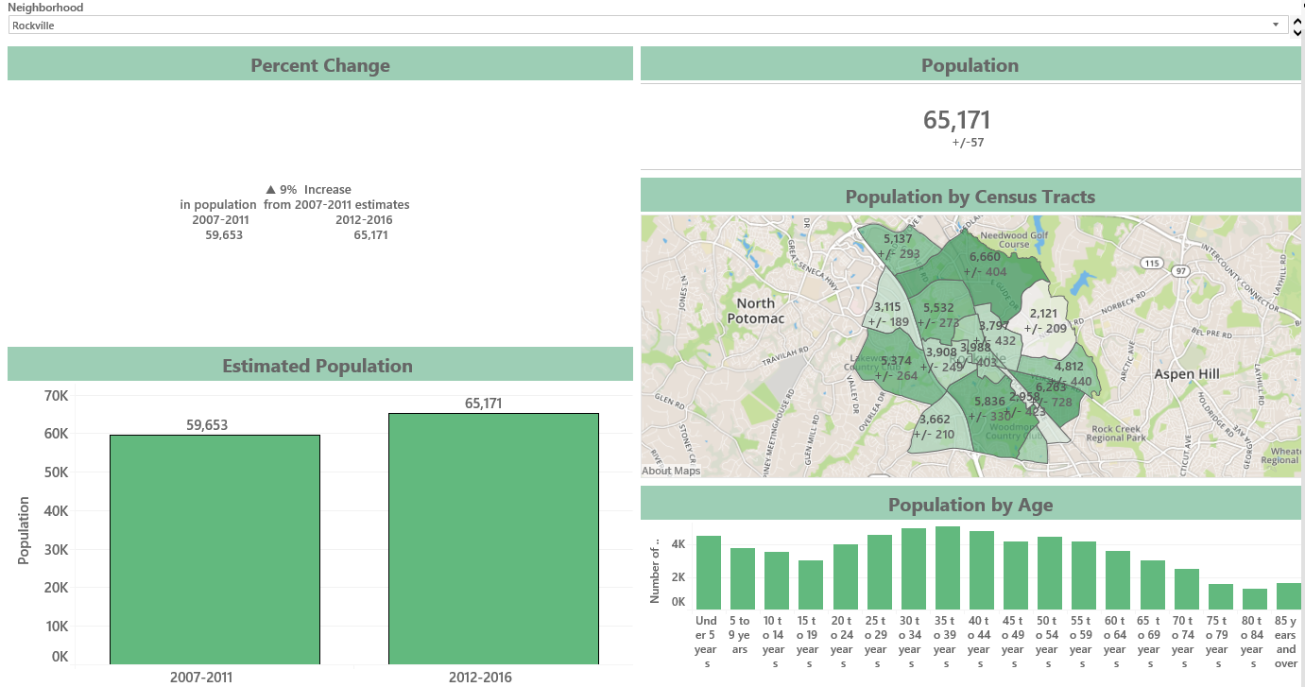
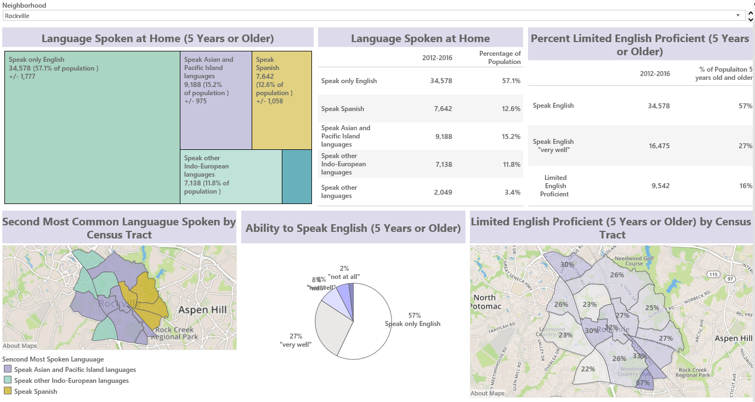

Slide 13
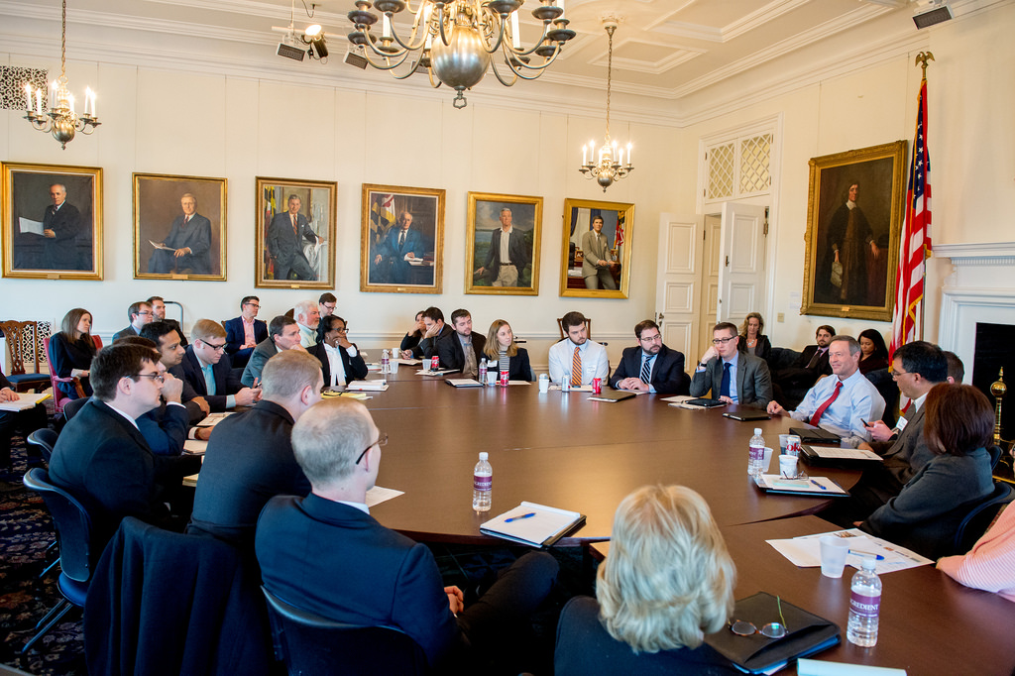
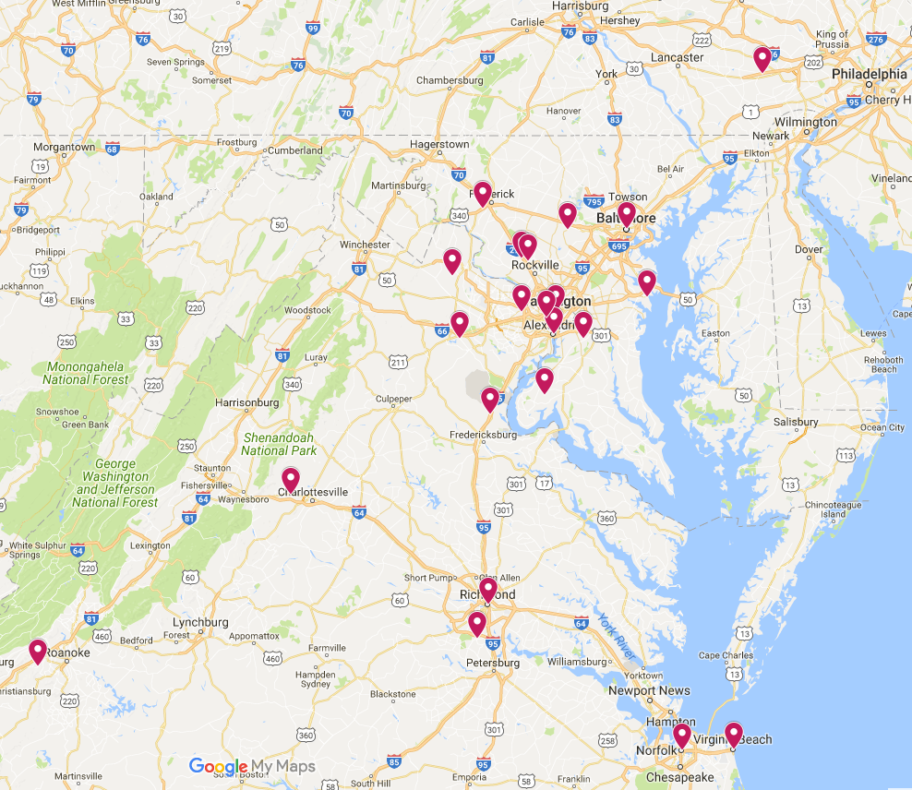
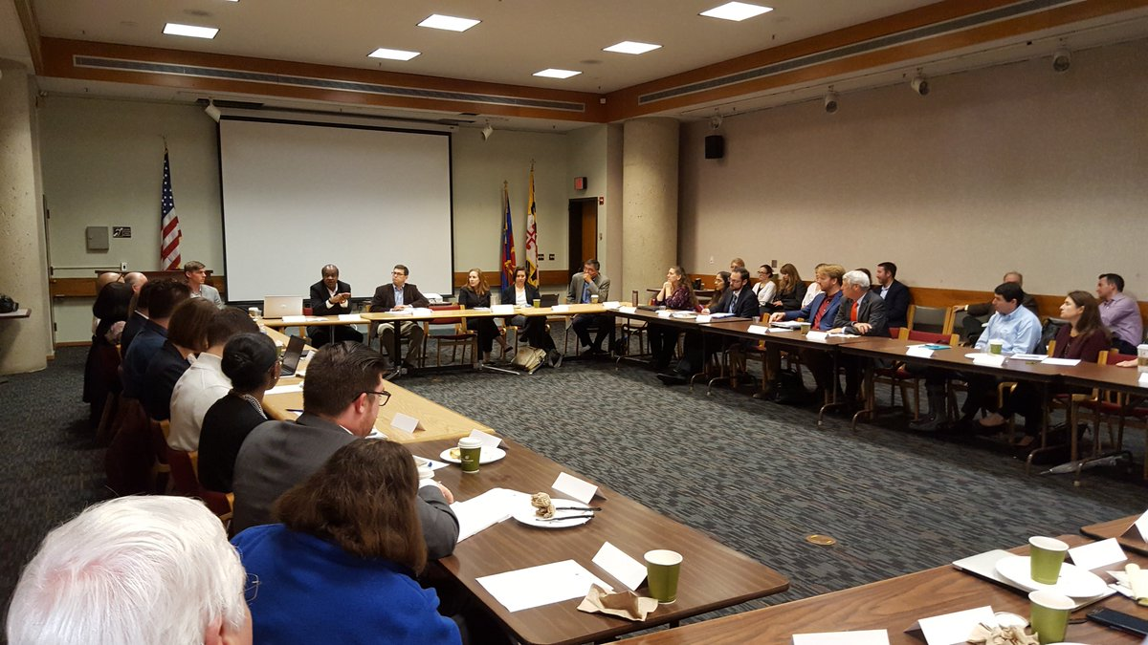
Mid-Atlantic StatNet (MASN)
The Meaning of MASN
The History of MASN
The Big Event: the MASN Semi-Annual Meeting
The Value of MASN for our members
Some MASN Lessons Learned
A Group Exercise: Your very own StatNet

Slide 14
Contact Information:
Dave Gottesman, CountyStat Manager david.gottesman@montgomerycountymd.gov
240-777-2627

Slide 16
The Stat Model for Data-Driven
Management
Andrew Kleine

Slide 17
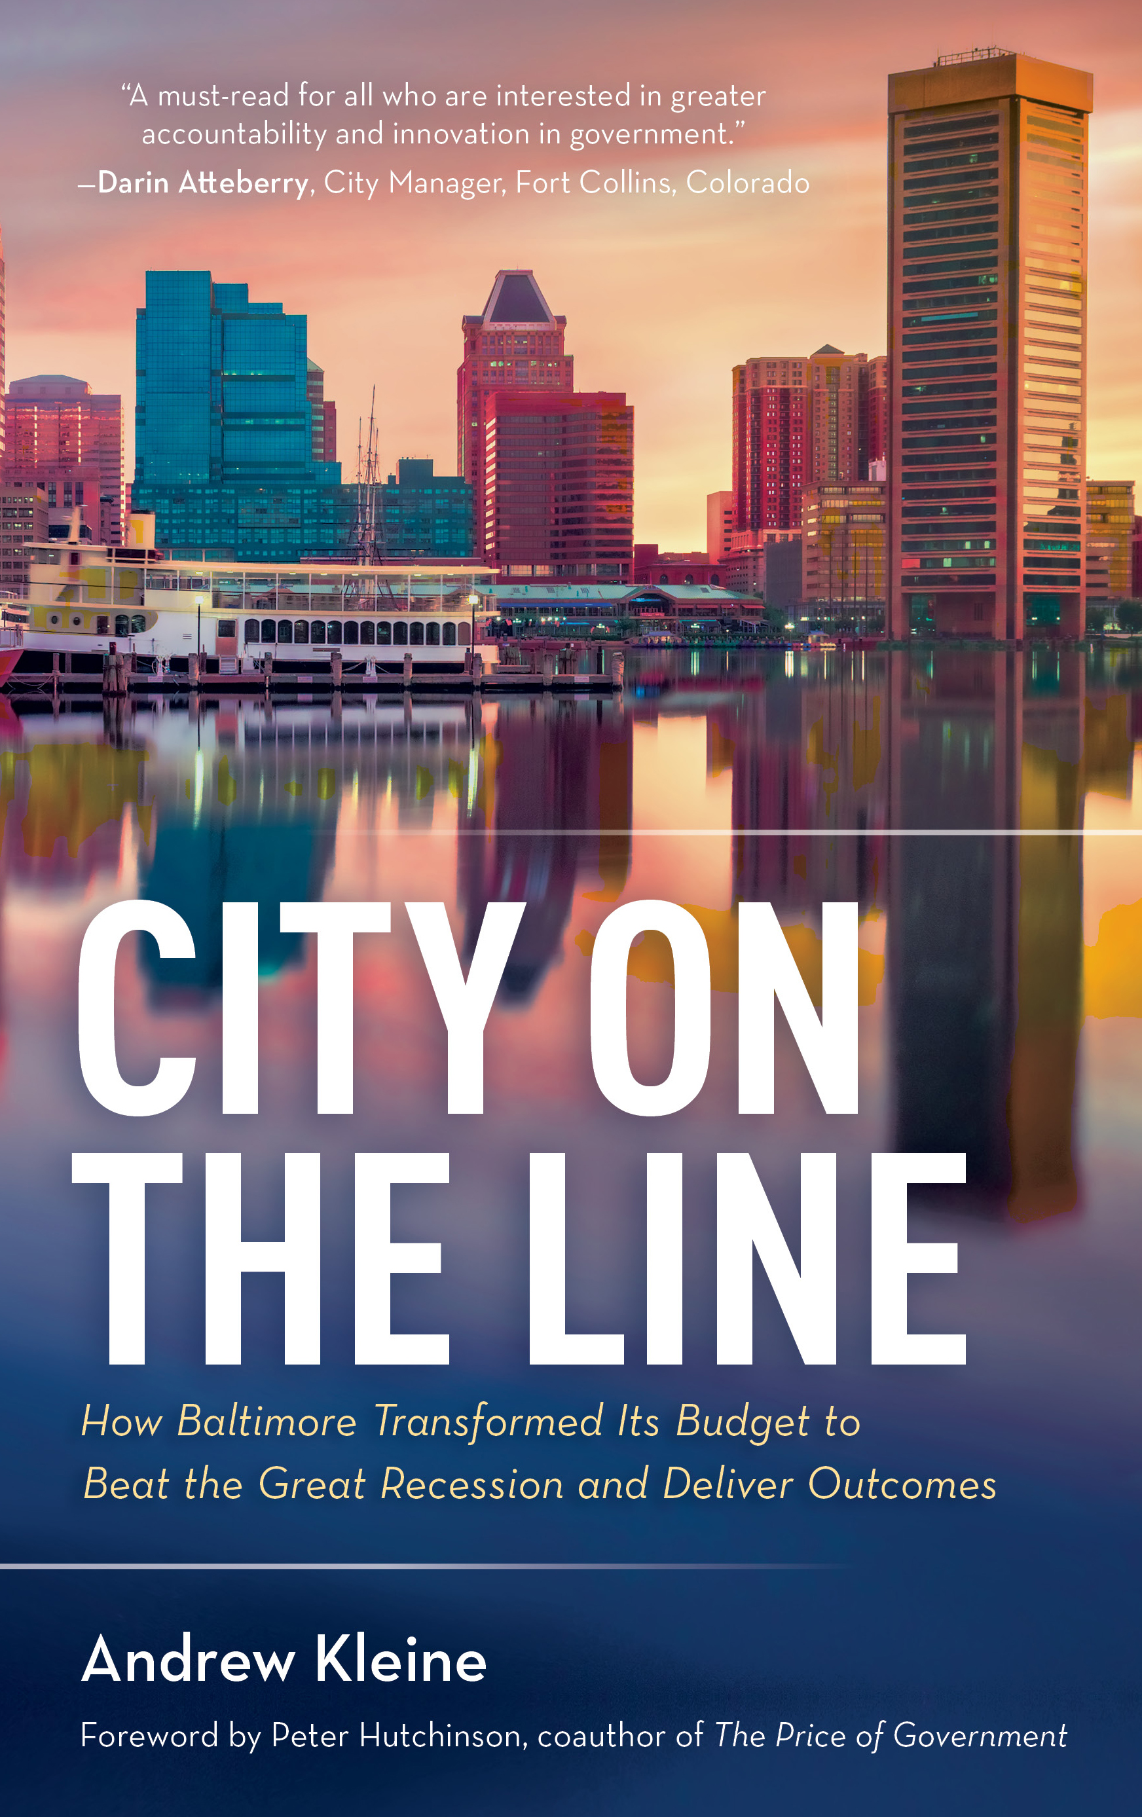
Former Baltimore Budget Director
Author of forthcoming book about how to transform city budgeting

Slide 18
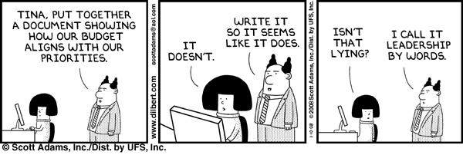

Slide 19


Baltimore’s Priority Outcomes
Safer Streets
Stronger Neighborhoods
Growing Economy
Innovative Government
A Cleaner City
A Healthier City
Better Schools

Slide 20
A Safe & Healthy Start
Kindergarten Readiness
Academic Achievement
College & Career Ready
Employment Rate
Number of Jobs
Visitors
Procurement
Prompt Payment
Special Events
Shootings
Property Crime
Perception of Safety
Cleanliness of Waterways
Energy Usage
Recycling Rate
Perception of Cleanliness
Blight Elimination
Neighborhood Investment
Sustainable Transportation
Recreation Visits
Heroin-Related Deaths
Mental Health
Childhood Asthma

Slide 21
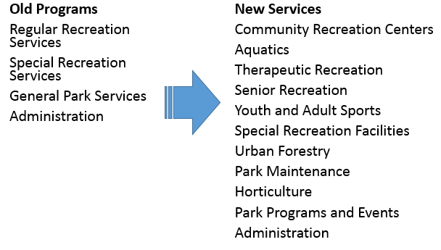
Defining Services
Notes:
Defining services

Slide 22
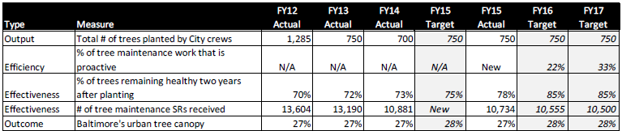
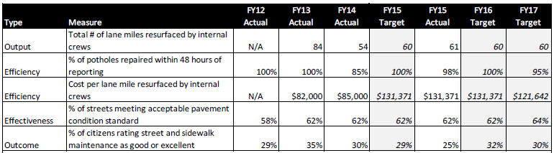
Performance Measures

Slide 23


Slide 24
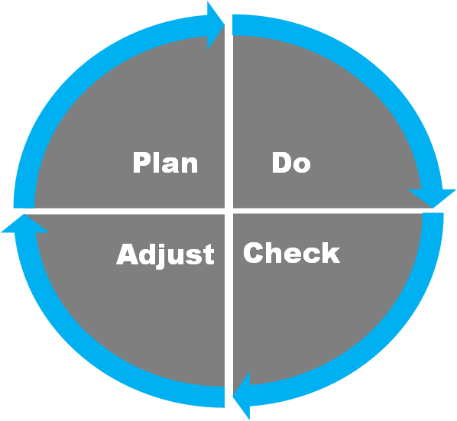

Slide 25
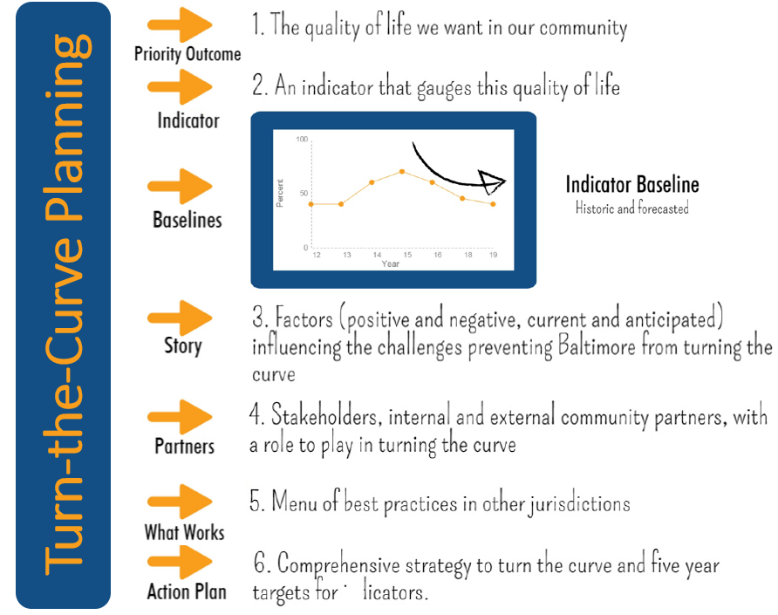

Slide 26
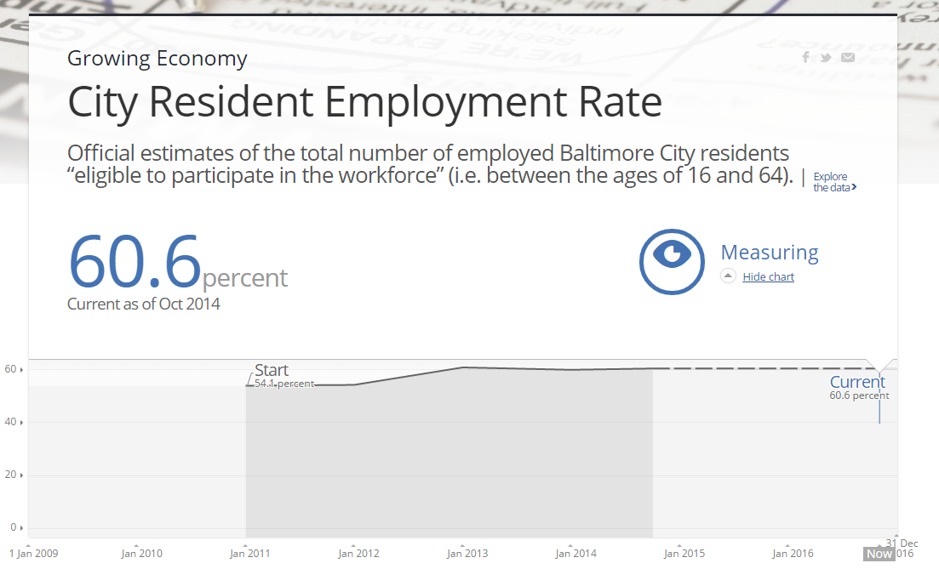

Slide 27
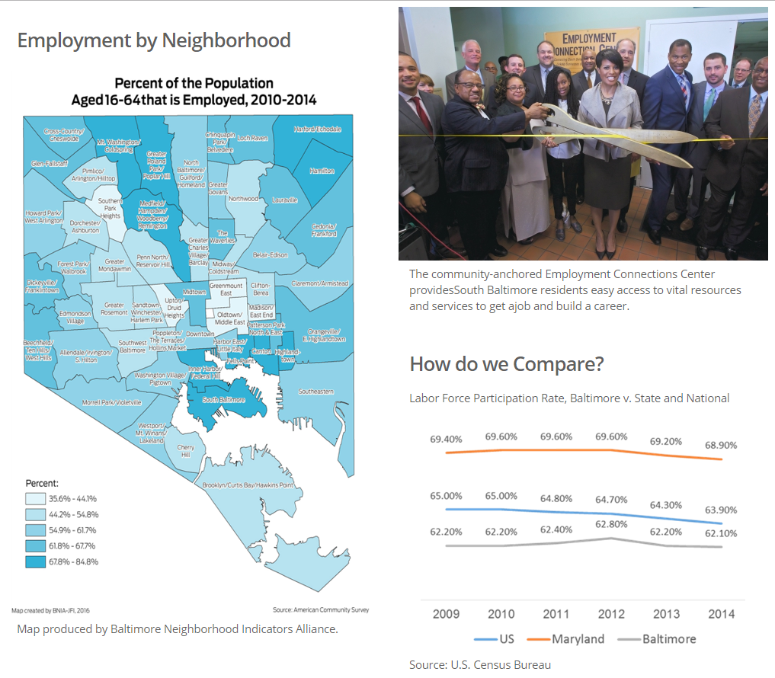

Slide 28
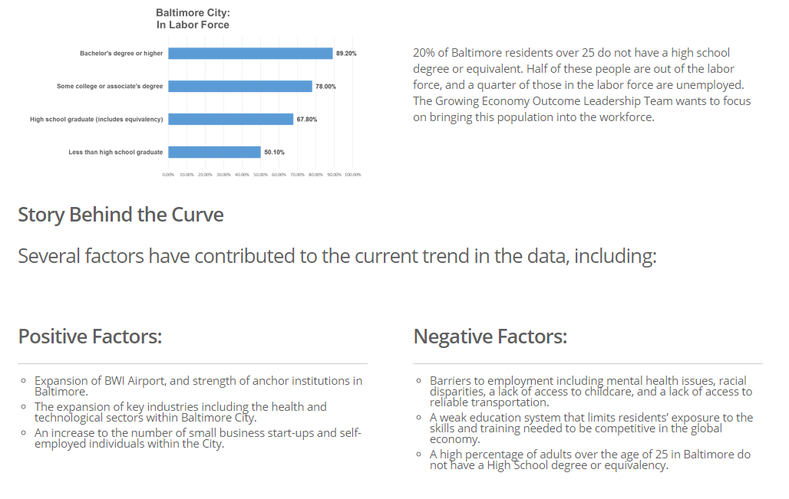

Slide 29
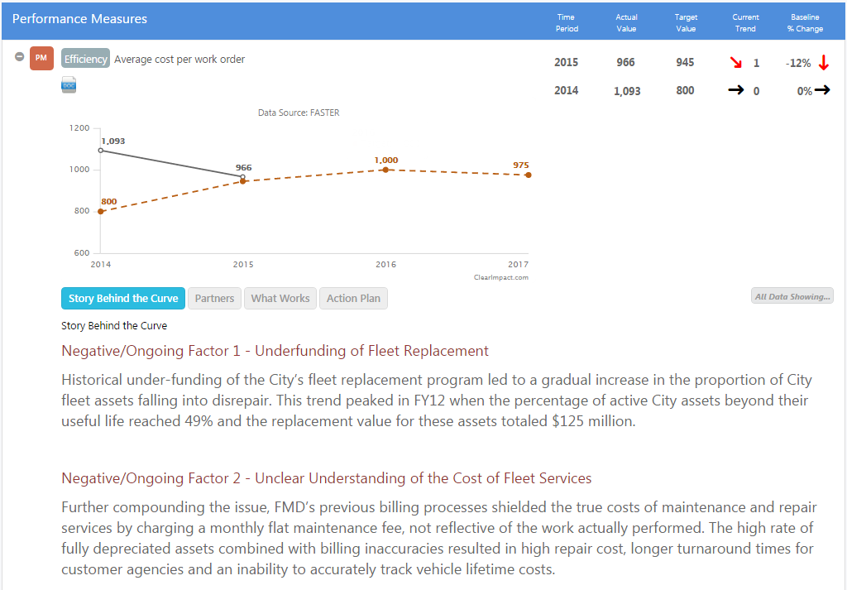
Service-Level Performance

Slide 30
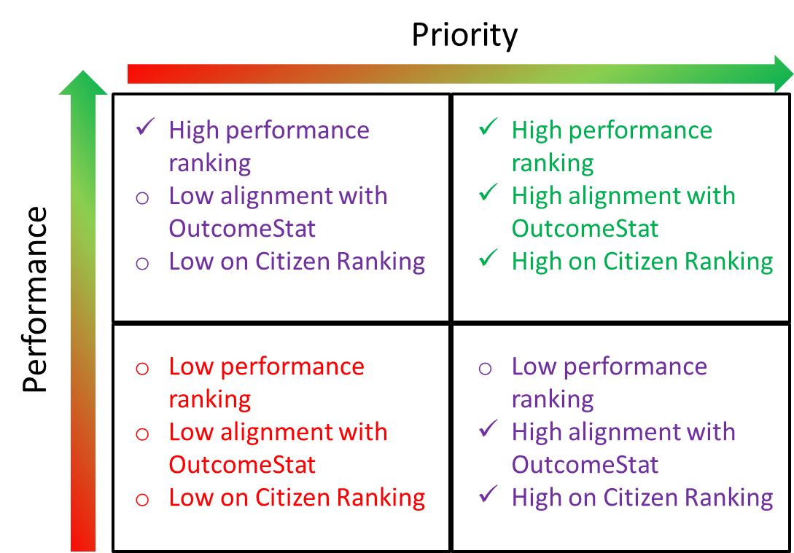

Slide 31
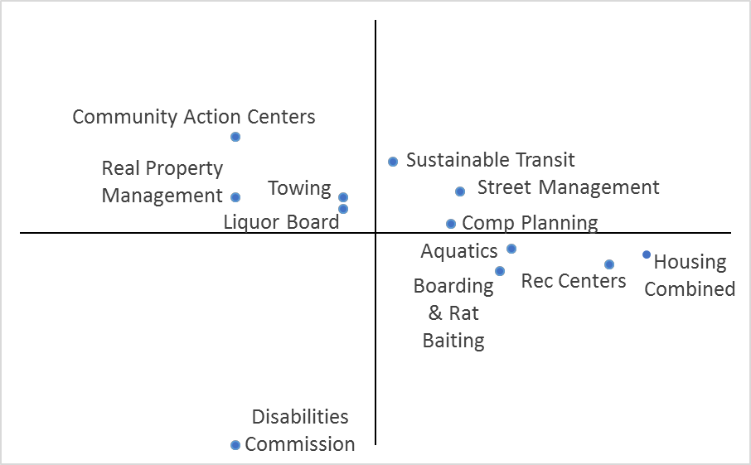
Priority
Performance
Stronger Neighborhoods

Slide 32
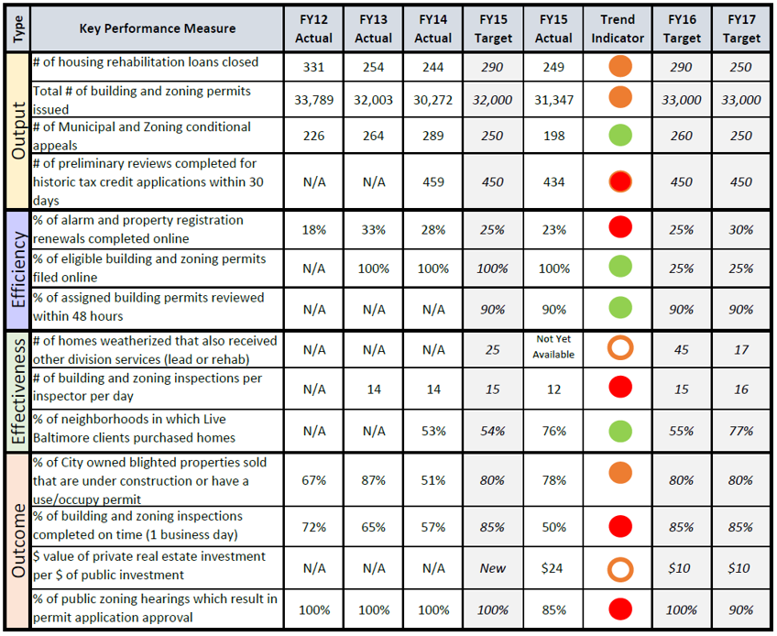

Slide 33
Keep in Touch
andrew@andrewkleine.com
@awkleine
cityontheline.com

Slide 35
MOSS CitiStatSMART is Getting Stat Unstuck
Kendra Parlock
Director, Mayor’s Office of Sustainable Solutions
City of Baltimore
Mayor Catherine E. Pugh

Slide 36

About Baltimore
Land Area: 81 square miles/ 210 sq km
Population: 622,793 residents
FY18 Operating Budget: $2.8 billion
FY18 Capital Budget: $1.1 billion
FY18 Full Time Positions: 13,594
Annual # 311 SRs: ~1,000,000
Annual # EMS Calls: 150,000
Birthday: July 30, 1729
Notes:
Why am I here?
What can I accomplish?
What will you glean from listening to me?
Overall City stats & City Government/Budget stats
The town was founded on July 30, 1729
Population
Land Area
Form of Government
Density
# City of Baltimore Employees
Budget
Annual # 311 Calls
# Calls for Service
#EMS Calls
July 30th, Baltimore’s Birthday

Slide 37
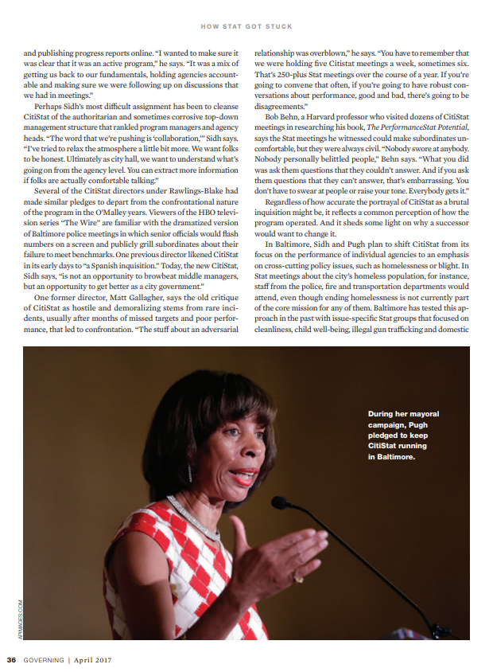
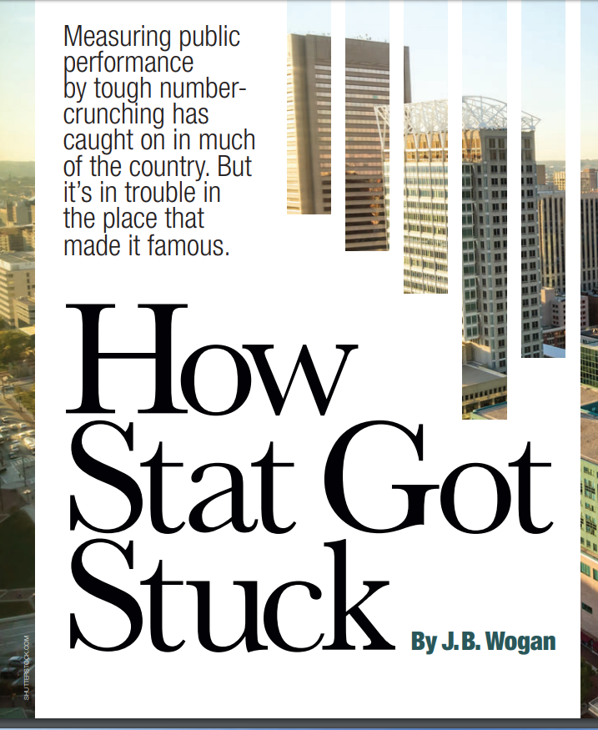
MOSS CitiStatSMART
UN
Notes:
Timeline
May 2017 – Sam Sidh resigned; uncertainty about executive commitment
August 2017 – Director appointed; Mayor wanted a new direction, new name – not CitiStat; only staffer resigned
August 2017 – Update to Mayor’s VRP
September 2017 – Relaunched PoliceStat under CitiStatSMART
October 2017 – All Hands On Deck at CitiStatSMART; 3 staffers hired
November 2017 – VRI launche
Nov – Feb – Performance Measure Review; Daily Performance Statting of VRI

Slide 38
From Stat to Sustainable Solutions
We have rebuilt and rebranded CitiStat as CitiStatSMART under the Mayor’s Office of Sustainable Solutions.
Our focus is on making Baltimore resilient by using data, innovation and technology to foster cross-agency collaboration and to develop solutions.
MAYOR’S OFFICE
OF SUSTAINABLE SOLUTIONS
PERFORMANCE MEASUREMENT WITH CITISTATSMART
IDEA INCUBATION, PROCESS IMPROVEMENT, PROBLEM SOLVING
Cross Agency Collaboration
Performance Measurement & Accountability
Notes:
Combine best performance measurement practices to achieve priority outcomes.
Be a process that uses a variety of tools to collect, analyze, & report data
Utilize a Performance Dashboard for monitoring and tracking
Allow for broader communication of progress and performance results
Facilitate accountability and business process efficiencies in operations
Incubate new ideas, lead ideation, process mapping, benchmarking and working group sessions

Slide 39
The Stat Process & Potential
Strategic Priorities
Be familiar with the processes that generate data
Performance Measures
Establish Key Performance Measures*
Data Reporting
Design process and owners for updating (monthly or bi-monthly)
CitiStatSMART Meetings for Performance Management
Performance Measure training
Establish Performance Agreement
Update Scorecard database
Train agencies
Diagnose Causes
Develop Strategies
Invest Resources
Build Solutions
Convene working groups in collaboration with Finance
Identify Priorities
Identify Problems
Provide Operational Updates
*More details @ https://govex.jhu.edu/wiki/performance-measures-how-less-becomes-more/
Notes:
Be familiar with processes that generate the data
Regularly updated (don’t want to look at same data point for 2 months in a row, should be refreshed regularly)
Is the data interpreted easily by lay people; can be explained in a stat meeting
Likely to be responsive to the efforts being made; data that will be changed based on the efforts (what mediates the influence)
Uncontroversial – you should have by-in from stakeholders – what is the right way to measure this
Measures that reflect the reality of the resident’s experience (a measure that is not process-related, it is grounded in what people are really experiencing); measures that residents touch (Citizen Survey and 311 SRs, ex. How many permits filled on the first day, choose measure that has public interaction adjacent to it)

Slide 40
SMART Objectives Drive Performance
Specific. The measure is clear and focused to avoid misinterpretation. It should include measurement assumptions and definitions.
Measurable. The measure can be quantified and compared to other data. It should allow for meaningful statistical analysis.
Ambitious and Agreed upon. The target should stretch to improve performance.
Realistic. The target should make sense and reflect the reality of the resident’s experience.
Time Bound. There should be a clear timeframe for achieving the targeted performance.
Notes:
Be familiar with processes that generate the data
Regularly updated (don’t want to look at same data point for 2 months in a row, should be refreshed regularly)
Is the data interpreted easily by lay people; can be explained in a stat meeting
Likely to be responsive to the efforts being made; data that will be changed based on the efforts (what mediates the influence)
Uncontroversial – you should have by-in from stakeholders – what is the right way to measure this
Measures that reflect the reality of the resident’s experience (a measure that is not process-related, it is grounded in what people are really experiencing); measures that residents touch (Citizen Survey and 311 SRs, ex. How many permits filled on the first day, choose measure that has public interaction adjacent to it)

Slide 41
MiniStat Meetings for Performance
Agency specific meetings
Performance measure agreements
3. DOT example

Slide 42
CitiStatSMART Mini Stat Process
ID Stakeholders
Review/ Create Measures
Develop MOU or Charter
Plan Data Collection (Scorecard)
Ongoing PerformanceStat Meeting
Performance Measurement Agreements Completed | 2
Performance Measurement Agreements In Progress | 2
Measures reviewed for Budget Process | 287
Agency reviews for Budget Process | 9
HEALTH HCD MOED MOHS | BCRP | FIRE |  | DOT BPD DPW

Slide 43
Major Stat Meetings for Performance
Issue based cross-agency performance stat meetings
Violence Reduction Initiative example
Procurement, Inclusion & Equity example
Neighborhood Revitalization example

Slide 44
Major Stat Collaborative Meetings Support Mayoral Priorities
Making Baltimore Safe
Violence Reduction Initiative (VRI)
Keeping Baltimore Healthy
Neighborhood Revitalization Initiative (NRI)
Engaging Baltimore Youth
YouthStat
Moving Baltimore Forward
Procurement, Inclusion & Equity (PIE)
Fire
MOED
DPW
Housing
Rec &Parks
ECB
BCPS
BPD
MOCJ
DHR
Health
DPW
DOT
MOHS

Slide 45




Mayor’s Violence Reduction Initiative
Transforming Baltimore city government through multi agency collaboration for improved public safety
Strategy |  |  | Indicators | Performance Measures
Reduce homicides and shootings in the VRI Zones by 15% in 2018
 | Physical/ Environment Condition | Identify and improve physical condition in focus areas Implement 311 Auditing | Quality of life Property value | # 311 SRs submitted by VRI team Time to Close public safety 311 SRs
 | Priority Businesses | Prioritize businesses for inspection Promote toolkit of services for improvement of businesses | Crime/business nexus analysis | #of priority businesses identified # of priority business violations # Businesses provided assistance
 | Coordinated Outreach | Identify high risk individuals Expand access to service needs identified | Unemployment Overdoses | # of High-risk individuals contacted # of People served with targeted resources
 | Community Engagement & Partnership | Prioritize agency activity and align private resources with community input Complete VRI asset maps | Community trust Collective efficacy | # of community meetings attended # of community assessments completed
Notes:
Monthly site visits
Each group tasked with refining and creating systems for tracking these indicators
Zone Coordinators could record/manage activity across groups, however additional analyst capacity is required for more sophisticated analysis, tracking and reporting.

Slide 46
Solutions Building
Convening Work Groups
Data Visualizations
Process Improvement Training

Slide 47
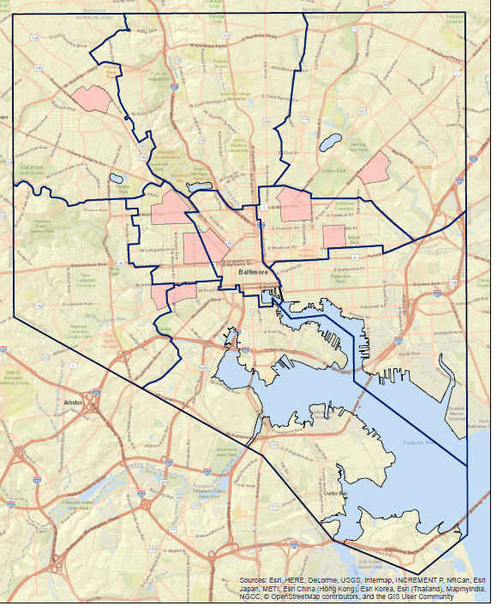
Mayor’s Violence Reduction Initiative
Transforming Baltimore city government through multi agency collaboration for improved public safety
Notes:
Monthly site visits
Each group tasked with refining and creating systems for tracking these indicators
Zone Coordinators could record/manage activity across groups, however additional analyst capacity is required for more sophisticated analysis, tracking and reporting.

Slide 48
Performance Measurement Development Exercise
Partner with 2 or 3 people seated next to you.
Identify a city government service, function or issue.
Develop 2 SMART objectives for the function or issue.
Create relevant performance measures.
Share work with another team.

Slide 49



