Slide 1
Harnessing Trends and Emerging Technology
Brandt S. Clark
Deputy County Attorney
Navajo County Arizona
ICMA Conference Presenter

Slide 2
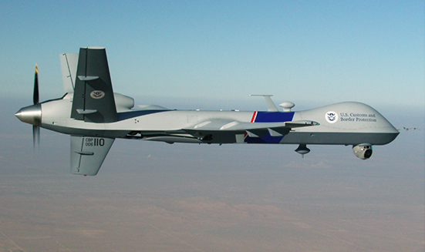
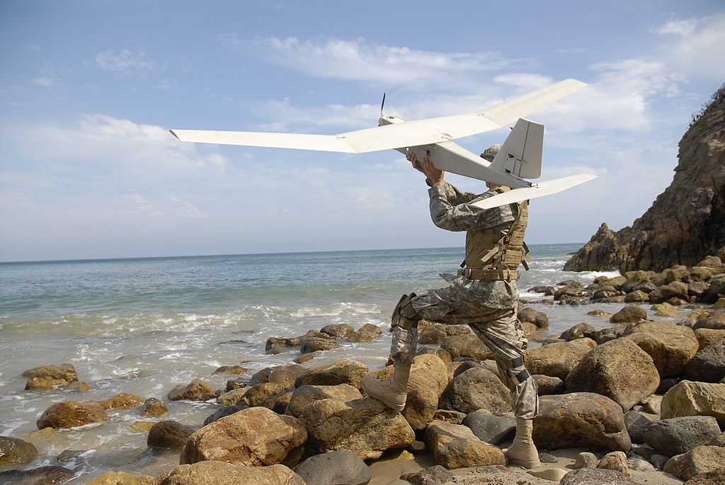
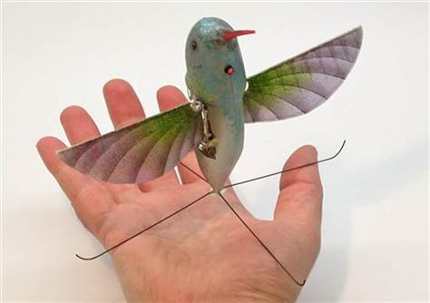
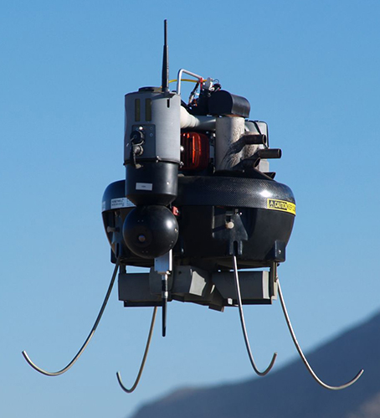
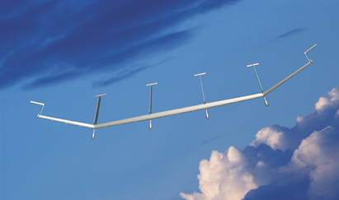
Unmanned Aerial Vehicles (UAV)
Predator
Nano Hummingbird
Puma AE
Honeywell T-Hawk
Solar Eagle
Notes:
Some Facts on Drones:
U.S. has used drones in the military since1918 and first flew Predator drone in Bosnia in 1995 (Customs and Border Protection flies10 Predators around the country)
Today almost 1 in 3 US warplanes is a drone (only 5% in 2005)
In 2010, $3 billion spent on drones in US
Drones already in use wide range of public agencies across US– from fire departments and research universities to the FBI and Customs and Border Protection to your local law enforcement agency
Also created & used by hobbyists
2015 – FAA opens skies to commercial flights (Google, film industry, news media, agriculture, private security companies)
FAA: By 2018 there will be more than 15,000 drones in U.S., with almost 30,000 deployed worldwide
Solar Eagle - high-altitude unmanned airplane (UAV) to operate continuously for a period of five years – Boeing & DARPA – solar powered
Honeywell T-Hawk – used by Miami-Dade PD
CBP flew more than 60 missions between 2010 and 2012 on behalf of state agencies like the Arizona Department of Public Safety, the Minnesota Bureau of Criminal Investigations, and various unnamed county sheriff’s departments

Slide 3
Unmanned Aerial Vehicles (UAV)
Video Available At Conference

