Slide 1
Opportunity Zones

Slide 2
Creation
The Opportunity Zone Program was created as part of the Federal Tax Bill
It was co-sponsored by Senators Tim Scott and Cory Booker
Purpose
Combat geographical inequality:
In the 1990s, half or more of all counties grew at the national rate. Now only 25% do
More than half of the country’s distressed zip codes contained fewer jobs and places of business in 2015 than they had in 2010
This bill should expand the geography of economic growth
Source: Economic Innovation Group (EIG), US Census Bureau
Notes:
Good morning, Thank you so much for having me this morning. I guess I have to start this morning with an apology
I know the first rule of PowerPoints is not to read the PowerPoint, but since it is being distributed after, I wanted it to make sense so it is a lot of text instead of more entertaining graphics and for that I am sorry.
How many of your are familiar with the OZ program?
This was a program that was part of the most recent tax legislation. It wasn’t really in the news until after the bill passed and we were contacted about the census tract nominations. Since then, there has been a lot more coverage and a lot of misinformation as well and I hope that I can help to explain it as it stands today in a way that you will understand.
One reason that this bill is special for South Carolina is because it was cosponsored by Tim Scott. As many of you know, during the most recent economic expansion, South Carolina has been doing quite well. Since 2011, unemployment in the State has fallen dramatically. Commerce has also recruited 120,000 new jobs and over $33 billion in capital investment. Entrepreneurs are flourishing and the economy as a whole has done well. However, this success was not spread out in a blanket fashion. Some communities have stagnated or even declined. This bill is intended to be a boost for some of those communities to help them attract private sector investment.

Slide 3
Program Intent
The program provides incentives to investors to invest in new businesses and development in particular geographies
There is no public money as part of this program
The incentive is market based: investments must provide an attractive return on investment in order to attract investors
The program is scalable and flexible
(Although rules are still being written) We do not expect there to be investment minimums or maximums required
Investors can invest in new businesses, new real estate, or substantial redevelopment of real estate (more than 100% of the acquisition cost spent on redevelopment)
Investors can NOT invest in so called sin businesses, defined as: golf courses, country clubs, massage parlors, hot tub facilities, tanning facilities, racetracks or gambling venues, or stores where the principal business is sale of alcoholic beverages for consumption off premises
Source: Economic Innovation Group (EIG), US Census Bureau
Notes:
The program provides incentives to private investors to invest in new businesses and development in particular geographies
There is no public money as part of this program
It’s a market-based solution: investments must provide an attractive return on investment in order to attract investors
The program is scalable and flexible
(Although rules are still being written) We do not expect there to be investment minimums or maximums required
Investors can invest in new businesses, new real estate, or substantial redevelopment of real estate (more than 100% of the acquisition cost spent on redevelopment)
There are some limits on the types of businesses and real estate one can invest in. Investors can NOT invest in so called sin businesses, defined as: golf courses, country clubs, massage parlors, hot tub facilities, tanning facilities, racetracks or gambling venues, or stores where the principal business is sale of alcoholic beverages for consumption off premises. Massage parlors and liquor stores aren’t anybody’s idea of a thriving city block, but this could also prohibit, for example, a micro-brewery.

Slide 4
How are OZs determined?
Governors of each state (and territory) were allowed to designate up to 25% of their low income census tracts
Two approaches to designate:
Data
Population
Income
Urban/Rural
Local Input
Notes:
Governors of each state were allowed to designate 25% of their low income census tracts to be opportunity zones.
We saw two avenues for reaching our nominations: objective data and local input. We tried both. We called on counties and municipalities to let us know, in a ranked order where they would like zones in their areas and why.
We designed a methodology that used both statistical data: things like population, income, and employment, plus proximal features like the presence of urban centers and interstate access. Using these numbers, we created a hierarchy of tracts.
County and municipal input was still extremely valuable, however, because the data could be misleading if looked at without additional context. The state of California came under fire after putting a totally data driven approach up for public review. One of their tracts was the Stanford campus, because college students are low income for the area. Apparently there was also a large cemetery in one tract with low income compared to its neighbors. So by relying on input from people that see these tracts every day, I think that we made good decisions.

Slide 5
How are OZs determined?
In South Carolina, we have 1,097 census tracts
538 were eligible to be submitted
Submitted 135 tracts
128 Low Income Community tracts were submitted
7 eligible contiguous tracts were submitted
Focus Areas:
Promoting economic vitality in parts of the state that have not shared in the general prosperity over the past few years
Funding the development of workforce and affordable housing in areas with escalating prices and inventory shortages
Investing in startup businesses who have potential for rapid increases in scale
Upgrading the capability of existing underutilized assets through capital improvement investments
Notes:
SO California had a thousand to nominate. What about us? All in, of the 1,097 census tracts, 538 were eligible, which meant we could nominate 135. 5% of these picks (that rounds to 7), could be adjacent, non-depressed tracts. So, to restate that: we nominated 128 low income community tracts, and 7 tracts that were contiguous but still up and coming. It was the view of the program designers that some tracts, by receiving investment on their own, and still meeting certain conditions such that affluent tracts could not be nominated, would benefit struggling tracts that were neighboring them. And both the low income tract as well as the contiguous tract would have to be nominated.
Because we wanted a fair division across the state, the Governor’s office instructed us to give each county at least one tract. The rest would be divided by population as well as economic need, so each county ended up with at least 10-20% of their eligible census tracts nominated. Some were also included because of economic need, which gave a boost to Fairfield County in the wake of the loss of the nuclear plant, as well as Georgetown because of the devastation from the fire on front street.

Slide 6
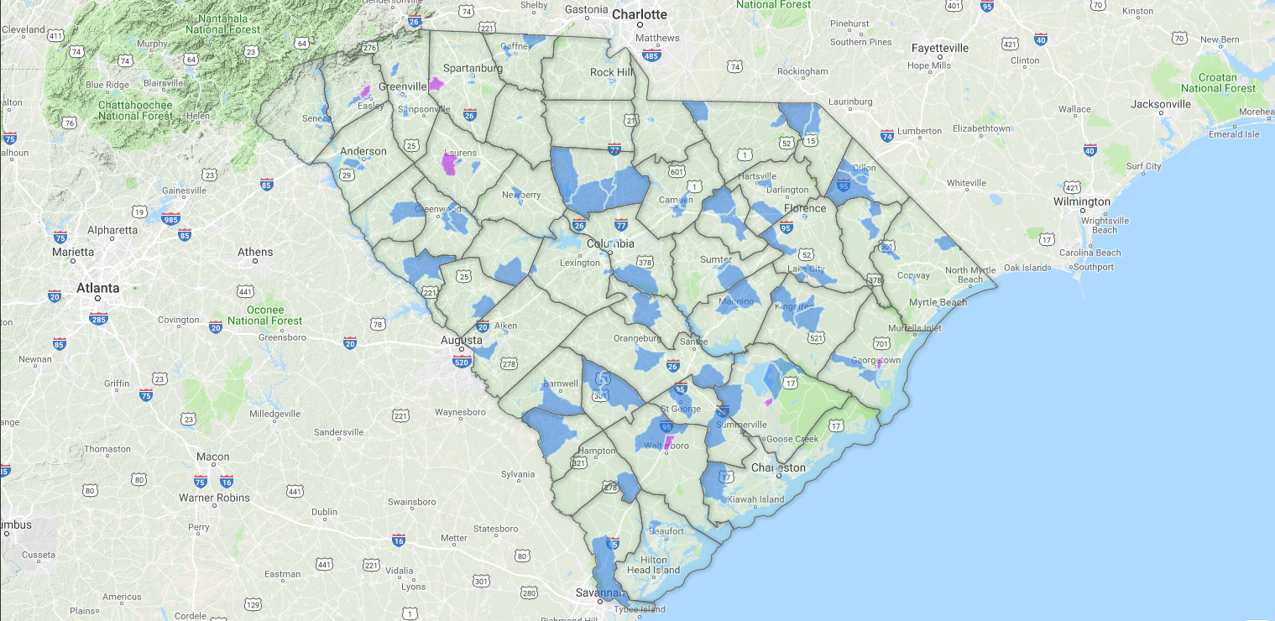
Where are they?
www.scopportunityzone.com
Notes:
To find specific tracts, visit www.scopportunityzone.com
And we didn’t neglect urban areas, their census tracts are smaller because the population is denser.

Slide 7
How will all this work?
IRS is still writing the rules
Expectations:
Capital gains from the sale of an investment (stocks, real estate, business etc.) will have six months to be invested in an opportunity fund
Any corporation or partnership will be able create an opportunity fund
Do not expect a minimum or maximum amount that can go into the fund
The fund will have six months to invest 90% of the funds assets into projects located in Opportunity Zones
Notes:
So how exactly does all of this work. Why would an investor put their money in an opportunity zone? What is cool about this?
First note, the IRS is still writing the rules, so we don’t know for sure how it will all play out. However, the guidance that we have been given so far would go as follows:
Investors will realize capital gains, whether from the sale of real estate, stocks or other investments. They will then have up to 6 months to invest those gains in an opportunity fund. We are of the belief that basically any corporation, LLC or partnership will be able to create their own self directed opportunity fund with no minimums or maximums.
The funds will then have another 6 months to invest at least 90% of their assets into projects in an opportunity zone.

Slide 8
Why would I do all this?
Capital gains will be deferred either until the sale of the new investment or until December 31, 2026.
Investments that are owned 5 years would see the original taxable amount reduced by 10%
Investments that are owned 7 years would see the original taxable amount reduced by 15%
Investments owned 10 years or longer would also see the new basis brought up to market value on the sale of the investment meaning new gains would not be taxed
Notes:
So what are the benefits?
Capital gains will be deferred by investing in a new investment in an opportunity Zone until the new investment is sold, or December 2026 when the individual portion of the tax bill ends. So if an investor takes their gains and invests in a new apartment complex and sells it in 3 years, those capital gains are then due.
If the investor owns their asset for 5 years, the basis is reduced to 90%, saving 10% of the capital gains bill that would be due. If they own their asset for 7 years, that basis is reduced to 85%, saving the investor 15%. So in order to take full advantage of the 7 year break, funds must be invested by 2019 to be held for 7 years before December 2026
The big savings occur after 10 years. After an investor holds the asset for 10 years, upon sale their basis is marked up to the market price, resulting in no new capital gains being paid.

Slide 9
One more time but this time in English…
 |  | Opportunity Zone | No Incentive
Original Capital Gain |  | 1,000,000 | 1,000,000
Capital Gains Due Now | 23.80% |  | 238,000
Balance |  | 1,000,000 | 762,000
Equity Investment |  | 900,000 | 762,000
7 Year Bond Purchase |  | 100,000
Year 1
Preferred ROI | 7% | 63,000 | 53,340
Bond Rate | 2.81% | 2,810
Year 2
Preferred ROI | 7% | 63,000 | 53,340
Bond Rate | 2.81% | 2,810
Year 3
Preferred ROI | 7% | 63,000 | 53,340
Bond Rate | 2.81% | 2,810
Year 4
Preferred ROI | 7% | 63,000 | 53,340
Bond Rate | 2.81% | 2,810
Year 5
Preferred ROI | 7% | 63,000 | 53,340
Bond Rate | 2.81% | 2,810
Year 6
Preferred ROI | 7% | 63,000 | 53,340
Bond Rate | 2.81% | 2,810
Year 7
Preferred ROI | 7% | 63,000 | 53,340
Bond Rate | 2.81% | 2,810
Deferred Tax Due | 23.80% | 202,300
Year 8
Preferred ROI | 7% | 63,000 | 53,340
Year 9
Preferred ROI | 7% | 63,000 | 53,340
Year 10
Preferred ROI | 7% | 63,000 | 53,340
Asset Sale | 50% | 1,350,000 | 1,143,000
Capital Gains Tax Due | 23.80% | 0 | 90,678
Total Returns |  | 2,797,370 | 2,347,722 | 449,648
Total Taxes Paid: |  | 202,300 | 328,678 | 126,378
Other Investment Income
Bond Investment: |  | 19,670
Preferred ROI Increase |  | 96,660
Sale of Asset |  | 207,000
Notes:
If you are like me, the concepts are great, but an example is better. In this example, let’s assume that we have an investor who has just realized a $1 million gain on the sale of an asset. They have the opportunity to invest as much of that gain as they want to into a new development and earn a 7% preferred return. One the column further left, we assume that the investor has put their gain into an opportunity fund. Because they are a little conservative, they know that they have a tax bill coming up, and they only have to invest 90% in the opportunity zone, we assume that they invest 90% into the new real estate development and 10% into a 7 year bond, which last time I checked was paying 2.81%. The investor in the right column doesn’t want to mess with paperwork and just pays his taxes due now, and invests the rest of his money in the new development. So day 1, the traditional investors pays $238,000 in taxes on his million dollar gain, and then invests 762,000 for which he gets a 7% preferred return. The Opportunity zone investor puts 100,000 into a bond, and the remaining 900,000 into the new development.
In year one, both investors get 7% of their investment in return: 53,000 for the traditional investor and 63,000 for the OZ investor. They also get 2,800 as a return on their bond.
Lets fast forward 7 years. Now the opportunity zone investor has to pay his tax bill. Because he has owned the investment for 7 years, how only has to pay taxes on 85% of his original capital gain, or 850,000. This means he only owes 202,000 compared to the traditional investor who paid 238,000 7 years earlier. So we assume that he cashes in his bond and those returns to pay his tax bill.
Time keeps trucking along with each investor earning 7%. At the end of year 10, or beginning of year 11, the investors decide to sell their assets. Because the market is going well, over 10 years, they are able to sell their interests for 50% more than they paid for them. The 900,000 interest is now worth $1,350 and the $762,000 interest is now worth $1,143,000. However, the traditional investor now must pay capital gains taxes again on the gains earned by their new investment. Those taxes come to $90,000. The OZ investor has a larger gain and nothing due in taxes.
So in this example, the opportunity zone investor earns $450,000 more on their million dollar gain. $126 is from tax savings, 116 is from increased investment income, and the final 207 is because of the sale of a larger interest in the asset.

Slide 10
Questions?
Notes:
With that, lets take some questions:

