Slide 1


| Digital Strategies Advisory Board

Slide 2
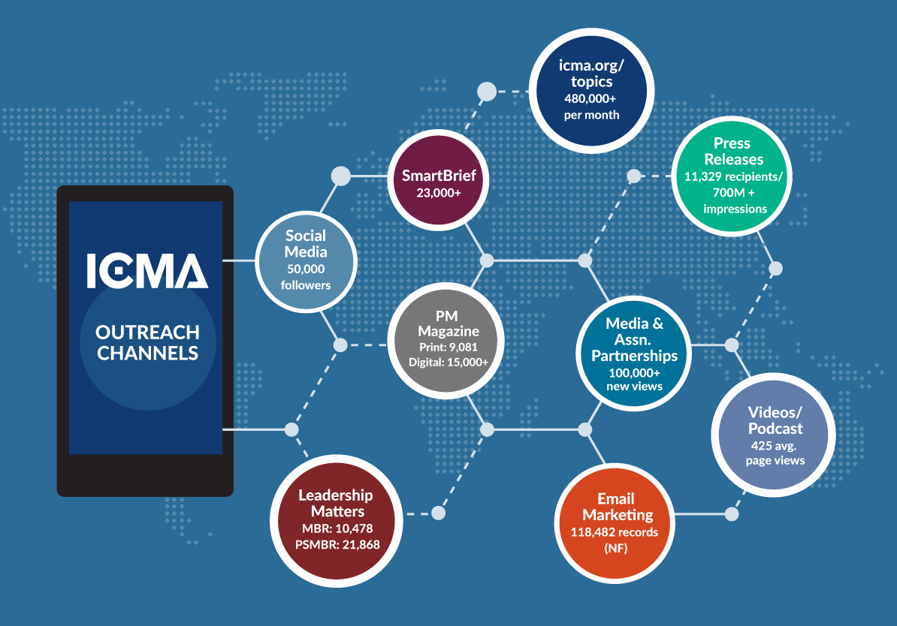
Who We Are
As the premier platform for professional networking and knowledge sharing in local government, ICMA.org represents a valuable ICMA member benefit and resource for the profession. We influence the growth of the network by helping to identify the knowledge-sharing needs of local government professionals and providing feedback on the current member experience. Advisory board members serve as leaders in the ICMA online community by making active contributions in their areas of expertise and encouraging colleagues to do the same.

Slide 3
Agenda
Intro of team members and why they were interested in joining advisory board – Toby/Pam to take lead
Recap of website launch and ongoing improvements - Ellen
Recap of social media successes - Ellen/Abbas
Update on performance management benchmarking – Gerald Young
On Deck for upcoming year:
  Further refinements of website – Ellen and input from team
  Expansion of social media footprint – Abbas and input from team
  Tackling digital strategy as outlined in strategic plan – Ellen and input from team
Wrap up – Meeting at ICMA Conference – what would team like to focus on?

Slide 4

Website Launch
Officially launched on May 23. 4 weeks of beta testing with DSAB and others. 2 months of alpha testing prior to beta testing. Included video tour of site as well as written tutorial. Monitored feedback
Status:
  All relevant content is moved; site performing well in mobile
  Improvements being made to:
    Job Center
    Who’s who
    Search
    Groups

Slide 5
Big 7 Community Growth
Total Community Size
 | CSG | ICMA | NACo | NCSL | NGA | NLC | USCM | GFOA | ELGL
Jan-17 | 8,544 | 40,740 | 12,742 | 24,967 | 12,726 | 29,593 | 20,083 | 10487 | 10861
Jul-17 | 9,051 | 47,895 | 14,643 | 27,273 | 16,554 | 33,675 | 23,037 | 11,787 | 11,938
Notes:
This means that we will need to engage Twitter accounts with a higher volume of followers; use more effective hashtags; increase the quality of our hashtags.

Slide 6
Gerald Young – Recap on Performance Project

Slide 7

Strategic Plan
Expand the Way ICMA Delivers Its Message
  Podcasts
  Re-imagine PM
  Expand You Tube channel
  Optimizing existing social media channels and adding relevant new channels
Ensure website is highly effective local government leadership, management, and brand hub

Slide 8


