Slide 1
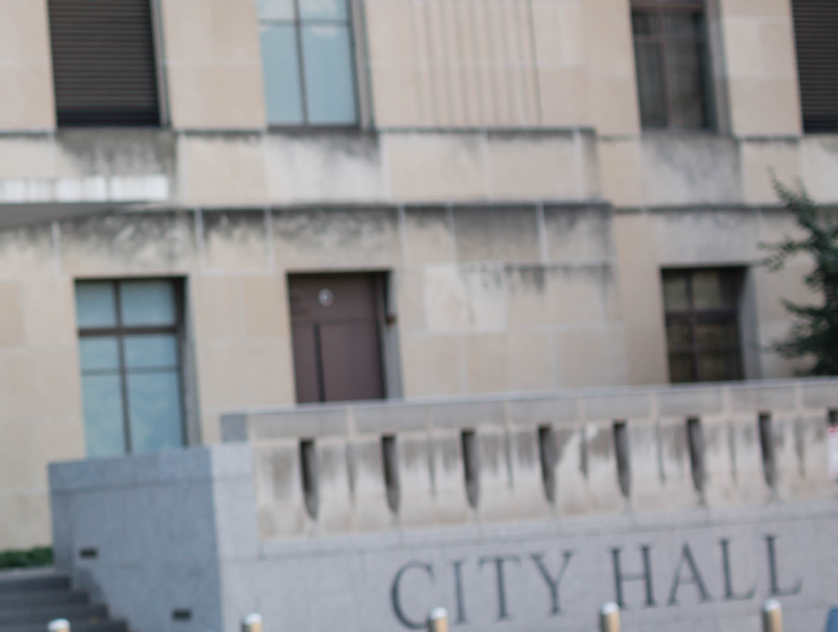

| Digital Strategies Advisory Board May Update

Slide 2
Agenda
Quick check in on the purpose of the DSAB – Description
Update on the App RFP and next steps
New digital product and service directory – ICMA Marketplace (demo and ideas for user outreach)
DSAB Engagement - Niles
Social media update - Abbas
Next check-in

Slide 3
Purpose of DSAB
  (From the volunteer web page) Serving on the Digital Strategies Advisory Board (DSAB) entails engaging on ICMA.org and via ICMA social media in several capacities: as an expert user, as an advocate for ICMA.org, answering and posing questions on a regular basis, posting documents, and commenting on articles and blog posts of interest. The purpose of the group is to help make ICMA.org a valuable, accessible resource for ICMA members and to help staff identify digital approaches that would support strategic plan objectives.

Slide 4

App RFP
The ICMA Member App is intended to improve networking amongst members, reach the mobile workforce, provide 24/7 access to the latest news in Local Government and integrate a full functioning multi-event app

Slide 5
App RFP
Conducted RFP; received only 3 responses
Those were optimized for event
Feedback on RFP
  “Kitchen Sink”
  Fear of “integration
Next Steps: Re-think; Focus; Involve new CIO
For DSAB – what is top priority for member app. Why would you open an ICMA app?

Slide 6
Mobile App
Purpose: Deliver priority member content to a mobile device in an organized way
Sign in (gets you to your profile and protected content)
News and Blogs
PM Magazine app
Social Media Channels
Job Center – customized search
Ask and Answer
Groups
Networking – Who’s Who and Linked In Members’ Group
Events
ICMA Annual Conference
Credentialing (status, course/learning suggestions)
Career stage customization (allows events and some content to be customized)
#localgov by topic – priority “nuts and bolts” content following our topic structure
ICMA Media – Podcasts and videos
Coaching/Mentor Match
Advocating for the Profession (resources, hot topics, support, donate)

Slide 7
ICMA Marketplace
Notes:
This means that we will need to engage Twitter accounts with a higher volume of followers; use more effective hashtags; increase the quality of our hashtags.

Slide 8
DSAB Engagement
Ask and Answer: Since January 1st 2018 Has accounted for about 14,000 page views with 29 new questions with 28 new answers over that time. Subscribe to the ask and answer email to get the questions straight to your inbox. https://icma.org/questions
ICMA Blog: The ICMA blog has an email feed with around 270 subscribers. Subscribe at https://icma.org/blog-posts
Local Gov Life: ICMA’s Podcast has 667 Subscribers. Subscribe on iTunes or wherever you get your podcasts.
Comments: We have had 32 Comments since January 1st 2018. They tend to be on content where we are congratulating a member.
Groups: We have 26 Groups in areas such as performance benchmarking and Veterans as well as the DSAB group and the New ICMA Social Media Influencers group.

Slide 9
Social Media Update
Quick Update
  Impressions, Engagements, Growth (5/1)
  The Facebook Issue & how to help
Taking your Influence to the Next Level
  Influencer Guide
  ICMA Influencer Group
The future of ICMA on Instagram
  IG Live/Stories
  Type of Content

Slide 10


