Slide 1
Food Industry Site Selection Criteria
By Larry D. Burks, MPA, CED
Assistant City Administrator
Bellevue, Nebraska
Information from the experts:
Michelle Comerford, Principal
Comerford Consulting Group LLC
J. Michael Mullis, President & CEO
J. M. Mullis, Inc.

Slide 2
Economic Development Trends
Positioning to compete for the biggest projects.

Slide 3
Site Selection Process
J. M. Mullis’
Typical Project Flowchart
www.jmmullis.com

Slide 4
Positioned to Compete
Comprehensive Labor and Workforce Analysis
Available Controlled Properties
Flexible Incentive Packages/Deal Closing Funds
Committed Local Leadership
Business & Political
Realization that You Get Only One Shot
Stronger Global Direct Marketing Program

Slide 5
What Do You Need to Attract, Retain, & Expand Food Industry in Your Community?

Slide 6
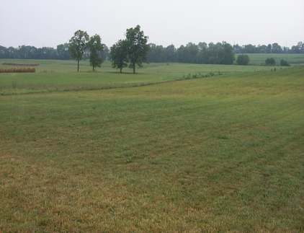
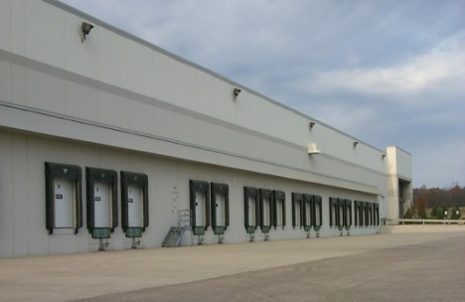
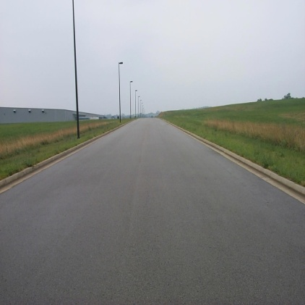
Food Industry Location Factors
Available Properties
- “Shovel-Ready” sites and buildings including community owned “spec” buildings
- Appropriate site setting; quality industrial park with light industrial neighboring uses
Transportation Infrastructure and Support
- Good highway accessibility
- assortment of rail / non-rail properties
- Third party cold storage facilities in area
3. Business Climate
- Incentives and other assistance programs
- expedited permitting process in place,
- absence of community impact development fees
- Presence of other food processors in area

Slide 7
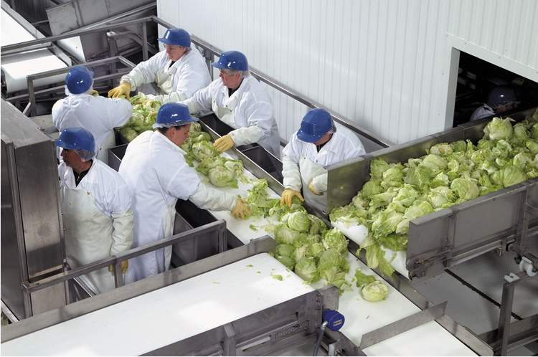
Food Industry Location Factors (cont’d)
4. Workforce
Available Skilled workforce - including refrigeration and repair technicians, maintenance mechanics, two-year science / biology technicians, quality control
Training programs - Area community / technical colleges offering curriculum for food industry
Experienced workforce - Work force with a background / experience in food processing

Slide 8
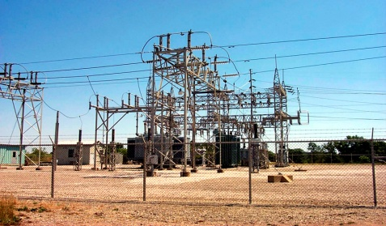
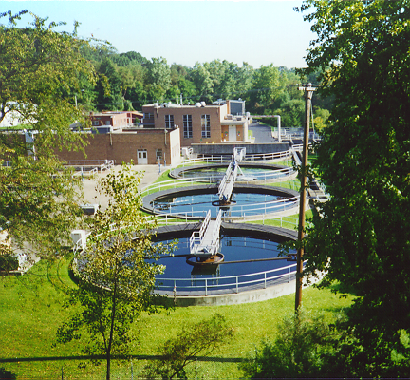
Food Industry Location Factors (cont’d)
5. Utility Infrastructure:
Electric power – available service, nearby substations with excess capacity
Natural gas - gas lines at property boundaries
Municipal water – quality and reliable water available today; plan for future expansion; strong water pressure including looped service
Municipal sanitary sewer – excess capacity; ability to accept high effluents (BOD, TSS) at little or no cost; plan for future expansion
Low start-up utility costs (i.e. utility connection and impact fees)

Slide 9
Critical Issues Affecting Food Industry

Slide 10
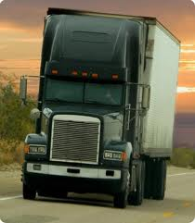
Critical Issues
Time to Market - reach consumer market faster than ever due to shorter shelf life
Customer Service - new locations to serve faster-growing population centers
Transportation considerations – overcoming obstacles including shortage of drivers and equipment, traffic congestion
Major customers considerations - Wal-Mart, Costco, Target, Kroger and other major retailers
Innovative Production - on-going replacement of aging production plants with newer, more-automated and efficient operations
Rising Energy Costs – for production and distribution of product
Utility costs and capacities – water, wastewater requirements

Slide 11
Critical Issues (Cont’d)
Proximity to suppliers – and raw materials
Availability and cost of commodities – food prices up 70% globally
Food Safety & Regulations – contamination, terrorist threats, FDA/USDA standards (ex. Peanut Corporation of America in GA)
Labor – available workforce with desired skills and ability to work in food environ
Sustainability – support company sustainability goals and cost savings measures
Incentives – to help close the deal, cut project costs

