Slide 1
Public / Private Partnership at the Mason Community Center

Slide 2
City of Mason Mission Statement
We are driven to make a difference. We work responsibly, speak honestly, act compassionately, and stand accountable to those who entrust us with their lives, their families, their livelihood and their dreams. Together - through the guidance of our community and the initiative of our employees - we make the difference that promises Mason an even better tomorrow.

Slide 3
Tools For Achieving Mission Statement
The 4 “C’s”
Cooperation
Communication
Coordination
Cost Savings
Creating and Maintaining Mutual Beneficial Relationships
Partnership & Collaboration

Slide 4
P3 = Public/Private Partnership
What Is It?
According to the National Council for Public/Private Partnerships, a P3 is defined as:
“A contractual agreement between a public agency (federal, state or local) and a private sector entity. Through this agreement, the skills and assets of each sector (public and private) are shared in delivering a service or facility for the use of the general public. In addition to the sharing of resources, each party shares in the risks and rewards potential in the delivery of the service and/or facility.”

Slide 5
P3 = Demonstration MMC & Economic Development
Achieve the Goals of:
Enhancing Health and Wellness and Amenities for the Residents and Businesses of Mason
Growing the City as a Healthy Community
Integrate Wellness into Economic Development Initiatives and Recruitment

Slide 6
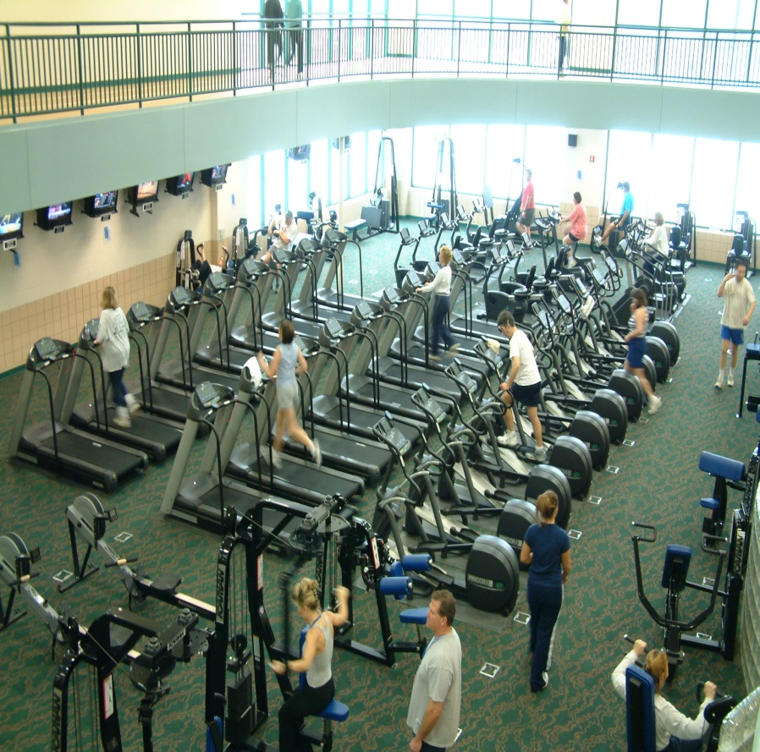
Mason Community Center - Past
Built in 2003
Partnership with Mason City Schools
Under pressure to increase rates
In 2008, operating at $1,000,000 in the red

Slide 7
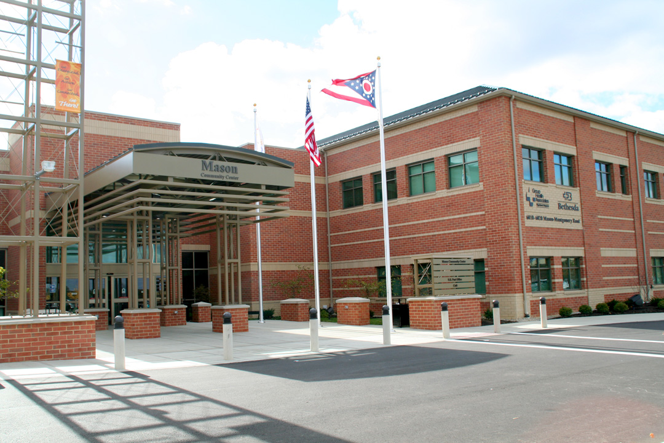
Mason Community Center - Present
2008 Expansion
Partnership with TriHealth and Assurex
Public/Private Partnership as backbone
Hub of healthy lifestyle and community wellness
By 2013, operating at $100,000 in the black

Slide 8
EcoDev Incorporates Wellness MCC Delivers
Unique incentive to potential business prospects
Emphasizes City’s commitment to a healthy lifestyle
Workforce and wellness working together
Differentiator

Slide 9
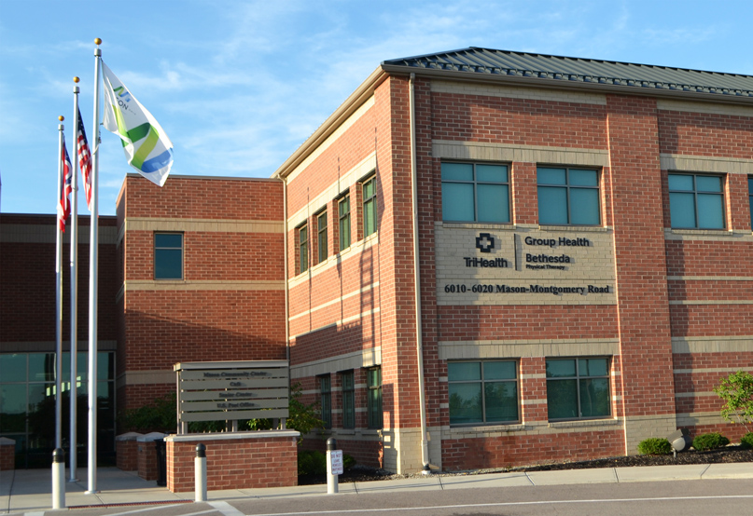
2007 TriHealth Partnership
Group Health Associates and Bethesda Physical Therapy located inside MCC
Creates additional opportunities to spur local job creation
Enhance membership/ revenue growth
Share operating expenses
Expands wellness opportunities

Slide 10
2010 Assurex Partnership
Adapting to unusual and unexpected business needs.
BioHealth and Wellness Strategic Focus.
Run with a business mindset, providing concierge level of service.
Collaborative environment, consider ourselves as important to our business community’s operations as a key supplier.
Execution (from ground breaking to grand opening through expansion and evolution) is a streamlined process in our system which means a valuable gain in time and money for you…this leads to a stronger return on a long-term investment.
Partnership and Collaboration
Partnership and Collaboration
City of Mason, Ohio
City of Mason, Ohio

Slide 11
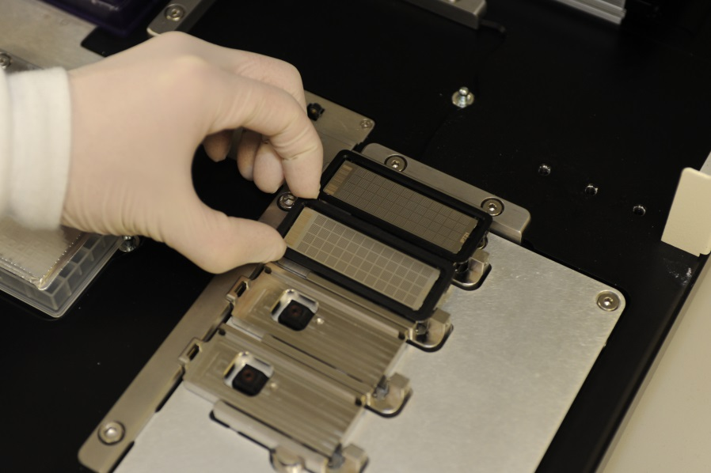
Sector: BioHealth/IT
Employment Now and Future: 120; 180-200 Worldwide in 2014
Country of Origin: United States
Year Established in Region: 2006; Leading Personalized Medicine Company Focusing on Neuropsychiatric Disorders
Technology inventors: Cincinnati Children’s Hospital and Mayo Clinic

Slide 12
MCC & ED Catalysts
Unique partnerships with private entities
Work with outside agencies to identify mutual benefits between public and private organizations
Examples:
Great Wolf Lodge
Christ’s Church at Mason
Mason Public Library
Mason Tech Center
Municipal Campus BioHealth and BioHealthIT Accelerator
OakPark Development District

