Slide 1
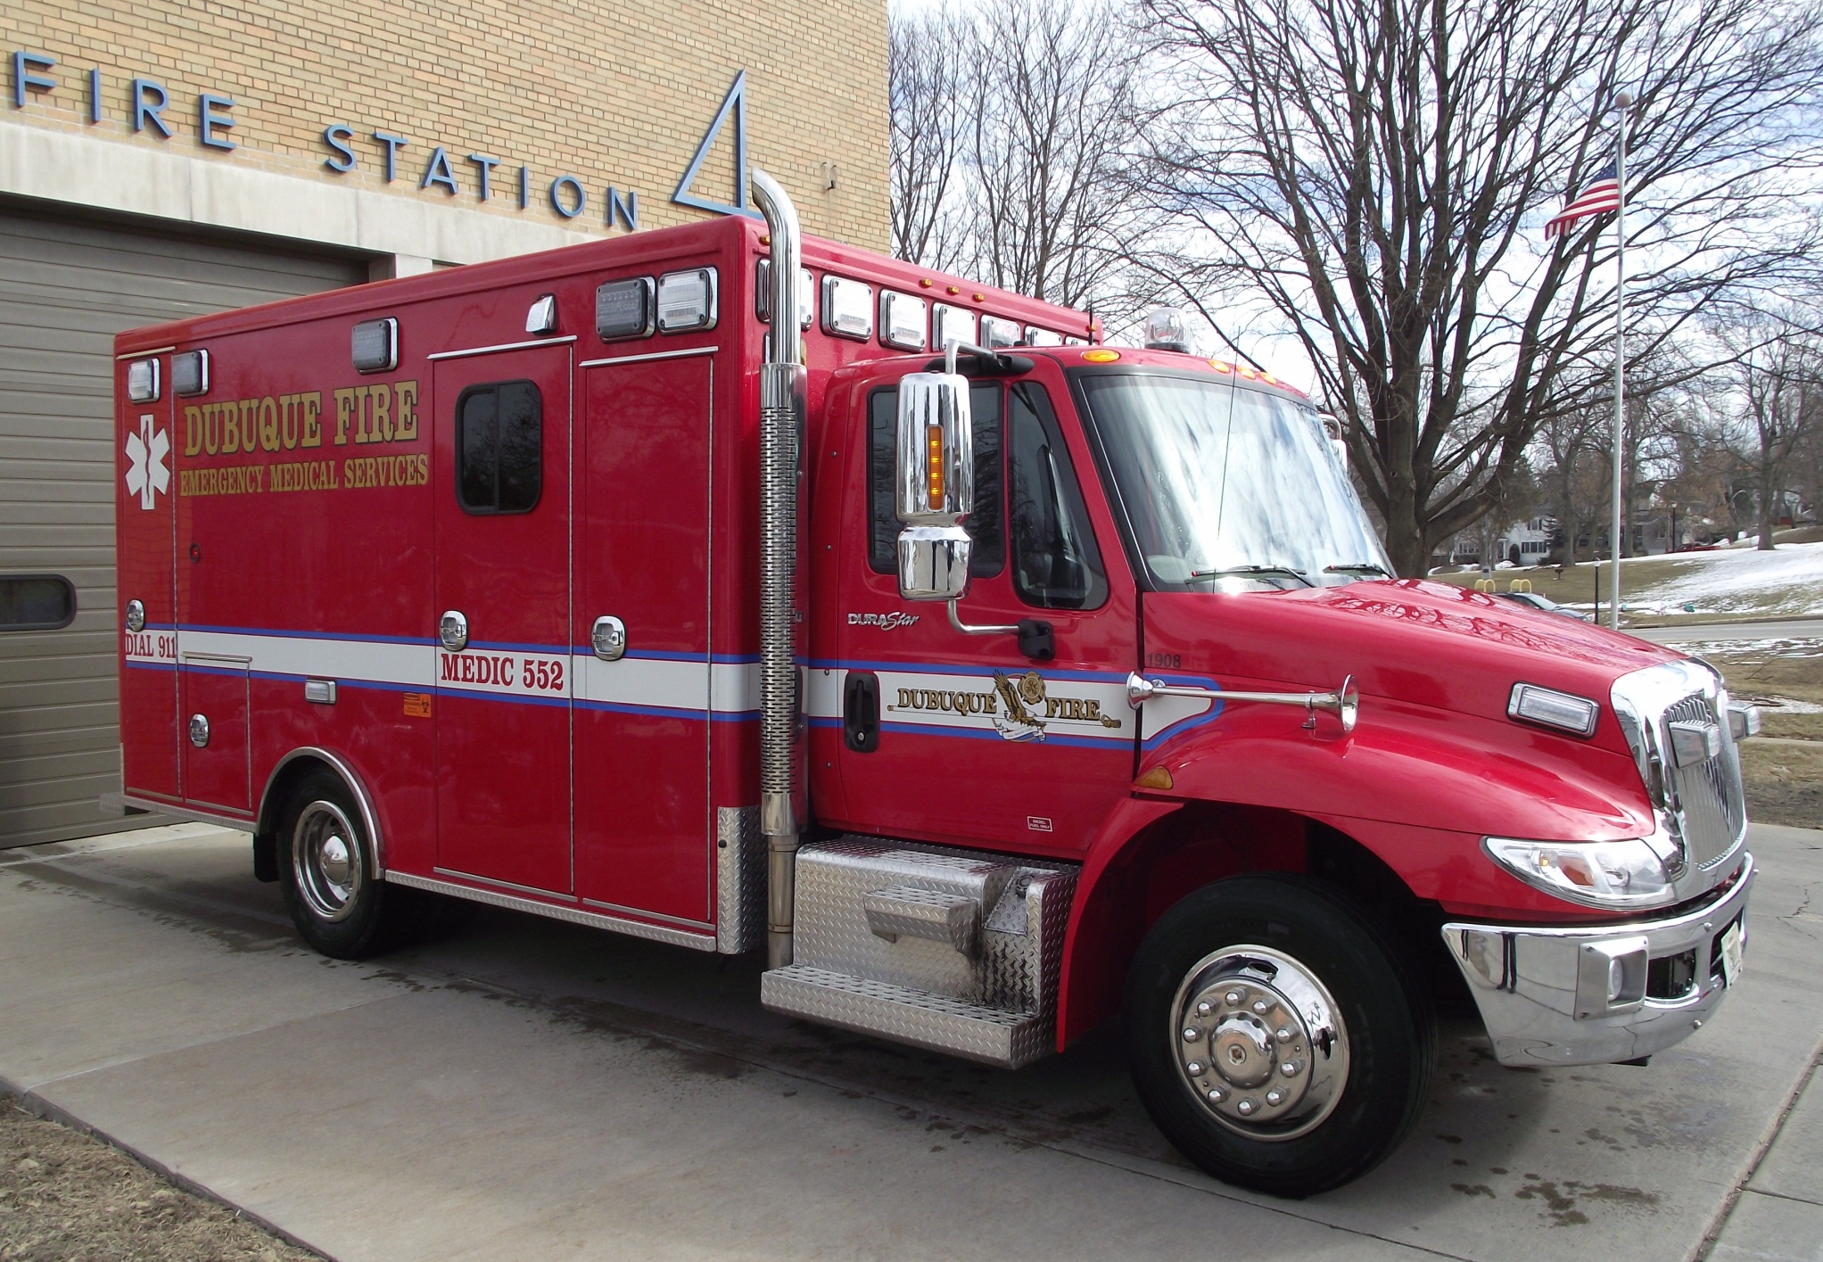

Slide 2
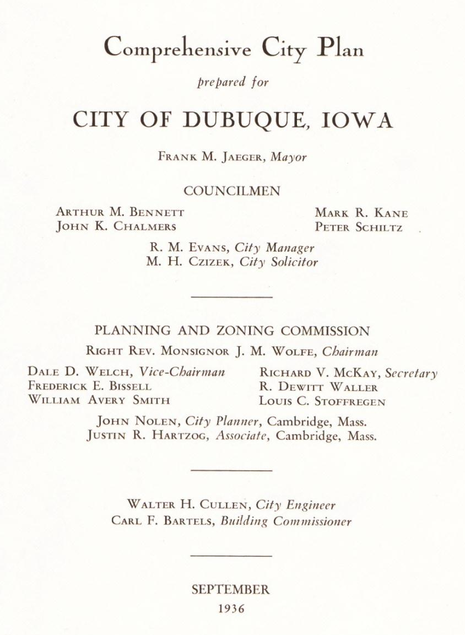

Slide 3
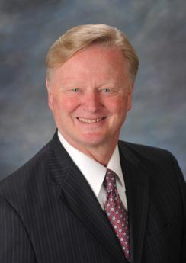
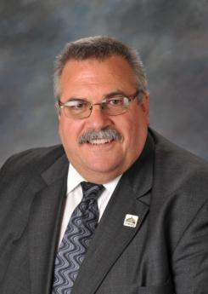
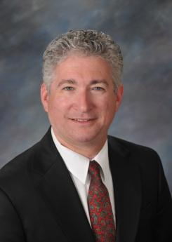
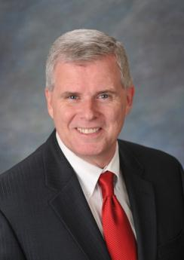
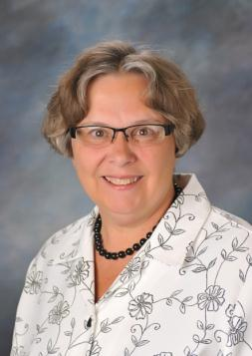
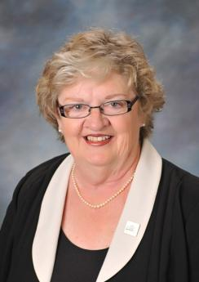
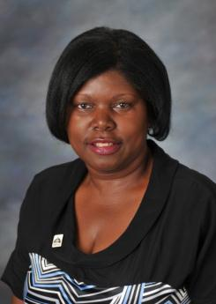
Mayor Roy D. Buol
Ric Jones, At-Large
David Resnick, At-Large
Kevin Lynch, First Ward
Karla Braig, Second Ward
Joyce Connors, Third Ward
Lynn Sutton, Fourth Ward

Slide 4

?

Slide 5
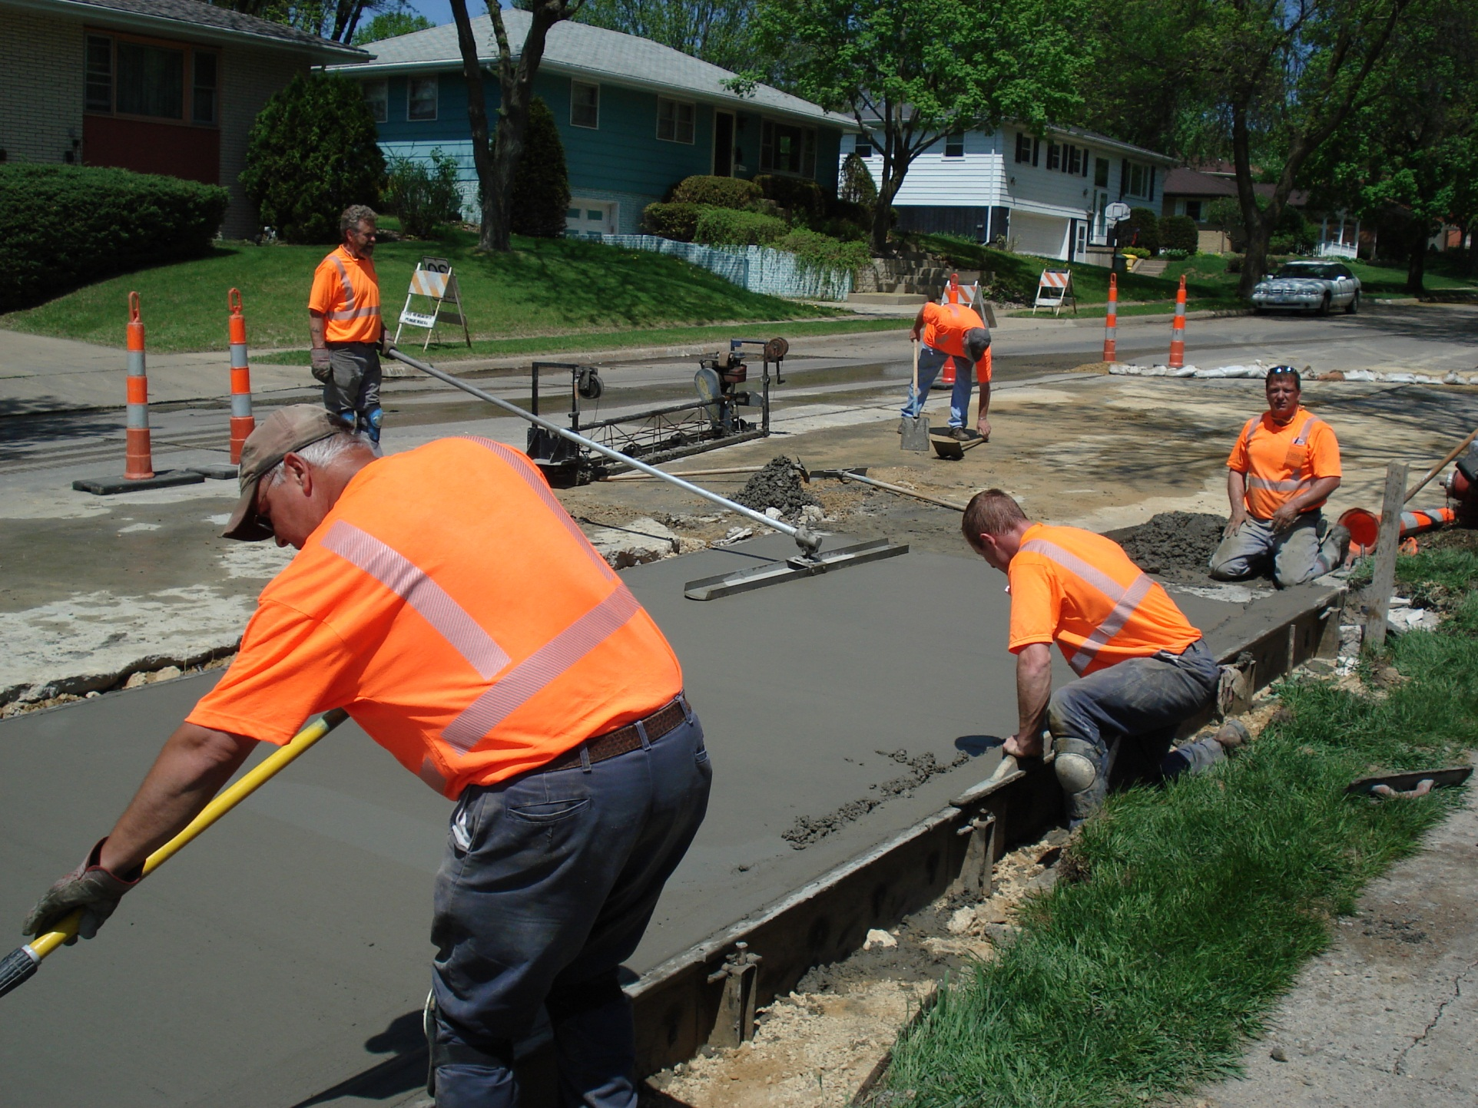

Slide 6
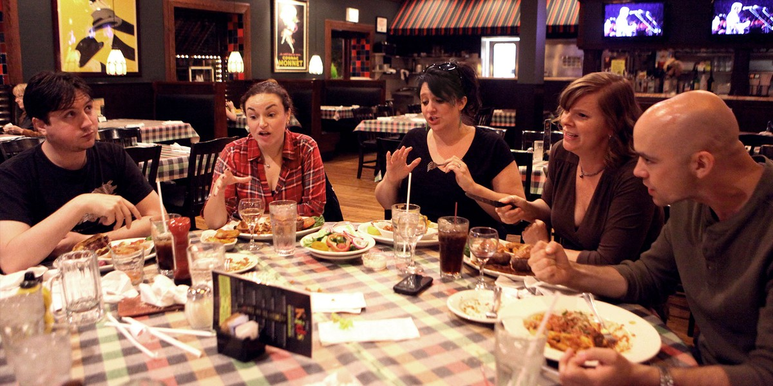

Slide 7







Dubuque Childhood Lead Poisoning Prevention Program
Family Self Sufficiency

Slide 8


Slide 9
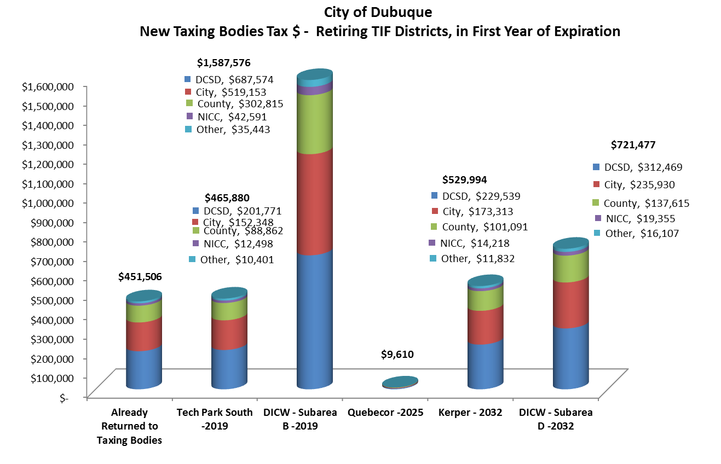
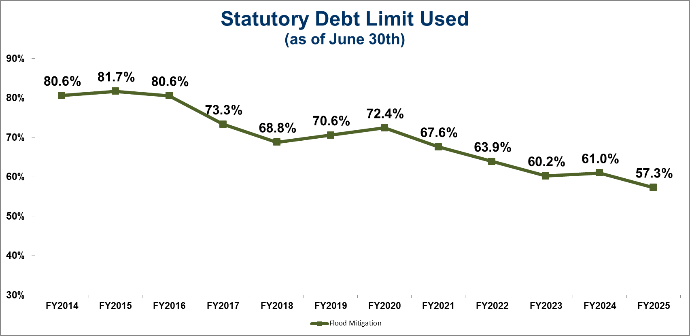

Slide 10


Slide 11
1965
1983
2014
2030

Slide 12


