Slide 1

ICMA Mountain Plains Regional Summit
Grapevine, Texas
May 1-2, 2014
  Organizational Development Strategies
  for Culture Change

Slide 2
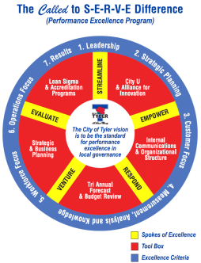

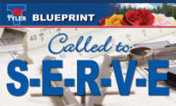

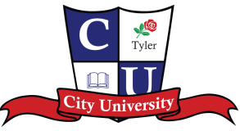


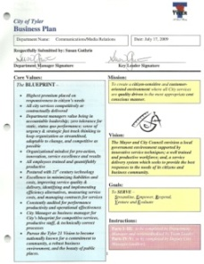
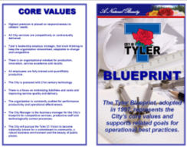
Why? To Maintain Continuous Improvement
VISION: To be the standard for performance excellence in local government.
Leadership Academy
2014
“Developing Leaders” Introduced
“Key Leaders” Introduced
1996

Slide 3
What? The High Performance Organization
 | Characteristics
Leadership | High performance teams of individual leaders drive urgency and direction
 | The pipeline is stocked with future leaders whose skills are matched to future needs
 | Middle managers embrace and translate strategy
Design | Structure and resource allocation reflect strategic tradeoffs
 | Few layers separate the CEO and the frontline, and spans of control are wide
 | Accountabilities, decision rights, and collaboration are constructed with thoughtful consideration
 | Individual capabilities are matched to role requirements
People | The employer brand is a core asset
 | Critical roles and key talents are clearly identified and treated with care
 | HR is a strategic partner and an enabler of the business
Change Management | Change is a disciplined cascade
 | The organization is evolutionary
Culture and Engagement | Culture accelerates strategic objectives
 | Engagement is measured and cultivated to generate discretionary effort from employees

Slide 4
How? Approaches for Consideration
Begin to Flatten the Formal Organization
Introduce a Parallel Organization
An Integrated Performance Excellence Program
Creating an Environment for “Small Company Speed”

Slide 5
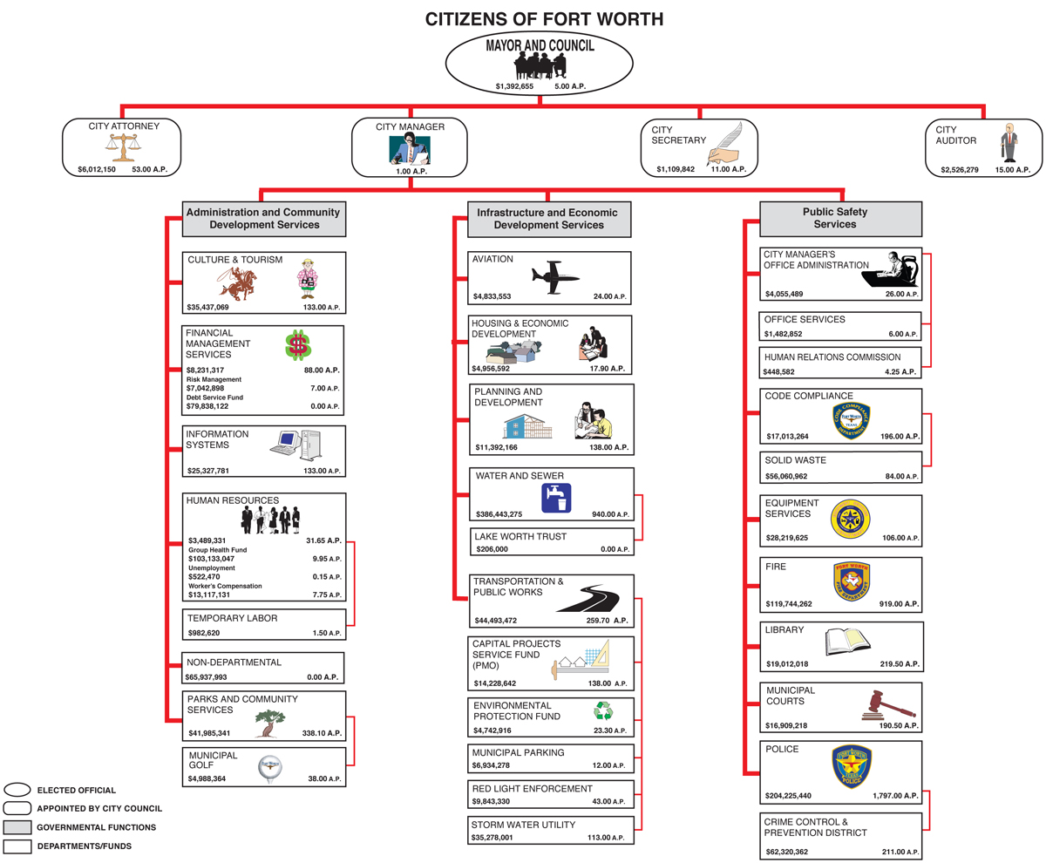
The Traditional City Organization
City of Metrop0lis
Traditional
Clear Hierarchy
Many Layers
Top Down

Slide 6
1. Begin to Flatten the Formal Organization
City Manager
ACM
ACM
ACM
Managing Director
(& Department Head)
Managing Director (& Department Head)
Managing Director (& Department Head)
Managing Director (& Department Head)
Managing Director (& Department Head)
Mayor & Council
Portfolio of Assigned Departments
Portfolio of Assigned Departments
Portfolio of Assigned Departments
Portfolio of Assigned Departments
Portfolio of Assigned Departments
Portfolio of Assigned Departments
Portfolio of Assigned Departments
Portfolio of Assigned Departments
NOTE: To be implemented over time, and in a measured way, according to priorities and staff skill sets/abilities.

Slide 7
Benefits to Flattening
Eliminates Layers & Reduces Bureaucracy
  More Nimble to React Quickly to a Changing Environment or Priorities
  Change Penetrates Organizational Layers More Quickly
  Reduces Costs
Tears Down Silos
  Less Empire Building & More Collegiate
  Improved Communications (Permission to Speak Freely)
Creates Greater Accountability
  Managing Directors on Assignment
  Allows for Greater Oversight of Smaller Number of Units
  Plays to Employee Talents & Strengths
  Improves Success Planning/Enhances Delegation

Slide 8
2. Introduce a Parallel Organization
City Manager
ACM
ACM
ACM
Managing Director
(& Department Head)
Managing Director (& Department Head)
Managing Director (& Department Head)
Managing Director (& Department Head)
Managing Director (& Department Head)
Master Black Belt
Managing Director
Black Belt
Black Belt
Master Black Belt
Black Belt
Black Belt
Black Belt
ACM
Black Belt
On Rotating Assignment
On Rotating Assignment
Lean Six Sigma
Cadre of
Green Belts
“Emerging Leaders”
The world moves too fast for central control.
Seth Godin, Linchpin

Slide 9
Benefits to a Parallel Organization
Allows the Organization to be Ambidextrous
  Fosters Fanatic Discipline & Empirical Creativity
  Pushes Innovation from the Bottom and Middle
Tears Down Departmental Silos
  Opens New Informal Channels of Communication
  Allows Ideas to Emerge
Reduces Cost
  Hard Savings
  Soft Savings (Mostly Time)
Significant Morale Booster
  Empowers Employees to Make a Difference
  Pushes People Out of Their Comfort Zones
The world moves too fast for central control.
Seth Godin, Linchpin

Slide 10
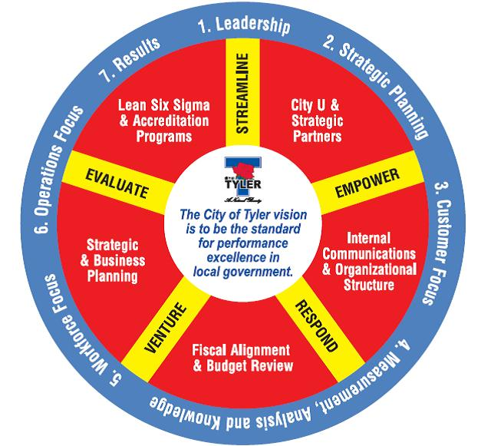
3. Performance Excellence Program (PEP)
  Thru Organizational Structure and Lean Six Sigma, but also:
    Strategic & Business Planning/Scoring (Using Balanced Scorecard & Baldrige Criteria)
    Strategic Partnerships (Alliance for Innovation, ASQ, ICMA, CALEA, etc.)
    Fiscal Alignment & Budget Reviews (Business Planning to Budgeting)
    City U (Foundational to Success)
    Internal Communications
    (The “Called to S-E-R-V-E” Difference)

Slide 11
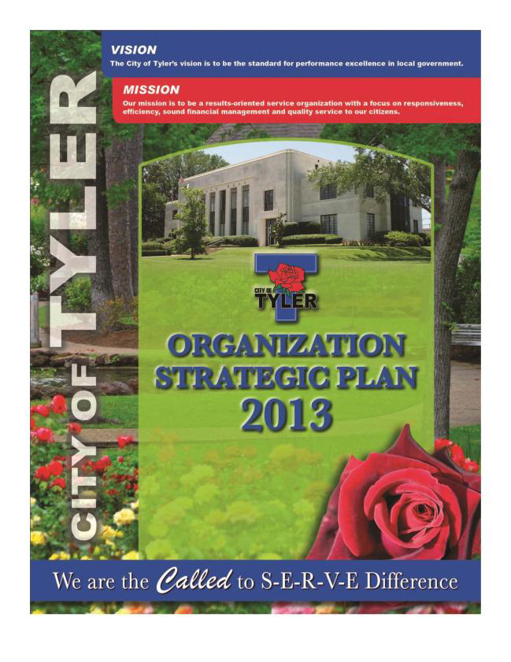
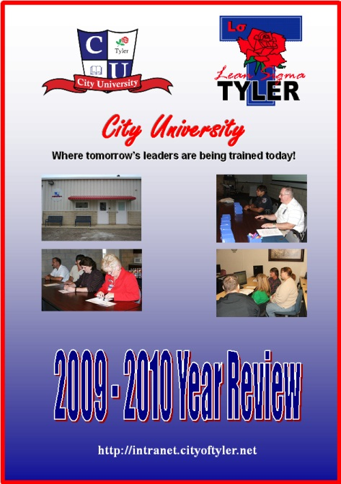

Monitoring Progress
  Lean Six Sigma/PEP Dashboard
  Quarterly/Annual Report Outs
  Strategic Planning – tracking organization-wide priority metrics
  Business Planning & Scoring
  Independent Evaluation through TAPE/Baldrige award programs
  Citizen and Employee Surveys
Notes:
COST – $900 per stone (we will do approx 5 per year)
FUNDING FROM - Contingency funds

Slide 12
  To conclude:
  No two cities are the same.
  Approaches must be tailored to accommodate your community.

