Slide 1

Doylestown Township
Preserving the Past, Embracing the Future
The Challenge of Culture Change: How do you create and sustain excellence?

Slide 2

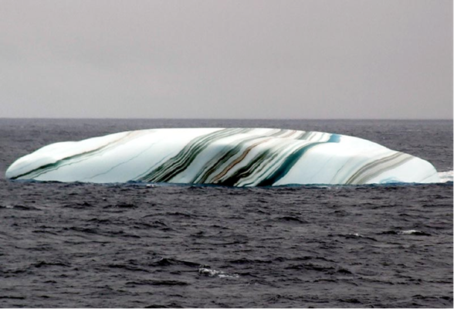



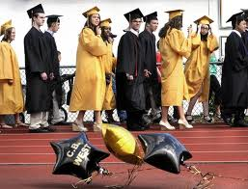
What is cultural Change?
Is it the Ice Berg? Or are ice obstacles to change?
When do you recognize Change?
How does your organization survive?
Embrace/Resist -
Positive Attitude/ Avoid Negativity
Sustain for future generations

Slide 3
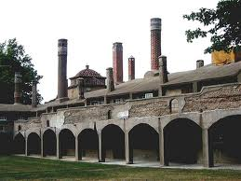
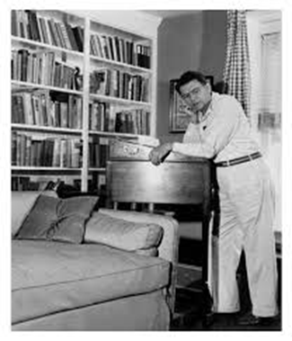
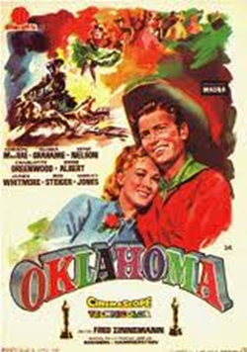

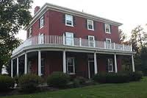

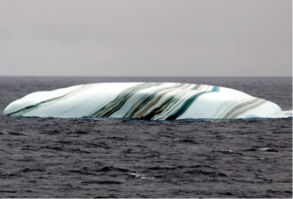
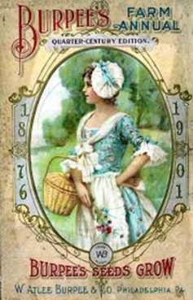
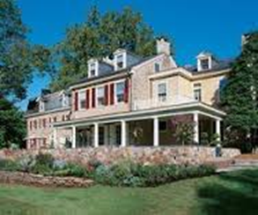
Preserving the Past
Be aware of the ice bergs and try not to repeat them.

Slide 4
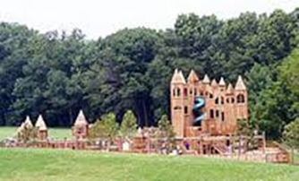
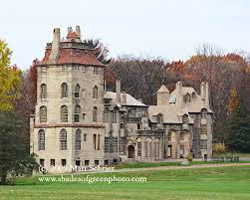
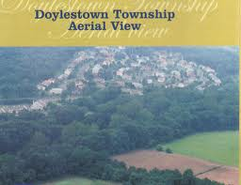
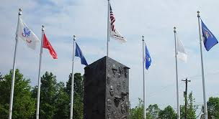
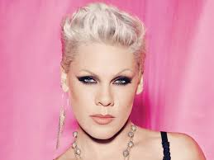
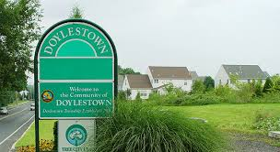
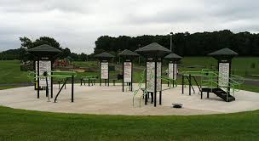


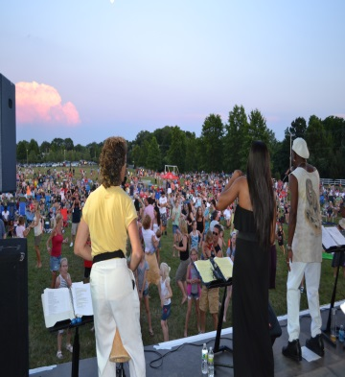
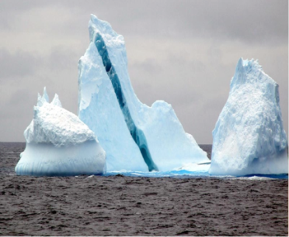
Embracing the Future
Watching out for the ice bergs on the way to the future. How does your organization survive through all the changes?

Slide 5

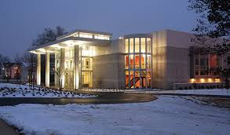



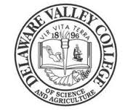
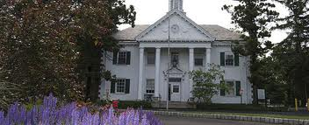
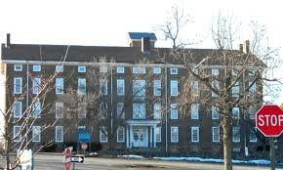
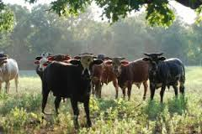
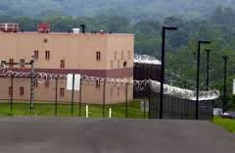
Del Val College is moving to
University Status. Home to County facilities.
Make connections to important institutions.
What is your role when changes are a foot?
Are you an agent of change?

Slide 6
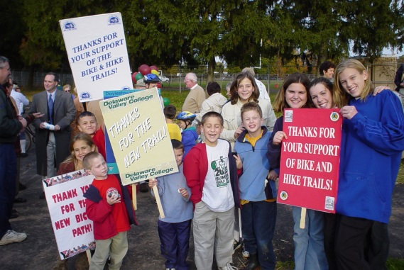
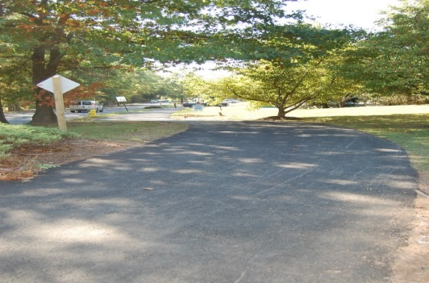
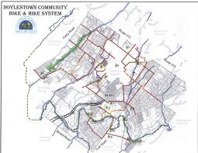
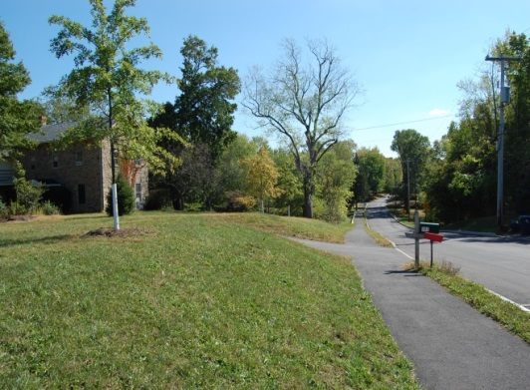

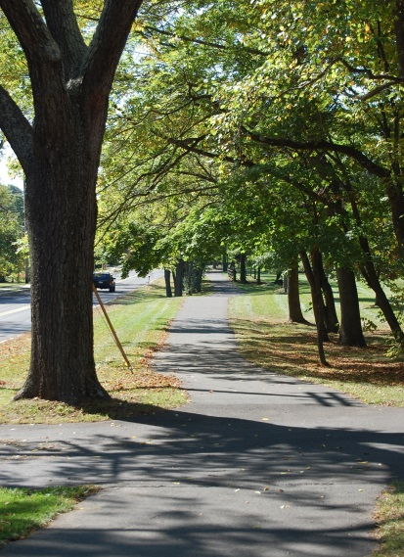
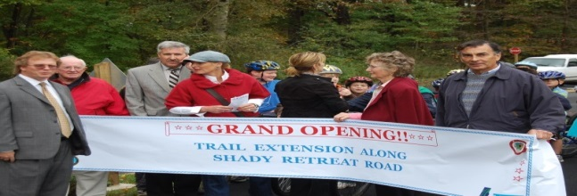

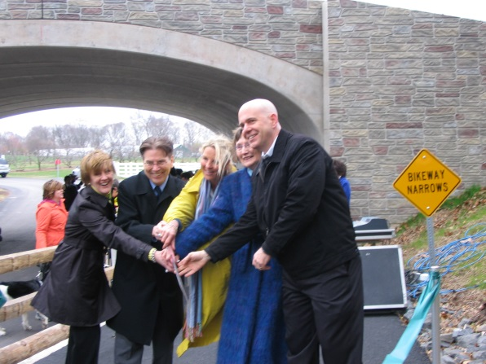
Our Story: 24 years/24 miles of trail. Connecting the Borough/College/Township
Changes, Challenges, Creativity, Innovation, Ice Bergs, Determination, and Pride!

Slide 7





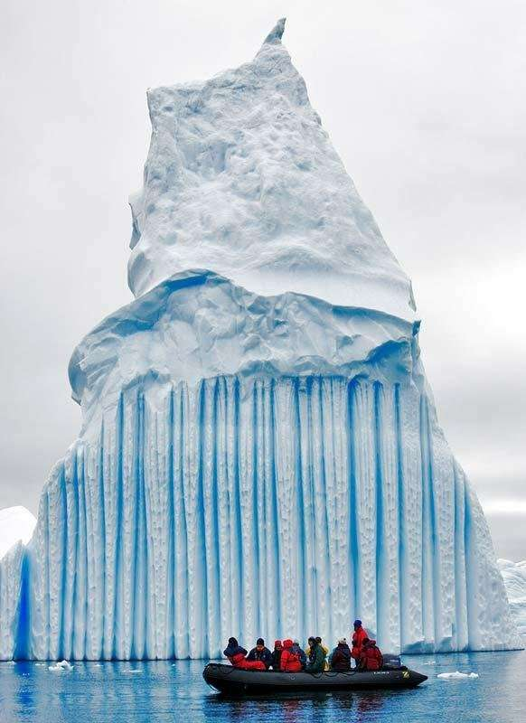
Sustaining the organization: teamwork, align the people who get it, positive attitude, don’t give up
Keep the ship afloat – don’t let the ice bergs sink it.

Slide 8

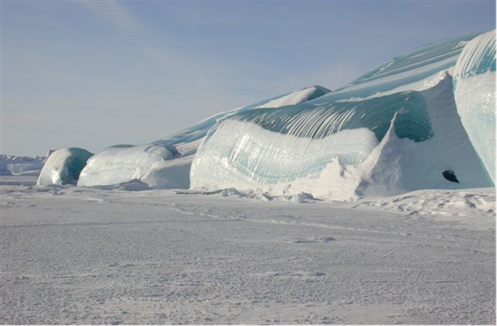
The Challenge of Culture Change: How do you create and sustain excellence? Avoid the Ice Bergs!
Don’t let Ice Bergs Prevent you from embracing cultural change and sustaining your organization!

