Slide 1

City of
North Port, FL
“Achieve Anything”
Jonathan Lewis, City Manager
4970 City Hall Boulevard
North Port, FL 34286
941-429-7077

Slide 2
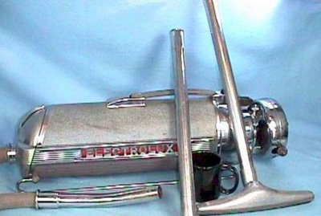
“Achieve Anything”

Slide 3
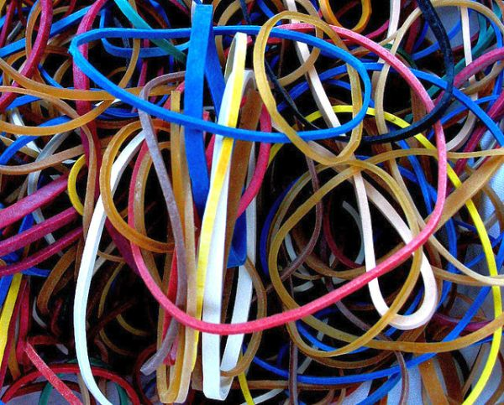
“Achieve Anything”

Slide 4
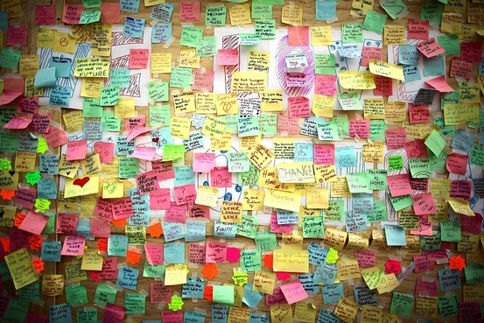
“Achieve Anything”

Slide 5

“Achieve Anything”

Slide 6
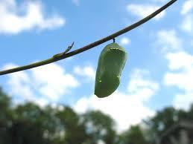
“Achieve Anything”

Slide 7

“Achieve Anything”

Slide 8

“Achieve Anything”

Slide 9
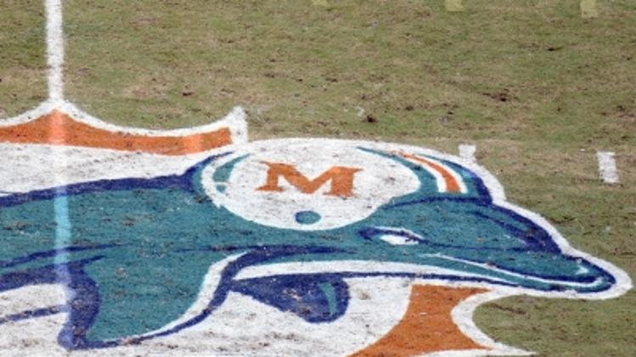
“Achieve Anything”

