Slide 1
W E L C O M E
Alliance for Innovation
Utility Lunch & Learn
City of Mesa, AZ
January 30, 2014

Slide 2
About the
Alliance for Innovation
“The Alliance for Innovation works to transform local government and advance community excellence through the discovery and application of leading ideas and practices.”

Slide 3
About the
Alliance for Innovation
35-Year Successful 503(c) Non-profit
Phoenix Headquarters at ASU
300+ Local Government Members
Strategic Partners:

Slide 4
20th TLG Anniversary
Transformation ~ Inside Out:
Team Based
Interactive and Experiential
22 Case Studies
Renown Keynote Speakers
Preconference Workshops
TLG – Denver – 2014
April 23rd – 25th

Slide 5
Karen Thoreson
President/COO
kthoreson@transformgov.org
888-496-0944
Pamela Muse
West Regional Director
pmuse@transformgov.org
888-468-6450
Questions?

Slide 6
Lunch and Learn Utility e-Billing / e-Payment Programs
Sponsors:
The City of Mesa
The Alliance for Innovation
Presentation Lead by --
John Schott, President and CEO, TWI
January 30, 2014

Slide 7
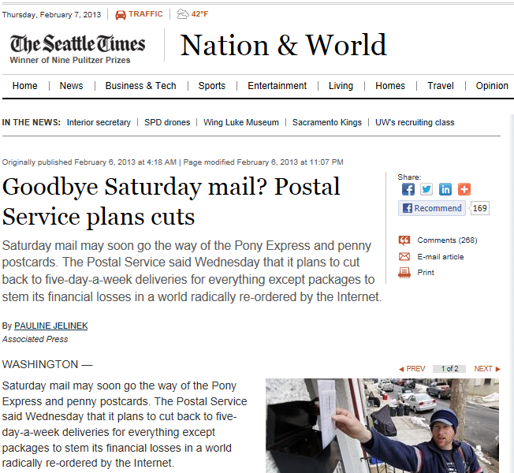

Slide 8
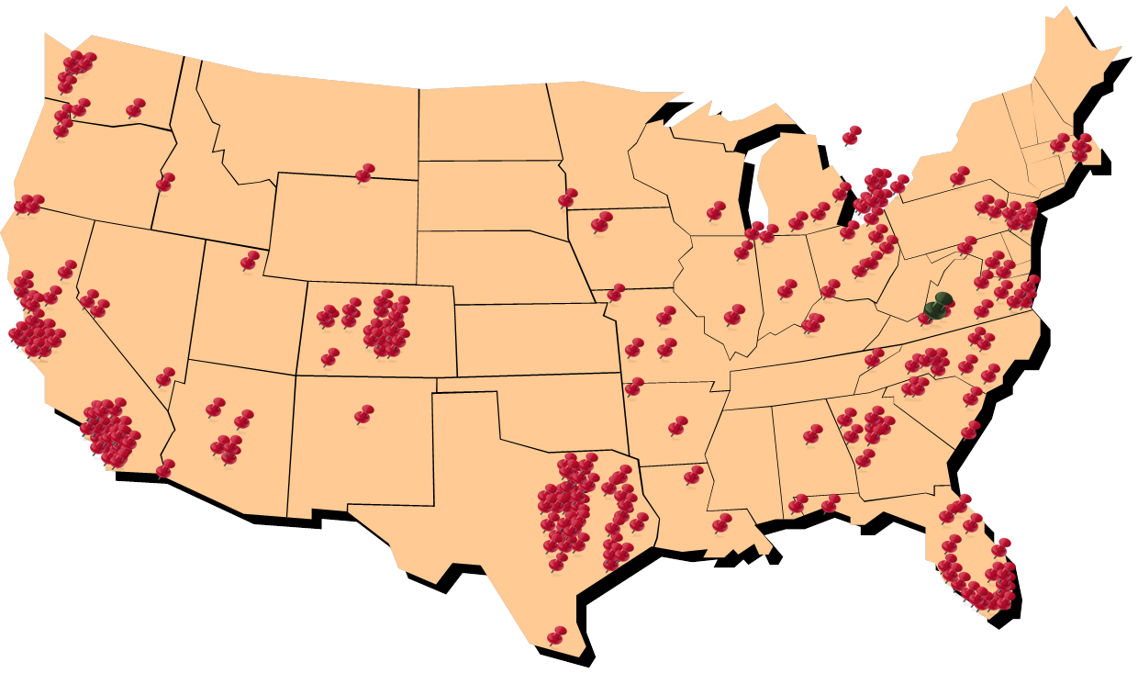
TWI Customers
Over 500 customer implementations

Slide 9
2011 NACHA eBilling Benchmark Study
More than 85% of billers said paperless was very significant to their organization.
Cost savings
More electronic payments
Improved customer service
Fewer customer service inquiries

Slide 10
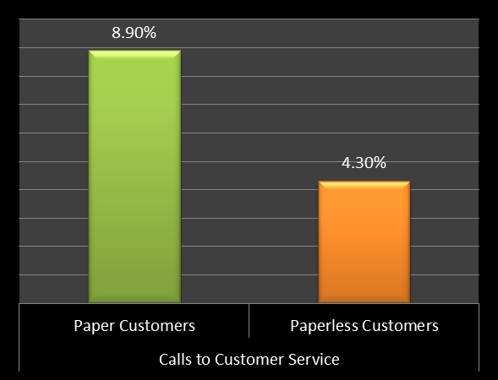
Con-Ed Case Study

Slide 11
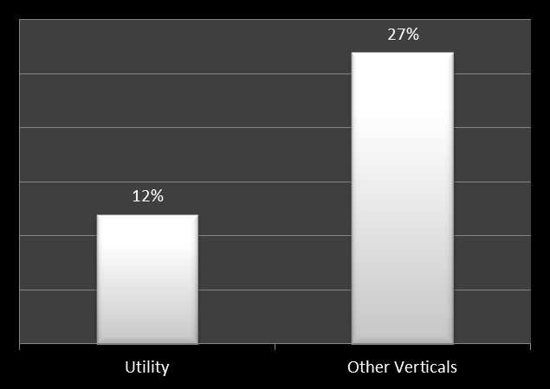
Customer Adoption of Paperless Billing

Slide 12
Adoption Goals
Do you have goals for electronic payments?
Do you have goals for Paperless Billing?
Do you have a roadmap to get there?

Slide 13
Billing and Payment Processes are Converging
Billing
Payment

Slide 14
A Single Bill-Pay System
A Single Bill-Pay System
Billing
Communication Technology
Payment
… but we see huge differences in how this is happening.

Slide 15
Make it Useful
We must overcome the obstacles and always provide a useful system for customers!!!

Slide 16
“The 7 Truths of Customer Usefulness”
Available
Easy
Fast
Up-to-Date
Trust-worthy
Informing
Valued
USEFUL

Slide 17
7 Truths of Customer Usefulness
Available
Easy
Fast
Up-to-Date
Trust-worthy
Informing
Valued
All channels
IVR, Web, Mobile, Text2Pay, Counter
All payment methods
All credit cards, eCheck, cash
Multiple languages
Always on

Slide 18
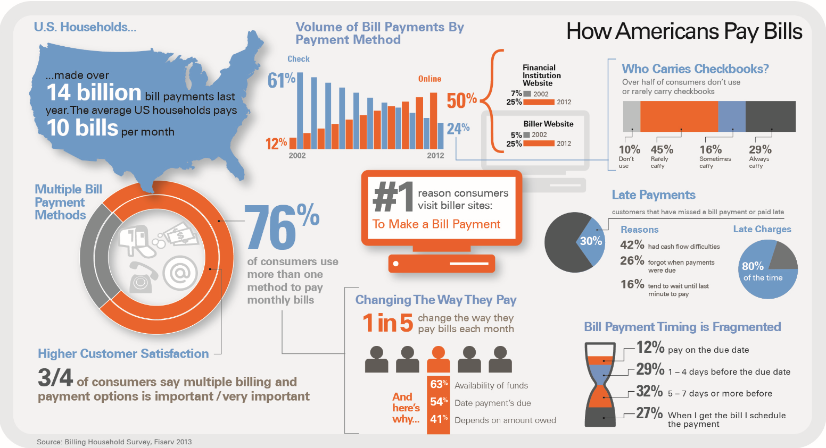

Slide 19
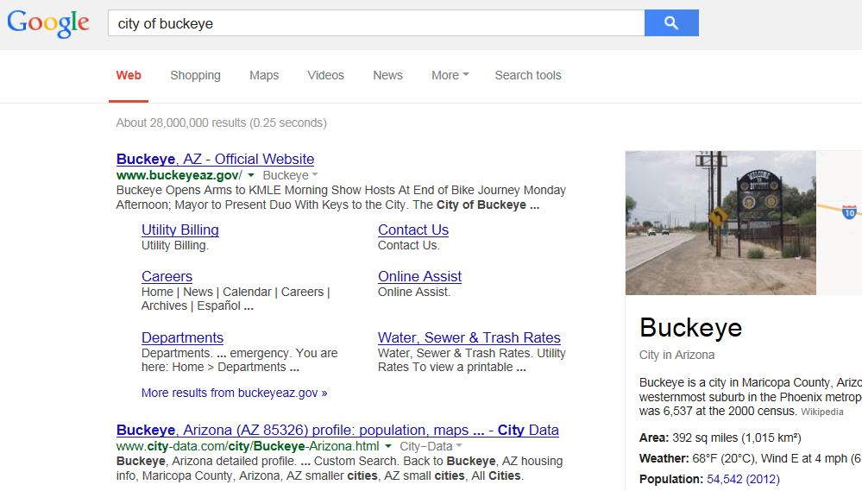

Slide 20
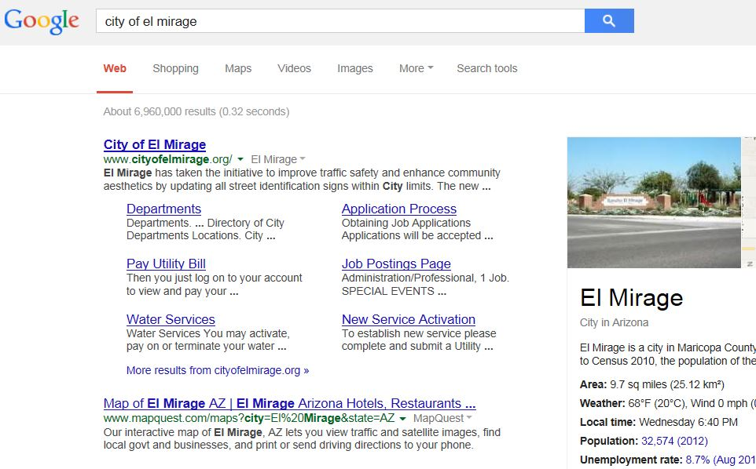

Slide 21
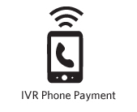
Inbound IVR
Standard Features
Real-time IVR interface with CIS database
24/7 customer self-service access
Hear account balances and payment history
Pay bills by credit card or eCheck
System-Wide Messages
Update Customer Phone Numbers
Get answers to common questions & FAQ’s
The IVR handles 30% of all call traffic.
Call Samples (click to listen)
Main Menu
Account Balance and Payment

Slide 22
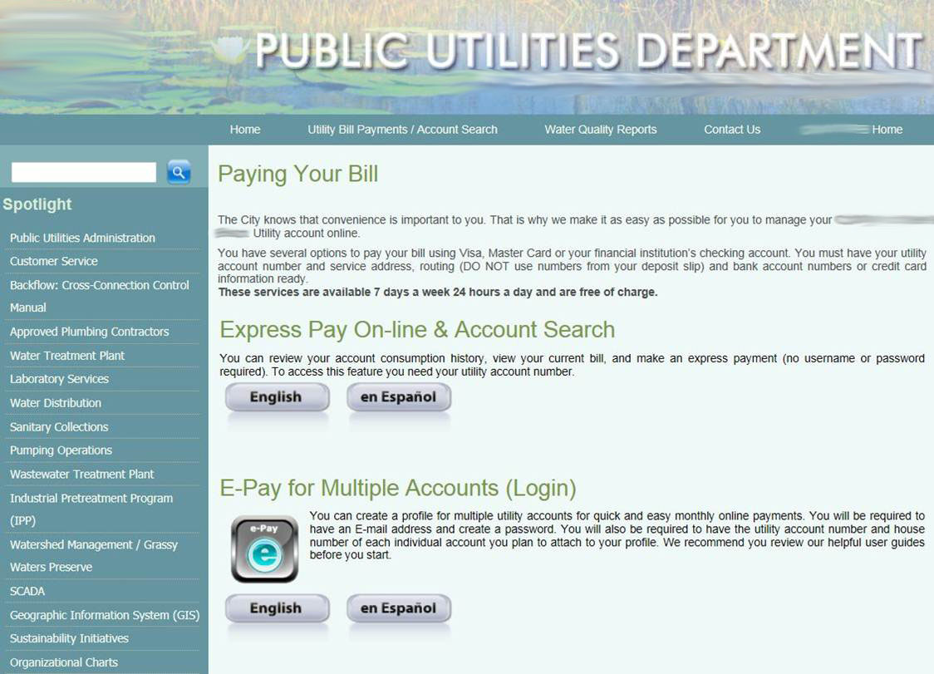

Slide 23
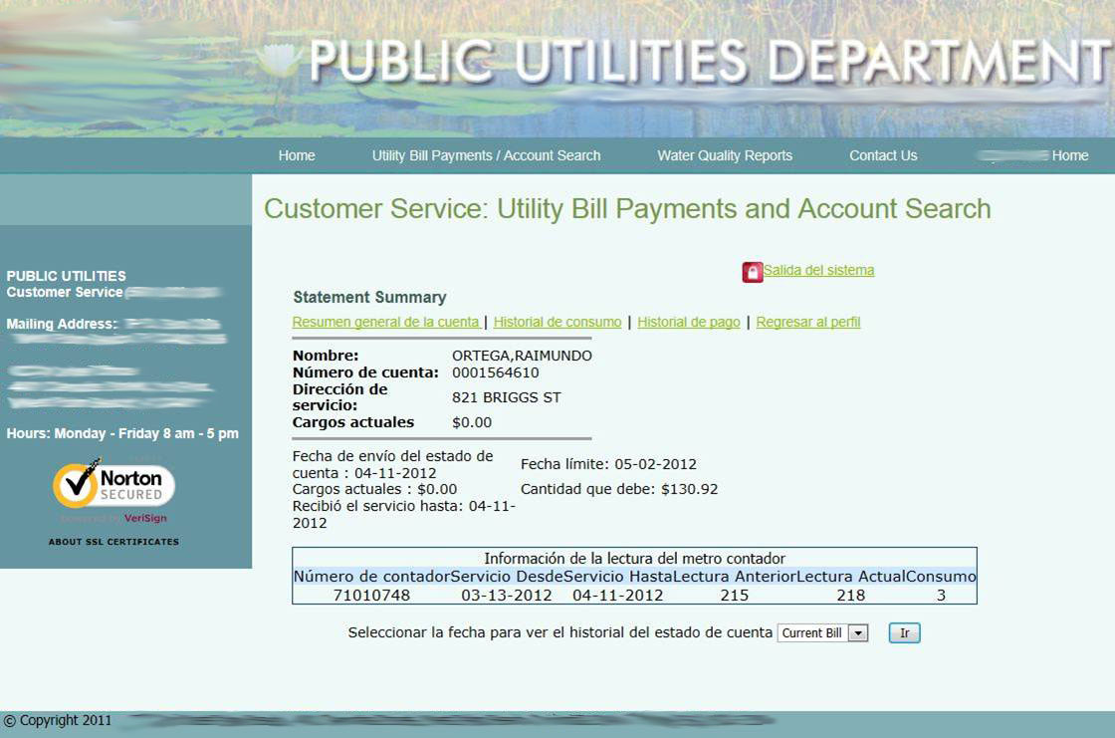

Slide 24
7 Truths of Customer Usefulness
Available
Easy
Fast
Up-to-Date
Trust-worthy
Informing
Valued
Make it easy for customers to do what they came to do.
Web pages should be simple and clear
Minimize text and instructions
IVR call flow should be streamlined
Consistency across all bill-pay channels
Question: Why are so many solutions not easy?
Answer: They were developed by programmers.

Slide 26
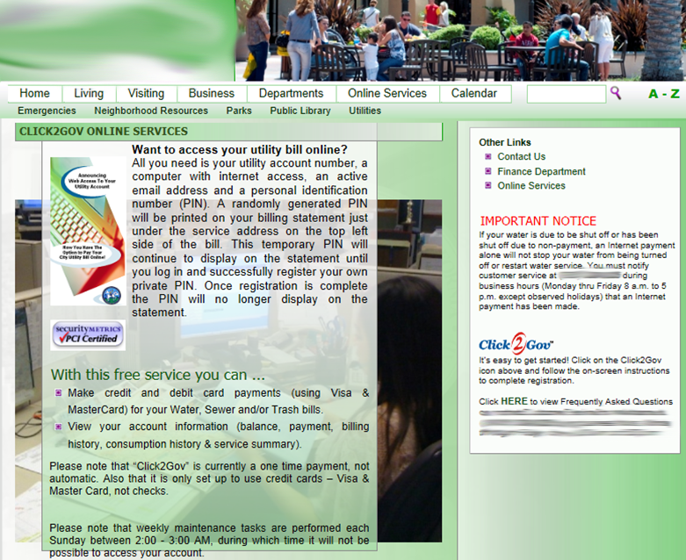

Slide 28
7 Truths of Customer Usefulness
Available
Easy
Fast
Up-to-Date
Trust-worthy
Informing
Valued
Make it easy for customers to do what they came to do.
Only collect the information you need
Minimize clicks and screens
Pay Now -- pay in under 2 minutes
Rapid registration
Provide recurring payments

Slide 29
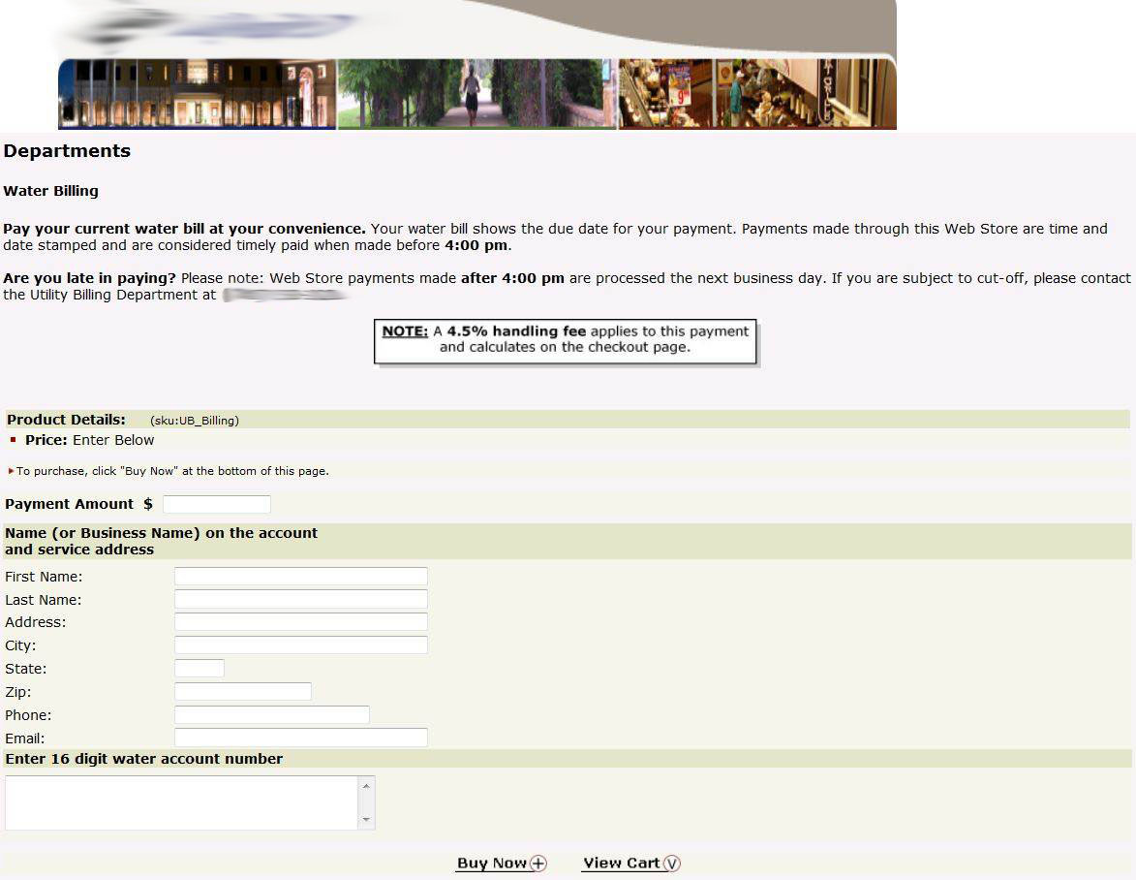

Slide 30
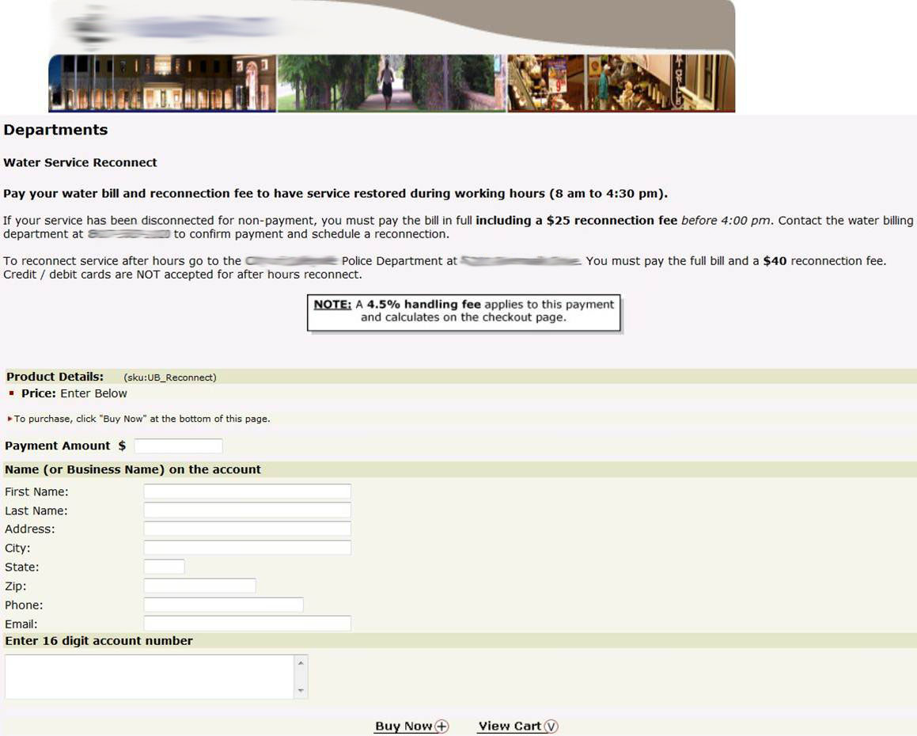

Slide 31
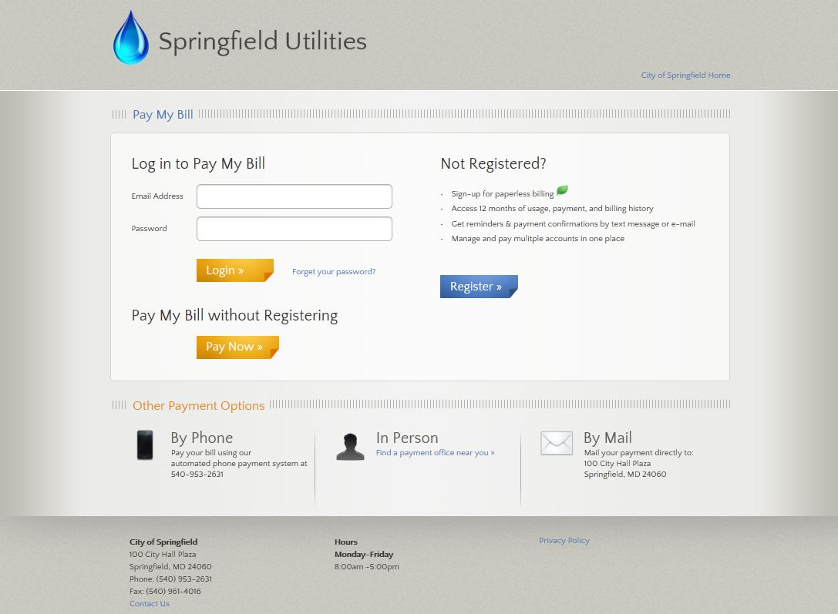

Slide 32
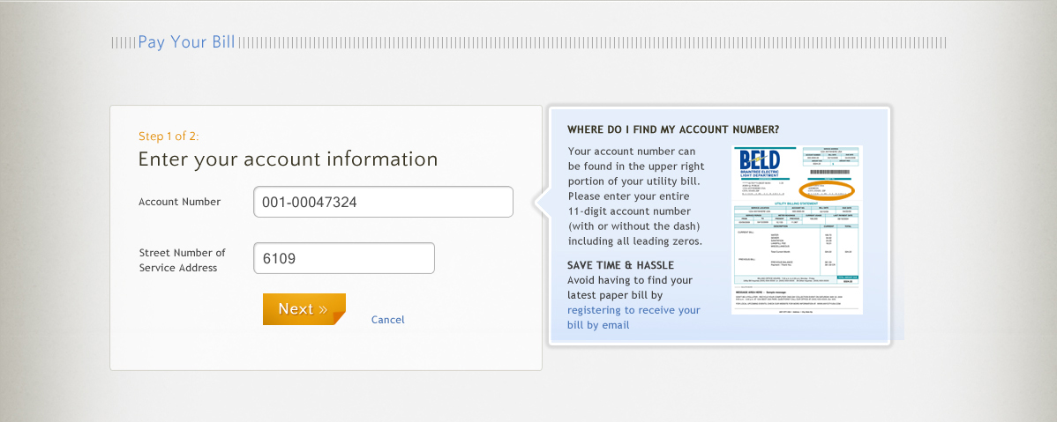

Slide 35
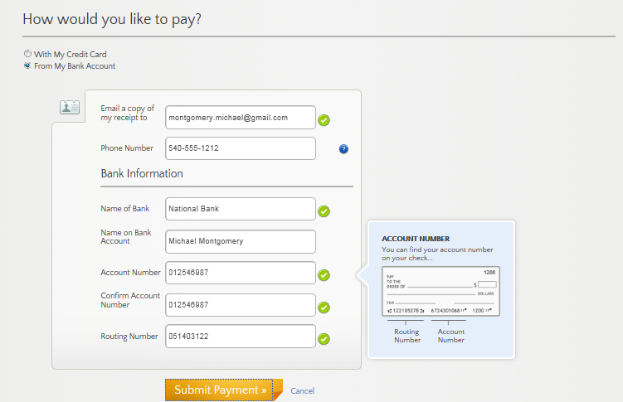

Slide 36
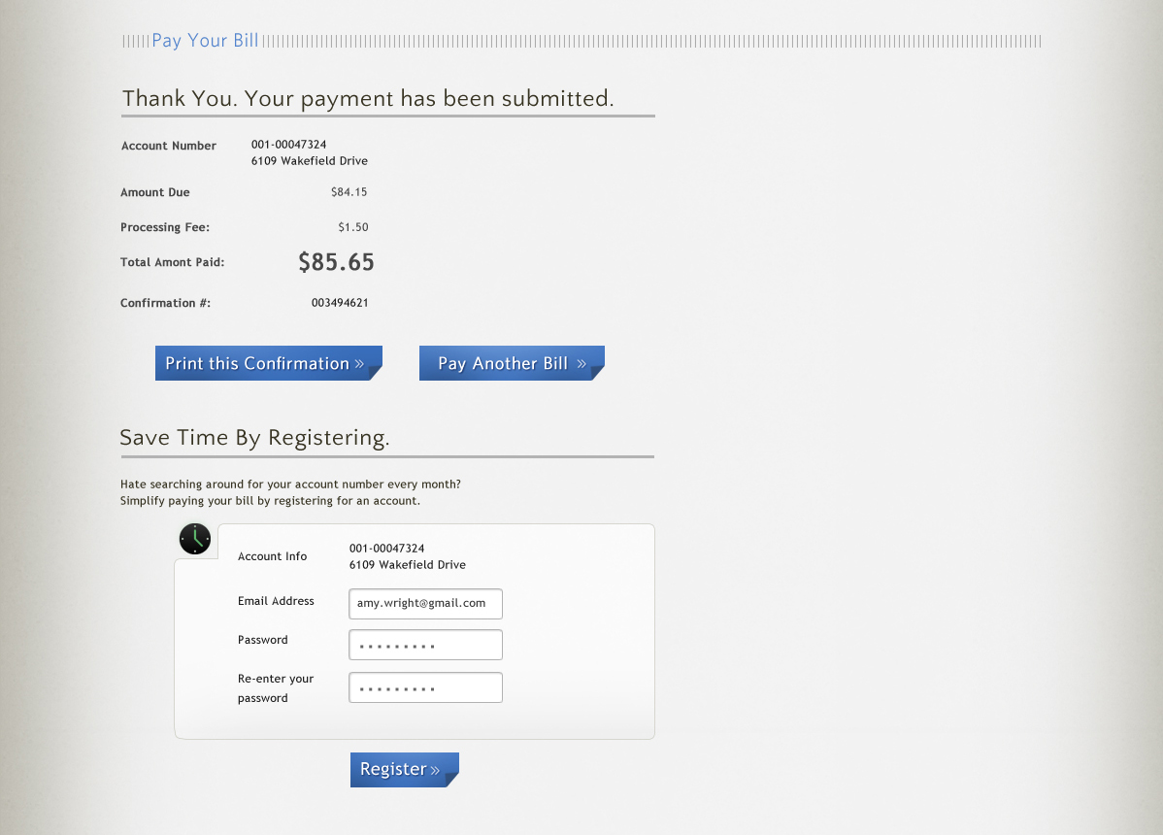

Slide 37
What are your customer’s thresholds?

Slide 38
7 Truths of Customer Usefulness
Available
Easy
Fast
Up-to-Date
&
Consistent
Trust-worthy
Informing
Valued
Must tackle integration hurdles
Multiple vendors can complicate
Real-time “Active” Data
Accurate
Each bill-pay channel needs to provide the same information.
Inconsistent data makes it harder on CSRs

Slide 39
A Worse Case Architecture Scenario
PP1
PP2
PP3
PP3
PP4
PP5
PP6
IVR/Phone
Web
Kiosk
Mobile
Text2Pay
EBPP / Auto-Pay
Notify
I1
I2
I3
I4
I5
I6
I7
CIS
Counter
Lock Box / Auto-Draft
PP7
PP8

Slide 40
Develop a Single Point of Integration
IVR/Phone
Web
Counter
Mobile
Text2Pay
eBilling
Notify
Integration Layer
Payment Processing
Customer Information System

Slide 41
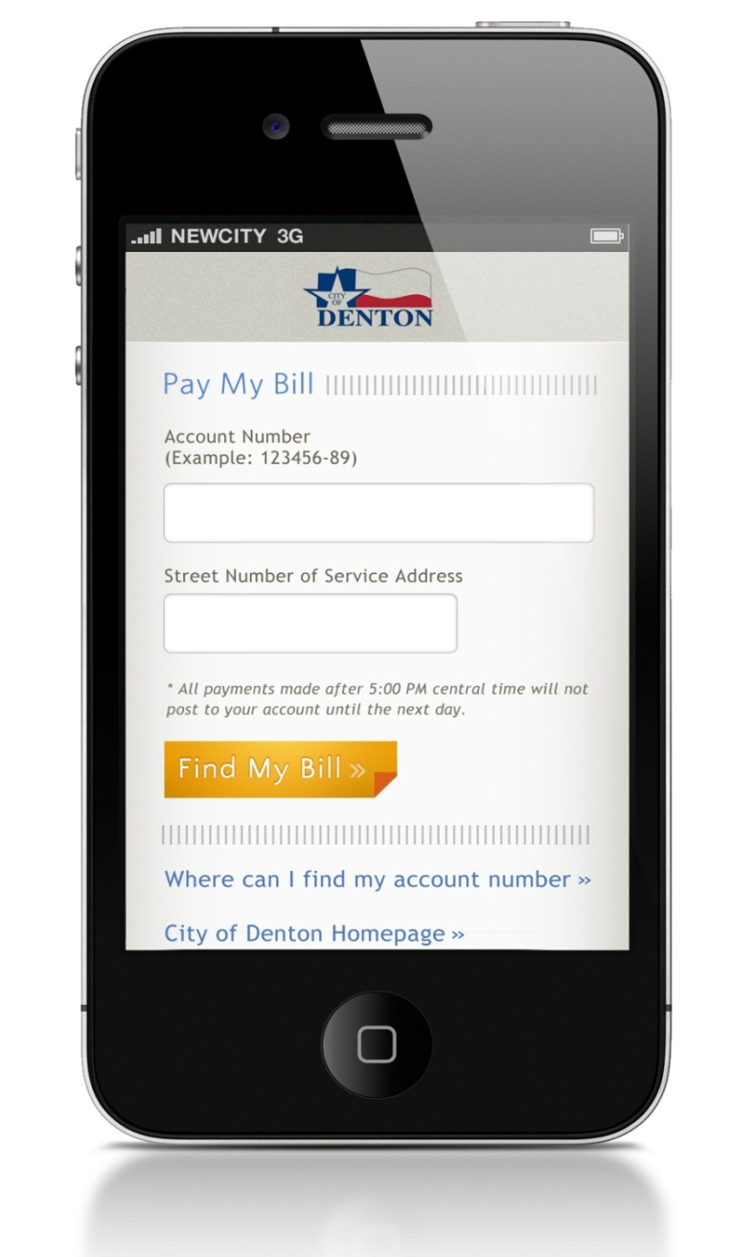
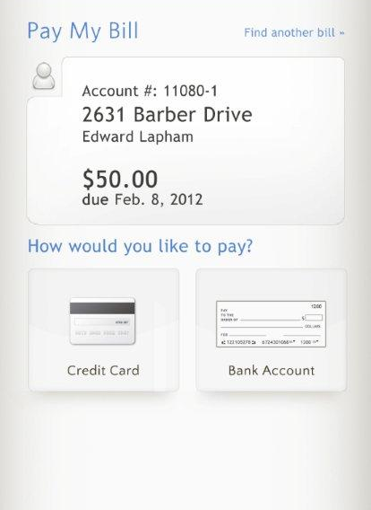
Mirroring Web Aesthetics…Consistency

Slide 42
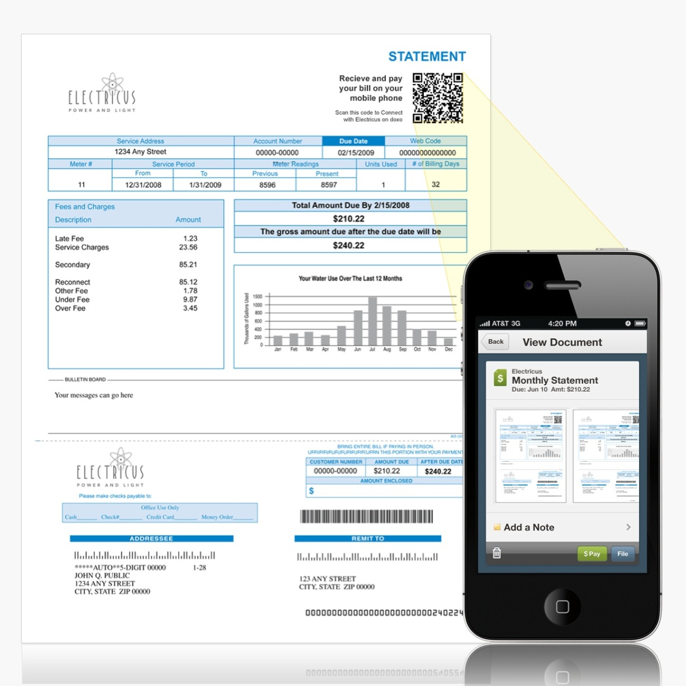
QR Code

Slide 43
7 Truths of Customer Usefulness
Available
Easy
Fast
Up-to-Date
Trustworthy
Informing
Valued
Customers must feel comfortable
Quality matters
Address the security concerns of your demographics
Collect the right information
It just has to feel right!

Slide 44
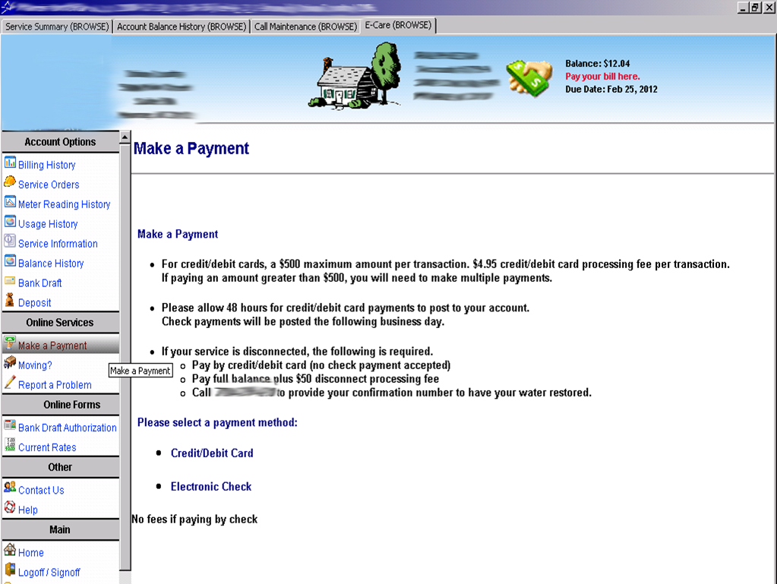

Slide 45
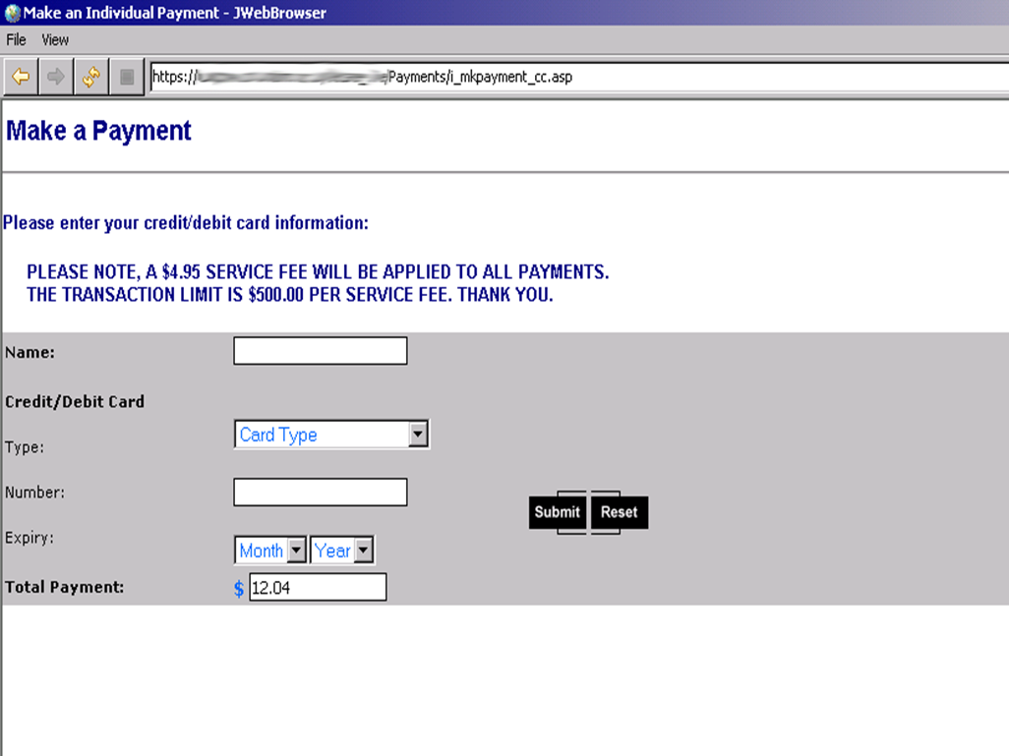

Slide 46
7 Truths of Customer Usefulness
Available
Easy
Fast
Up-to-Date
Trust-worthy
Informing
Valued
When it comes to bills, people fear forgetting to pay.
Be proactive
Timely (and appropriate) reminders are key
Past Due Courtesy Reminder Calls
Customers appreciative
Highly effective

Slide 47
Be Proactive // But Not a Nuisance
Bill Due
Next Bill Cycle Mailed
Account Shut-Off
Late Fee Applied
2nd Notice Mailing
Bill Mailed
Bill Ready Email
Bill Pay Reminder Email 1
Bill Pay Reminder Email 2
Bill Ready / Last Chance Email
Pre-Late Fee Courtesy Call
Pre-Disconnect Courtesy Call 1
Pre-Disconnect Courtesy Call 2

Slide 48
Notifications
Automatically notify thousands of customers in minutes
Manage multiple notification campaigns
Deliver customer-specific messages with data from your CIS database
“Press-2-to-Pay” to enter CIS and make payment
High volume callouts, email alerts, and text messages
Recorded voice or text-to-speech
Benefits:
Proactive notifications ensure customers are informed and satisfied
Reduce delinquencies and shutoffs from 30-70%
Examples:
Past-due courtesy notices
Service interruptions
Boil alerts
Weather alerts
Water restriction notices
Call Samples (click to listen)
Past Due Courtesy Call
Boil Water Notice

Slide 49
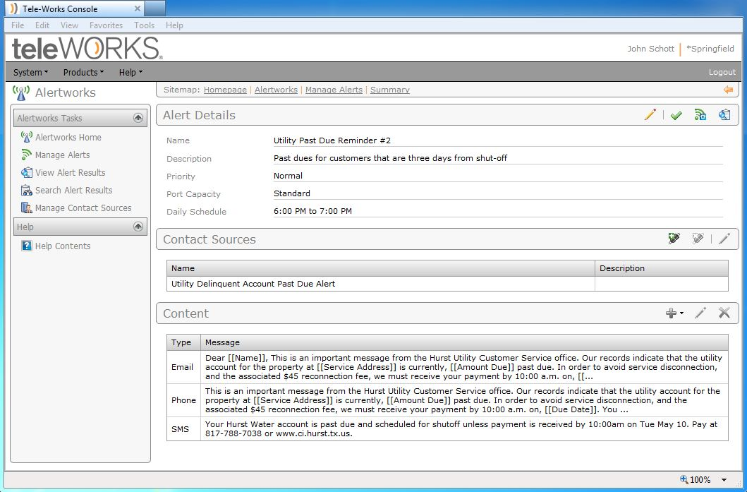

Slide 50
Build an Accurate Contact Database
Customers will want you to have their contact info!
Home Number
Mobile Number
Email
Text

Slide 51
7 Truths of Customer Usefulness
Available
Easy
Fast
Up-to-Date
Trust-worthy
Informing
Valued
People use things that they deem valuable
Provide useful features and functions
Is your customer self-service solution valued?

Slide 52
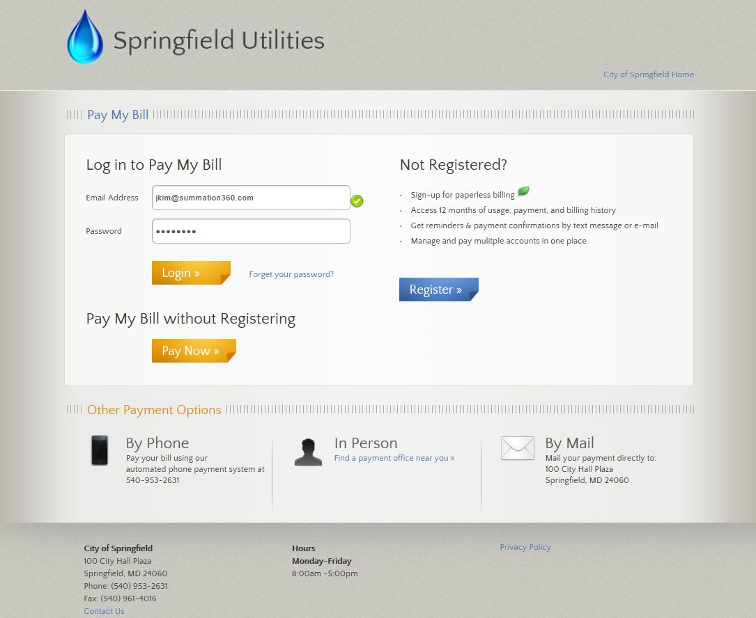

Slide 53
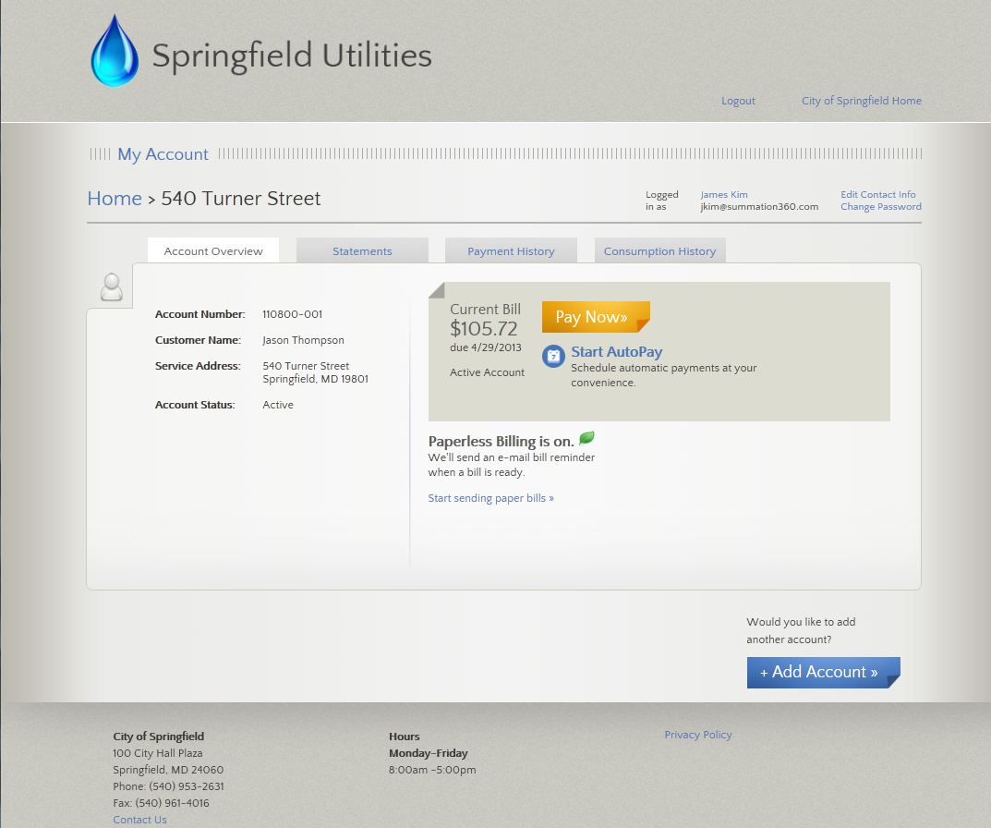

Slide 54
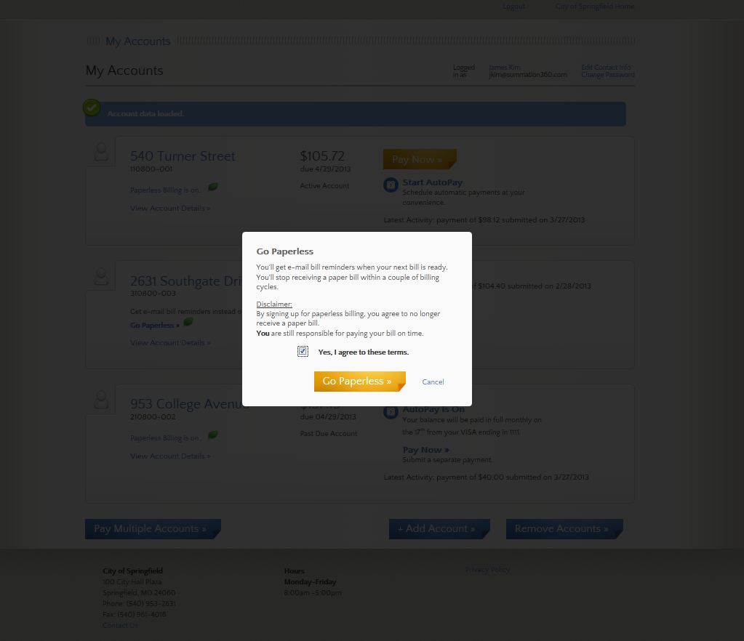

Slide 55
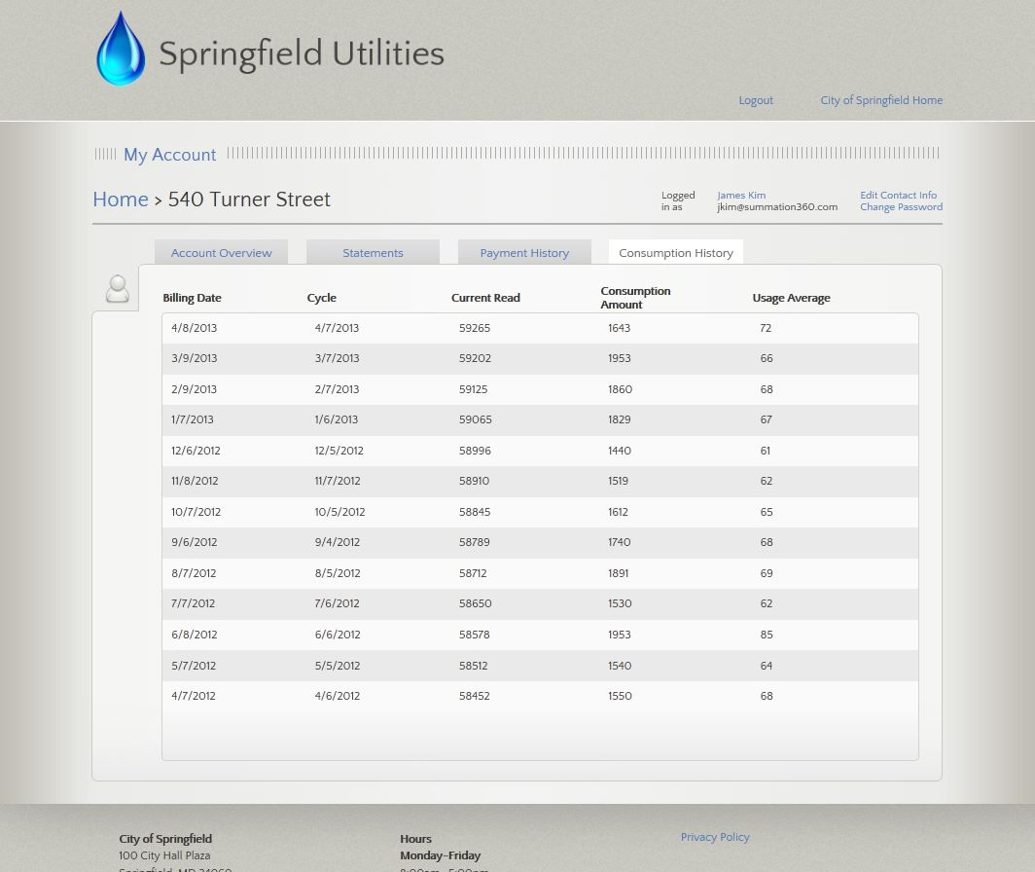

Slide 56
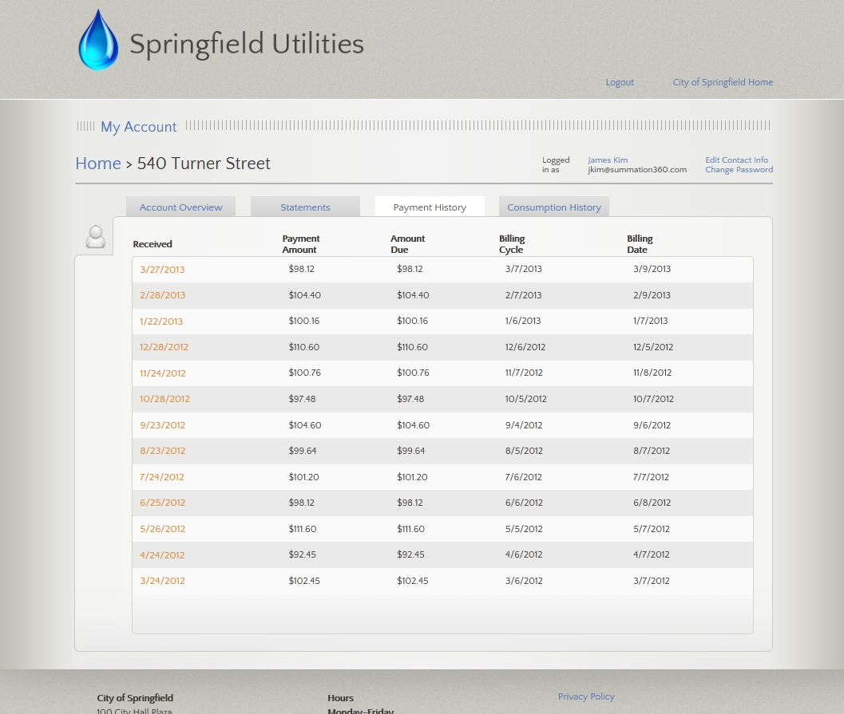

Slide 57
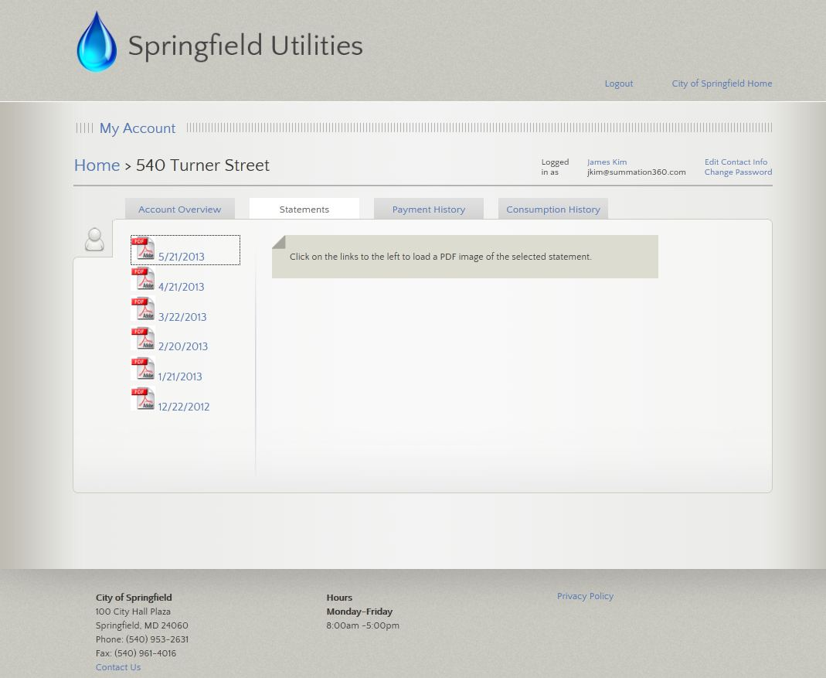

Slide 59
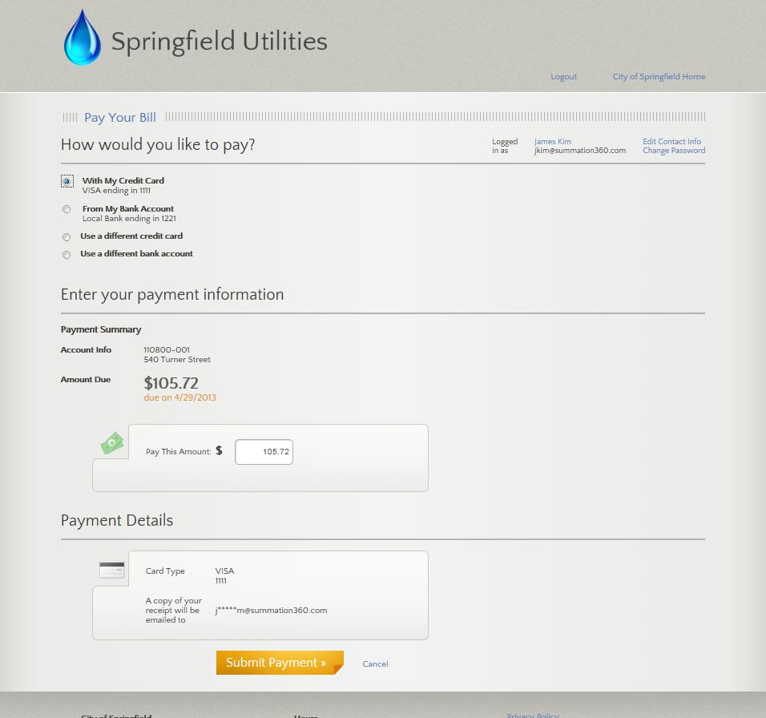

Slide 60
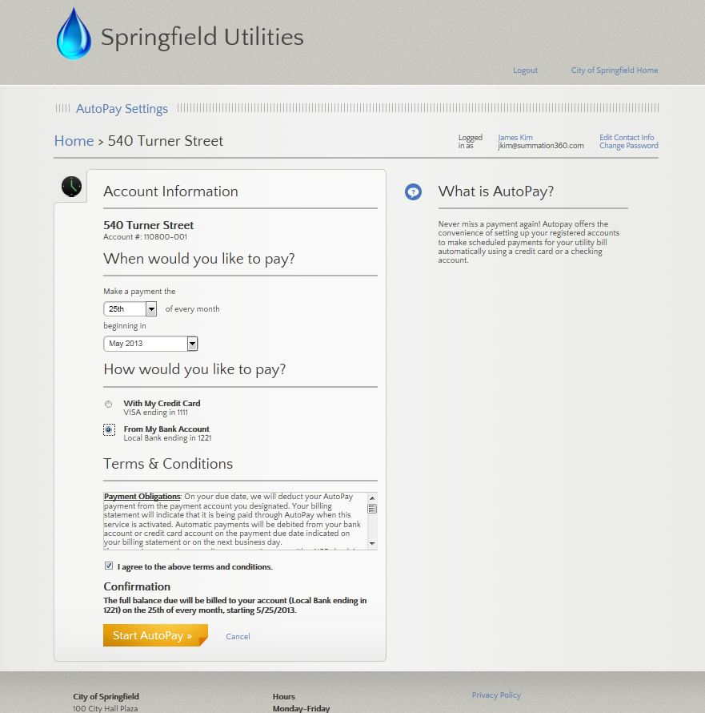

Slide 61
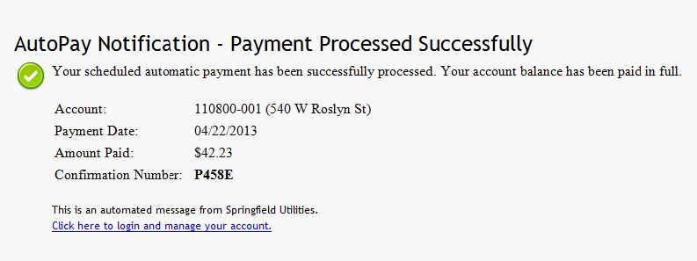
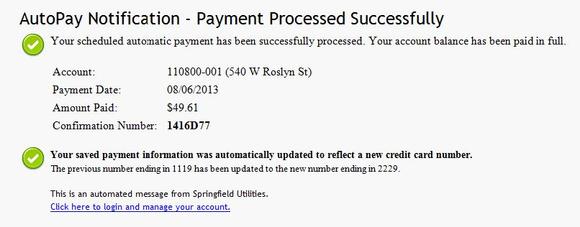

Slide 64
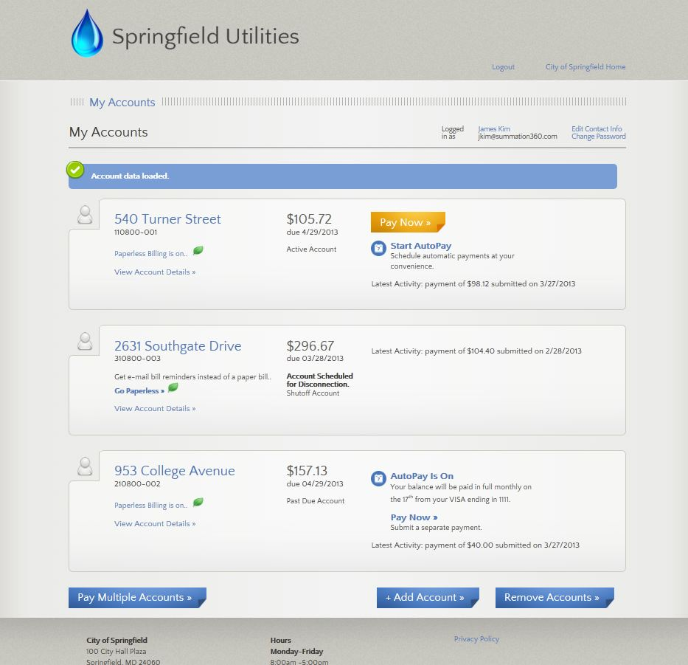

Slide 65
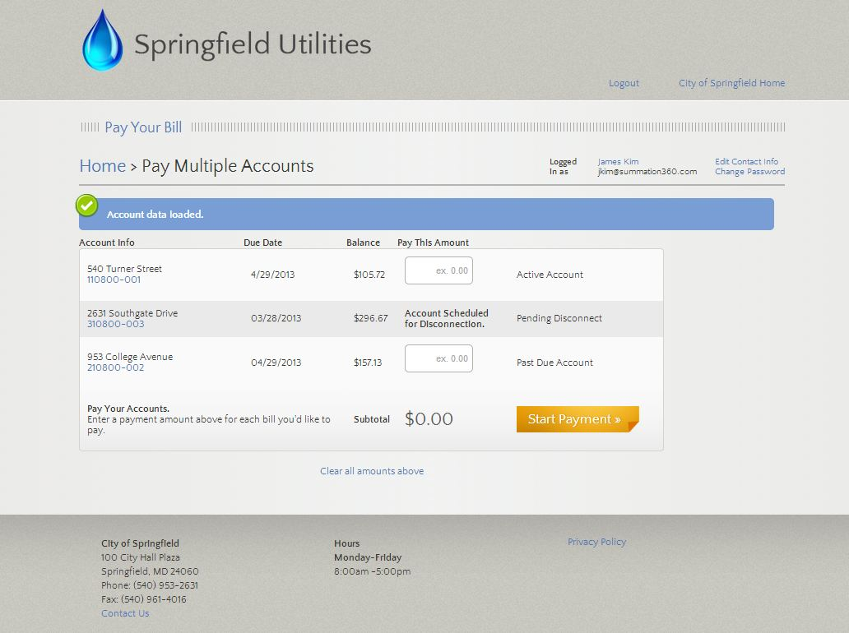

Slide 66
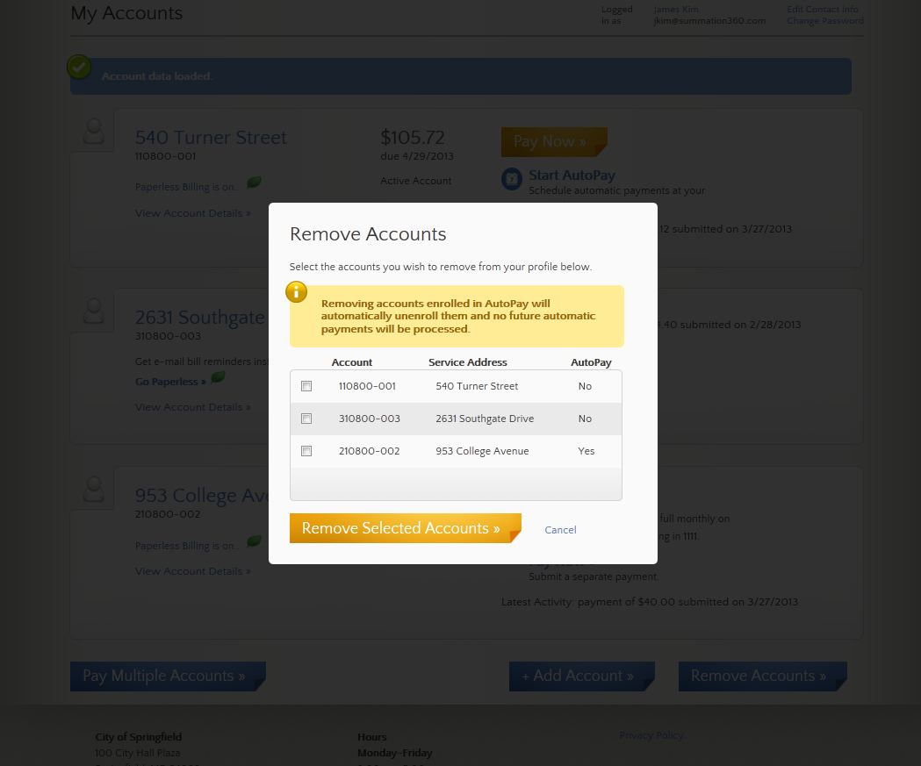

Slide 67
Made it!

Slide 68
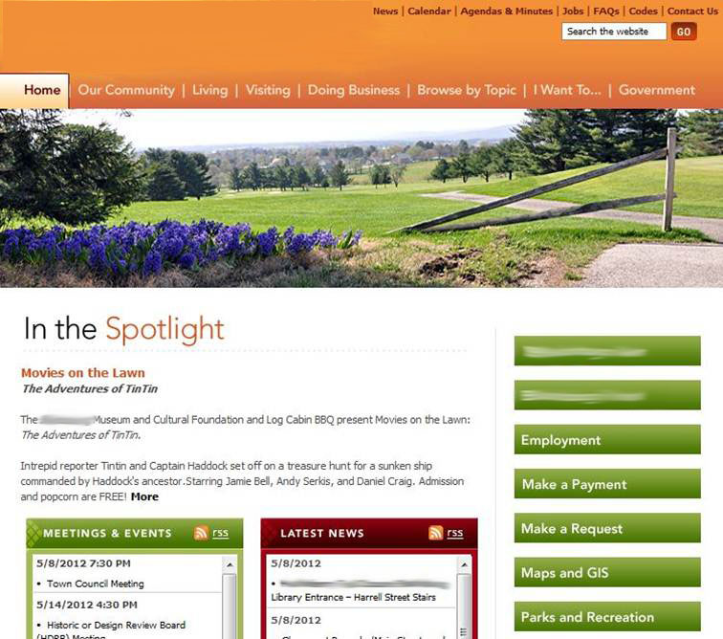

Slide 69
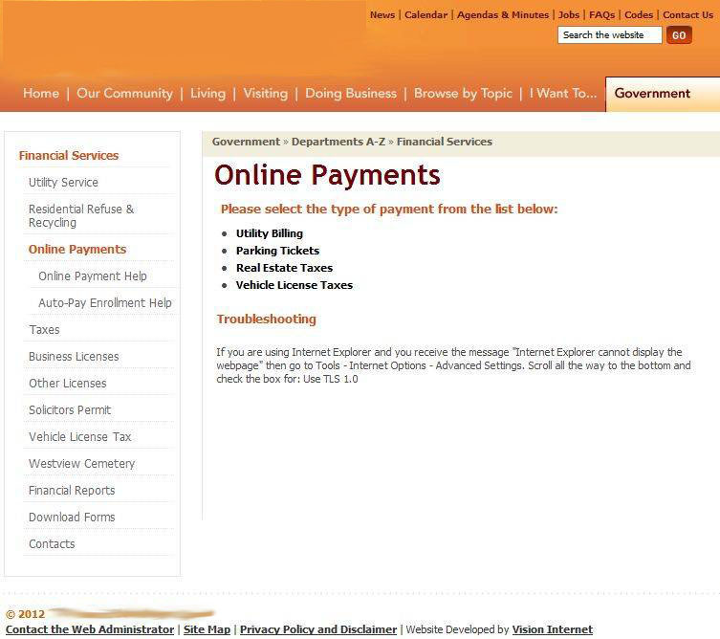

Slide 70
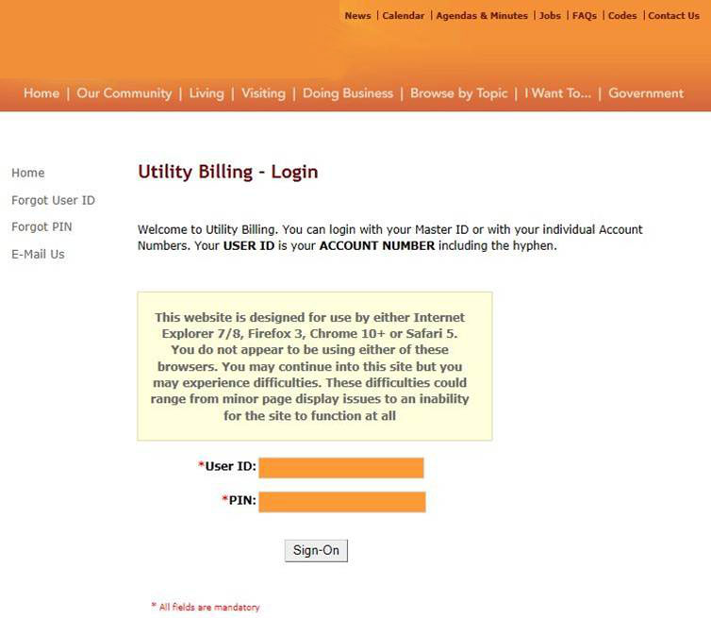

Slide 71
The Benefits of Usefulness
Like the Field of Dreams …
“Make it easy, and they will return.”

Slide 72
Promotion

Slide 73
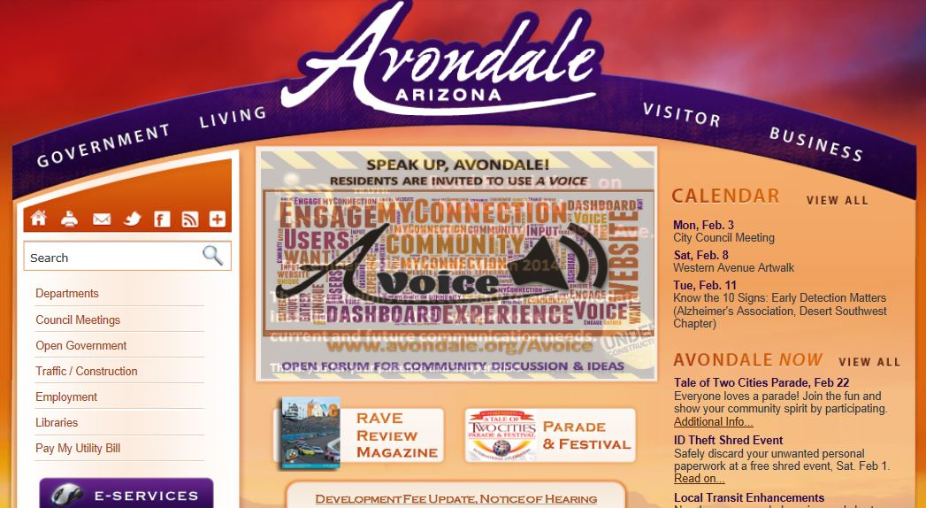
Promotion
.

Slide 74
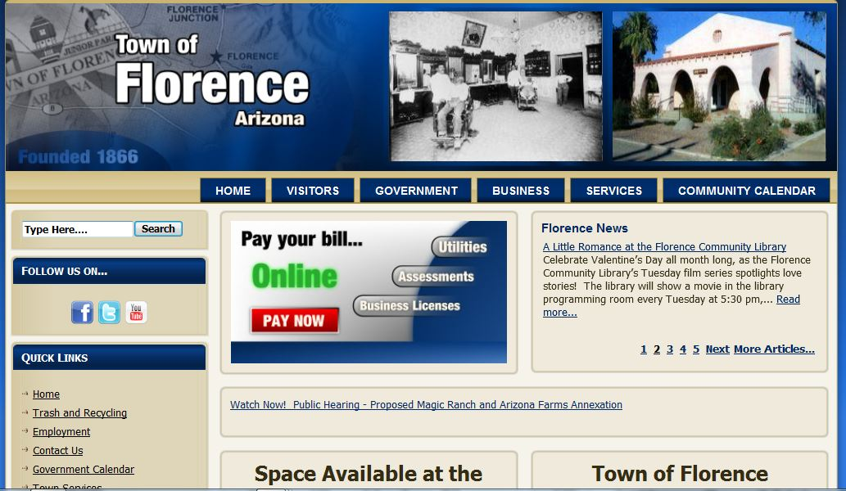
Promotion
.

Slide 75
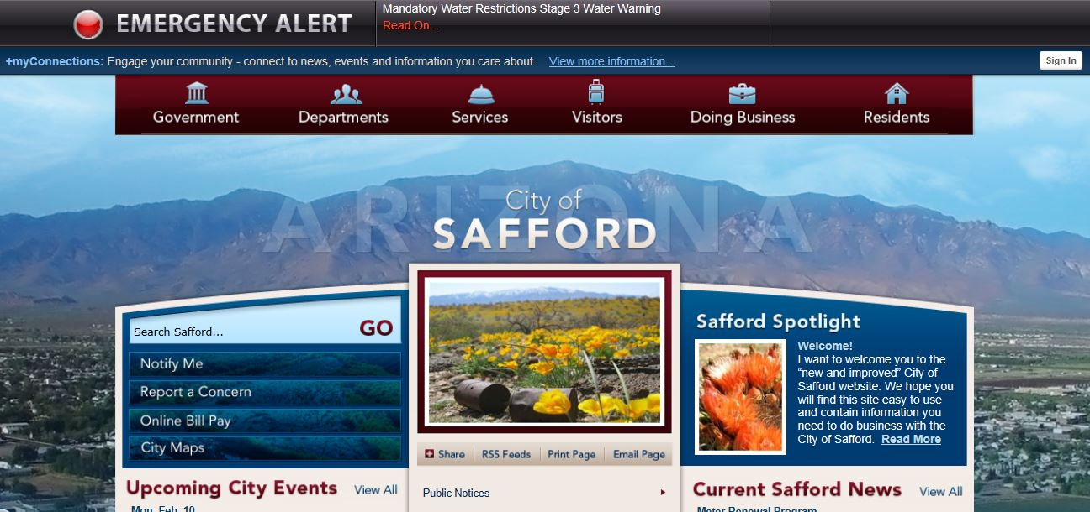
Promotion
.

Slide 76
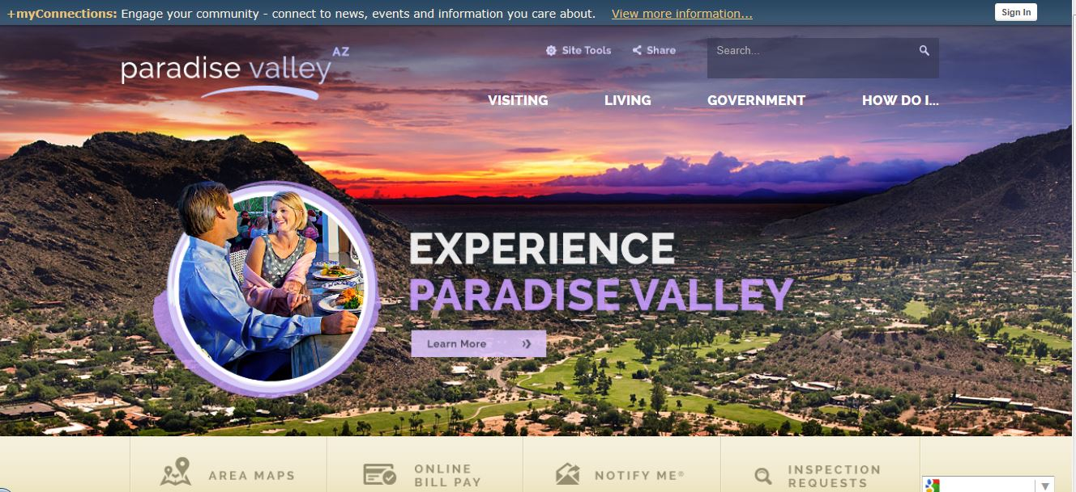
Promotion
.

Slide 78
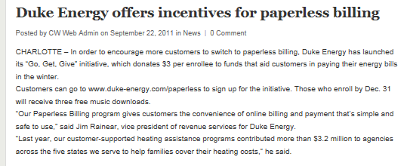

Slide 79
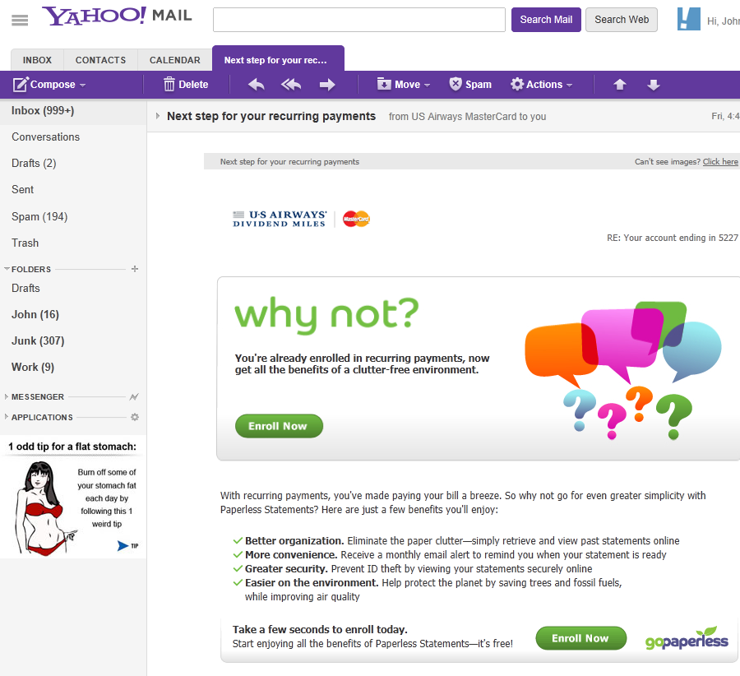

Slide 80
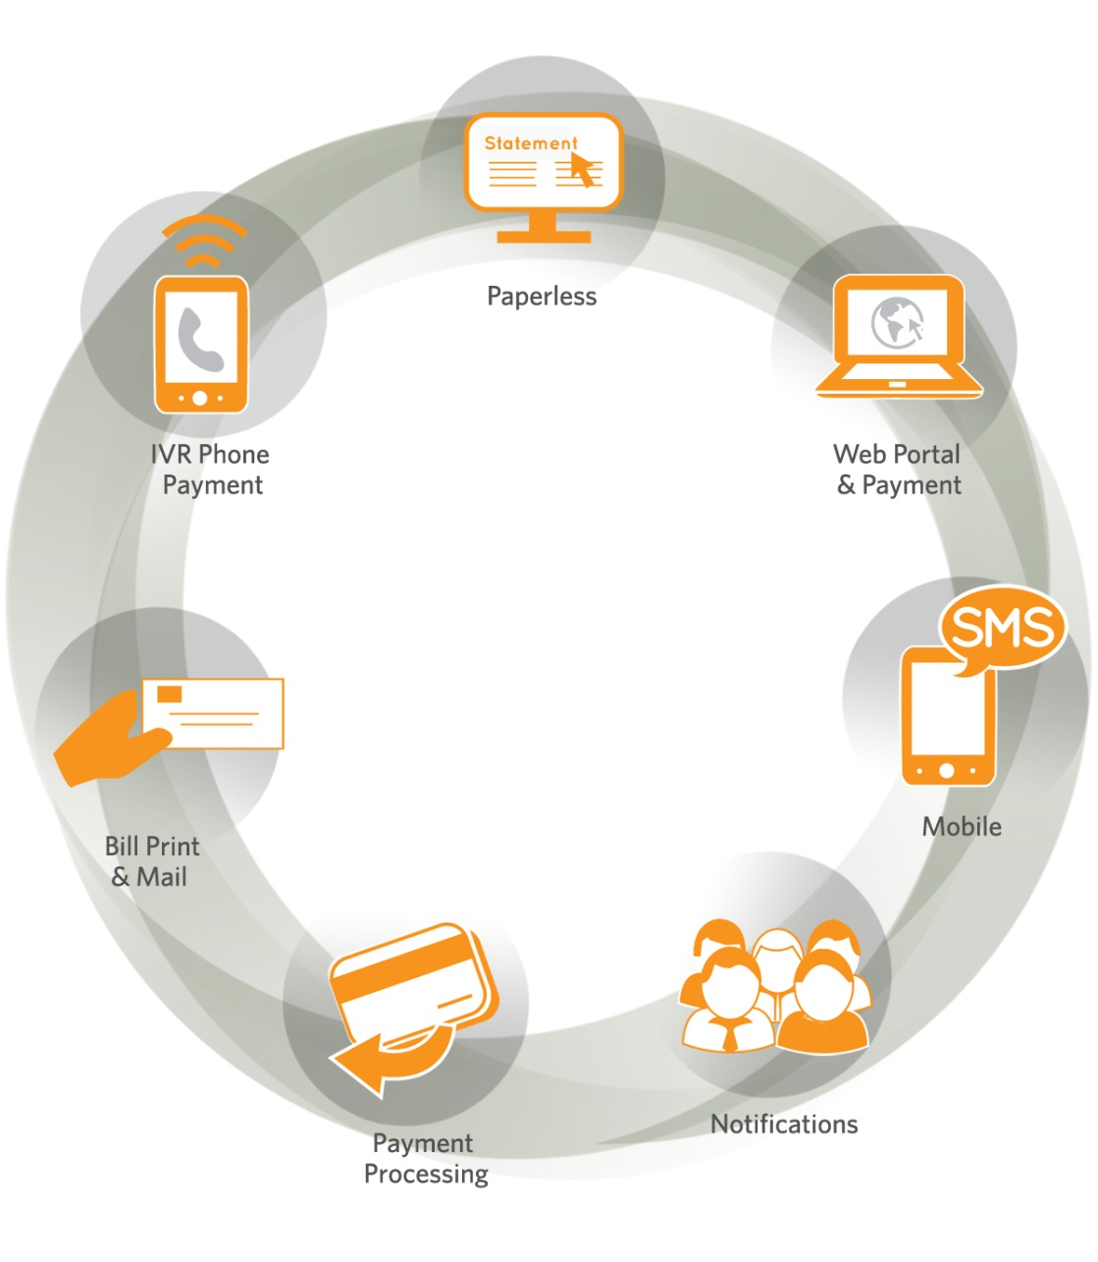
Consider a Single Vendor Deployment
Cross Promotion of eServices
One Call Issue Resolution
Single Point of Integration
One Contract to Manage
Cost Efficiencies

Slide 81
Benefits of Using a Specialized 3rd Party
Scale
Better Usability
More features
Reduced PCI Compliance Burden
Lower Cost
Must Find Right Partner
Growth and focus is important
Continuous improvement

Slide 82
Summation360: The all-in-one billing, payment, and customer communication solution.
one
expert vendor one
hosted service
one
call issue resolution
one
data integration
one
payment processor
one
price for all services

Slide 83
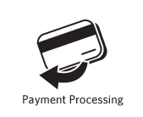
TWI Payment Processing Services™
Process credit card and eCheck payments by Web, IVR, mobile, and at the counter
Single view simplifies search, reporting, and reconciliation
Virtual Terminal & Card Readers Provided
Auto-Pay by credit, debit or eCheck
Auto-Updater Service for reducing interruptions in transactions (updates expired/lost/stolen cards)
Next-day funding
Level 1 PCI Compliant
Cross-departmental use

Slide 84
Focus
“Any man who can drive safely while kissing a pretty girl is simply not giving the kiss the attention it deserves.”
-Albert Einstein

Slide 85
Connect with TWI
Billing and payment blog at www.summation360.com/learn
Information and Questions
John Schott
President and CEO
jschott@summation360.com
(540) 951-6470

