Slide 1
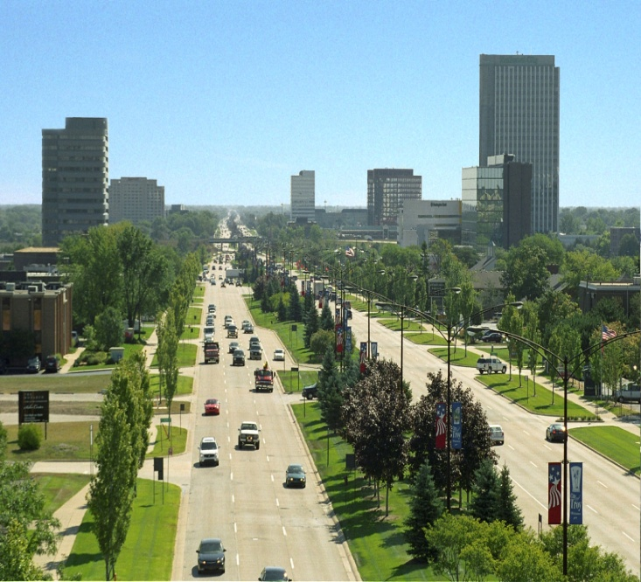
Economic Development
Building Inspections
Planning & Zoning
Creating
an Environment for Investment in Troy
Public
Infrastructure
Community Affairs

Slide 2
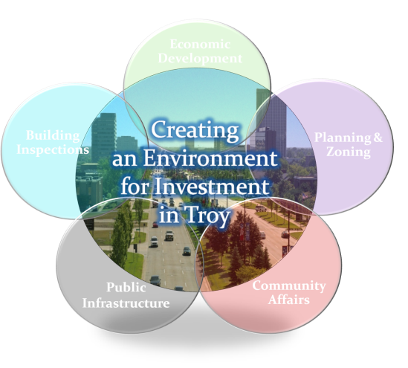
OVERVIEW
Outstanding Community Assets/National Recognition
Zucker Report – A Roadmap for Improved Development Processes
Departmental Coordination
Community Affairs
Economic Development
Planning & Zoning
Building Inspection & Plan Review
Testimonials
Questions/Answers

Slide 3
COMMUNITY ASSETS
Largest City in Oakland County (pop. 80,980)
Outstanding Central Location & Highway Access
Diverse & Highly Educated Population
One of Oakland County’s Lowest Tax Rates
6,400 Businesses Employ 129,000 People
Michigan’s Top Location for Automotive R&D
Home of Automation Alley
Major Financial Services Hub for State
World Headquarters for Two Fortune 500 Companies: Meritor and Kelly Services
Nationally Ranked School District
Twenty Parks & Recreational Facilities of 900+ Acres

Slide 4
NATIONALLY RECOGNIZED
In 2013, Family Circle Magazine Named Troy One of Top Ten Cities for Families in U.S.
Named the #1 Best Place to Live in Michigan and 26th Best in U.S. by CNN Money Magazine in 2012
Named the #1 Safest City in Oakland County and #3 Safest in Michigan Over 75,000 in Population
For the 3rd time Named a “Top Performing” Community for Attracting & Retaining Entrepreneurial Companies in 2012 by the University of Michigan-Dearborn’s eCities Initiative and 6th year receiving top rankings overall
Certificate of Achievement for Excellence in Financial Reporting from Government Finance Officers Association

Slide 5
TRANSFORMATION OF DEVELOPMENT APPROVAL PROCESSES
2008 Zucker Systems Report Evaluated Troy’s Development Approval and Permit Processes
102 Recommendations Set Forth
Led to Streamlining of Development Systems
Hybrid Model of City Staff and Private Consultants Implemented for Planning and Engineering Depts.
Building Department Contracted Out for Cost Savings and Increased Level of Service

Slide 6
COMMUNITY AFFAIRS
New Website Launched in December 2012
New Economic Resource Guide Published 2012
Troy Prominently Featured in Publications Like Xology, Prosper, Asource and Others
Quarterly Troy Today & Business E-News Highlights New & Expanding Businesses
Media/Publicity/Ribbon Cuts - Support Provided to Businesses
Promote Troy as Michigan’s Premier Address for Business, Retail and Commerce
Contact: Cindy Stewart at 248.524.1147

Slide 7
COMMUNITY AFFAIRS BEST PRACTICES
www.troymi.gov
Troy’s new website has been redesigned to make navigation easier for residents, businesses and visitors.

Slide 8
ECONOMIC DEVELOPMENT
Economic Gardening: Provide Information, Infrastructure and Connectivity to Address Business Needs and Encourage Growth
Emphasize Partnerships & Collaboration
Serve Entire Business Community and Target 2nd Stage Companies
Expanded Tools/Online Resources: Business Roundtable Meetings, One-on-One Business Visits, New Business Checklist, Business Interest Form, Insyght Resources Tool, Intern in Michigan Link, Business Development E-Blast, Small Office Site Search Tool
Key Partners: MEDC, Oakland County, Automation Alley, Walsh College, Troy Chamber
Contact: Glenn Lapin at 248.524.3314

Slide 9
ECONOMIC DEVELOPMENT BEST PRACTICES
Troy Michigan Business Connect
Troy’s Economic Gardening initiative emphasizes strong partnerships and collaboration in order to address business needs and encourage growth.

Slide 10
PLANNING & ZONING
2008 Master Plan Sets Innovative Vision, Expands Range of Land Uses, and Protects Neighborhoods
2011 Zoning Ordinance is User-Friendly, Flexible, and Responsive to Market Conditions
2011 Big Beaver Design Guidelines Promotes Placemaking
Sustainable Development Project tool encourages sustainable measures in exchange for regulatory flexibility
On-Line Resources: Master Plan, Zoning Ordinance, GIS Mapping, Big Beaver Design Guidelines
Contact: Brent Savidant at 248.524.3366

Slide 11
PLANNING & ZONING BEST PRACTICES
Granite City
699 W. Big Beaver
Troy’s Big Beaver Zoning District requires active people-oriented uses adjacent to the street.

Slide 12
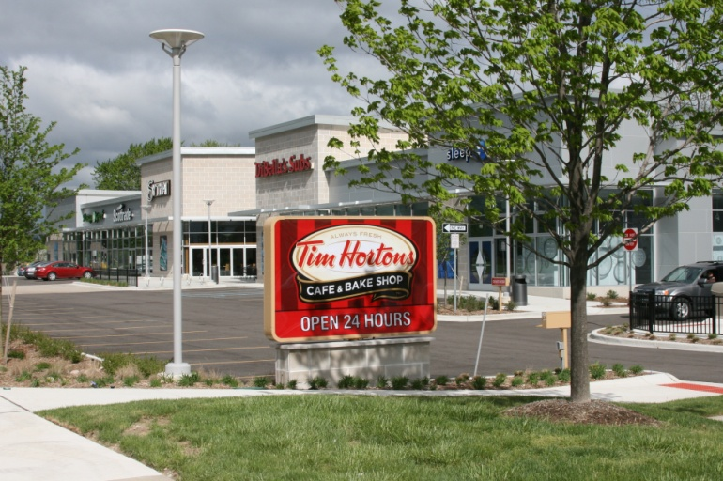
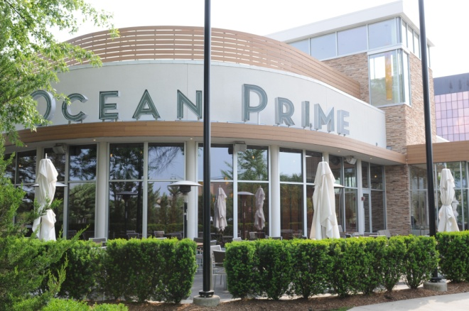
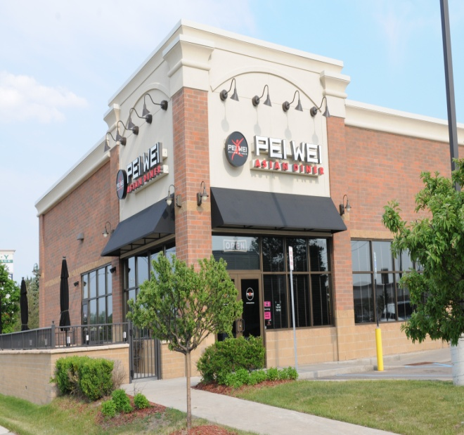
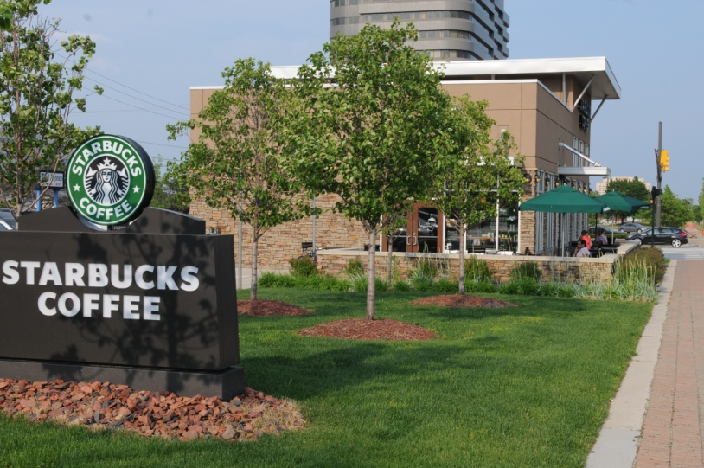
PLANNING & ZONING

Slide 13
BUILDING SERVICES
SAFEbuilt Building Department Services
Troy is Largest Michigan City with All Building Plan Review & Inspection Contracted Out
Fast, Fair & Predictable Permit & Inspection Services
Commercial Plan Review in Ten Days or Less
Residential Plan Review in Five Days or Less
98% Customer Satisfaction Rating
Coordination with Engineering & Fire Departments
Contact: Steve Burns at 248.524.3344

Slide 14
BUILDING SERVICES BEST PRACTICES
O’Brien Construction
966 Livernois
Fast, fair and predictable permit and inspection services led to project completion in a timely manner. Troy’s Sustainable Development Project tool encourages “green” building design in exchange for regulatory flexibility.

Slide 15
TESTIMONIALS
“The City of Troy has a distinguished business-friendly attitude. Our company, UBT, purchased a building in Troy and completely redesigned it with “green” technology including geothermal wells, radiant heating, foam insulation, white PVC membrane roof technology, energy efficient lighting and electrical components, and recycled bamboo furniture. When we experienced obstacles with plumbing and our geothermal wells throughout the redesign, the City of Troy was fantastic in obtaining the pertinent historical data we needed to make the repairs and move our team into our new home. And to our pleasant surprise, the City of Troy followed up in person to verify that our construction was running smoothly so that we could safely operate our business once we settled in. We are extremely happy to have relocated to Troy and would highly recommend this city to any business looking for a new home!”
Michelle D’Souza
Chief Executive Officer
Unified Business Technologies
April 2013
“Thanks for taking the time to organize the Manager’s Business Roundtable. It was very informative and I look forward to working with the City and you in particular. The event was so good that 3 out of the 4 businesses already have connected and purchase orders will be issued within a week…”
Sri Bramadesam President Autoline Industries Ltd. January 2013
"I am very grateful for the wonderful help you provided and was extremely impressed how Troy went above and beyond what any other economic development agency provided. I know that the companies were also very impressed and that they will consider Troy when they are ready to set up in Michigan. Thank you again so much.“
Patrick Dine President & CEO PSD Global (Representing Portuguese Delegation Visit) September 2012

Slide 16
TESTIMONIALS
"Mahindra looked at Illinois, the Netherlands and other locations when scouting a spot for a technical center in the West. And we found that Troy was the best location for engineers, for access to design and testing. Mahindra is keen to be a part of this ecosystem and culture.“
Rajan Wadhera Chief Executive for Technology, Products & Sourcing Mahindra Engineering September 2012
“Huntington Bank is proud to call Troy home for our East Michigan Headquarters. The City of Troy has been a supportive and collaborative Team to work with and we feel very welcomed by the community. Troy’s central location in the region is critical to our Huntington East Michigan Operation.”
Mike Fezzey Regional President Huntington - East Michigan April 2012
"I work with many cities in Macomb and Oakland County and unfortunately deal with a lot of bureaucracy which causes long delays in my line of business. However, working with the city of Troy is just the opposite. I get things done quickly, efficiently and professionally. I enjoy working with the City of Troy and look forward to many more successful years together."
Jamie Blumenthal President, H.E.R Management Long Lake Plaza January, 2012

Slide 17
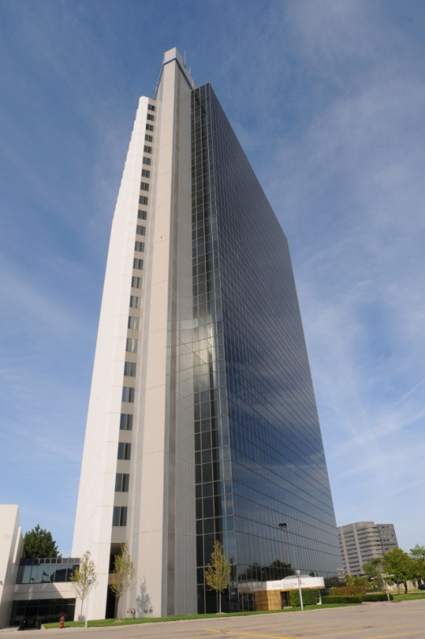
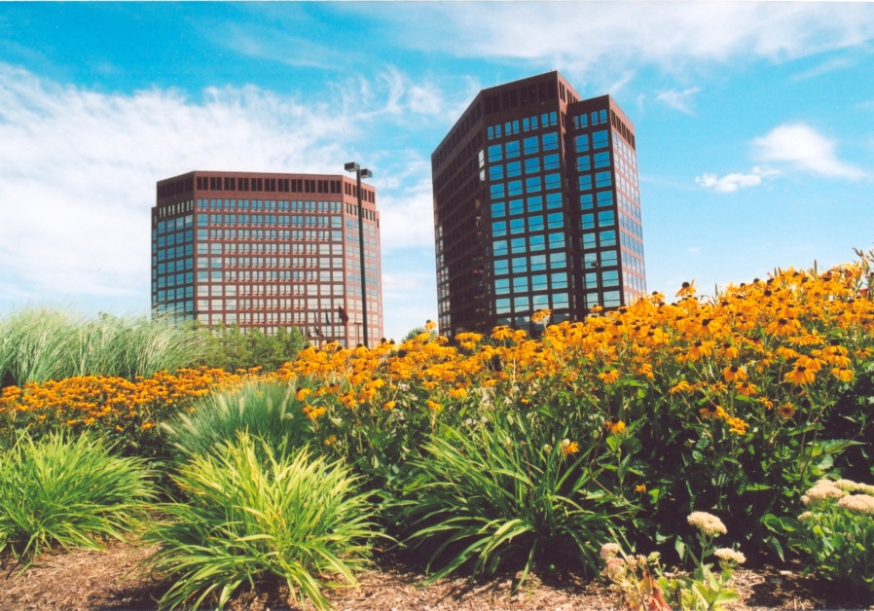
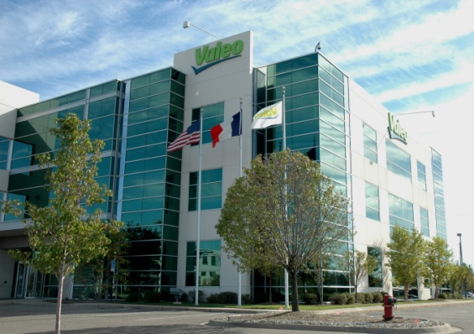
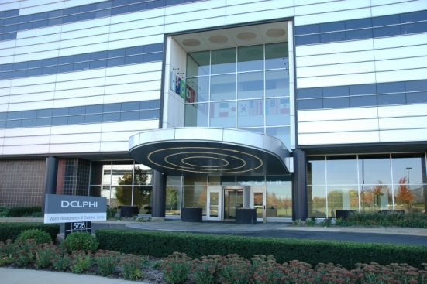
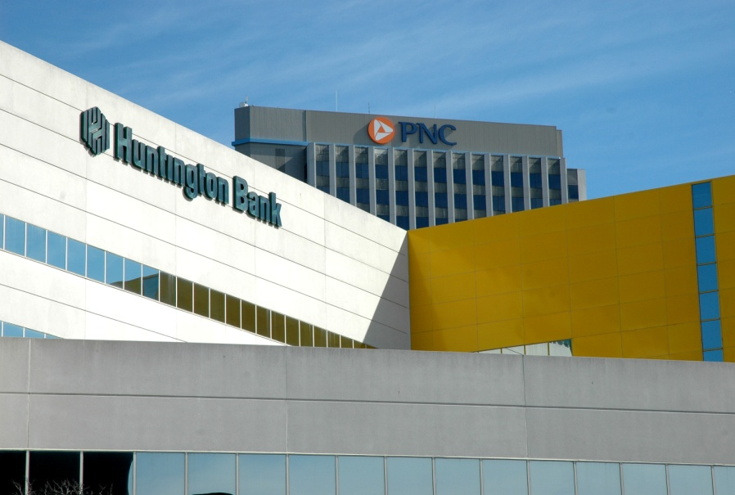
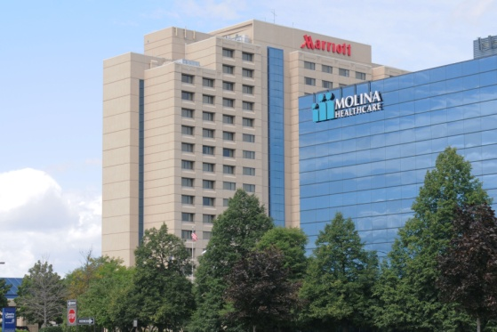
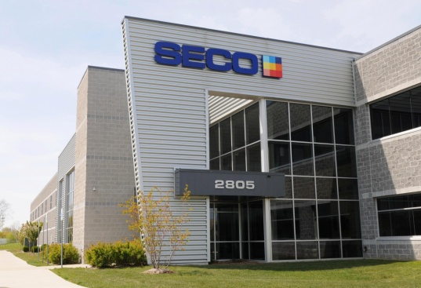
QUESTIONS & ANSWERS
Thank You!
www.troymi.gov

