Slide 1
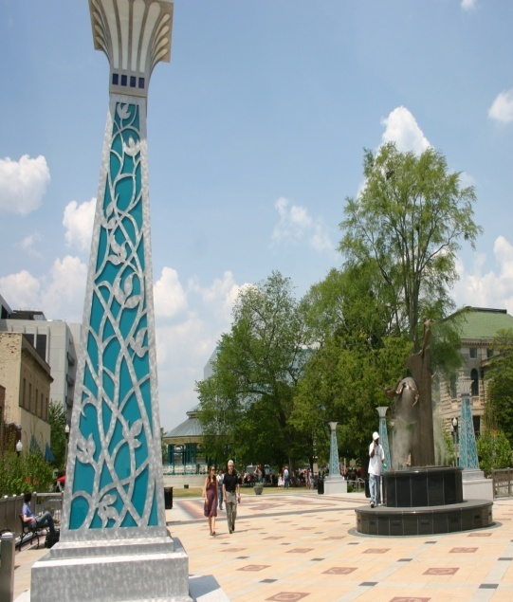
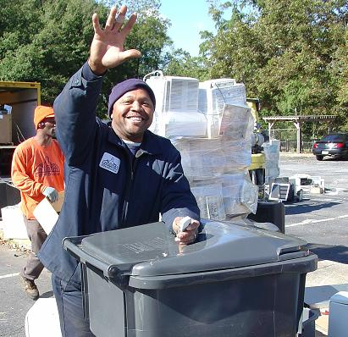
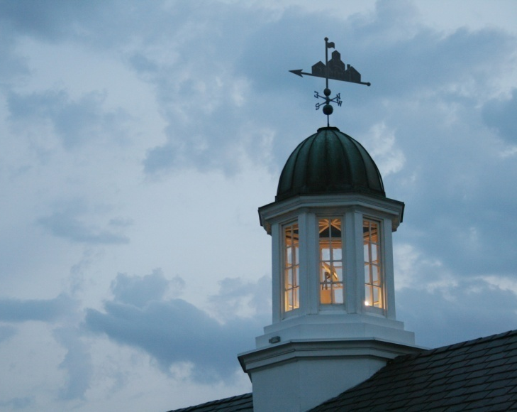
City of Decatur, Georgia
ICMA
Southeastern Regional Summit
“Great by Choice”
July, 2011

Slide 2
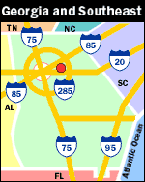
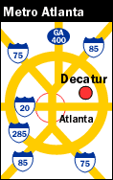
Decatur, Georgia 30030
12 Minutes East of Downtown Atlanta
Population 19,337 in 4.27 sq. miles
County Seat
Home to Agnes Scott College and close to Emory University and the CDC.
Full Range of Municipal Services
AA+ Bond Rating
All combined budgets = $40mm
205 FTE

Slide 3
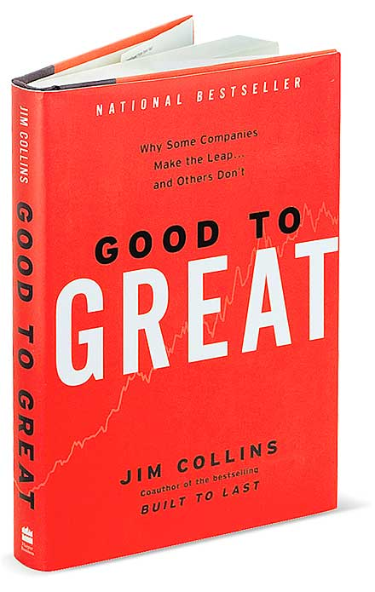
An “AH HA” Moment
Good to Great –
Jim Collins
  First Who…
  Keeping the Faith
  Know Your Core Business
  Be Disciplined about Performance
  The Flywheel

Slide 4
SMaC
Specific Methodical and Consistent
A set of durable operating practices that is clear and concrete.
Includes practices “not to do.”
Helps people keep their bearings and sustain high performance when in extreme conditions.
The signature of mediocrity is not an unwillingness to change; the signature if mediocrity is chronic inconsistency.
A great company must evolve its recipe, revising selected elements when conditions merit, while keeping most of the recipe intact.

Slide 5
SMaC
The signature of mediocrity is not an unwillingness to change; the signature if mediocrity is chronic inconsistency.
A great company must evolve its recipe, revising selected elements when conditions merit, while keeping most of the recipe intact.
Far more difficult than implementing change is figuring out what works, understanding why it works, grasping when to change and knowing when not to.

Slide 6
Return on Luck
Some significant aspect of the event occurs largely or entirely independent of the actions of the key actors in the enterprise
The event has a potentially significant consequence (good or bad)
The event has some element of unpredictability.
The critical question is not “Are you lucky?” but “Do you get a high return on luck?”

Slide 7
Return on Luck
Cultivating the ability to zoom out to recognize luck when it happens.
Developing the wisdom to see when, and when not, to let luck disrupt your plans.
Being sufficiently well-prepared to endure the inevitable spate of bad luck
Creating a positive return on luck

Slide 8
SMaC Operating Practices
Downtown Redevelopment is a key to future economic and community development
  Availability of transit is a positive
  Civic aesthics should reflect a thriving community
  Special events reflect the community and provide a showcase for the CBD
  The CBD should have a mixture of uses
  A mixture of uses requires a “critical mass”
  A “critical mass” is provided through residential density

Slide 9

SMaC Meets Luck

Slide 10
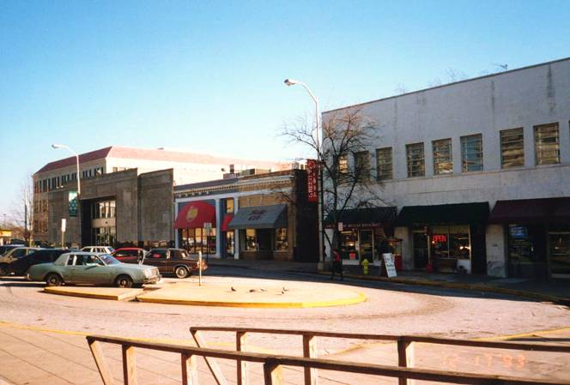
East Court Square Before

Slide 11
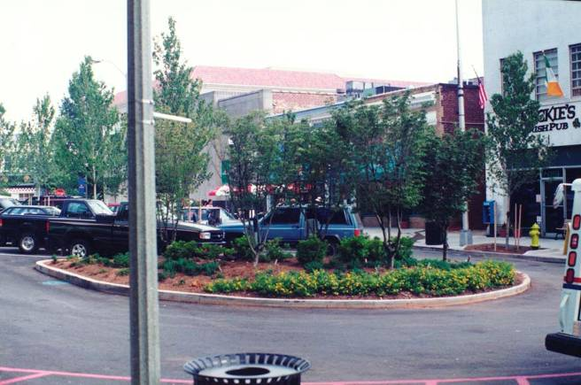
East Court Square After

Slide 12
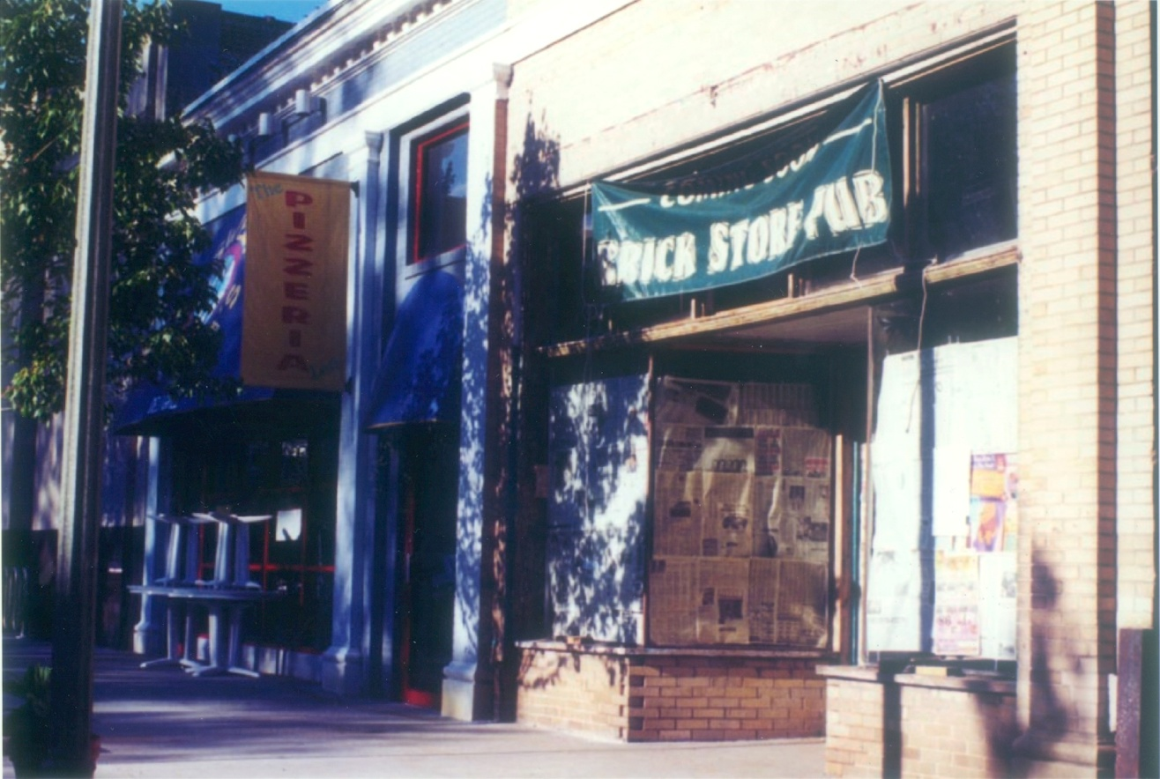
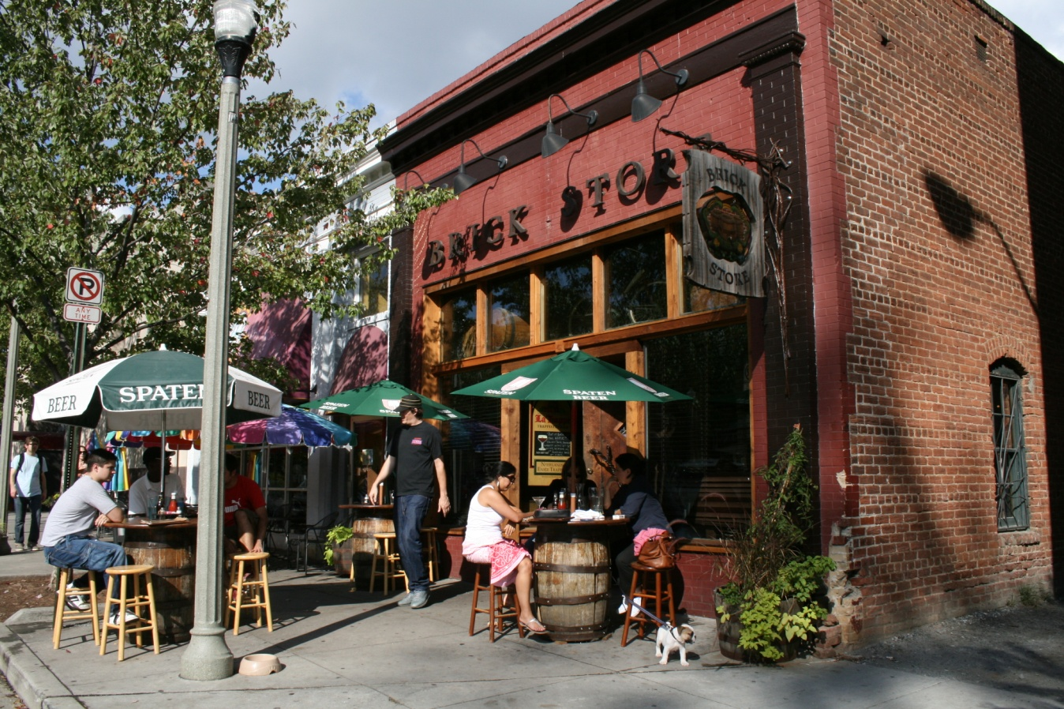
East Court Square
25 Years of Downtown Development
Before
After
Retail and restaurant growth around the square and along the Ponce de Leon corridor has created a vibrant downtown commercial district that encourages more pedestrian activity.

Slide 13
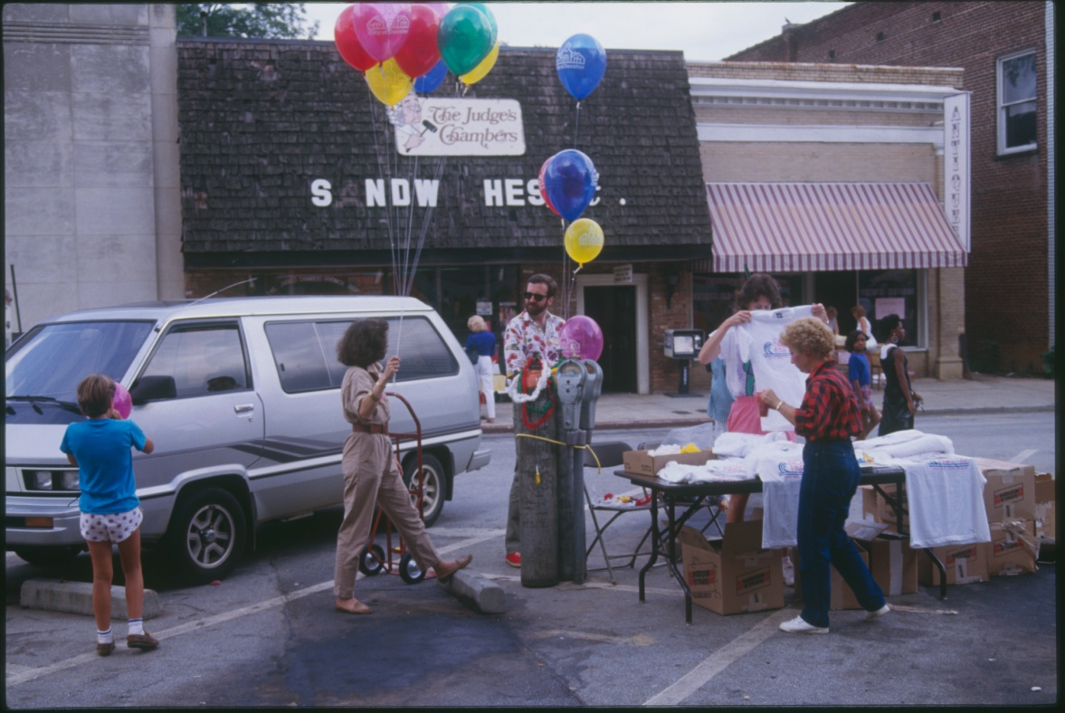
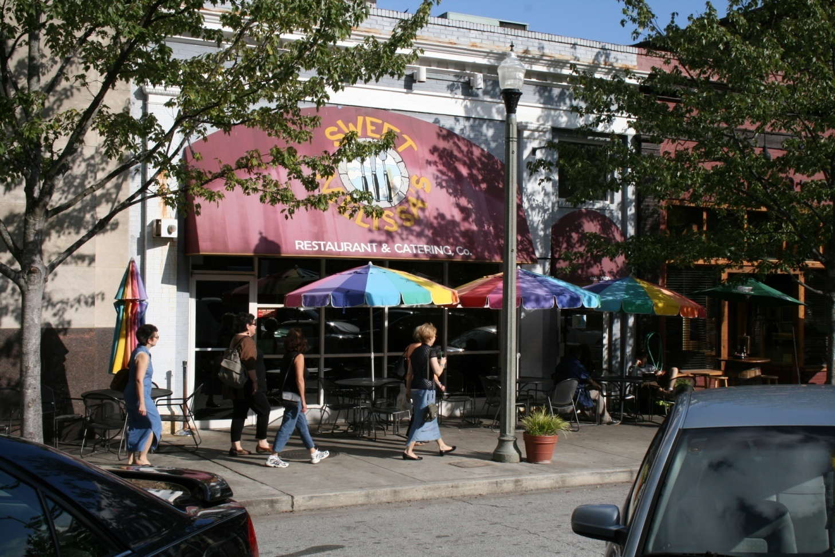
East Court Square
Before
After
“[Citizens] also called for landscape and streetscape treatments – trees, pedestrian crossings, lighting, graphics coordination – that would make downtown a delightful and safe place for pedestrians night and day, in all seasons.”
- Decatur Town Center Plan, pg. 11

Slide 14
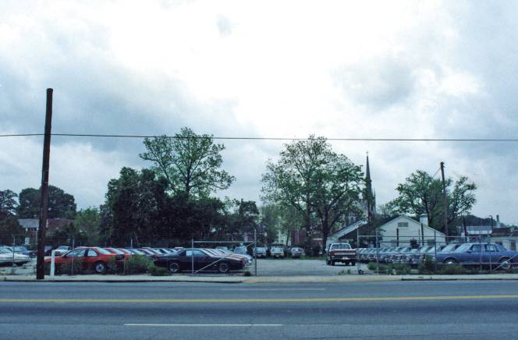
East Ponce de Leon BEFORE

Slide 15
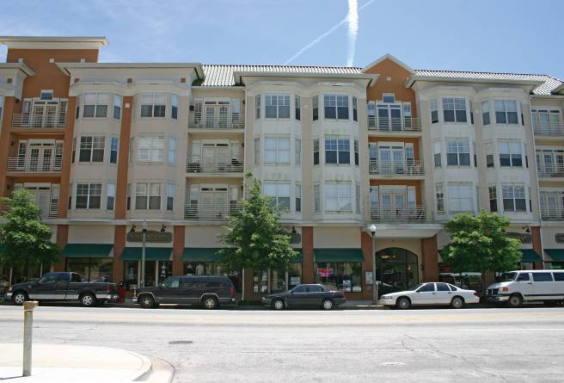
East Ponce de Leon AFTER

Slide 16
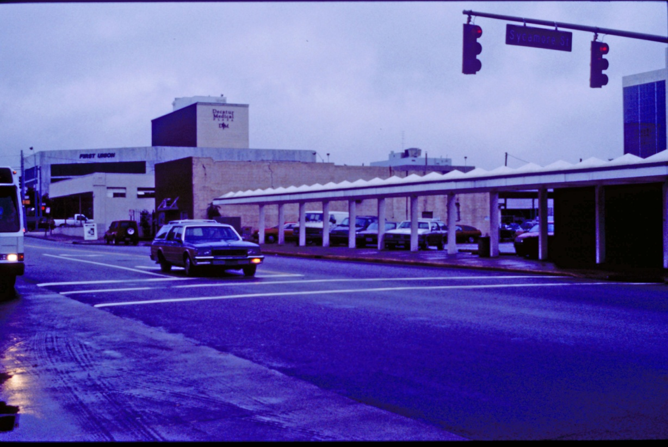
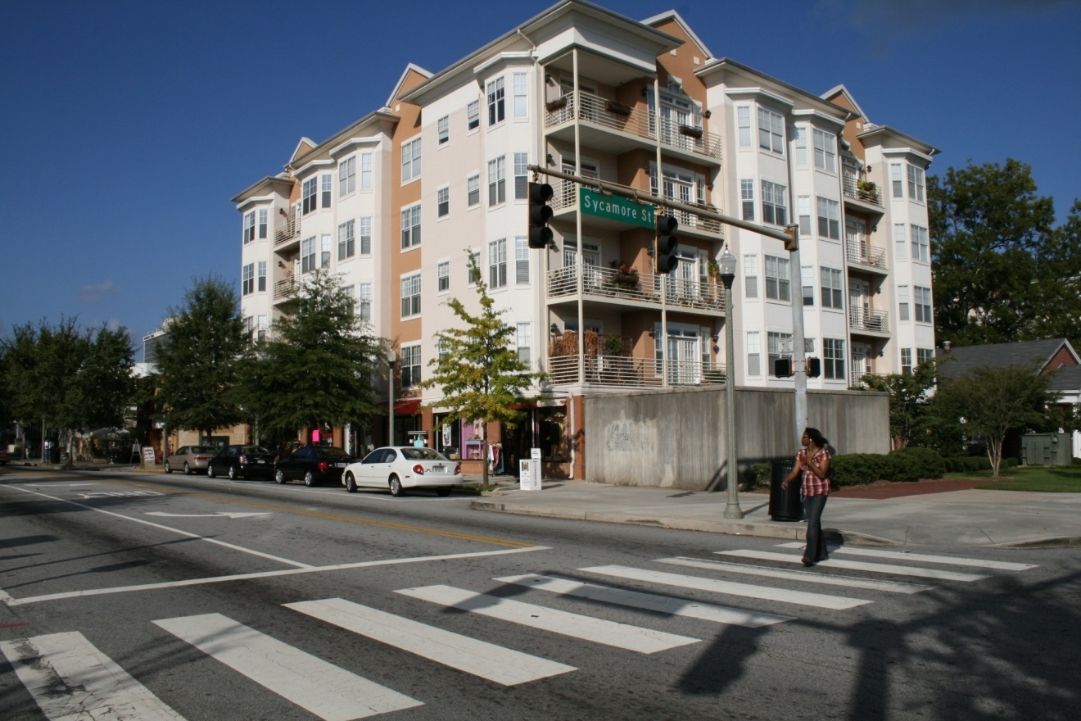
Church Street
Before
After

Slide 17
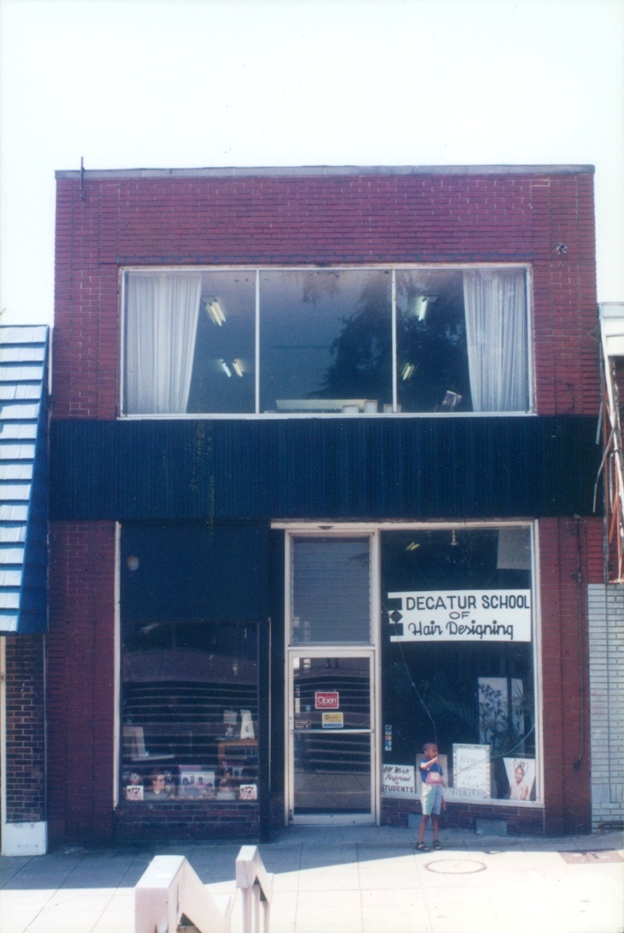
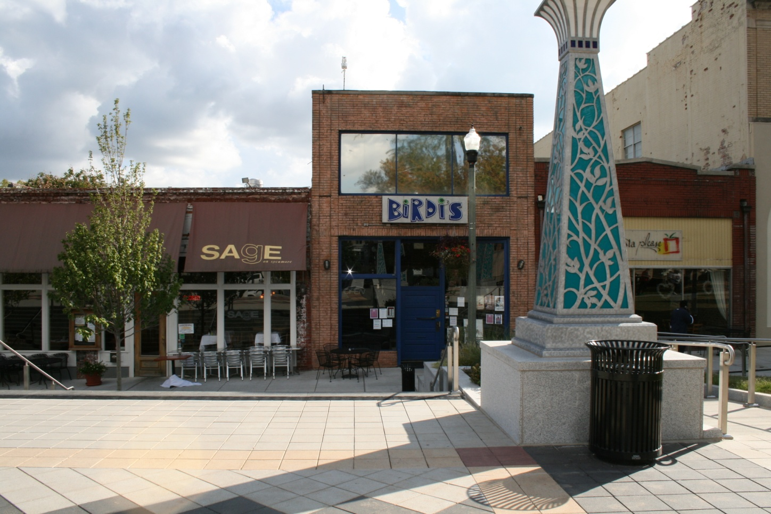
MARTA Plaza
Before
After
The completion of the Decatur MARTA Station Redevelopment Project in 2007 marked a major milestone in the history of Decatur’s long-term downtown redevelopment strategy.

Slide 18
People
In selecting teammates, choose people to get stranded with.
…the ultimate hedge against danger and uncertainty is who you have on the mountain with you.
Of all the luck we can get, people luck – the luck of finding the right mentor, partner, teammate, leader, friend – is one of the most important.

Slide 19
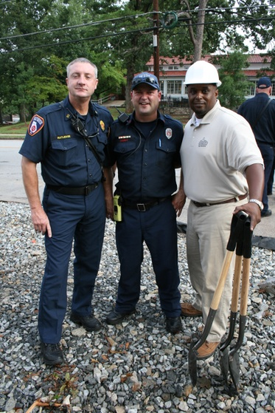
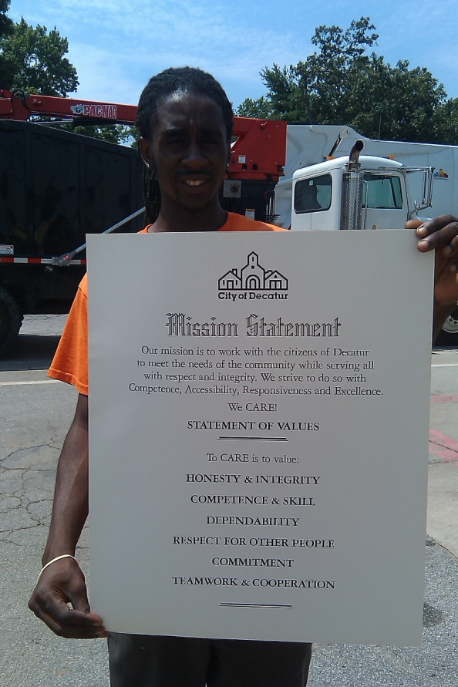
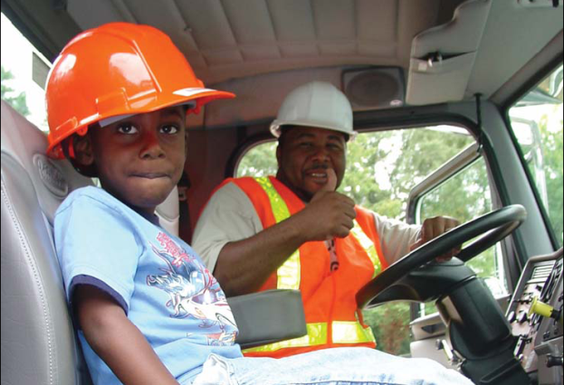
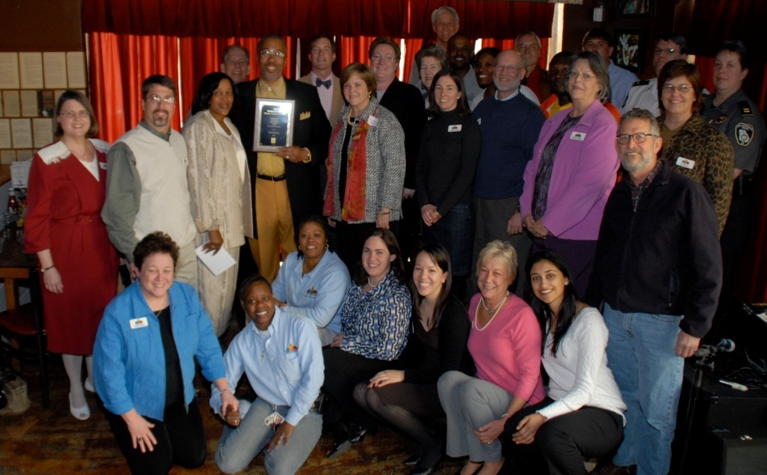
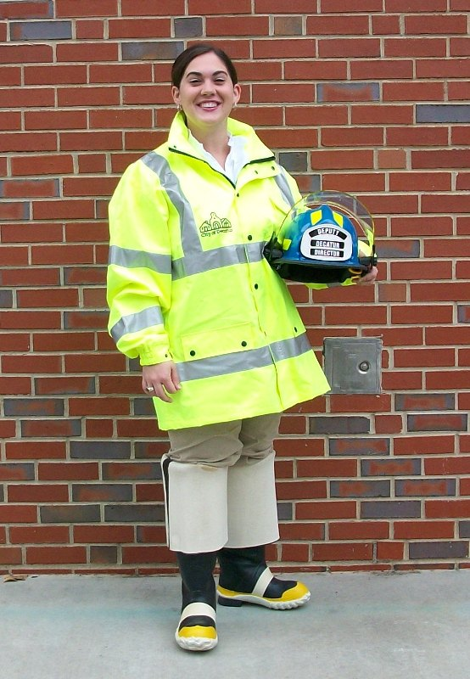
People

Slide 20
The End
Blessed are the flexible, for they shall not be bent out of shape. Anonymous
Contact me at:
Peggy.Merriss@decaturga.com; or 404-370-4102
Notes:
Other words for flexibility –
Adaptable
Adjustable
Modifiable
Malleable

