Slide 1
Drivers in Local Government
Ron Carlee, DPA, CM
Chief Operating Officer, ICMA
Adjunct Professor, Public Administration/Public Policy, GWU
August 2012

Slide 2
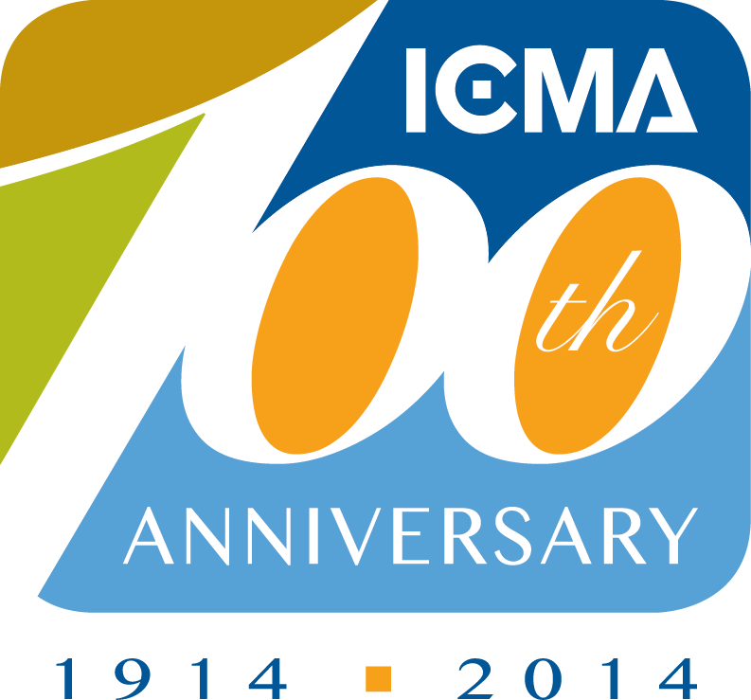
…creating excellence in local governance by supporting professional leaders to build sustainable communities that improve people’s lives worldwide…
Notes:
ICMA, the International City/County Management Association, develops and advances professional local government management to create sustainable communities that improve lives worldwide. ICMA provides member support; publications; data and information; peer and results-oriented assistance; and training and professional development to nearly 9,000 city, town, and county experts and other individuals and organizations throughout the world. The management decisions made by ICMA's members affect millions of individuals living in thousands of communities, from small villages and towns to large metropolitan areas.
Core Beliefs
ICMA members believe in:
Serving as stewards of representative democracy.
Practicing the highest standards of honesty and integrity in local governance, as expressed through ICMA’s Code of Ethics.
Advocating for professional management as an integral component of effective local governance and community building, with council-manager government as the preferred local government structure.
Building sustainable communities as a core responsibility of local government.
Networking and exchanging knowledge and skills across international boundaries.
Ensuring that local governments and the association reflect the diversity of the communities we serve.
Committing to lifelong learning and professional development.
Building up the quality of the profession and the association through an engaged network of members personally committed to that end.

Slide 3
INTRODUCTION
The following is a collection of data from a variety of internet based sources. In virtually every case, a primary source is used. The source is documented in the “Notes” section of the PowerPoint.
These data formed the basis of presentations by Dr. Carlee made to the local government professional associations in the states in George, New Work, and Texas in the first half of 2012.
The data selected are illustrative of external forces that are affecting local governments. This discussion of drivers of local government is a supplement to Dr. Carlee’s article in the ICMA’s Municipal Yearbook 2012, “The Politics of Apolitical Leadership: Professional Management in a Digital and Divided Society.”
Your comments and additions to the presentation are encouraged. Please contact Dr. Carlee at…
rcarlee@icma.org
@roncarlee

Slide 4
Drivers
Economy
Social/Political
Environment
Technology

Slide 5
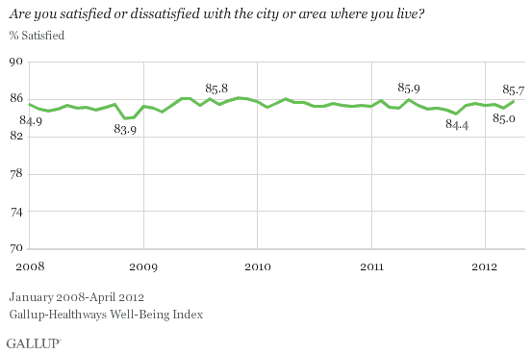
Notes:
http://www.gallup.com/poll/154892/Americans-City-Optimism-Reaches-Four-Year-High.aspx
May 25, 2012
Americans' City Optimism Reaches Four-Year High
Large majority remains satisfied with current local conditions
by Alyssa Brown
Americans expressed a high level of satisfaction with current conditions in their city, as has been the case since Gallup and Healthways started tracking this metric. The 85.7% who said they were satisfied with their city in April is on par with the highest readings on record and is higher than what was found throughout 2008 and early 2009.
Still, it is important note that the percentage of Americans satisfied with their city or area has stayed in a narrow range between 83.9% and 86.1% over the past four and a quarter years. Americans' satisfaction with where they live dropped to a low of 83.9% in November 2008 -- amid the financial crisis. The highest level of satisfaction on record came one year later in November 2009, at 86.1%.

Slide 6
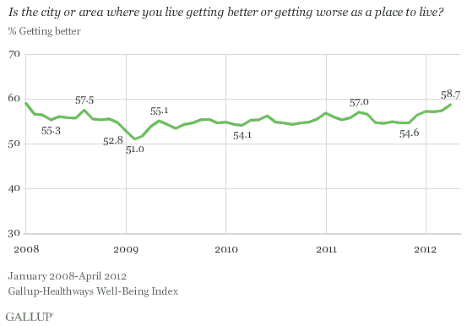
Notes:
May 25, 2012
Americans' City Optimism Reaches Four-Year High
Large majority remains satisfied with current local conditions
by Alyssa Brown
The Gallup-Healthways Well-Being Index tracks community satisfaction and optimism on a daily basis. These findings are based on approximately 30,000 interviews with American adults conducted each month from January 2008 through April 2012.
The percentage of Americans who said their city or area is getting better slowly declined leading up to the financial crisis in the first half of 2008, and fell to an all-time low of 51.0% in February 2009.
After reaching 57.0% in May 2011, Americans' optimism about their cities declined to the 54% range in the summer and fall of 2011. City optimism had dropped to an 11-month low at the same time that economic optimism hit a 26-month low in August 2011. Now optimism appears to be increasing again -- mirroring Americans' improving economic optimism and overall life evaluation ratings.

Slide 7
D1 Economy

Slide 8
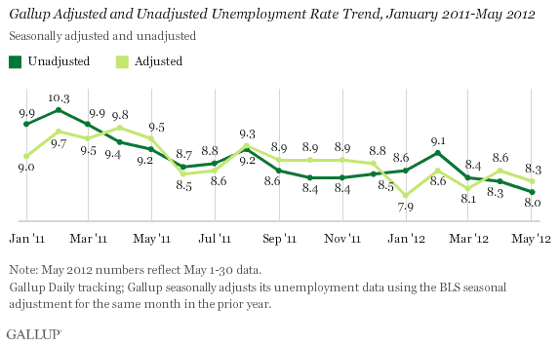
Notes:
May 31, 2012
U.S. Unemployment Drops in May, to a New Unadjusted Low
Underemployed are now more hopeful that they will find work in the next 30 days
by Jenny Marlar
WASHINGTON, D.C. -- U.S. unemployment, as measured by Gallup without seasonal adjustment, dropped to 8.0% in May, a new low since Gallup began measuring employment in 2010, and more than a full percentage-point decline from May 2011. Gallup's seasonally adjusted number for May is 8.3%, down from 8.6% in April. However, that remains higher than the seasonally adjusted low of 7.9% recorded in January 2012.
These results are based on Gallup Daily tracking interviews, conducted by landline and cell phone, with almost 30,000 Americans throughout the month. Gallup calculates a seasonally adjusted unemployment rate by applying the adjustment factor the government used for the same month in the previous year.

Slide 9
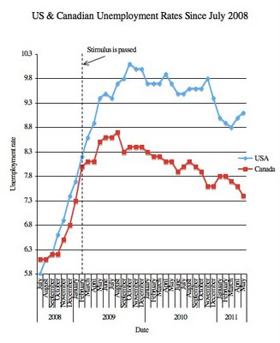
Notes:
http://johnrlott.blogspot.com/2011/06/comparing-canadian-and-us-unemployment.html

Slide 10
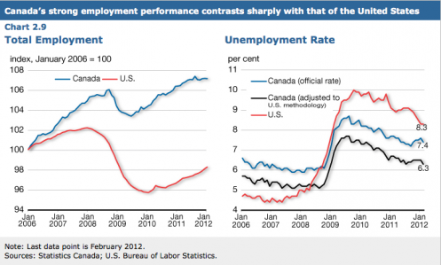
Notes:
http://milescorak.com/2012/05/04/the-gap-between-us-and-canadian-unemployment-rates-is-bigger-than-it-appears/
At 8.1% the unemployment rate in the United States is about one percentage point above the 7.2% currently reported for Canada, but this gap would be almost two percentage points if the Canadian rate was measured in the same way as the American.
This revealing picture from the recent Canadian federal government Budget paints a more accurate portrait by using unemployment rates defined in a similar way across the two countries.

Slide 11
State Budgets

Slide 12
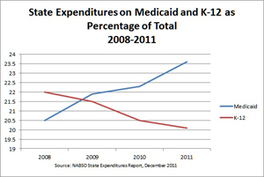
Notes:
http://www.nga.org/cms/home/special/col2-content/state-fiscal-information.html
NGA, 6/12/12
State Fiscal Information

Slide 13
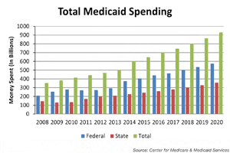
Notes:
http://www.nga.org/cms/home/special/col2-content/state-fiscal-information.html
NGA, 6/12/12
State Fiscal Information

Slide 14
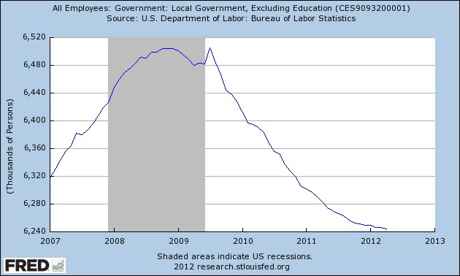
Notes:
The peak local government employees (seasonally adjusted) was 6.51 million in July 2009, down to 6.24 million in April 2012, a loss of 261,000 jobs (4.0%)
According to PolitiFact.com, local government has been the sector hardest hit, sustaining a loss of 443,000 workers (3%) from January 2009 to June 2011, a loss of 204,800 local education workers (2.5%); and a loss of 238,400 non-education workers (3.7%). This compares with an increase of more than 1 million workers in the private sector.10
10 Louis Jacobson, “Paul Krugman Says Government Jobs Have Fallen by Half Million since January 2009,” politifact.com/truth-o-meter/statements/2011/jul/11/ paul-krugman/paul-krugman-says-government-jobs- have-fallen-half/.

Slide 15
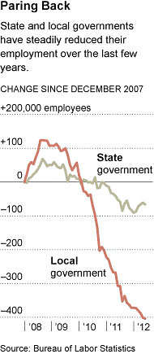
Notes:
http://www.nytimes.com/2012/06/20/business/public-workers-face-continued-layoffs-and-recovery-is-hurt.html?_r=1&hp
une 19, 2012
Public Workers Face New Rash of Layoffs, Hurting Recovery
By SHAILA DEWAN and MOTOKO RICH
Companies have been slowly adding workers for more than two years. But pink slips are still going out in a crucial area: government.
In California, the governor is threatening to eliminate 15,000 state jobs. When school begins in Cleveland this fall, more than 500 teachers probably will be out of work. And in Trenton — which has already cut a third of its police force, hundreds of school district employees and at least 150 other public workers — the only way the city will forestall the loss of 60 more firefighters is if a federal grant comes through.
Government payrolls grew in the early part of the recovery, largely because of federal stimulus measures. But since its postrecession peak in April 2009 (not counting temporary Census hiring), the public sector has shrunk by 706,000 jobs. The losses appeared to be tapering off earlier this year, but have accelerated for the last three months, creating the single biggest drag on the recovery in many areas.
With the economy expanding, albeit slowly, state tax revenues have started to recover and are estimated to exceed prerecession levels next year. Yet governors and legislatures are keeping a tight rein on spending, whether to refill depleted rainy-day funds or because of political inclination.
At the same time, costs for health care, social services, pensions and education are still rising. Fourteen states plan to resolve their budget gaps by reducing aid to local governments, according to a report by the National Governors Association and the National Association of State Budget Officers.
So while the federal government has grown a little since the recession, and many states have recently begun to add a few jobs, local governments are making new cuts that outweigh those gains. More than a quarter of municipal governments are planning layoffs this year, according to a survey by the Center for State and Local Government Excellence. They are being squeezed not only by declining federal and state support, but by their devastated property tax base.
“The unfortunate reality is our revenue streams have not rebounded,” said Timothy R. Hacker, the city manager of North Las Vegas, which has cut its work force to 1,300 from 2,300 and is about to lay off 130 more. “Shaking this recession is becoming increasingly difficult.”
Pennsylvania, for example, has shed 5,400 government jobs this year, and many school districts and social service agencies are contemplating more layoffs. “We have slipped to the middle of the pack in terms of job growth,” said Mark Price, a labor economist at the Pennsylvania Budget and Policy Center. “And that was driven mainly by the fact that we lost so many jobs in the public sector.”
Public workers became a point of contention in the presidential campaign recently when Mitt Romney, the presumptive Republican nominee, criticized President Obama for wanting to increase the number of government employees through stimulus measures. “He says we need more firemen, more policemen, more teachers,” Mr. Romney said, adding: “It’s time for us to cut back on government and help the American people.”
Mr. Obama has made the counterargument that during past recessions the government sector has grown, rather than shrunk. The White House later said he meant recessions and the recoveries that followed.
“Each time there was a recession with a Republican president,” he said, “we compensated by making sure that government didn’t see a drastic reduction in employment.”
If governments still employed the same percentage of the work force as they did in 2009, the unemployment rate would be a percentage point lower, according to an analysis by Moody’s Analytics. At the pace so far this year, layoffs will siphon off $15 billion in spending power. Yale economists have said that if state and local governments had followed the pattern of previous recessions, they would have added at least 1.4 million jobs.
Conservatives have argued that the government was bloated after a hiring surge during the housing boom and is now returning to a more appropriate size. Michael D. Tanner, a senior fellow at the Cato Institute, criticized the president’s budget proposal to give states an additional $30 billion for teachers, police officers and firefighters. “Those new public sector jobs must be paid for with more debt and taxes borne by the private sector,” he wrote.
But those with disappearing jobs say that the effects are not just economic — they mean longer response times to fires, larger class sizes, and in some cases lawsuits when short-staffed agencies are unable to provide the required services.
After 32 firefighters were laid off in Muncie, Ind., the area that could be reached within eight minutes was cut by half, said Mike Whited, the president of the firefighters union. A federal grant restored 25 workers, but the city does not know if it will be renewed.
Mr. Whited chafed at portrayals of public workers as overpaid or greedy, saying his union and others had made concessions, including paying more for their health insurance and forfeiting raises. “I think a lot of people don’t understand what we do,” he said. “They’re looking for somebody to blame, and I think they’re being led the wrong way.”
Businesses can also be hindered by government cuts. They not only lose prospective middle-class customers but may face long waits for services. Roland Pott, a real estate broker and developer in Trenton, said that fewer city inspectors adds to construction delays. And the shortage of police officers means he must assuage the safety concerns of prospective tenants. “It makes it harder to lease a space or market a space because people are choosing between Trenton or another area,” he said.
Even if the overall economy improves, local governments are likely to lag behind. Property tax receipts, which are projected to fall slightly in 2012, “will be weak through at least fiscal 2014,” wrote Daniel White, an economist at Moody’s Analytics, in a report this month. “As a result, local government fiscal conditions will remain under pressure.”
Jobs in education have accounted for more than half the losses in local governments. Teachers and other school employees continue to receive layoff notices in California, Colorado, Nevada and Ohio, among others. In Los Angeles, about 11,700 teachers and others were notified in the spring. On Saturday, the teachers union ratified an agreement to save more than 4,000 jobs by taking furlough days.
To close a $64 million budget gap, the district in Clark County, Nevada, which encompasses Las Vegas, sent layoff notices to 400 teachers this month and will not fill 600 openings.
In Cleveland, the school district cited a $66 million budget deficit when announcing the layoff of more than 500 teachers this spring. David Quolke, president of the Cleveland Teachers Union, said it followed two years of cutbacks and $25 million in concessions from the union. He said that some classes would have more than 40 children.
Kimili Gulley, 32, has been teaching middle and high school math for nine years and expected her tenure to provide protection. But this month, she too is out of work. “So much emphasis is put on educating kids,” she said, “and yet funding is getting cut when it comes to educating kids. So it’s kind of hypocritical.”
This article has been revised to reflect the following correction:
Correction: June 20, 2012
An earlier version of this article misstated the number of government jobs lost since the postrecession peak in April 2009 as 657,000, rather than 706,000.

Slide 16
Notes:
The NCS™ resident opinions hold up to ground truthing
Thomas I Miller, Ph.D., President and CEO, and Shannon E Hayden, MS, Senior Director of Special Projects, National Research Center, Inc
Perspectives, Vol 10, no. 1, Spring 2012
*The NCS line is the average of the sum of the “very positive” and “positive” responses of residents to the question: “What impact, if any, do you think the economy will have on your family income in the next 6 months?” Each data point represents the average of the three prior quarters. The number of respondents to the survey question averaged around 4,000 each quarter. The correlation (r) is -.88.

Slide 17
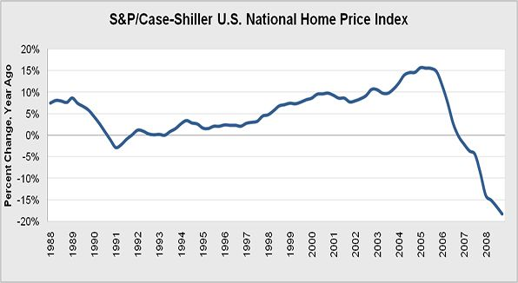

Slide 18
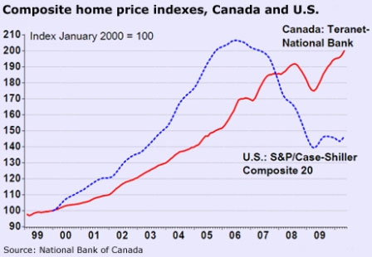
Notes:
Canada’s housing market remains an outperformer among developed nations, but conditions here too have cooled. Adjusted for inflation, the national average house price fell 2% y/y in Q1. Price trends are relatively steady in the majority of local markets, though a few, notably Toronto, continue to report strong appreciation.
Despite historically low borrowing costs, demand has been tempered by moderate income growth and tighter mortgage insurance rules. Meanwhile, supply conditions are becoming better balanced in most parts of the country. We anticipate fairly flat sales and average prices over the latter half of the year. http://www.gbm.scotiabank.com/English/bns_econ/retrends.pdf
Canada’s housing market frothy, but not a bubble
Tighter regulation, healthier banking sector insulate housing market
August 20, 2012|Ronald D. Orol, MarketWatch
TORONTO (MarketWatch) — Canada’s pricey housing market is frothing — driven by debt-ridden borrowers — but a dangerous U.S.-style housing crisis isn't in the cards, experts say.
“We don’t expect the base Canadian housing market to experience the trauma of the U.S. market,” said Robert Hogue, senior economist at Royal Bank of Canada (US:RY) in Toronto.
Regulatory observers said they agree that a series of actions taken by the Canadian government starting in 2008 and culminating in a June 2012 package of reforms to limit access to credit for borrowers is having its intended effect of cooling the frothy Canadian housing market.
Responding to the financial crisis of 2008, the Canadian government set a minimum down payment of 5% for government-backed mortgages. It also began a gradual reduction in the maximum amount of time borrowers could take to pay down their mortgages. The limit was set at 35 years in 2008 and was last cut in June to 25 years. The moves were imposed to tighten up underwriting standards that had been loosened between 2004 and 2008.
The steps were necessary, observers say, in the face of rising home prices — Canadian house prices have roughly doubled in the past decade, according to credit rater Standard & Poor’s — that forced borrowers to take on high debt to buy a house.
“There are signs that the market has been slowing. The measures [to tighten mortgage underwriting standards] by public authorities are preventative as well as reactive and cautionary, and they are having an effect,” said Sheryl Kennedy, CEO of Promontory Canada and deputy governor at the Bank of Canada from 1994 to 2008.
Kennedy argued that the regulatory actions taken over the past four years to tighten mortgage insurance and underwriting standards along with public pronouncements by the Bank of Canada and Ministry of Finance to ensure that Canadians understand they should be working to cut debt levels, have contributed to the cooling of the housing market.
Tom Lewandowski, a Canadian bank analyst with Edward Jones in St. Louis, said the Canadian housing market could experience some form of slowdown, with more delinquent borrowers and a small hike in foreclosures, but nothing akin to the millions of foreclosures experienced in the U.S.
“There isn’t a U.S.-style bubble to be burst,” said Lewandowski. “Given the structure of the Canadian mortgage market, I don’t think you are going to see a similar amount of foreclosures [as in the U.S.].”
In fact, statistics show that Canada’s housing market continues to cool. The number of homes newly listed for sale dropped 3.3% in July, from June, according to an RBC report earlier this month.
http://articles.marketwatch.com/2012-08-20/economy/33281500_1_canadian-real-estate-association-home-prices-mortgage-insurance

Slide 19
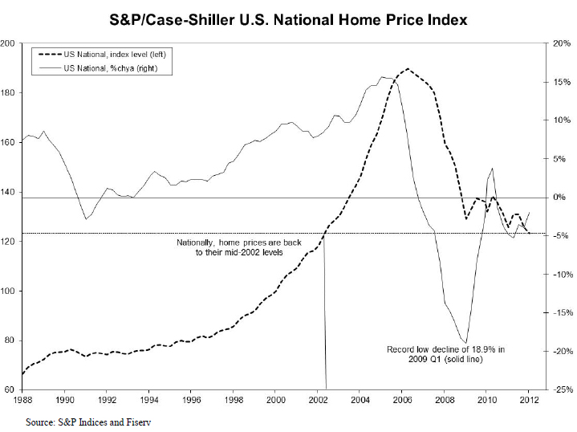
Notes:
http://www.worldpropertychannel.com/north-america-residential-news/median-home-prices-spcase-shiller-home-price-indices-case-shiller-home-price-index-national-home-prices-distressed-home-sales-current-home-prices-david-blitzer-cities-with-home-price-declines-5693.php

Slide 20
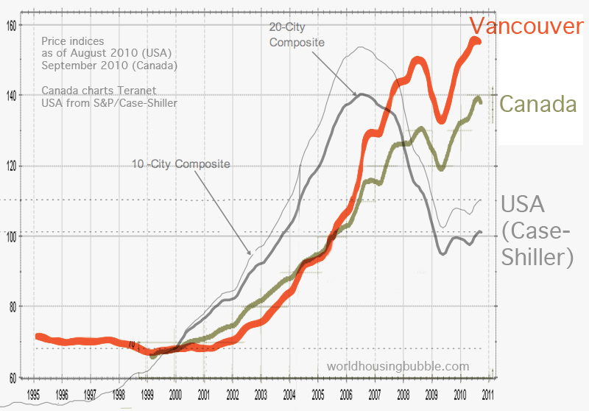

Slide 21
Negative Equity Falls in Q2; Half of Borrowers Under 40 Underwater
Negative equity rate for U.S. homeowners with a mortgage declined to 30.9% from 31.4% in the first quarter 2012.
15.3 million homes are underwater, totaling $1.15 trillion in negative equity in the second quarter, down from 15.7 million homes and $1.19 trillion in negative equity in the first quarter.
Negative equity disproportionately affects borrowers under age 40; nearly half (48%) of homeowners with mortgages under the age of 40 are underwater.
Home values increased 0.5 percent to $151,600 from June to July 2012
Notes:
http://www.zillow.com/blog/2012-08-22/negative-equity-falls-in-q2-half-of-borrowers-under-40-underwater/
Zillow Research, August 22, 2012. Alison Raoli
http://www.zillow.com/blog/research/2012/08/20/u-s-home-values-climb-for-eighth-consecutive-month-over-60-of-metros-show-increasing-values/
Zillow Research, August 20, 2012. Stan Humphries

Slide 22
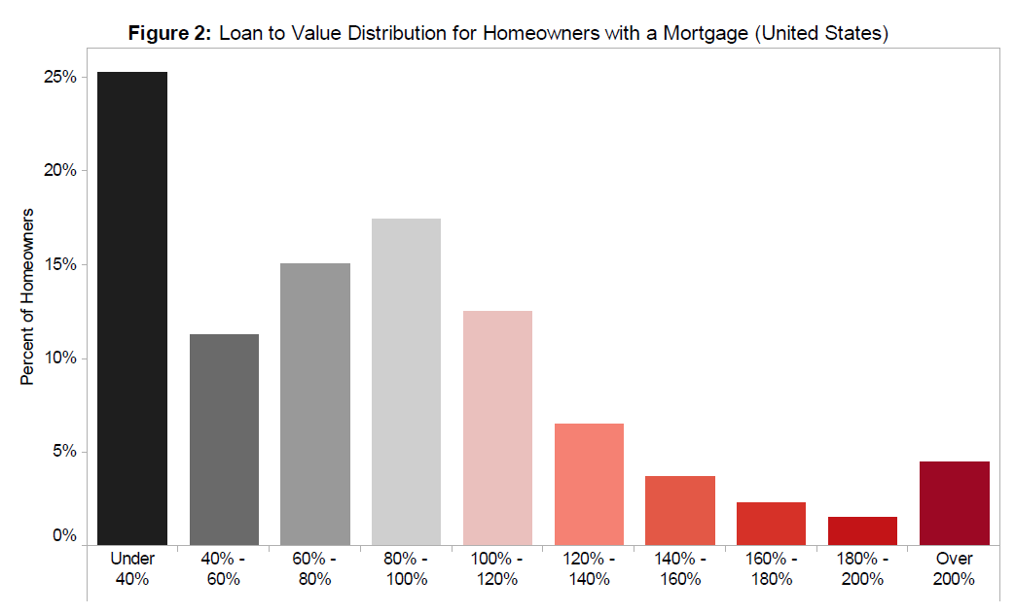
Notes:
http://www.zillow.com/blog/research/2012/08/22/negative-equity-declines-slightly-on-the-back-of-modest-home-value-gains/

Slide 23
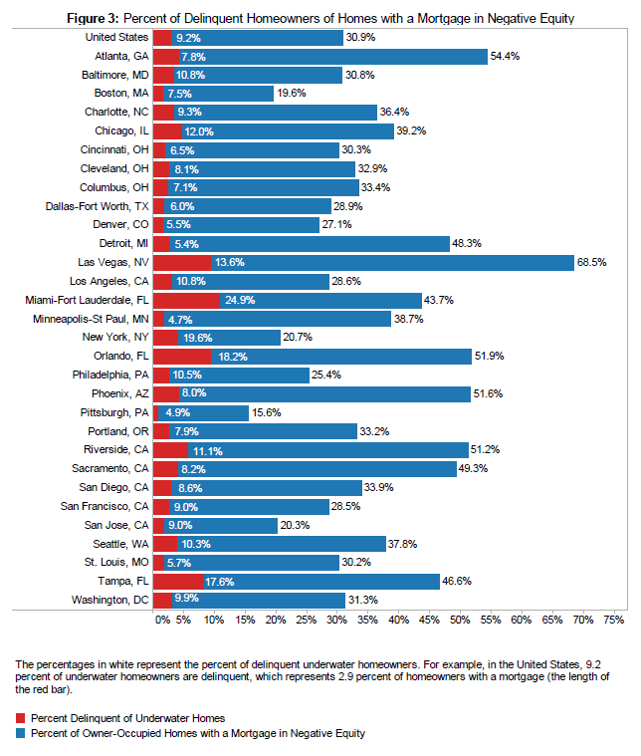
Notes:
http://www.zillow.com/blog/research/2012/08/22/negative-equity-declines-slightly-on-the-back-of-modest-home-value-gains/

Slide 24
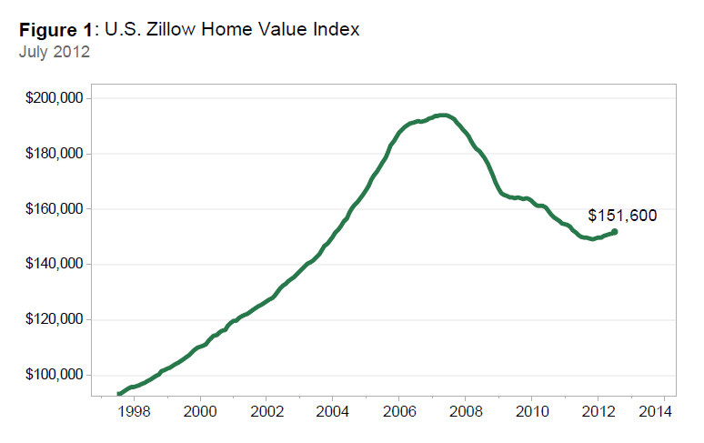
Notes:
http://www.zillow.com/blog/research/files/2012/08/figure1.png

Slide 25
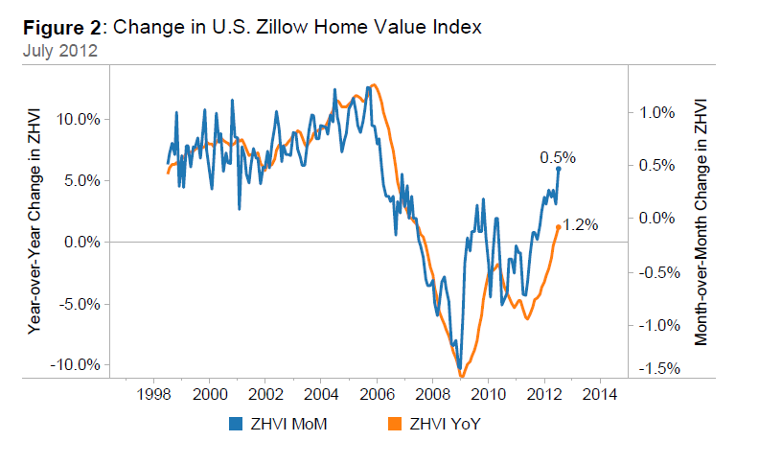
Notes:
http://www.zillow.com/blog/research/files/2012/08/figure1.png

Slide 26
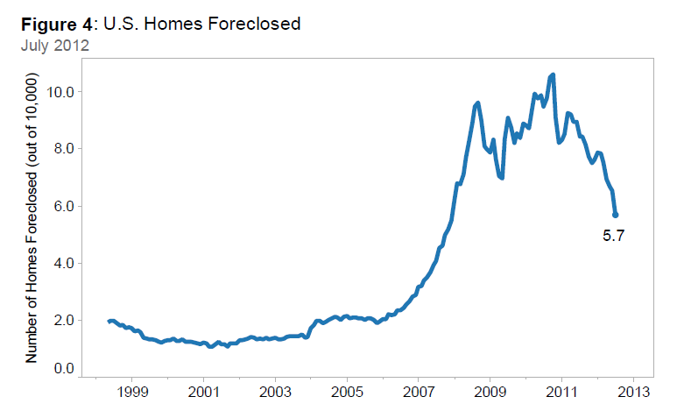
Notes:
http://www.zillow.com/blog/research/files/2012/08/figure1.png

Slide 27
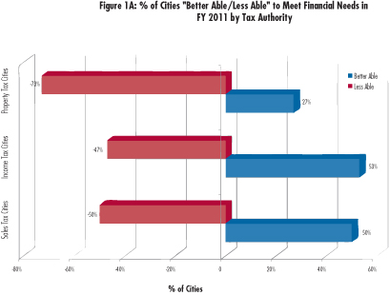
Notes:
Christopher W. Hoene & Michael A. Pagano, Sept 2011 NLC
Finance officers in cities that rely more upon property taxes (73%) – the most common local tax source – are more likely to say that their cities are less able to meet fiscal needs in 2011 than those in cities reliant upon sales taxes (50%) or income taxes (47%).

Slide 28
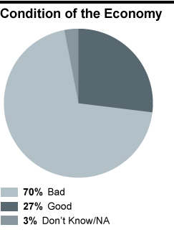
Notes:
http://www.cbsnews.com/8300-503544_162-503544.html?categoryId=10329&tag=cnav
Poll: Economic outlook dim, but improving
By Stephanie Condon
April 18, 2012
Americans are still largely down on the economy but have become slightly more optimistic, according to the latest CBS News/ New York Times poll.
As many as seven in 10 Americans say the economy is in bad shape, according to the poll, conducted April 13-17. Another 27 percent think the economy is at in at least somewhat good shape - a low figure, but the best it's been since 2008.

Slide 29
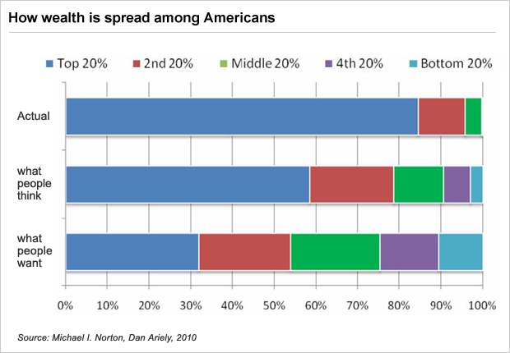
Notes:
http://www.cbsnews.com/8301-503544_162-20102289-503544.html?tag=mncol;lst;3
September 7, 2011 5:00 AM
Left behind in America: Who's to blame for the wealth divide?
By Brian Montopoli
In the study, Americans were asked how they thought wealth was actually distributed; they estimated that the top 20 percent controlled about 59 percent of the nation's wealth, while the bottom controlled about three percent.
That wasn't even close: In reality, the top 20 percent controlled about 84 percent of the wealth, while the bottom quintile controlled just 0.1 percent. The combined net worth of the bottom 40 percent, in fact, accounted for just 0.3 percent of the nation's wealth.
One indicator of where you fall on the spectrum is race: White households, on average, had a median wealth of $113,149 in 2009 - 20 times the median wealth of black households ($5,677) and 18 times that of Hispanic households ($6,325). That's the largest gap between whites and minorities since the census started tracking such data in 1984.

Slide 30
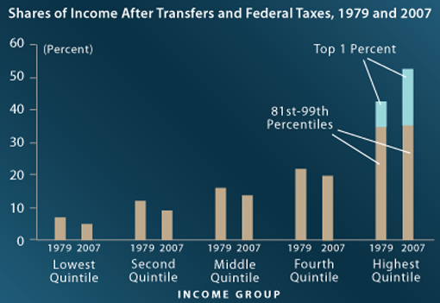
Notes:
http://www.cbo.gov/publication/42729
CBO, October 2011
The share of income going to higher-income households rose, while the share going to lower-income households fell.
The top fifth of the population saw a 10-percentage-point increase in their share of after-tax income.
Most of that growth went to the top 1 percent of the population.
All other groups saw their shares decline by 2 to 3 percentage points.
CBO finds that, between 1979 and 2007, income grew by:
275 percent for the top 1 percent of households,
65 percent for the next 19 percent,
Just under 40 percent for the next 60 percent, and
18 percent for the bottom 20 percent.

Slide 31
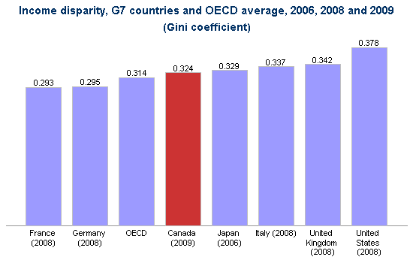
Notes:
http://www4.hrsdc.gc.ca/.3ndic.1t.4r@-eng.jsp?iid=22

Slide 32
Notes:
http://www.huffingtonpost.ca/2012/05/27/income-inequality-infographic_n_1548973.html
This feature was produced by Jeff Fraser, a student in Ryerson University's School of Journalism, in partnership with The Huffington Post Canada.
Statistics suggest that income inequality is growing rapidly in Canada -- twice as fast as in the United States. Here's an infographic to help you understand how large the problem is.

Slide 33
Key Messages
Income inequality in Canada has increased over the past 20 years.
The richest group of Canadians increased its share of total national income between 1993 and 2008, while the poorest group lost share. Middle-income Canadians also lost share.
Although the gap between the rich and poor widened, Canadians in the poorest income group still saw their income levels rise, albeit minimally.
Notes:
http://www.conferenceboard.ca/hcp/hot-topics/caninequality.aspx
Key Messages
Income inequality in Canada has increased over the past 20 years.
The richest group of Canadians increased its share of total national income between 1993 and 2008, while the poorest group lost share. Middle-income Canadians also lost share.
Although the gap between the rich and poor widened, Canadians in the poorest income group still saw their income levels rise, albeit minimally.

Slide 34
http://www.huffingtonpost.ca/2012/06/25/income-inequality-statscan-cuts_n_1625345.html#slide=943075

Slide 35
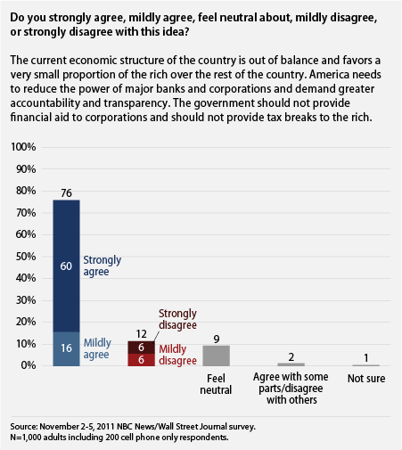
Notes:
http://www.americanprogress.org/issues/2012/01/snapshot011712.html
Public Opinion Snapshot: Yes, the Rich Are Different. They Have Too Much Power
By Ruy Teixeira |January 17, 2012

Slide 36
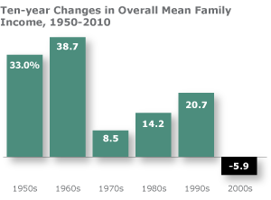
Notes:
http://www.pewsocialtrends.org/2012/08/22/the-lost-decade-of-the-middle-class/
Pew Center
Released: August 22, 2012
The Lost Decade of the Middle Class
Fewer, Poorer, Gloomier
As the 2012 presidential candidates prepare their closing arguments to America’s middle class, they are courting a group that has endured a lost decade for economic well-being. Since 2000, the middle class has shrunk in size, fallen backward in income and wealth, and shed some—but by no means all—of its characteristic faith in the future.
These stark assessments are based on findings from a new nationally representative Pew Research Center survey that includes 1,287 adults who describe themselves as middle class, supplemented by the Center’s analysis of data from the U.S. Census Bureau and Federal Reserve Board of Governors.
Fully 85% of self-described middle-class adults say it is more difficult now than it was a decade ago for middle-class people to maintain their standard of living. Of those who feel this way, 62% say “a lot” of the blame lies with Congress, while 54% say the same about banks and financial institutions, 47% about large corporations, 44% about the Bush administration, 39% about foreign competition and 34% about the Obama administration. Just 8% blame the middle class itself a lot.
Their downbeat take on their economic situation comes at the end of a decade in which, for the first time since the end of World War II, mean family incomes declined for Americans in all income tiers. But the middle-income tier—defined in this Pew Research analysis as all adults whose annual household income is two-thirds to double the national
median 1 —is the only one that also shrunk in size, a trend that has continued over the past four decades.

Slide 37
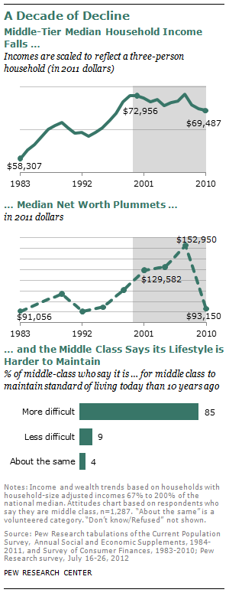
Notes:
http://www.pewsocialtrends.org/2012/08/22/the-lost-decade-of-the-middle-class/
Pew Center
Released: August 22, 2012
The Lost Decade of the Middle Class

Slide 38
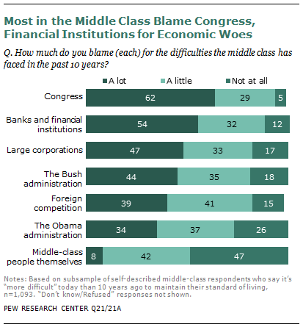
Notes:
http://www.pewsocialtrends.org/2012/08/22/the-lost-decade-of-the-middle-class/
Pew Center, Released: August 22, 2012. The Lost Decade of the Middle Class
Income Tiers: Analysis based on census data refers to lower-, middle- and upper-income groups, or tiers. Using income as the criterion, the middle tier is defined as those living in households with an annual income that is two-thirds to double (67% to 200%) the national median; the upper tier is made up of those in households above the 200% threshold, and the lower tier is made up of those below the 67% threshold. The assignment of a household to a tier depends on what its income expressed in 2011 dollars is estimated to be after it is scaled to a three-person household (see Appendix 2 for details on the adjustment process).
In addition to looking at a “statistical middle” derived from government data, this report looks at those who self-identify as middle class, based on a Pew Research Center national survey of 2,508 adults. In the survey, 49% of adults describe themselves as middle class; 53% said the same in a similar survey in early 2008, when what is now known as the Great Recession was gathering steam.

Slide 39
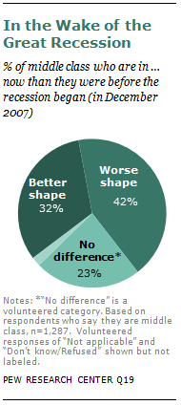
Notes:
http://www.pewsocialtrends.org/2012/08/22/the-lost-decade-of-the-middle-class/
Pew Center
Released: August 22, 2012
The Lost Decade of the Middle Class

Slide 40
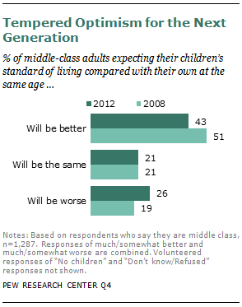
Notes:
http://www.pewsocialtrends.org/2012/08/22/the-lost-decade-of-the-middle-class/
Pew Center
Released: August 22, 2012
The Lost Decade of the Middle Class

Slide 41
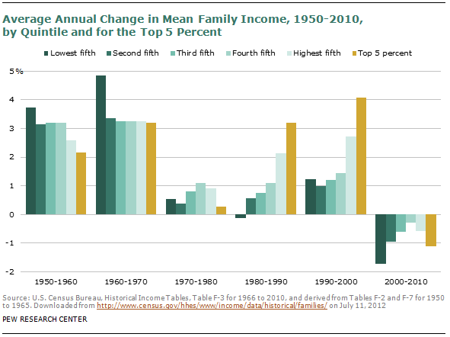
Notes:
http://www.pewsocialtrends.org/2012/08/22/the-lost-decade-of-the-middle-class/
Pew Center
Released: August 22, 2012
The Lost Decade of the Middle Class

Slide 42
D2 Social/Political

Slide 43
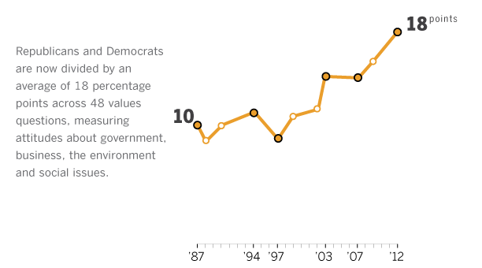
Notes:
http://www.people-press.org/2012/06/04/partisan-polarization-surges-in-bush-obama-years/
Released: June 4, 2012
Partisan Polarization Surges in Bush, Obama Years
Trends in American Values: 1987-2012
Americans’ values and basic beliefs are more polarized along partisan lines than at any point in the past 25 years. Party has now become the single largest fissure in American society, with the values gap between Republicans and Democrats greater than gender, age, race or class divides. The parties also have become smaller and more ideologically homogeneous over this period. Republicans are dominated by conservatives, while a smaller but growing number of Democrats are liberals.
The survey finds that neither party is solely responsible for the growing partisan gap. In different ways, both Democratic and Republican values have become more partisan over the past 25 years — and polarization extends to independents as well.

Slide 44
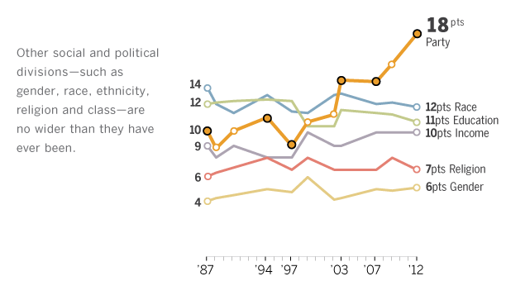

Slide 45
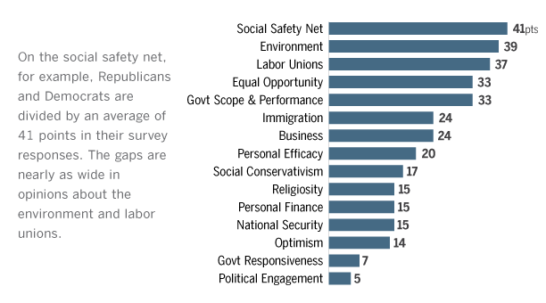

Slide 46
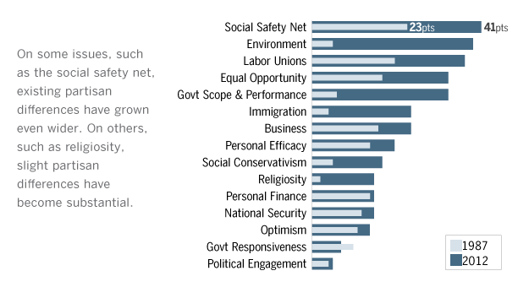

Slide 47
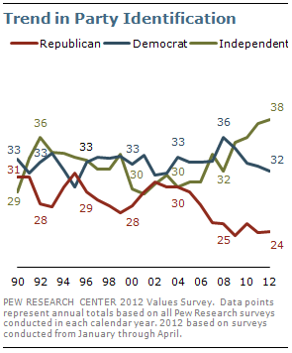

Slide 48
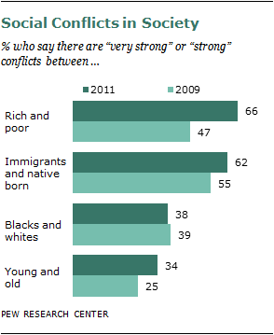
Notes:
http://www.pewsocialtrends.org/2012/01/11/rising-share-of-americans-see-conflict-between-rich-and-poor/
Rising Share of Americans See Conflict Between Rich and Poor
by Rich Morin
January 11, 2012

Slide 49
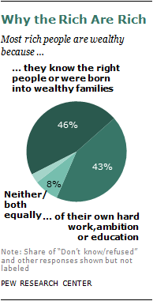
Notes:
http://www.pewsocialtrends.org/2012/01/11/rising-share-of-americans-see-conflict-between-rich-and-poor/
Rising Share of Americans See Conflict Between Rich and Poor
by Rich Morin
January 11, 2012

Slide 50
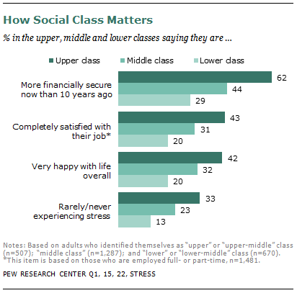
Notes:
Pew Research Center
http://www.pewsocialtrends.org/2012/08/27/yes-the-rich-are-different/
Released: August 27, 2012
Yes, the Rich Are Different
by Kim Parker

Slide 51
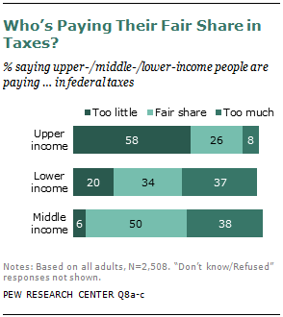
Notes:
Pew Research Center
http://www.pewsocialtrends.org/2012/08/27/yes-the-rich-are-different/
Released: August 27, 2012
Yes, the Rich Are Different
by Kim Parker

Slide 52
June 2012
45% say they are better off than at the beginning of 2009;
36% say they are worse off.
In March, poll respondents split almost evenly on that question…Bloomberg National Poll
Notes:
Americans Say They’re Better Off Since Obama Took Office
By David J. Lynch - Jun 20, 2012 4:00 AM ET
A plurality of Americans now say they are better off than they were when President Barack Obama was inaugurated, providing a surprising lift to Obama’s re- election campaign despite troublesome economic news.
Forty-five percent of those surveyed in a Bloomberg National Poll say they are better off than at the beginning of 2009 compared with 36 percent who say they are worse off. In March, poll respondents split almost evenly on that question after having been decidedly negative since the aftermath of the worst recession in seven decades.
“I’m just tired of the doom and gloom,” says Jim Seeley, 52, a mortgage banker in Traverse City, Michigan, and a poll respondent, in a follow-up interview. “I think it’s looking better. People just need to stay positive.”
The poll, conducted June 15-18, contains more unlikely cheer for the president, with larger numbers of respondents saying their household income is higher than a year ago. While 44 percent say they are treading water, the better off outnumbered the worse off by 28 percent to 22 percent.
The share saying they are making substantial purchases they had been delaying, dining out more often, or taking deferred vacations all rose compared with March 2011. Seeley and his wife are among them. Earlier this year, the couple went on a seven- day cruise in the Gulf of Mexico, joining 27 percent of respondents who say they are taking postponed trips compared with 20 percent in March 2011.
Clash With Data
The poll of 1,002 U.S. adults was conducted for Bloomberg News by Selzer & Co. of Des Moines, Iowa. The results have a margin of error of plus or minus 3.1 percentage points.
The poll’s findings of respondents’ brightening assessments of how they’re doing are at odds with recent data. The latest figures on industrial production, consumer confidence, initial jobless claims and retail sales all showed a weakening economy. Since the last Bloomberg National Poll in March, the Standard and Poor’s 500 Index is down about 1 percent.
About the only recent positive news for consumers has been a steady two-month decline in gasoline prices. Since peaking at $3.94 a gallon on April 5, regular unleaded gasoline has fallen to $3.50, according to AAA.
“Even as the market signals continuing softness in the economy, gloom at the personal level seems to have bottomed out,” says J. Ann Selzer, who directs the Bloomberg poll.
Wall Street Banks
There are hints of unease in the findings: 32 percent of Americans say they’re hopeful about improvement in the economy, down from 37 percent in March. And 19 percent say they’re fearful, compared with 17 percent three months ago.
Major Wall Street banks last week underscored the economy’s subpar outlook. Goldman Sachs Group Inc. (GS) cut its second-quarter tracking estimate for growth to 1.6 percent from 1.8 percent. Morgan Stanley (MS) sliced its 2012 estimate to 2 percent from 2.3 percent and said the economy likely would slow further in 2013.
Even with the run of bad reports, Americans say they prefer Obama’s economic vision to that of his presumptive Republican rival, former Massachusetts Governor Mitt Romney, by a margin of 49 percent to 33 percent. That finding reflects a 7-percentage- point gain for Obama since March and an equal loss for his opponent, identified then as “Republicans” and in this survey as Romney.
“You don’t just trust the private sector to do the right thing,” says Chris Howell, 23, who works at a nonprofit organization in West Chester, Pennsylvania. Obama’s policies are better suited to providing “long-term solutions” for the economy’s problems, he added.
‘Hatchet Job’
Obama gets poor marks from some respondents for his handling of the nation’s economic situation.
“He’s done a hatchet job on the economy,” says Larry Wilson, 49, a production supervisor at a corrugated box maker in Lancaster, Pennsylvania.
Wilson complains that prices are outstripping his salary and that the president is stifling business with excessive regulation. He’s anticipating a Romney presidency that will repair the damage.
“I expect him to do something similar to what Reagan did: exude some confidence in the American people, not government,” Wilson says.
The public also has flip-flopped on its view of the appropriate government role in the economy since the March 2011 Bloomberg poll.
New Focus
Fifteen months ago, as congressional Republicans pressed the White House to agree to deep budget cuts, a majority of poll respondents echoed the party’s argument that government should focus on deficit-cutting. Now that the presidential choice has narrowed to Obama or Romney, Americans by a margin of 51 percent to 43 percent are endorsing the administration’s call to invest in infrastructure and alternative energy projects to boost hiring.
“I’m a Keynesian,” says Dale Phillips, 60, a management consultant in Houston. “Government does play a role.”
Phillips is among those counting themselves better off. His six-figure salary has risen about 15 percent since the recession’s depths in early 2009.
The improving public mood remains precarious and, in some cases, should be characterized as less awful rather than better. A plurality of poll respondents still expect American children to have a lower standard of living than their parents do. Yet the 45 percent to 28 percent margin is narrower than a year ago, when 55 percent expected the next generation’s living standards to drop compared with only 23 percent who retained their faith in the American Dream.
Home Prices
And amid indications that the decline in housing prices may be at or near an end, 14 percent of respondents say the market value of their home increased in the past year compared with 33 percent who say it declined. The last time that question was asked, in December 2009, only 8 percent said their home’s value had increased.
Americans also split about evenly over changes in their overall sense of financial security in the past year, with the largest share, 47 percent, reporting no change.
“I’m hopeful for improvement, but I temper that with pragmatism,” says Catherine Lahey, 28, a sports marketing executive in DeLand, Florida.
After 40 consecutive months of a jobless rate higher than 8 percent, Americans in general, too, are slowly growing less anxious about employment. Those reporting improved job security for people in their household rose to 19 percent, still less than the 22 percent saying their hold on employment is shakier.
That divide reflected an improvement from December 2009, when those who said their job security was worsening outweighed those feeling more secure 28 percent to 7 percent.
“I started working full time and making more money,” says Nathan Blubaugh, 25, a mental health counselor in Media, Pennsylvania. “Things are getting better. They’re not getting better quickly, but they’re getting better.”
To contact the reporter on this story: David J. Lynch in Washington at dlynch27@bloomberg.net
To contact the editor responsible for this story: Jeanne Cummings at jcummings21@bloomberg.net

Slide 53
D3 Environment

Slide 54
“S************y
“Some of today's’ critics present sustainability as a dangerous philosophy that promotes a not-too-distant future in which freedom, library and the timeless aspirations of leave a better life for our kids are trampled buy a new world order outlines in a United Nations document know as agenda 21.”
Tad McGalliard, PM, June 2012
Notes:
Adapted from Andrew P. McCoy
Virginia Tech
Source document EPA 2009 Buildings and Their Environment

Slide 55
Prepared, Resilient, Enduring: Sustainable
Major Disasters
1953 - 2011
Notes:
http://www.fema.gov/news/disaster_totals_annual.fema
99 major declarations in 2011 – highest on record.

Slide 56
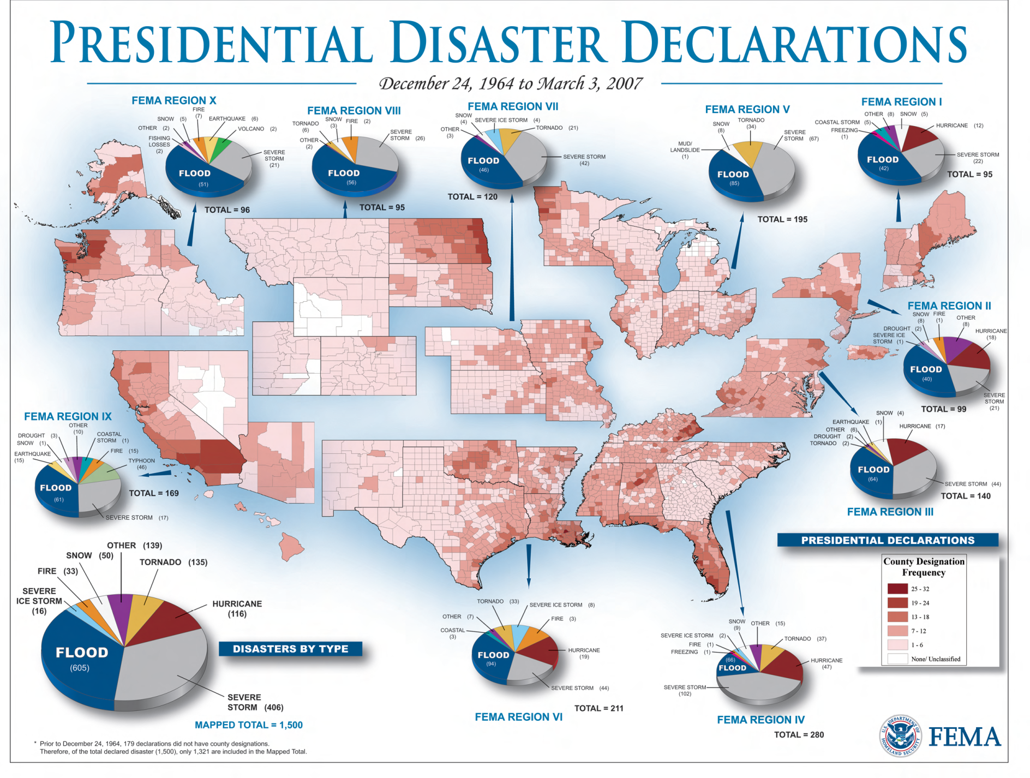

Slide 57
D4 Technology

Slide 58
Notes:
Rose & Grace Camden, iconic representatives of a future generation.

Slide 59
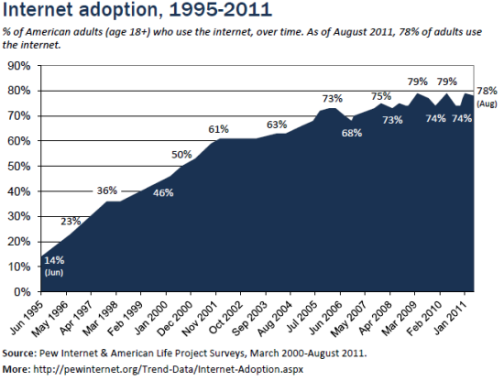
Notes:
internet-adoption-digital-online-broadband-mobile
Digital Differences
For Some Groups Digital Disparities Still Remain
April 13, 2012
One-in-five adults do not use the internet. The difference between that group and the majority of Americans who do go online remains strongly correlated with age, education, and household income, which are the strongest positive predictors of internet use. Certain aspects of the current internet population still strongly resemble the state of internet adoption in 2000, when one of Pew Internet's first reports found that minorities, adults living in households with lower incomes, and seniors were less likely than others to be online. Yet while gaps in internet adoption persist, some have narrowed in the past decade. The internet access gap closest to disappearing is that between whites and minorities. Differences in access persist, especially in terms of adults who have high-speed broadband at home, but they have become significantly less prominent over the years. Almost half of adults don't use the internet because they don't think the it is relevant to them -- often saying they don't want to use the internet and don't need to use it to get the information they want or conduct the communication they want.

Slide 60
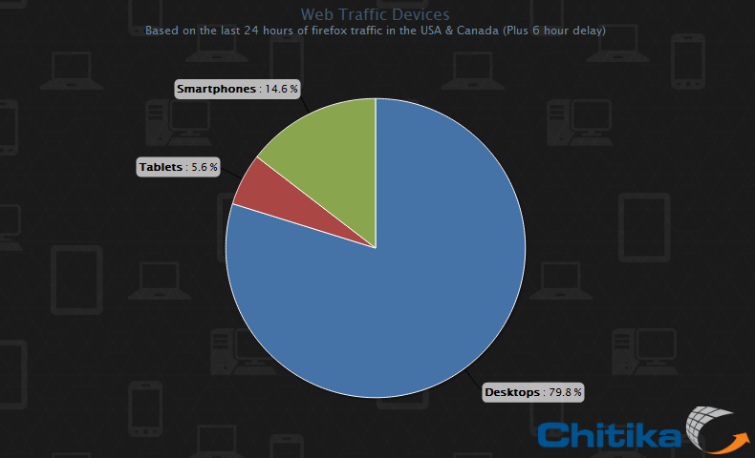
Notes:
http://allthingsd.com/20120525/mobile-devices-now-make-up-about-20-percent-of-u-s-web-traffic/
Mobile
Mobile Devices Now Make Up About 20 Percent of U.S. Web Traffic
Published on May 25, 2012 by Ina Fried
Mobile Web browsing continues to take off, with smartphones and tablets accounting for 20 percent of Web traffic in the U.S. and Canada, according to a new report.
The analysis, from online advertising network Chitika, finds that those stodgy old PCs still produce just under 80 percent of Web traffic, with smartphones accounting for 14.6 percent and tablets making up 5.6 percent.
Other findings of note, Windows Phone now accounts for a third as much traffic as BlackBerry devices. Undoubtedly its market share is far less than that, but its more powerful browser and larger screen likely make it more conducive to Web surfing.
Also, as it has seen in the past, Chitika said that tablet and mobile phone Internet usage peak in the evening hours. That’s when people leave their computers for a bit and pretend to have a real life, while nonetheless staring at their phones or sitting on the couch watching TV and simultaneously pawing an iPad.
Speaking of iPads, Chitika says that 95 percent of tablet Web traffic comes from an Apple device, compared to phones, where Apple’s share is 72 percent, compared to 26 percent for Android devices.
On the desktop, Chitika says that just over 85 percent of Web traffic comes from Windows machines, compared with slightly more than 13 percent stemming from Macs.
Return to: Mobile Devices Now Make Up About 20 Percent of U.S. Web Traffic
URL: http://allthingsd.com/20120525/mobile-devices-now-make-up-about-20-percent-of-u-s-web-traffic/
Brought to you by The Wall Street Journal | © 2005-2012 Dow Jones & Company, Inc. All Rights Reserved.

Slide 61
88% cell phone
57% laptop
19% e-book reader
19% tablet
Notes:
U.S. Tech

Slide 62
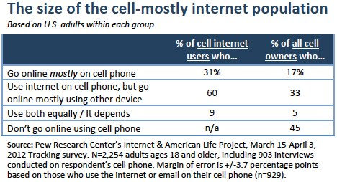
Notes:
http://www.pewinternet.org/Reports/2012/Cell-Internet-Use-2012/Key-Findings.aspx
Cell Internet Use 2012
Jun 26, 2012
by Aaron Smith
Some 88% of U.S. adults own a cell phone of some kind as of April 2012, and more than half of these cell owners (55%) use their phone to go online. We call these individuals “cell internet users” throughout this report, and this represents a notable increase from the 31% of cell owners who said that they used their phone to go online as recently as April 2009.
Moreover, 31% of these current cell internet users say that they mostly go online using their cell phone, and not using some other device such as a desktop or laptop computer. That works out to 17% of all adult cell owners who are “cell-mostly internet users”—that is, who use their phone for most of their online browsing.

Slide 63
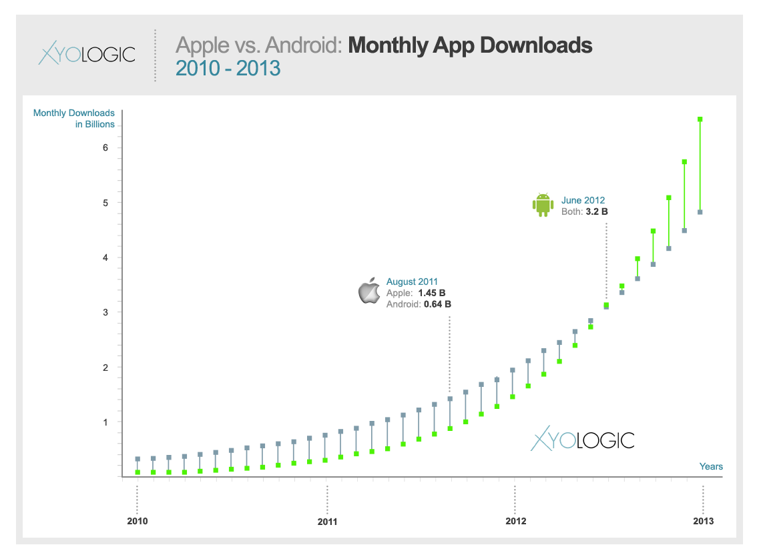

Slide 64
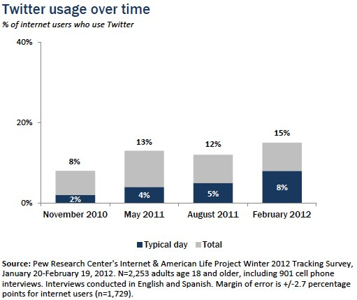
Notes:
http://www.pewinternet.org/Reports/2012/Twitter-Use-2012/Findings.aspx
Some 15% of online adults¹ use Twitter as of February 2012, and 8% do so on a typical day. Although overall Twitter usage has nearly doubled since the Pew Research Center’s Internet & American Life Project first asked a stand-alone Twitter question in November 2010, the 15% of online adults who use Twitter as of early 2012 is similar to the 13% of such adults who did so in May 2011. At the same time, the proportion of online adults who use Twitter on a typical day has doubled since May 2011 and has quadrupled since late 2010—at that point just 2% of online adults used Twitter on a typical day.² The rise of smartphones might account for some of the uptick in usage because smartphone users are particularly likely to be using Twitter.

Slide 65
61% visit local gvt web site
43% watch public meetings
27% attend public meeting
Notes:
National Research Center

Slide 66
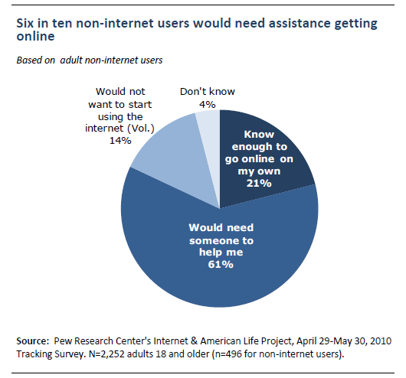
Notes:
http://www.pewinternet.org/Reports/2010/Home-Broadband-2010/Part-1/Most-non-users-would-need-help.aspx
Home Broadband 2010
by Aaron Smith
Aug 11, 2010
A fifth of American adults (21%) do not use the internet. Many non-users think online content is not relevant to their lives and they are not confident they could use computers and navigate the web on their own.
They do not find online content relevant to their lives. Half (48%) of non-users cite issues relating to the relevance of online content as the main reason they do not go online.
They are largely not interested in going online. Just one in ten non-users say would like to start using the internet in the future.
They are not comfortable using computers or the internet on their own. Six in ten non-users would need assistance getting online. Just one in five know enough about computers and technology to start using the internet on their own.
Not only are most non-users uninterested in getting online, many say that they do not know enough about computers or technology to use the internet on their own. When asked if they know enough about computers and technology to start using the internet on their own, just one in five non-users (21%) say that they do while six in ten (61%) say that they would need someone to help them. An additional 14% volunteered that they would not want to start using the internet.

Slide 67
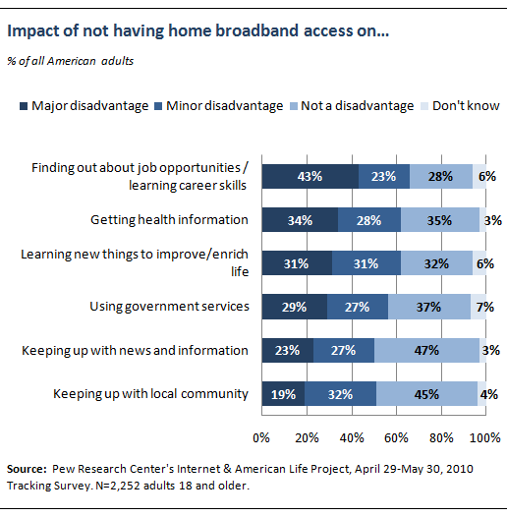
Notes:
http://www.pewinternet.org/Reports/2010/Home-Broadband-2010/Part-1/Most-non-users-would-need-help.aspx
Home Broadband 2010
by Aaron Smith
Aug 11, 2010
Americans are split in their views of how much a lack of access hurts non-users. The worst disadvantage they cited related to job opportunities and career-improvement skills.
In order to evaluate the importance that Americans place on a high-speed internet connection, we asked all of our survey respondents (including broadband users, dial-up users and non-internet users) whether individuals who do not have access to high speed internet access at home are at a disadvantage when it comes to different aspects of modern life. In all of the examples we gave, a majority of respondents said they thought lack of broadband access was a “minor disadvantage” or “not a disadvantage” to doing the activities.
Generally, Americans view those without broadband access as being most disadvantaged when it comes to job and career opportunities. Some 43% of Americans feel that individuals who do not have broadband at home are at a major disadvantage when it comes to finding out about job opportunities or learning career skills, with an additional 23% saying that a lack of broadband access is a minor disadvantage in this regard. Other areas where a lack of broadband is seen as a relatively significant disadvantage include:

Slide 69
Community Planning
Collaboration of IMLS, ICMA, UW, WEBJUNCTION, TECHSOUP

Slide 70
Building Digital Communities
Vision
Framework
help community leaders
initiate community discussions
conduct asset mapping
foster digital inclusion
Principles
Goals
Strategies

Slide 71
Building Digital Communities
ACCESS
Availability
Affordability
Design for inclusion
Public access
ADOPTION
Relevance
Digital literacy
Consumer safety
Economic and workforce development
Education
Health care
Public safety and emergency services
Civic engagement
Social connections

Slide 72
imls.gov
Building Digital Communities

Slide 73
Collaboration of the Bill and Melinda Gates Foundation, Urban Libraries Council, ALA,, PLA, Lyrasis, TechSoup, WebJunction-OCLC, State Libraries of CA, NC, OK, and TX, U. Maryland, U. Washington, ICMA

Slide 74
Edge Where People Connect, Communities Achieve
Community Value
Engaging the Community and Decision-Makers
Organizational Management
This is a work in progress; items are representative and not necessarily reflective of the final product.

Slide 75
Community Value
Recognize libraries that provide the staffing, support and services that patrons need to take advantage of digital opportunities so that patrons are able to fully utilize technology services to achieve life-enriching benefits.
Benchmark 1: Library staff and volunteers provide assistance and training with the goal of increasing the level of digital literacy in the community
Benchmark 2: Libraries provides access to relevant digital content and enables community members to create their own digital content.
Benchmark 3: Libraries provide technology to meet community members’ job-seeking and entrepreneurial needs.
Benchmark 4: Libraries provide technology to meet community members’ demand for government and legal information and services/assistance.
Benchmark 5: Libraries provide technology to meet community members’ demand for educational support.
Benchmark 6: Libraries provide technology to meet community members’ demand for health and wellness information.
Where People Connect, Communities Achieve

Slide 76
Engaging the Community and Decision Makers
Encourage libraries to raise awareness of and build a positive perception of the library as a valuable community resource so that communities experience an innovative, agile and inspirational organization and service.
Benchmark 7: Libraries have leaders and staff who actively engage in high-level community planning and digital inclusion efforts to amplify their value in the community.
Benchmark 8: Libraries build strategic relationships with community partners to maximize public access technology resources and services provided to the community.
Benchmark 9: Libraries support continuous improvement in public access technology services by sharing expertise & best practices with other providers locally, regionally & nationally.
Where People Connect, Communities Achieve

Slide 77
Organizational Management
Manage library resources to ensure equitable access to opportunities through technology so that members of the community who need or want access can get it at their public libraries regardless of ability, skill, personal technology, or available time.
Benchmark 10: Libraries integrate public access technology into planning and policies.
Benchmark 11: Libraries have sufficient staff with technology expertise to help patrons achieve their goals.
Benchmark 12: Libraries have sufficient devices and bandwidth to accommodate user demand.
Benchmark 13: Libraries manage their technology resources to maximize quality.
Benchmark 14: Libraries ensure participation in digital technology for people with unique needs, including those with disabilities.
Where People Connect, Communities Achieve

Slide 78
Who Do People Trust?

Slide 79
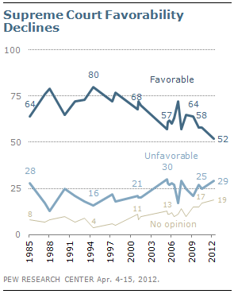
Notes:
http://www.people-press.org/2012/05/01/supreme-court-favorability-reaches-new-low/
Released: May 1, 2012
Supreme Court Favorability Reaches New Low
Public assessments of the Supreme Court have reached a quarter-century low. Unlike evaluations over much of the past decade, there is very little partisan divide. The court receives relatively low favorable ratings from Republicans, Democrats and independents alike.
The survey by the Pew Research Center for the People & the Press, conducted April 4-15, 2012 among 1,514 adults nationwide, finds 52% offering a favorable opinion of the Supreme Court, down from 58% in 2010 and the previous low of 57%, in 2005 and 2007. About three-in-ten (29%) say they have an unfavorable view, which approaches the high reached in 2005 (30%).

Slide 80
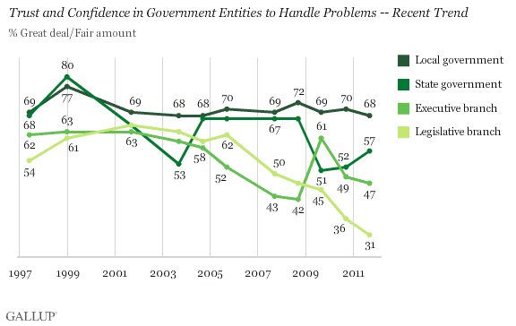
Notes:
http://www.gallup.com/poll/149888/Local-State-Governments-Retain-Positive-Ratings.aspx
October 3, 2011
In U.S., Local and State Governments Retain Positive Ratings
In contrast to low trust in Washington, majorities trust state and local governments
by Lydia Saad
PRINCETON, NJ -- Two-thirds of Americans have a great deal or fair amount of confidence in their local governments to handle local problems, and a solid majority feel the same way about their state government.
Confidence in state government matched confidence in local government as recently as 2008; however, the former fell sharply in 2009 as statehouses across the country began to grapple with major budgetary problems, and it has yet to fully recover.
Still, Americans remain more confident in state and local government than in the two policymaking branches of the federal government, according to findings from the Sept. 8-11 update of Gallup's annual Governance poll.

Slide 81
Notes:
http://www.gallup.com/poll/149888/Local-State-Governments-Retain-Positive-Ratings.aspx
October 3, 2011
In U.S., Local and State Governments Retain Positive Ratings
In contrast to low trust in Washington, majorities trust state and local governments
by Lydia Saad
PRINCETON, NJ -- Two-thirds of Americans have a great deal or fair amount of confidence in their local governments to handle local problems, and a solid majority feel the same way about their state government.
Confidence in state government matched confidence in local government as recently as 2008; however, the former fell sharply in 2009 as statehouses across the country began to grapple with major budgetary problems, and it has yet to fully recover.

Slide 82
Notes:
http://www.gallup.com/poll/154892/Americans-City-Optimism-Reaches-Four-Year-High.aspx
May 25, 2012
Americans' City Optimism Reaches Four-Year High
Large majority remains satisfied with current local conditions
by Alyssa Brown
Americans expressed a high level of satisfaction with current conditions in their city, as has been the case since Gallup and Healthways started tracking this metric. The 85.7% who said they were satisfied with their city in April is on par with the highest readings on record and is higher than what was found throughout 2008 and early 2009.
Still, it is important note that the percentage of Americans satisfied with their city or area has stayed in a narrow range between 83.9% and 86.1% over the past four and a quarter years. Americans' satisfaction with where they live dropped to a low of 83.9% in November 2008 -- amid the financial crisis. The highest level of satisfaction on record came one year later in November 2009, at 86.1%.

Slide 83
Notes:
Lifewellrun.org
Life, Well Run is a campaign to raise awareness of and appreciation for the value professional local government managers bring to building great communities. Professional managers are key to making local government services more effective, ethical, and efficient in 27 percent of counties across America, and more than 59 percent of cities and towns with a population of 2,500 and over.
A professional local government manager is an executive or administrator hired to serve the public interest of a city, town, or county.
As the scope and complexity of local government services has grown, so, too, has the need for greater professionalism in government management.
Professional managers work closely with local elected officials – mayors, city, town, and county councils — to manage their policies and programs and oversee the day-to-day business of the government ethically and transparently.
Professional managers:
are trained in the business of managing government and resources.
maintain political neutrality and put the overall welfare of the community first.
bring a community-wide perspective to policies and programs.
strengthen local democracy by bringing all groups and all interests into the legislative process.
ensure that services are fairly distributed to all members of the community.
nurture organizational excellence and promote innovation.
The benefits of professional management
Professional managers oversee the day-to-day operations of more than 59 percent of cities and towns with a population of 2,500 and over, and 27 percent of counties across America.
They are involved in thousands of individual decisions, large and small, that define our communities and affect our quality of life.
Commitment to excellence
An important part of their job is supervising the many hard-working public servants who keep their communities thriving. They bring a commitment to excellence that sets the tone for all employees.
There are professionals at all levels of local government – from department directors down. A professional manager expects his or her staff to meet high standards in service delivery, accountability, and ethics. Together, they look for better and more efficient ways to serve the members of their community.
Professional city, town, and county managers make tomorrow happen.

