Slide 1
Salt Lake City, Utah

Slide 3
Compelling Interests
Aiding the SLC Green initiatives by reducing paper, trips to the City offices; reducing traffic/emissions/time
Reducing overhead costs by eliminating the need to store large rolled sets of paper plans
Making it seamless for developers/ contractors/ architects to do business with the City
Improving the accuracy and speed of plan review turn-around-time
Enabling employees to have access to review/access plans from anywhere with internet connection
Speeding the review process/ timeline and / or enabling parallel review

Slide 4
Mayor Ralph Becker, 2010 State of the City Address:
“We have seen great efficiency with the implementation of software for external access to City services and information. Residents, business owners and developers continue to appreciate the One-Stop Shop, where permit applications are accepted online.”
“Because of our combined web-based database and our electronic plan review software, these customers did not need to print out multiple sets of drawings, and they did not need to fly in to submit.”

Slide 5
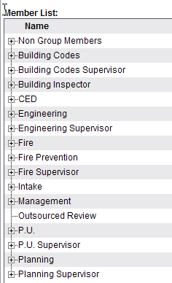
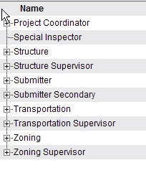
All Stake Holders included:
Inter departmental Review Routings
Building
Zoning
Engineering
Transportation
Public Utilities
Planning
Fire
Outsource Reviews!
Structural Reviews
Expedited Reviews
Submitter
Primary Submitter (Project Manager)
Secondary Submitter (Design Team, Owner, etc.)

Slide 6
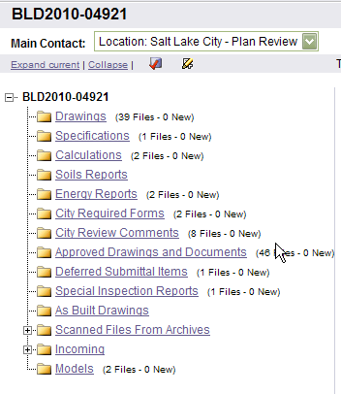
Folder Structure:
Orderly organization of files
Post permit activity tracking
Deferred submittal management
Special inspection Reports
As Built Drawings

Slide 7
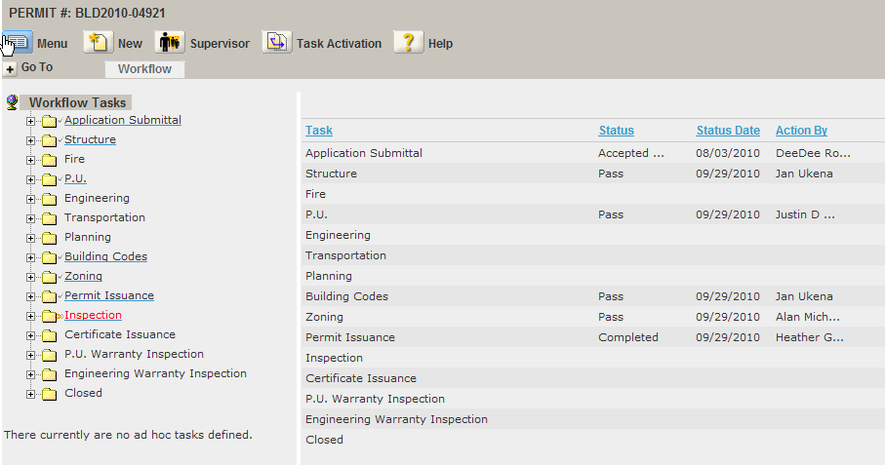
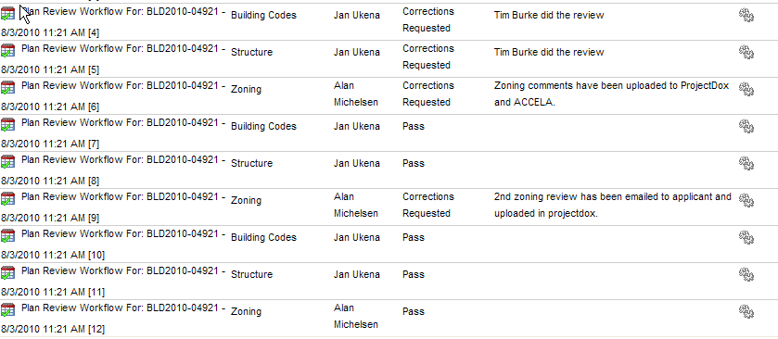
Workflow Integration:
Accela Automation – Permitting
Routing Workflows are established in our permit tracking system
Comments and statuses from reviewers are updated to both systems
Comments and Statuses are viewable to the public through our Citizen Access Portal
ProjectDox – ePlan Management

Slide 8
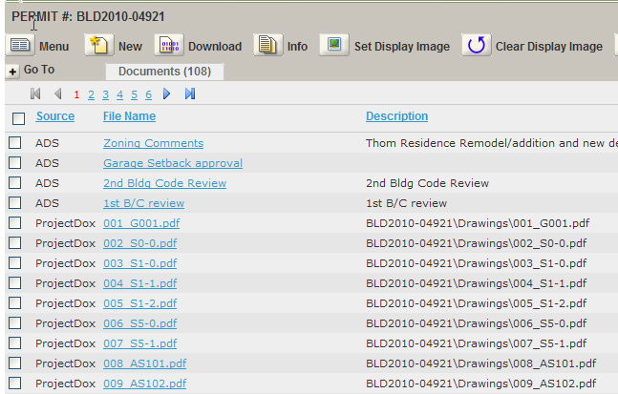
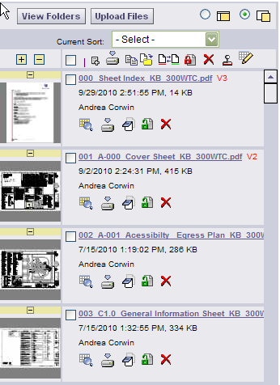
Document Access:
ProjectDox documents/drawings are available from plan tracking software
Transparency goals are achieved while protecting intellectual property.
Communication tools (topics/notes) are available to specific documents.
Mark-up tools are available to specific documents.

Slide 9
Archives and Digital Conversions

Slide 10
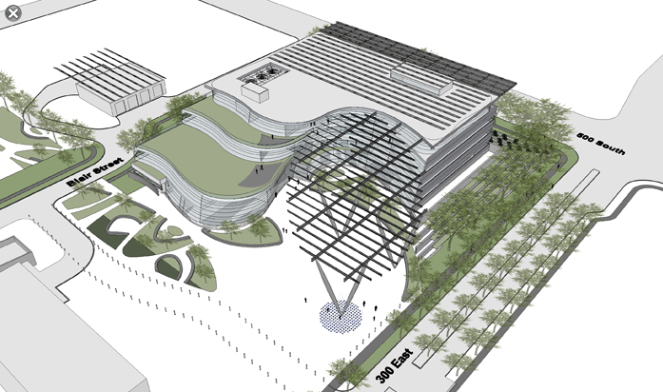
Design Build Template:
Salt Lake City is leveraging the flexibility of the ePlan templates to create a platform where plans can be submitted and reviewed during the development process. Included in this project are the designers, owners and subcommittees, and all review disciplines.
Goal: Maximize early reviews; minimize review times and surprises at permit issuance

Slide 11
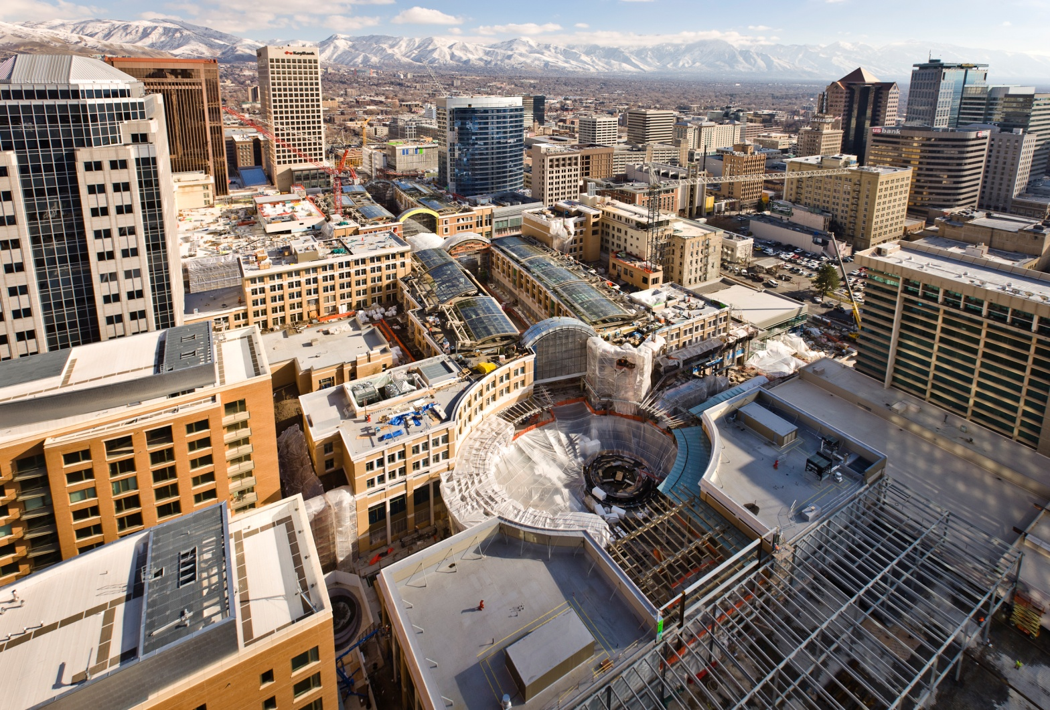
Design-Build Template: City Creek
We have developed a project using our design build template for the tenant Improvements of the City Creek Center.
Project size over 25 Acres
Base plans uploaded into project.
Hundreds of TI plans to be submitted
Each TI will show tie-ins to base plans

Slide 12
Contact Us
www.slcpermits.com
https://aca.slcgov.com/citizen/

