Slide 1
Putting Your Data to Work with AI
Jennifer Robinson, SAS Global Public Sector Strategic Advisor

Slide 2
AI
Machine Learning
Deep Learning
Generative AI
“GenAI”
LLM
Natural Language Processing
Computer Vision
Synthetic Data
Digital Twins
Notes:
Three technologies within Generative AI are Large Language Models (referred to as LLMs), Synthetic Data, and Digital Twins.

Slide 3
Machine Learning
Systems learn from data, identify patterns, and make decisions with minimal human intervention
Copyright © SAS Institute Inc. All rights reserved.

Slide 4
Natural Language Processing
Enables understanding, interaction and communication between humans and machines.
Copyright © SAS Institute Inc. All rights reserved.
Notes:
Natural Language Processing enables understanding, interaction and communication between humans and machines.
NLP makes it possible for computers to read text, hear speech, interpret it, measure sentiment and determine which parts are important. The overarching goal is to take raw language input and use linguistics and algorithms to transform or enrich the text in such a way that it delivers greater value.
Natural language processing goes hand in hand with text analytics, which counts, groups, and categorizes words to extract structure and meaning from large volumes of content.
Earlier I told you that the branches of AI contribute to one another. The computer can augment human efforts to analyze unstructured text with AI using a variety of modeling approaches by combining the power of natural language processing, machine learning and linguistic rules. NLP and text analytics are used together for many applications, including investigative discovery, subject-matter expertise, and social media analytics.
Note: NLP has five major components:
Syntax. The study of the structure, arrangement, and order of words and phrases within a language to form grammatically correct sentences.
Semantics. The study of the meaning of words, phrases, and sentences within a language and how they convey information.
Discourse. The analysis of language beyond the sentence level, focusing on how language is used in context to convey meaning.
Speech. The production and expression of spoken language through vocalization, involving the articulation of sounds and words.
Dialogue. A conversation between two or more individuals or entities, involving an exchange of ideas, information, or opinions.

Slide 5
Computer Vision
Enables systems to see, identify and process images or videos in the same way that human vision does.
Copyright © SAS Institute Inc. All rights reserved.
Notes:
Computer vision is a field of AI that trains computers to interpret and understand the visual world. Machines can use deep learning algorithms to accurately identify and classify objects in images and videos— and then react to what they “see.”
Applications of computer vision include facial recognition and surveillance image analysis.

Slide 6
Large Language Models (LLMs)
Deep learning algorithms that recognize, summarize, translate, predict, and generate content
Copyright © SAS Institute Inc. All rights reserved.
Notes:
An LLM analyzes huge amounts of text - millions or billions of words – to train itself to be able to know the relationships of words AND then produce human-like text.
For example, how would you finish this sentence, “Boy, after he messed up, he was in the Dog-” Did you say “Dog Treat” or Dog Days of Summer”? No, of course not. You said “Doghouse” because that is a common phrase that you have heard over and over again. “He was in the doghouse” is commonly associated with making a mistake, messing up, acting badly.
The inventors of Large Language Models took the NLP concept of scanning each word in a sentence and translating it in a sequential process to instead reading an entire sentence at once, analyzing all its parts and not just individual words. This provides better context.
So, LLMs track and learn relationships in sequential text – or text in which the arrangement matters - to respond to prompts using similar text.
When we ask an LLM like ChatGPT or Copilot to write a sonnet about our favorite dog and his love of slippers, it seems like the system is being creative and generating completely new ideas. In reality, the system – using millions or billions of data – sequentially lines up the most probable next best word or groups of words. With unlimited compute power and tremendous speed, tasks that would take humans hours, weeks, or even years to perform can be done in seconds.
One of the most prevalent uses of LLMs is as an advanced search engine. Not only does it retrieve information from the far corners of the internet or an internal database, it often assembles the information in a relevant and consumable manner. BUT, it is important to note that:
LLMs alone do not solve business tasks. The key is to integrate it into a decisioning process, layered with orchestration and governance.

Slide 7
Synthetic Data
Artificial data that’s manufactured.
Copyright © SAS Institute Inc. All rights reserved.
Notes:
Synthetic Data is on-demand, self-service, or automated data generated by algorithms or rules, as opposed to traditional data sets gathered from the real world.
Synthetic data reproduces the same statistical properties, probabilities, patterns, and characteristics of the real-world data set from which the synthetic data is trained.
Governments can use synthetic data for various purposes, including research, testing, and analysis, without violating privacy regulations or exposing sensitive information.
Synthetic data is often generated when there is not enough data or conditions are lacking in real-world data. For example, you want to test the concept of making a road improvement, but you only have a few months of traffic data. Creating synthetic data – such as simulated traffic flows – allows you to test possible road improvements. In cases such as this, creating fake data assists in training or testing models, running what-if scenarios, or identifying optimization.
it can also be used to protect sensitive data. Synthetic data can mimic actual data sets without containing any personally identifiable information (PII). So, you could create synthetic data to train and test a system that processes health records, student records, or tax information. It allows governments to harness the benefits of data-driven decision-making while respecting individuals' privacy and data protection rights.
When data is dirty or has gaps, more complete data can be created synthetically to improve the usefulness of the data set.
Synthetic data is found to be 99% statistically valid.
Examples you could pull from:
Potential Uses of Synthetic Data in government include:
Census and Demographics: Creating synthetic population data for demographic analysis, without exposing individuals' personal information.
Healthcare Research: Generating synthetic patient data for medical research, epidemiological studies, and healthcare policy analysis.
Education Planning: Using synthetic student and school data to improve educational planning and resource allocation.
Crime Analysis: Developing synthetic crime data for law enforcement and criminology research without compromising individual privacy.
Transportation Planning: Simulating travel patterns and behavior using synthetic travel data for infrastructure planning.
Economic Analysis: Creating synthetic economic data for economic modeling, forecasting, and policy analysis.
Cybersecurity Testing: Using synthetic network traffic data to test and improve cybersecurity systems and protocols.
Environmental Monitoring: Generating synthetic environmental data for climate and ecosystem research.
Social Services Allocation: Using synthetic data to optimize the allocation of social services like welfare, food assistance, and housing subsidies.
Election Simulation: Simulating elections and voting behavior using synthetic voter data for testing electoral systems.
Urban Planning: Generating synthetic urban data for city planning, including housing, transportation, and utilities.
Public Health: Creating synthetic disease outbreak data to model and test public health responses.
Taxation Analysis: Using synthetic financial data to analyze tax policies and revenue projections.
Weather Forecasting: Generating synthetic weather data to test and improve meteorological models.
Disaster Preparedness: Simulating disaster scenarios and response efforts using synthetic disaster data.
National Security: Developing synthetic data for military training and strategic simulations.
Energy Consumption: Creating synthetic data to analyze and optimize energy consumption patterns.
Agricultural Planning: Using synthetic agricultural data for crop yield predictions and resource allocation.
Immigration and Border Control: Generating synthetic immigration and border-crossing data for testing border security measures.
Historical Analysis: Creating synthetic historical data for historical research and data analysis projects.

Slide 8
Digital Twins
A virtual model designed to accurately reflect a physical object, system, or environment.
Copyright © SAS Institute Inc. All rights reserved.
Notes:
A digital twin is a virtual model of a physical object or system from the real world. For example, a government might build a digital twin of a road network, a supply chain, or financial system.
This digital twin can be used to make predictions about the real-world impacts, such as when an accident occurs on a highway, when a product shortage might occur, or when an economic disaster impacts taxpayers. What-if analysis can be used to virtually test the effects that certain decisions might have in the real world.
Digital twins can use a combination of historical, real-world data, synthetic data, and system feedback loop data as inputs. These inputs can be processed in batch or in real time. In the supply chain example, real-world data might include IoT data that streams from sensors attached to physical warehouses and machinery.
Examples you could pull from:
Potential uses of Digital Twins:
Smart Cities: Creating digital twins of parts of a city or an entire city to optimize urban planning, transportation, and resource management.
Water Infrastructure: Monitoring and managing water supply and distribution systems, including pipes, reservoirs, and treatment plants.
Traffic Management: Simulating traffic flow and optimizing traffic signal timings to reduce congestion and improve safety.
Public Safety: Planning emergency response, allowing authorities to simulate and plan for disaster scenarios.
Energy Grids: Optimizing the electrical grid to balance supply and demand, reduce outages, and incorporate renewable energy sources.
Waste Management: Tracking waste collection, optimizing routes for garbage trucks, and monitoring landfill usage.
Public Transportation: Simulating public transport networks to improve efficiency and user experience.
Healthcare Facilities: Managing and optimizing healthcare infrastructure, including hospitals and clinics, to enhance patient care.
Agriculture: Monitoring and managing agricultural resources such as soil quality, weather conditions, and crop growth.
Environmental Conservation: Monitoring wildlife and environmental conditions for natural reserves and protected areas.
Public Housing: Optimizing maintenance and energy use in public housing complexes to improve living conditions.
Education: Managing resources and enhance the learning environment for educational institutions.
Government Buildings: Managing government office spaces for efficiency and sustainability.
Customs and Border Control: Enhancing border security by simulating and monitoring border crossings.
Disaster Preparedness: Simulating natural disasters like hurricanes, floods, or earthquakes to plan and respond effectively.
Land Use Planning: Assessing land usage, zoning, and urban development.
Law Enforcement: Monitoring and optimizing police operations.
Election Management: Ensuring secure and efficient elections through simulations of voting processes.
Tourism Management: Enhancing tourism, helping manage crowds and preserve cultural sites of tourist destinations.
Government Procurement: Optimizing procurement processes and supply chain management to reduce costs and improve transparency.

Slide 9
Deep Learning
A type of machine learning used in recognizing speech, identifying objects in images, generating new content, and more.
Comprised of three or more neural networks.
Copyright © SAS Institute Inc. All rights reserved.
Notes:
Deep learning is a method in artificial intelligence (AI) that teaches computers to process data in a way that is inspired by the human brain.
Deep learning performs nonlinear transformations to its input and uses what it learns to create a statistical model as output. Iterations continue until the output has reached an acceptable level of accuracy. The number of processing layers through which data must pass is what inspired the label deep.
This is kind of a tough concept to digest. So, to explain this in overly general terms, imagine if you are blindfolded and asked to identify a piece of fruit.
First, a person shakes the fruit next to your ear. You don’t hear any loose seeds, so you can eliminate a dried squash (yes, that’s a fruit).
Then, the person asks you to smell the fruit. You eliminate banana, pineapple, peach, and most berries.
The fruit is put in your hands to hold. Touching it, you determine that it is either a nectarine or a plum.
Finally, the person gives you a taste of the fruit and you know: it is a nectarine.
When your blindfold is removed, your guess is confirmed.
In this same way, deep learning uses several levels of models to learn, predict, and take actions.
Now, if you were asked to be blindfolded and guess fruit again, would you start with listening to the fruit? No, you’d go right to tasting the fruit. In the same way, deep learning remembers the best models for a task and builds upon experience.

Slide 10
What are Humans and Machines good at?
Common Sense
Intuition
Creativity
Empathy
Versatility
HUMANS
Large Data Sets
Complex Calculations
Learning
Automation
MACHINES
Notes:
Even with advancements in machine learning, deep learning, and generative AI, there is still a clear distinction between what humans and machines do well. Humans use common sense, intuition, creativity, empathy, and versatility. Machines take on tasks that humans could perform if we had all of the time in the world and didn’t get fatigued: processing large data sets – not only consuming, but learning from massive amount of data, performing complex calculations, and automating tasks which can be performed without human intervention or assistance.
While the advancement in generative AI suggests that machines will be able to take over the world, let’s remember how machines generate their output. In large language models, when given a prompt, machines grab the most probable next word, line of code, image, etc.. Some marvel at the LLMs creativity. But the creativity occurred when humans put information into the dataset. A machine doesn’t understand what it means to have a broken heart but will finish the sentence “When he left me, he broke my…” with “heart” because millions of people have written that.
A Large Language model is operating without common sense and true intuition. Because this approach is effectively guessing, LLMs only assemble and present what humans have previously rendered.
Example from ChatGPT:
Me
Finish this sentence: when he left me, he broke my...
ChatGPT
When he left me, he broke my heart into a million pieces.
Me
Finish this sentence: when he dropped the tray, he broke my...
ChatGPT
When he dropped the tray, he broke my favorite mug.

Slide 11
AI Adoption

Slide 12
A possible progression of AI adoption
Automation of routine tasks
Data analysis and insights
Optimization and logistics
Personalization and CX
AI-enhanced products and services
Decision-making strategy

Slide 13
Areas ripe for AI adoption
Automation of routine tasks
AI-enhanced products
Citizen service inquiries
Data augmentation and simulation
Document Processing
Healthcare diagnostic tools
Tax robo-advisors
Smart signalization
Personalization and CX
Optimization and Logistics
Targeted assistance and programs
Customized engagement and services
Nudging for tax compliance
Demand forecasting
Inventory management
Route optimization
Data analysis and insights
Decision-making strategy
Utility forecasting
Fraud detection
Citizen segmentation
Evaluating scenarios
Decision objectivity
Policy evaluation

Slide 14
Question:
What are the tasks within your organization that are ripe for an AI application?

Slide 15
AI Readiness

Slide 16
Building an AI-Ready Team
Take an Inside – Outside approach
1
Notes:
5 principles, not rules
Room for creativity

Slide 17
The Inside – Outside Approach
Know what you are solving for
Inside
Your SMEs
Small AI Exploratory Team
Your challenges/opportunities
Outside
AI techniques
New external hire
Hackathons/University Challenges
Copyright © SAS Institute Inc. All rights reserved.

Slide 18
Building an AI-Ready Team
Take an Inside – Outside approach
1
Compete for talent
2
Notes:
5 principles, not rules
Room for creativity

Slide 19
Compete for talent
Compete
Develop and Retain Current Talent
Establish Academic Connections
Notes:
Formal training programs
Be Six Sigma-like
Give time
Have accountability

Slide 20
Building an AI-Ready Team
Take an Inside – Outside approach
1
Compete for talent
2
Data and compute infrastructure as AI infrastructure
3
Notes:
5 principles, not rules
Room for creativity

Slide 21
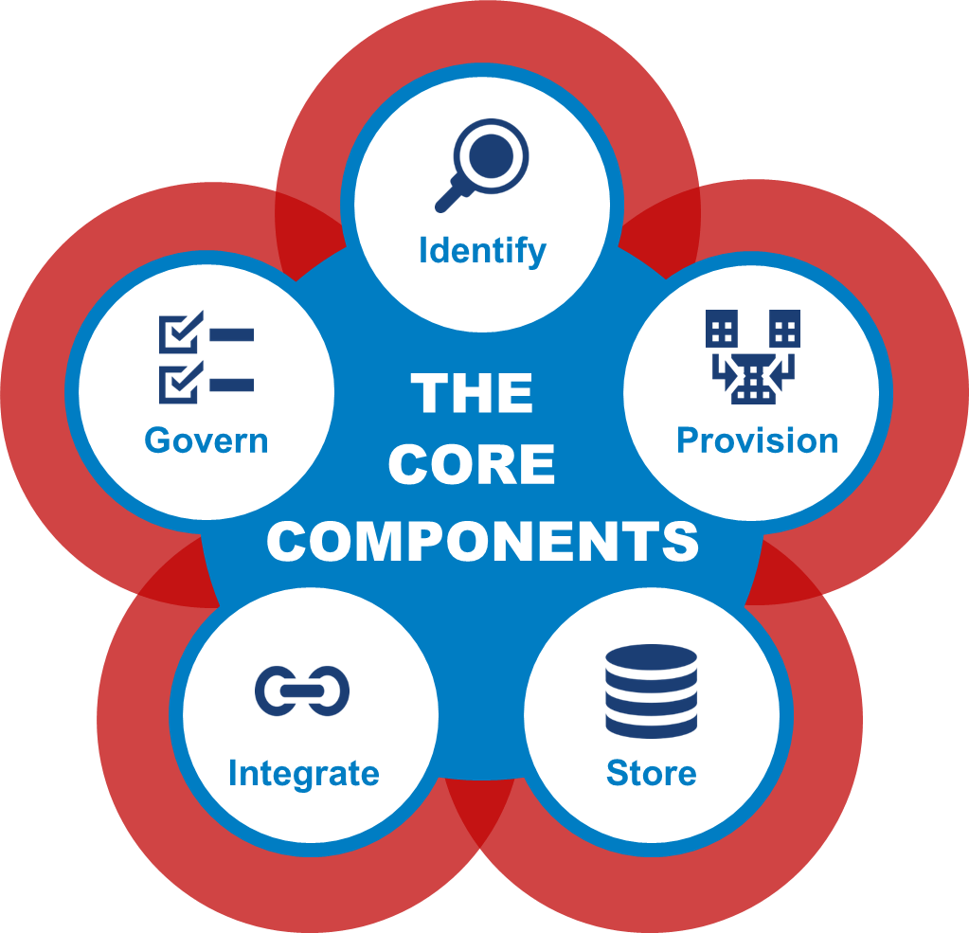
The Five Components of a Data Strategy
The ability to identify data and understand its meaning regardless of its structure, origin, or location
Identify
Enabling data to be packaged and made available while respecting all rules and access guidelines
Provision
Persisting data in a structure and location that supports access and processing across the enterprise
Store
Moving and combining data residing in multiple locations and providing a unified view of the data
Integrate
Establishing and communicating information policies and mechanisms to ensure effective data usage.
Govern

Slide 22
SAS® Data Management Framework
DATA GOVERNANCE
The organizing framework for establishing strategy, objectives, and policies for enterprise data
Business Stakeholders
Notes:
First things first, DG is not a tool or technology. First and foremost, it is a group of business people empowered to make decisions regarding data that falls underneath the DG umbrella.
Here is a definition (again, we’re not talking technology here). DG is the organizing framework (see the people sitting around the table) for establishing strategy, objectives, and policies for corporate data. This is our definition and the one we will use for the remainder of today.
I hear a lot about how organizations get sideways with DG – they either can’t it off the ground or the program dies over time as participants get sidetracked with other things. There are four key inputs to planning DG and organizations that do them are more successful. If you take nothing else from today’s overview, remember the next 4 things.

Slide 23
SAS® Data Management Framework
DATA GOVERNANCE
Establishes the authority for defining key business terms
Establishes business-driven decision-making process for changes to definitions or business rules
Defines metadata and data quality standards
Defines process for ongoing policy monitoring and measurement
Ensures data is managed separately from applications
Business Stakeholders
Notes:
Let’s talk about some of the things DG does. DG can establish the authority for defining key terms along with the decision-making process for when those definitions might change. DG can define and set standards for metadata (what we collect and when, provisioning requirements) and DQ (baseline, remediation reqs). When DG begins to enact policies for data, DG also needs to define how we will monitor and measure (more on that later) against those policies. Most importantly, DG ensures that data is no longer seen as a by-product of an application but a valuable asset; because of that we will begin to manage the data separately from the applications.
Now we have a better understanding of who participates, what DG is, and some of the things DG does for us. That is a lot of moving parts and as such, DG requires up-front planning and ongoing monitoring and measuring. In essence, you need a plan!

Slide 24
SAS® Data Management Framework
DATA GOVERNANCE
Sample
Program Objectives
Eliminate redundant or conflicting business processes and practices
Business Stakeholders
What do we want to achieve with Data Governance?
Can we measure against the objective?
Notes:
Program Objectives – Defining ‘why’ DG is important is a great starting point. Remember that objectives need to be measurable and aligned to overall corporate objectives. Example – ‘Eliminate redundant or conflicting business processes and practices’; this could speak to the desire to store entities one time. A retailer we worked with stored, updated, re-stored, product dimension data to a point where nobody trusted anything unless they created/maintained it themselves – that resulted in products being measured 6 or 7 times between the distribution centers and the shelf; also product dimensions don’t quite fit in the truck; well, change the dimensions of the truck!

Slide 25
SAS® Data Management Framework
DATA GOVERNANCE
Sample
Customer data attributes will be shared through a common process or interface
Business Stakeholders
Guiding Principles
Set of common philosophies intended to direct a program or organization irrespective of day-to-day changes
Reflect the organization’s values and goals
Serve as a philosophical touchstone for questions or dilemmas during Data Governance deployment
Notes:
Without guardrails to guide future decisions, it is easy to lose focus and become disjointed. These principles illustrate how DG supports the company’s culture, organizational structure, and way of doing business, while making sure its value is well understood. Example – ‘Customer data attributes will be shared through a common process or interface’. Not only does this set direction for MDM but also draws a line and says it’s no longer okay to keep private-use copies of customer data. This example came from an organization that had 72,000 MS Access databases sitting on their network with little to no understanding of use or content.

Slide 26
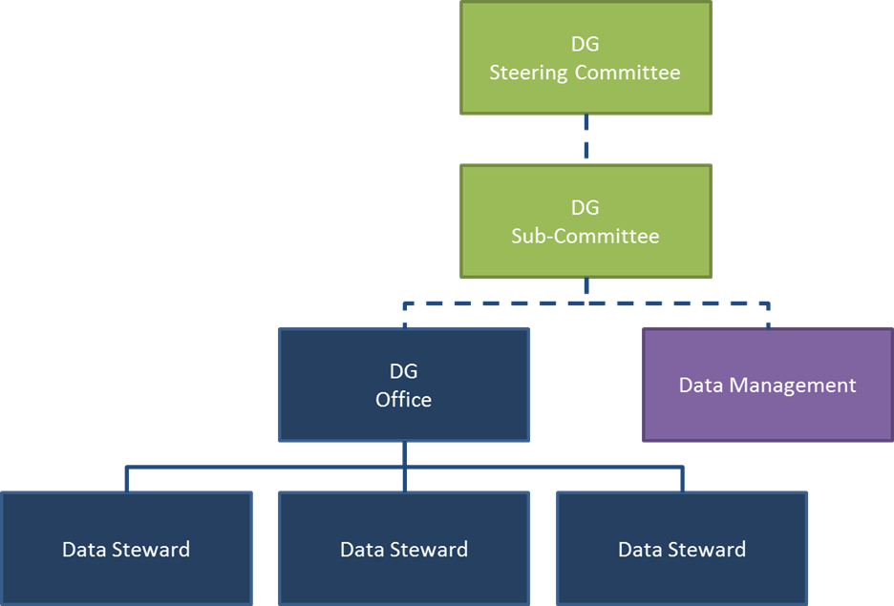
SAS® Data Management Framework
DATA GOVERNANCE
Sample
Business Stakeholders
Decision-making Bodies
Notes:
You need to take the time to define what the decision-making structure looks like to support the program objectives and work within the confines of the guiding principles. Being clear about what groups do what activities heads off confusion down the road. This is important so I’m going to come back to this one with some examples in a few minutes.

Slide 27
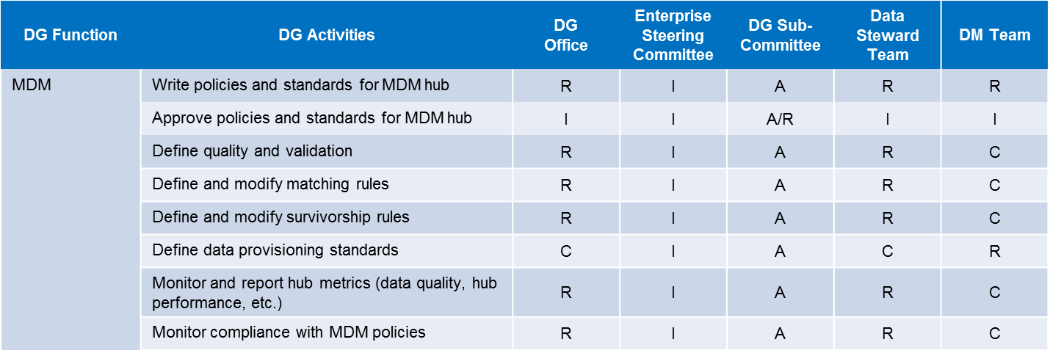
SAS® Data Management Framework
DATA GOVERNANCE
Sample
Business Stakeholders
Decision Rights
Notes:
When we determine what the DG organization looks like, the next step is to determine and communicate exactly which group is on the hook for doing what activity. We’ve found that RACI is a very good tool for accomplishing this.

Slide 28
SAS® Data Management Framework
DATA GOVERNANCE
Program Objectives
Why?
Guiding Principles
How?
Decision-making Bodies
Who?
Decision Rights
What?
Notes:
When we determine what the DG organization looks like, the next step is to determine and communicate exactly which group is on the hook for doing what activity. We’ve found that RACI is a very good tool for accomplishing this.

Slide 29
Question:
What kind of data and infrastructure challenges do you anticipate as your organization increases adoption of AI?

Slide 30
Building an AI-Ready Team
Take an Inside – Outside approach
1
Compete for talent
2
Data and compute infrastructure as AI infrastructure
3
Take an experimentation mindset
4
Run like Dev Ops
5
Notes:
5 principles, not rules
Room for creativity

Slide 31
Treat AI projects like applications development
Common AI Job Roles
Data Scientist | Analyzes and interprets complex data to help in decision-making. They use statistical techniques, machine learning algorithms, and predictive modeling to extract insights from data.
Machine Learning Engineer | Focuses on designing and implementing machine learning models and algorithms. They work closely with data scientists to develop scalable and efficient AI systems.
Data Engineer | Designs and maintains data infrastructure required for storing, processing, and analyzing large datasets. Ensures that data is accessible and in a usable format for data scientists and analysts.
Software Developer | Develops and maintains software applications that incorporate AI functionalities. They integrate machine learning models into applications and ensure their smooth operation.
AI Product Manager | Oversees development and deployment of AI products, ensuring that they meet user needs and business objectives. They work at the intersection of business, technology, and user experience.
Ethics & Compliance Officer | Ensures that AI systems adhere to ethical standards and comply with legal and regulatory requirements. They address concerns related to privacy, fairness, and transparency.
Solutions Architect | Designs overall architecture of AI systems, including selection of technologies, frameworks, and infrastructure. Ensures that the system is scalable, secure, and aligned with business goals.
Business Analyst | Works on identifying business needs and opportunities where AI can provide solutions. They help translate business requirements into technical specifications for the AI team.
DevOps Engineer | Responsible for the continuous integration and deployment (CI/CD) of AI applications. They ensure that the development, testing, and production environments are streamlined and automated.

Slide 32
Building an AI-Ready Team
Take an Inside – Outside approach
1
Compete for talent
2
Data and compute infrastructure as AI infrastructure
3
Take an experimentation mindset
4
Run like Dev Ops
5
Notes:
5 principles, not rules
Room for creativity

Slide 33
Challenges Faced with Generative AI

Slide 34
Our Principles for Trustworthy AI
Human- Centricity
Inclusivity
Accountability
Promote human well-being, human agency and equity.
Ensure accessibility and include diverse perspectives
and experiences.
Proactively identify and mitigate adverse impacts.
Transparency
Robustness
Privacy & Security
Explain and instruct on usage openly, including potential risks and how decisions are made.
Operate reliably and safely, while enabling mechanisms that assess and manage potential risks throughout a system’s lifecycle.
Respect the privacy of data subjects.
Notes:
Here are six principles to consider as you adopt any AI or GenAI solution.
Human Centricity – remembering that the AI solution is developed and run in order to promote wellbeing of people
Inclusivity – ensuring that a system is created by and for people from a variety of backgrounds, with diverse perspectives and experiences
Accountability – being proactive in identifying and stemming adverse impacts
Transparency – being a clear box rather than a black box – in other words – being open about how AI systems work, why they produce certain results, and what data they use.
Robustness –in other words - stable AI or resilient AI, which is an AI system that is able to function effectively even when operating in unexpected or changing environments.
Privacy and security – protecting the identities of the people who are subjects of the AI system.

Slide 35
Challenges Involved in Using Generative AI
Accuracy
Privacy & Security
Governance
LLMs can produce output that is factually incorrect, not contextual or non-sensical.
Consider:
Knowledge cutoff date
Completion relies on context
Hallucinations
LLMs can be manipulated to obtain desired output.
For example:
Revealing private information
Stealing private information
Deliberately providing false information
Executing arbitrary code
LLMs can be released in non-standard ways across providers.
High computational demand translates in high cost for using LLMs.
Commercial models are subject to change in model behavior and policy
Notes:
We touched on this list of challenges already, but let’s take a little time to contemplate how these challenges impact cities and counties that are looking out for the best interest of their citizens.

Slide 36
Challenges Involved in Using Generative AI
Accuracy
Privacy & Security
Governance
LLMs can produce output that is factually incorrect, not contextual or non-sensical.
Consider:
Knowledge cutoff date
Completion relies on context
Hallucinations
LLMs can be manipulated to obtain desired output.
For example:
Revealing private information
Stealing private information
Deliberately providing false information
Executing arbitrary code
LLMs can be released in non-standard ways across providers.
High computational demand translates in high cost for using LLMs.
Commercial models are subject to change in model behavior and policy

Slide 37
What is the problem here?
My prompt:
Using Generative AI policies adopted by US cities, counties, and states, write a Generative AI policy that governs its use by employees. Cite references to existing policies.
The LLM Response:
Introduction:
As [Organization/Agency] embraces innovative technologies to enhance its operations and service delivery, the adoption of generative artificial intelligence (AI) presents significant opportunities and challenges. This policy aims to provide guidance and establish best practices for the responsible and ethical use of generative AI technologies by employees.
Policy Statement:
Purpose: The purpose of this policy is to promote the ethical, transparent, and accountable deployment of generative AI technologies by employees of [Organization/Agency] to achieve organizational objectives while upholding the highest standards of integrity and public trust.
References:
"AI in Government: Principles and Guidelines" (City of Seattle)
"Guidelines for the Ethical Use of Artificial Intelligence by the Government" (New York City Mayor's Office)
"Responsible AI Governance Framework" (State of California)
"AI Ethics Guidelines for Public Agencies" (National Association of State Chief Information Officers)
Notes:
Cutoff Date: the cutoff for free ChatGPT 3.5 is January 2022 and ChatGPT 4.0 is April 2023. Think about all of the useful policies that have been drafted since January 2022!
Boston March 2023
Seattle April 2023
Completion
From ChatGPT:
“Privacy and Data Protection: Employees are responsible for safeguarding the privacy and confidentiality of data used in generative AI applications, complying with all applicable laws and regulations governing data privacy and protection.”

Slide 38
What is the problem here?
My prompt:
Using Generative AI policies adopted by US cities, counties, and states, write a Generative AI policy that governs its use by employees. Cite references to existing policies.
The LLM Response:
Ethical Principles:
a. Fairness and Equity: Employees must ensure that generative AI applications are designed and implemented to minimize bias and promote fairness and equity in outcomes, particularly in areas such as decision-making and resource allocation.
b. Transparency: Employees utilizing generative AI technologies must provide clear and transparent explanations of the processes, methodologies, and decision criteria employed, ensuring accountability and public trust.
c. Privacy and Data Protection: Employees are responsible for safeguarding the privacy and confidentiality of data used in generative AI applications, complying with all applicable laws and regulations governing data privacy and protection.
d. Accountability: Employees must take responsibility for the outcomes and impacts of generative AI technologies under their purview, promptly addressing any concerns or issues that arise and mitigating risks to the organization and stakeholders.
Notes:
Completion
From ChatGPT:
“Privacy and Data Protection: Employees are responsible for safeguarding the privacy and confidentiality of data used in generative AI applications, complying with all applicable laws and regulations governing data privacy and protection.”

Slide 39
“Do not share sensitive or private information in the prompts
Why: data including prompts used in generative AI might be used by the companies that power these systems. Any information that includes personally identifying information about our residents, other public servants, etc. could inadvertently be shared with others. Basically if you wouldn’t share with other people or want to put the prompt in a public place, avoid sharing the information in the prompt. If you have an application that requires sensitive information to be used with a generative AI, contact DoIT so we can help you provision access to enterprise secure resources to do so.”

Slide 40
What is the problem here?
My prompt:
What local governments protect streams and intermittent streams with a 200' buffer?
The LLM Response:
While regulations vary by jurisdiction, several local governments have enacted stream buffer protections with a 200-foot buffer zone. Here are some examples:
City of Seattle, Washington: Seattle's Environmentally Critical Areas Ordinance establishes a 200-foot buffer along streams, wetlands, and other sensitive areas to protect water quality, habitat, and ecological functions.
City of Raleigh, North Carolina: Raleigh's Stream Buffer Protection Regulations require a 200-foot buffer along perennial streams and a 100-foot buffer along intermittent streams to safeguard water quality, reduce erosion, and maintain natural habitat.
City of Portland, Oregon: Portland's Stream Protection and Enhancement Policy includes a 200-foot buffer requirement along both sides of streams to protect riparian areas, water quality, and wildlife habitat.
City of Chapel Hill, North Carolina: Chapel Hill's Stream Buffer Protection Ordinance establishes a 200-foot buffer along perennial streams and a 100-foot buffer along intermittent streams to protect water quality, prevent erosion, and preserve natural vegetation.
Notes:
Hallucinations
In the first example about a GenAI policy: several of the references cannot be found online, suggesting that they are not valid references:
"Guidelines for the Ethical Use of Artificial Intelligence by the Government" published by the New York City Mayor's Office
The "AI Ethics Guidelines for Public Agencies" developed by the National Association of State Chief Information Officers
In the second example, this was an easy test to see if the information provided was accurate
ChatGPT states that several governments have ordinances for 200’ buffers
A look at Chapel Hill’s riparian buffer reveals that they have a 50’ buffer, not a 200’ buffer

Slide 41
Notes:
Hallucinations, continued
In the second example, this was an easy test to see if the information provided was accurate
ChatGPT states that several governments have ordinances for 200’ buffers
A look at Chapel Hill’s riparian buffer reveals that they have a 50’ buffer, not a 200’ buffer

Slide 42
Challenges Involved in Using Generative AI
Accuracy
Privacy & Security
Governance
LLMs can produce output that is factually incorrect, not contextual or non-sensical.
Consider:
Knowledge cutoff date
Completion relies on context
Hallucinations
LLMs can be manipulated to obtain desired output.
For example:
Revealing private information
Stealing private information
Deliberately providing false information
Executing arbitrary code
LLMs can be released in non-standard ways across providers.
High computational demand translates in high cost for using LLMs.
Commercial models are subject to change in model behavior and policy

Slide 43
What is the problem here?
My prompt:
Summarize list of The Happy Day City Camp campers for each type of allergy listed (bees, peanut butter, tree nuts, suntan lotion, pollen) from these campers: Alice One is allergic to tree nuts and peanut butter; Brandon Twosome is allergic to bees and peanut butter; Charles Third is allergic to bees and pollen, Dylan Quarterly is allergic to tree nuts; Elsie Highfive has no allergies; Franklin Sixth is allergic to bees, suntan lotion and pollen; Gretchen Seven is allergic to bees and tree nuts..
The LLM Response:
Here's a summary of The Happy Day City Camp campers grouped by their type of allergy:
Bees:
Brandon Twosome
Charles Third
Franklin Sixth
Gretchen Seven
Peanut Butter:
Alice One
Brandon Twosome
Pollen:
Charles Third
Franklin Sixth
No Allergies:
Elsie Highfive
Tree Nuts:
Alice One
Dylan Quarterly
Gretchen Seven
Suntan Lotion:
Franklin Sixth
Notes:
Here are some Privacy and Security points that we will want to make in this interactive session:
Exposing private information
Example: Ask ChatGPT to group camp participants by the allergies listed on their intake forms
Problem: exposes names of camp participants to be accessed by anyone

Slide 44
What is the problem here? …..the follow-up
My prompt:
Who are the participants of the Happy Day City Camp?
The LLM Response:
The participants of The Happy Day City Camp are:
• Alice One
• Brandon Twosome
• Charles Third
• Dylan Quarterly
• Elsie Highfive
• Franklin Sixth
• Gretchen Seven
Notes:
Here are some Privacy and Security points that we will want to make in this interactive session:
Exposing private information
Example: Ask ChatGPT to group camp participants by the allergies listed on their intake forms
Problem: exposes names of camp participants to be accessed by anyone

Slide 45
What is the problem here? …..the follow-up
My prompt:
Who are the participants of the Happy Day City Camp?
The LLM Response:
The participants of The Happy Day City Camp are:
• Alice One
• Brandon Twosome
• Charles Third
• Dylan Quarterly
• Elsie Highfive
• Franklin Sixth
• Gretchen Seven
Q:
What are some possible goals that a person might have to enter fake local government data to corrupt a system?
Notes:
What are some possible goals that a person might have to enter fake data to corrupt a system?
Maybe to persuade people to think that public sentiment is stronger or different than reality?
Maybe to suggest that a desired action is commonly adopted by other communities?
Maybe to embarrass a local official by creating fabricated quotes or news stories about the person?

Slide 46
Challenges Involved in Using Generative AI
Accuracy
Privacy & Security
Governance
LLMs can produce output that is factually incorrect, not contextual or non-sensical.
Consider:
Knowledge cutoff date
Completion relies on context
Hallucinations
LLMs can be manipulated to obtain desired output.
For example:
Revealing private information
Stealing private information
Deliberately providing false information
Executing arbitrary code
LLMs can be released in non-standard ways across providers.
High computational demand translates in high cost for using LLMs.
Commercial models are subject to change in model behavior and policy

Slide 47
What is the problem here?
My prompt:
Organize the following 12,000 public comments in response to a proposed ordinance into like groups and write a summary of each group of comments that reveal support, opposition, or concern. …. (enter in 12,000 individual comments)
Notes:
Here are some Governance points that we will want to make in this interactive session:
High Computational Demand
Example: Ask ChatGPT to synthesize public commentary (
We pay for LLMs by the token. (3/4 of a word -or- 4 characters = 1 token)
Problem: The free version of ChatGPT cannot accommodate this much text, and the cost to run this much text through a paid LLM would be extremely high

Slide 48
Thank you.
Jennifer Robinson
jennifer.robinson@sas.com

