Slide 1
Public Policy and AI: Implications for Local Government
Marc Pfeiffer, Associate Director
Bloustein Local, Center for Urban Policy Research
Bloustein School of Planning and Public Policy, Rutgers University
With help from some friends: Gen AI ChatBots Claude, Gemini, and CoPilot

Slide 2
First thing – Online Comment Option
Text Message Send techcity and your message to 37607
On your laptop: go to PollEv.com​/techcity
Use for questions or comments.
They are anonymous and not displayed – I will see them and use them for discussion

Slide 3
Level Setting

Slide 4
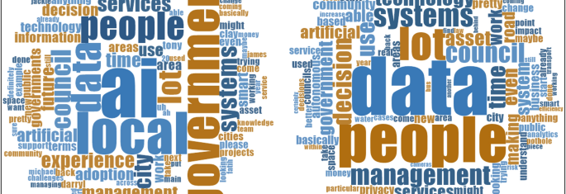
AI will be integrated into most digital technology products (e.g., goods and services) in 3-5 years (if not sooner!).
Notes:
That means we need to start applying AI considerations to most government services since digital tech is showing up in most government activities.

Slide 5
What AI technologies are we talking about?
Machine learning – learning from user provided input
Natural language processing – understanding spoken and written text and make the meaning useful
Robotics – think Amazon warehouse robot, but also for robotic processes (e.g., business process automation, processing of forms)
Generative AI/Large Language Models – Chat bots, article writer, programmer
Image (still and video) creation – based on prompt, produces artwork
Computer vision – understanding what it “sees” in video cameras or recordings.

Slide 6
Where do we find AI at work in local government today?
Operational Efficiency and Automation
Urban Planning and Infrastructure
Public Safety and Emergency Response
Citizen Services and Engagement
Environmental Sustainability
Healthcare and Public Health
Data-Driven Decision-Making
Notes:
Operational Efficiency and Automation:
Process Automation: AI streamlines routine tasks, such as managing utility services, traffic flow, and waste collection. It optimizes resource allocation and enhances operational efficiency ¹.
Predictive Maintenance: AI can predict equipment failures (e.g., water pumps, streetlights) and schedule maintenance proactively, reducing downtime and costs.
Urban Planning and Infrastructure:
Traffic Management: AI-powered traffic control systems optimize signal timings, reduce congestion, and improve overall mobility.
Energy Consumption: AI analyzes data to optimize energy usage in public buildings and street lighting.
Smart Grids: AI helps manage electricity distribution, load balancing, and renewable energy integration.
Public Safety and Emergency Response:
Predictive Policing: AI analyzes crime data to predict hotspots and allocate police resources effectively.
Emergency Dispatch: AI assists in prioritizing emergency calls and dispatching responders efficiently.
Natural Disaster Preparedness: AI models predict floods, earthquakes, and other disasters, aiding evacuation planning.
Citizen Services and Engagement:
Chatbots and Virtual Assistants: AI-powered chatbots handle citizen inquiries, service requests, and appointment scheduling.
Personalized Services: AI tailors services based on individual needs, such as personalized transit routes or health recommendations.
Social Services: AI assesses eligibility for benefits and identifies vulnerable populations.
Environmental Sustainability:
Air and Water Quality Monitoring: AI analyzes sensor data to detect pollution levels and trigger alerts.
Green Initiatives: AI supports urban forestry, waste reduction, and sustainable practices.
Healthcare and Public Health:
Health Monitoring: AI tracks disease outbreaks, monitors hospital capacity, and predicts health trends.
Healthcare Resource Allocation: AI optimizes healthcare facility locations and staffing.
Data-Driven Decision-Making:
Data Analytics: AI processes vast datasets to inform policy decisions, budget allocation, and service improvements.
Performance Metrics: AI provides real-time insights into service delivery and citizen satisfaction.

Slide 7
Discussion
Identify uses/examples of each in your organization
Machine learning
Natural language processing
Robotics Generative
AI/Large Language Models
Image (still and video) creation
Computer vision

Slide 8
Moving on…

Slide 9
What do we mean when we refer to “public policies”
Set the strategic direction, legal framework, and priorities for the government.
Agency management policies follow with policies that focus on the internal operations and procedures
Overlapping issue: when execution of public policies affect public actions that involve AI technology:
Use case: Role of data and AI: IoT and “big”
Notes:
Public policies set the strategic direction, legal framework, and priorities for the government.
Agency management policies focus on the internal operations and procedures of individual agencies in line with those overarching public policies.
Overlapping issue: when execution of public policies may public actions that may involve AI technology: IoT and big data use

Slide 10
Adopting technology has public policy implications.
What are some public policies that need to be considered when deploying an AI (or any technology) tech?
Ensure ethical and equitable tech use
Establish and maintain public trust
Oversee the effectiveness of tech use
Identify and address environmental and sustainability concerns
Understand the costs, benefits, and returns on the investment
Ensure a process to identify issues to be addressed and how to manage them

Slide 11
Public policies are not necessarily management policies.
But management policies can affect public policies
Service delivery choices and who is making them in the organization
How the data is governed and kept safe/secure
How to workforce capability to work with the tech
How we procure the tech
How the tech is managed and data security practices
Ensuring compliance with laws, policies, standards, accountability

Slide 12
Discussion ?
When we look at applying AI/tech tools to a given service or practice– what are examples of public policy considerations?

Slide 13
Use of data – where it comes from, security of storage, how it will be used, potential for public disclosure
The public/impact on recipients is equitable (access to all who need it), fair (decisions are made fairly and without illegal or unethical discrimination), accountable (organizational responsibility is clear)
Financial impact is understood and manageable
Impact on employment – replacing or augmenting employees or both?
Understanding the value of the impact of AI issue being addressed
Does AI affect or alter the underlying value of the services – is the impact appropriate; positive or negative across the range of those affected (there may be different impacts
Surveillance implications on criminal justice or quality of life
Impact of traffic signaling controls on congestion vs. speed?
Value of public safety priority signaling
Implications of red-light camera ticketing practices
Is decision-making transparent? Should machine-made decisions be reviewed by humans, and under what circumstances?

Slide 14
Remember Policy Analysis?

Slide 15
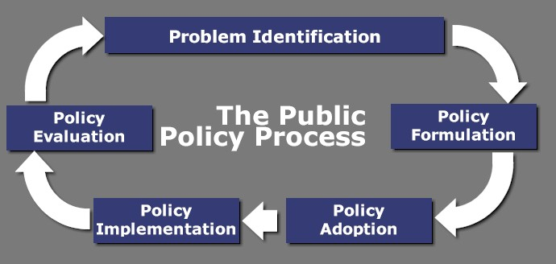

Slide 16
Considering values and policy decisions…
There are no single value problems
No one value always trumps others
Satisfying only one value is unjust – there are at least two in conflict and each is significant
Focus on win-win…getting the most from competing values
Trading for more or trading for less are viable, but not necessarily better
Notes:
That’s a course you likely had in grad school. We’re not going into it today. Recall that values often drive decisions.

Slide 17
Examples of AI Use and Public Policies
Notes:
Discuss based on title of each case – after discusses click to bullet points

Slide 18
Use Case #1 Use of surveillance cameras in various venues: e.g., parks, downtown, traffic. Public vs. private cameras (stores, doorbell, property)
How are they monitored (AI or human), how are “incidents” tagged and responded to?
Under what circumstances are private recordings made available or are accessible to public officials?
Who can access them and under what circumstances?
Value issues: personal security, crime prevention, data-driven decisions, public perception
Notes:
Discuss – based on the Use case description, discuss what policy questions or issues should be addressed for the policy.
Bullet points are shown after the discussion

Slide 19
Use Case #2 AI in personnel recruiting: from screening to interviewing to recommending
What data was it trained on to make decisions? Was it equitable? Was it tested? Is it kept refreshed?
How are the decisions supported or explained?
How is it maintained?
Value issues: “importance of the human touch,” dealing with inherent personal biases, how audited
Notes:
Discuss – based on the Use case description, discuss what policy questions or issues should be addressed for the policy.
Bullet points are shown after the discussion

Slide 20
Use Case #3 Gen-AI chatbots for inquires
Is access available to all groups e.g., income, language, location)? If not are alternatives available for those who can’t?
Can it be tied to a 3-1-1 or related intake management system?
Was training tested to ensure answer are reliable? What happens if a problem erupts from an incorrect answer?
How often is it updated?
Value issues: access/availability, accuracy, human touch
Notes:
Discuss – based on the Use case description, discuss what policy questions or issues should be addressed for the policy.
Bullet points are shown after the discussion

Slide 21
Your Turn

Slide 22
Make a policy inventory: Pick an AI tool and develop a brief policy issue inventory
Public policies
Ethics/equity
Ensure public trust
Oversight
Environment/sustainability
Costs/benefits/ROI
What else?
Management policies
Service delivery choices/who makes them
Data governance and protection
Workforce capacity
Procurement policy
Tech management
Legal/Regulatory/Community Compliance
Notes:
Group or individual assignment.

Slide 24
WAIT!!! Don’t forget the supplemental material!
Notes:
My use of AI; how to develop policies

Slide 25
AI Generated (and human edited) Supplemental Reference Contents (i.e., Cheat Sheet) Contents
10 Key Considerations in Setting Policies (via MS CoPilot)
AI Implementation Policies (via Google Gemini)
Key Public Policies to Consider when City Governments Adopt Artificial Intelligence
Artificial intelligence (AI) impacts on city government activities.
------------------------------------------------
Separate file – PDF of the deck slides

