Slide 1
Garbage Gone Genius: How AI and Innovations are Reshaping The Future of Environmental Services in Your Municipality
Richard Coupland
Vice President, Municipal Sales
Republic Services

Slide 2
Environmental Services Industry – Complexity at Scale
AI
AI
AI
AI
AI
Collection Routes
MSW
Bulk
Recycling
Organics
ES / HHW
Over 5.1M stops per day across our operation
Trucks touch 800-1200 homes per day
Operations and Material flow never stops
Tip Floors at Transfer Stations and Recycling Centers must be cleared daily
Efficiency and insights are key
Consolidation
Transfer Stations
TSDF
Processing / Disposal
AI
AI
Landfill
Recycling Centers
Compost / Digesters
Haz Landfill
Circular Processing
AI
Landfill Gas to Energy
Polymer Centers
Circular Products
Power / RNG
New Products
Compost / Power / RNG
Utilizing AI to increase productivity, quality and accuracy of field data is critical to running an essential service operation at scale.

Slide 3
AI Cameras on Route

Slide 4
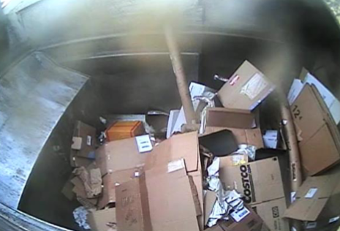
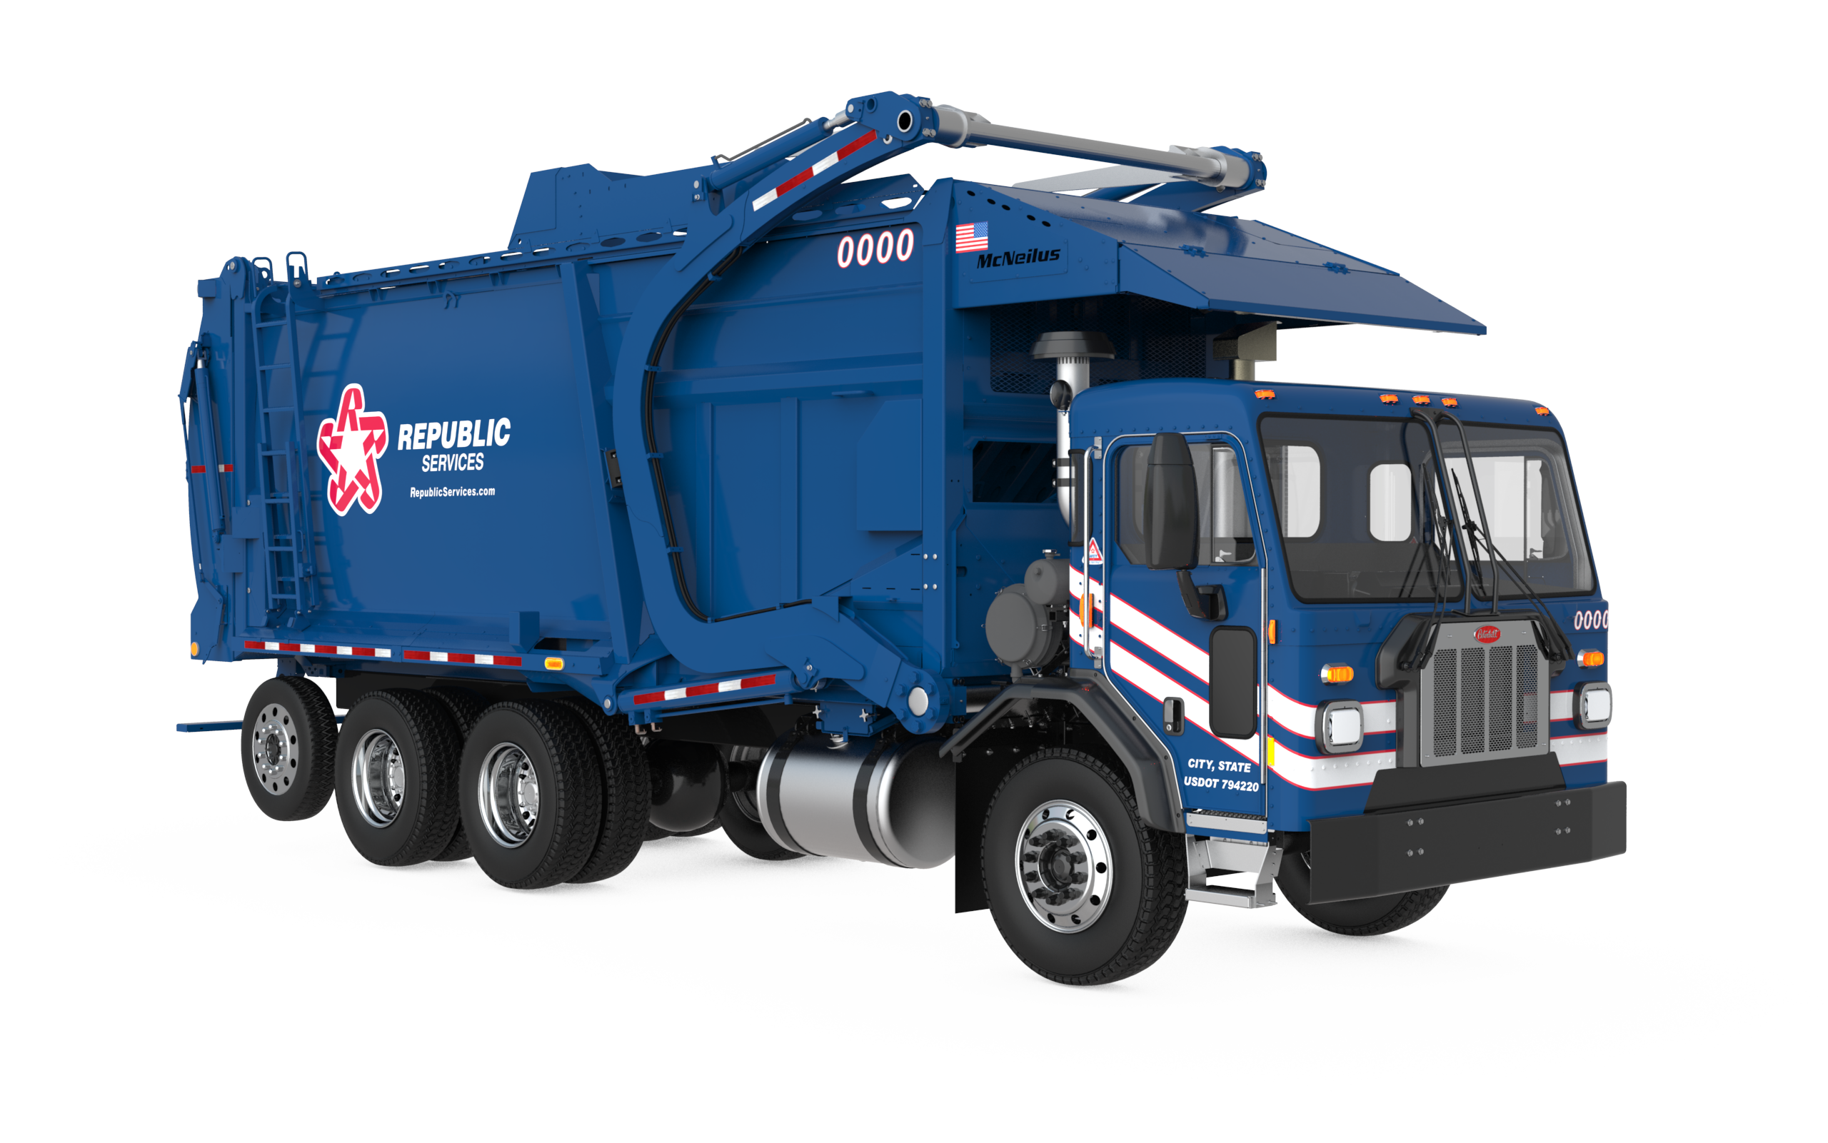
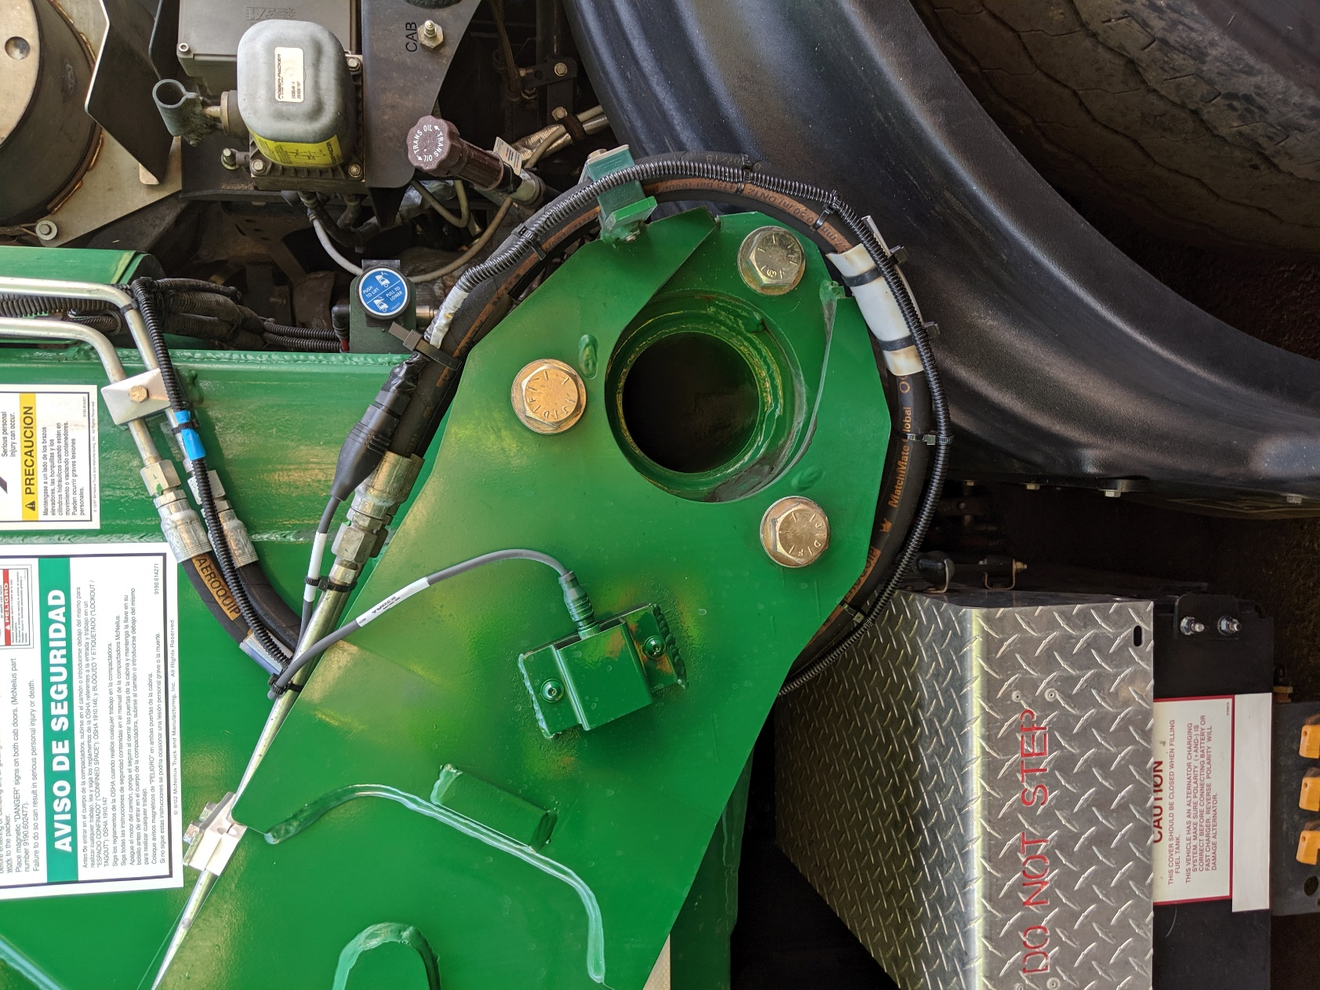
Route Collection - Contamination Tracking
Recycling Contamination
Hopper Camera
Detect contamination
Video clip captured
Cameras and AI technology enable inspection and video of each collection
Unlocks potential for individual public education and feedback
Ultimately intended to drive behavior, lower contamination, and achieve better quality
Inclinometer
Service verification

Slide 5
Route Collection - Extra Yards
Detect extra yards / over-filled containers
Capture image and document
Right-size collection service if appropriate
Safer - Eliminates manual effort and driver distraction

Slide 6
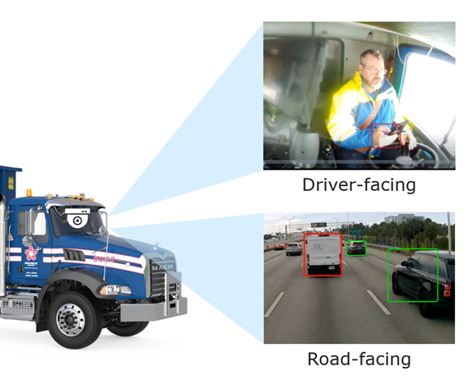
Driver Safety / Collision Avoidance
Internal and External facing cameras with AI offer safer operations through AI-assisted alerts and reporting.
Ties to driver performance and coaching opportunities.
Newer EV vehicles have state-of-the-art camera and sensor technology

Slide 7
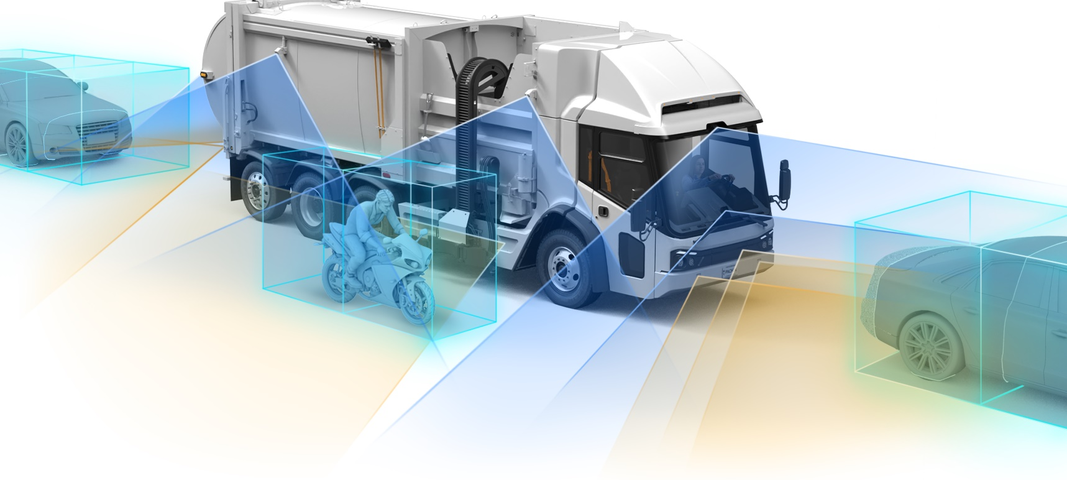
EV – Next-Gen Driver Safety / Collision Avoidance
Driver Visibility
Blind Spot
Braking
Window design
Camera system
360° view camera
Blind spot warning
Cross traffic
Auto braking
Collision warning

Slide 8
AI in Recycling and Circularity

Slide 9
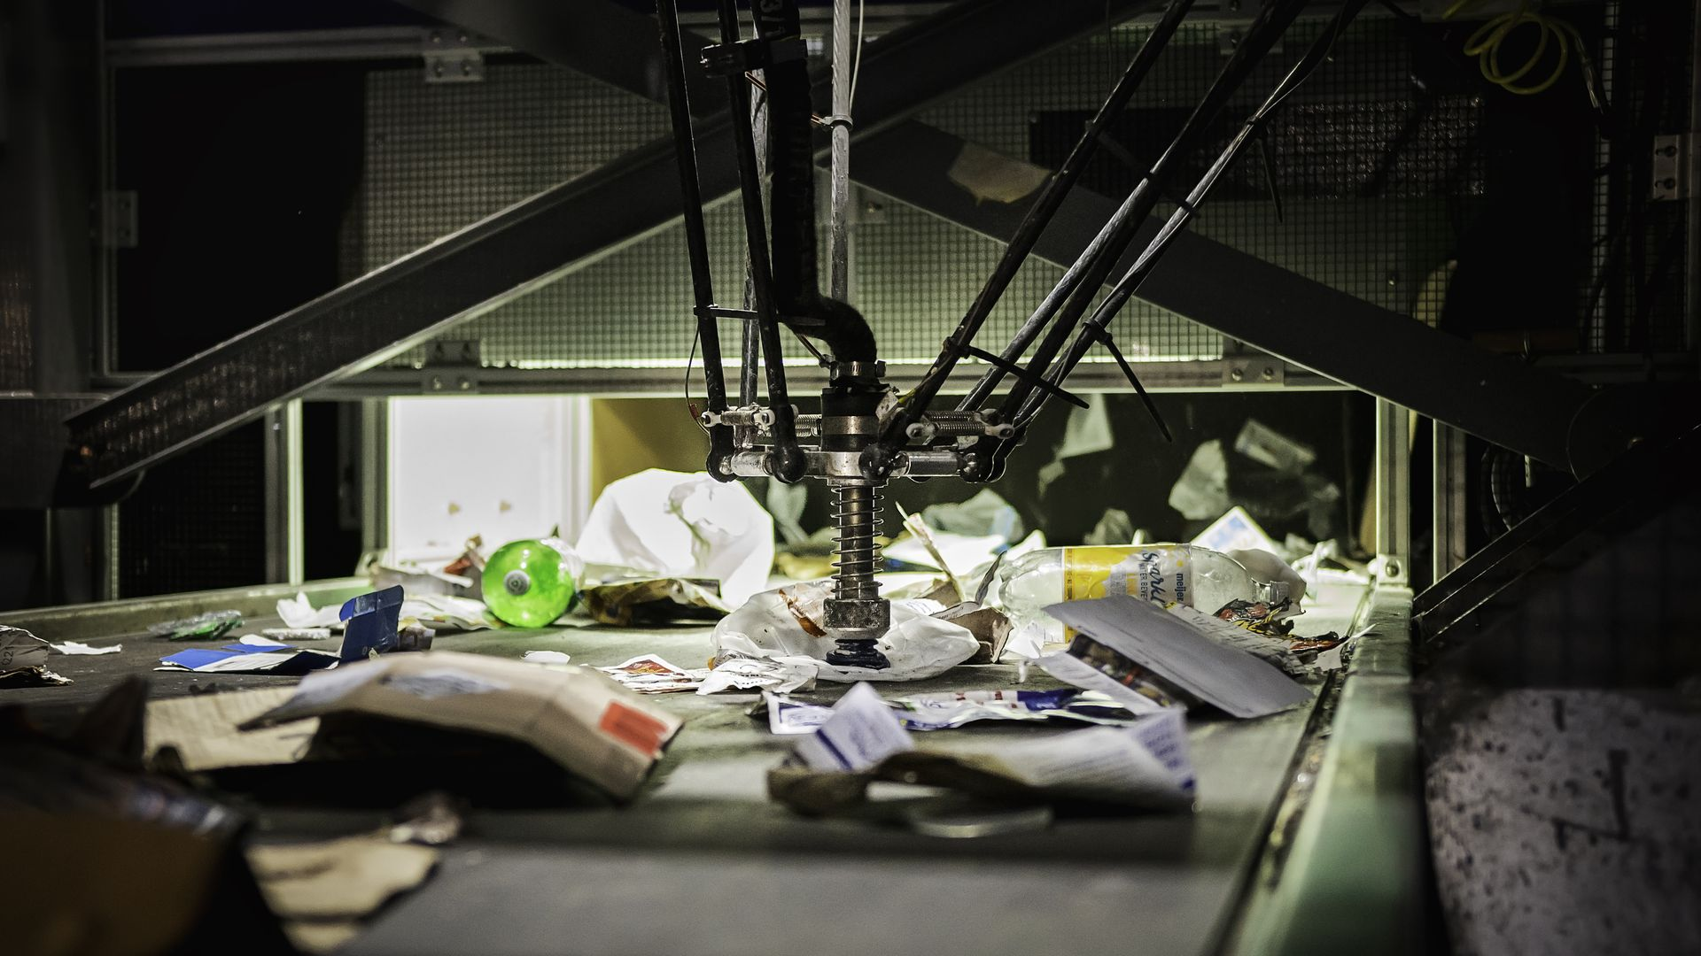
Sorting Recyclables - Robotics
Identifying and picking individual items
May eliminate need for some manual labor
Best suited for predictable materials (shape, etc)

Slide 10
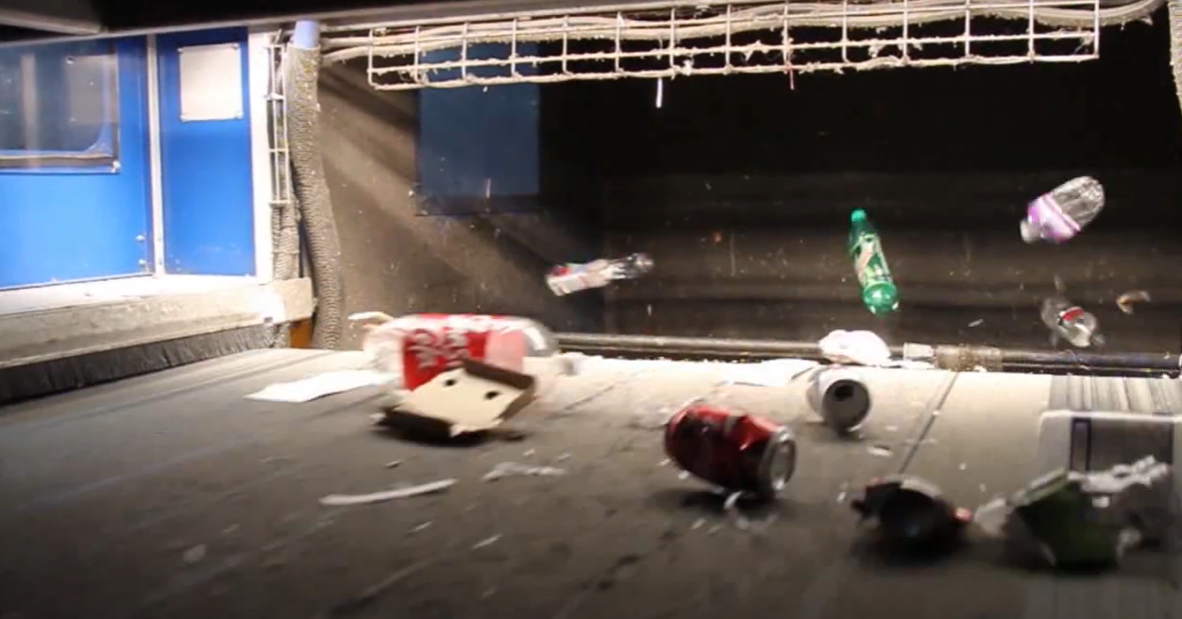
Sorting Recyclables - Optical
Identifying specific material and triggering sortation techniques
PET sort in image – AI triggers air blasts that lift material to alternate line

Slide 11
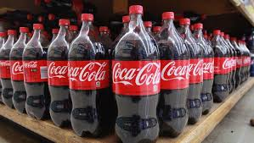
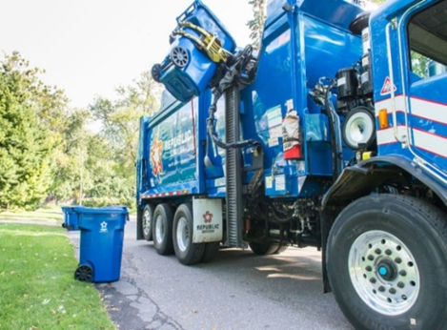
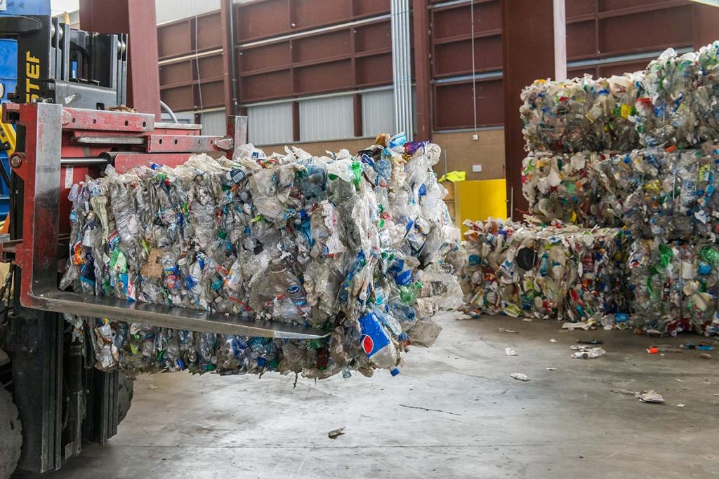
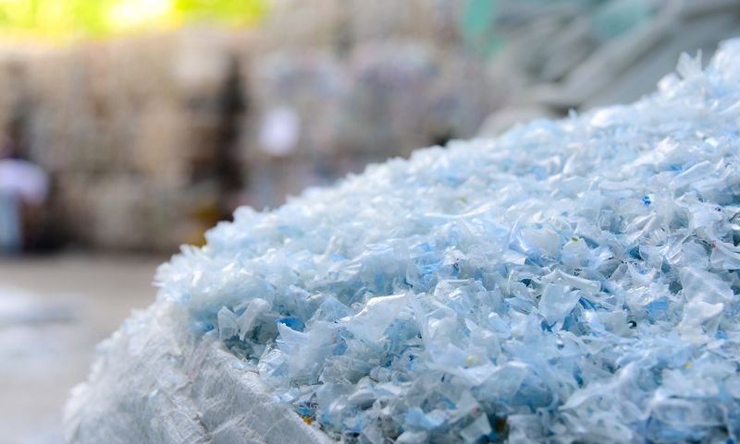
Plastics Circularity – Polymer Centers
Residents purchase, use and recycle plastics in curbside cart
Collection trucks take plastics to traditional MRF
MRF bales of plastics transported to Polymer Center
Chipped, washed flakes transported to Blue Polymers for production preparation
Production / food grade pellets sold to CPG companies to create new packages
Solving plastics circularity at a national scale
4 Centers planned to cover the Country – 1st center opened in Dec 2023 in Las Vegas
AI enables fine-grain sorting (polymers and olefins, colors, etc)

Slide 12
Other Applications

Slide 13
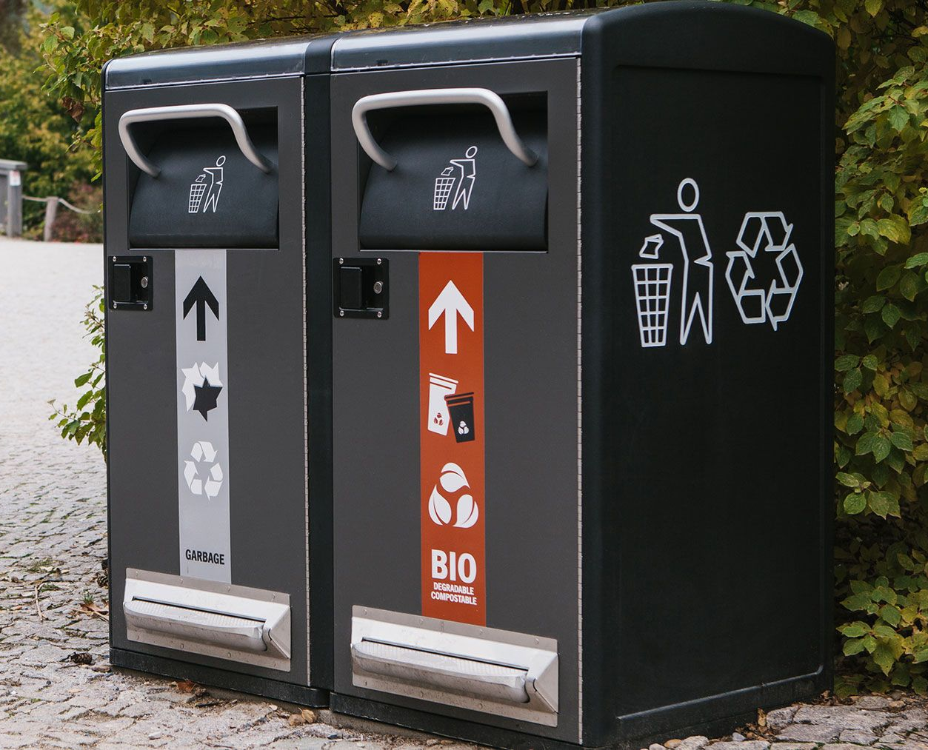
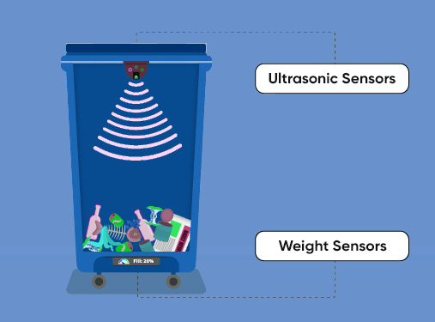
Smart Bins
Used by some in industry
AI monitors waste levels and can alert when collection is needed
Can track waste generation patterns and offer insights into future collection route planning

Slide 14
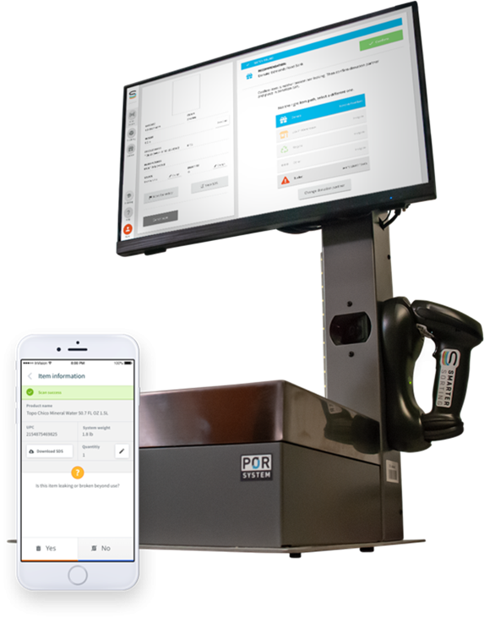
Hazardous/Non-Hazardous Waste Classification
Safely and accurately classifies and segregate RCRA, hazardous and non-hazardous waste
Allows retailers to scan a product’s bar code and accurately identify, weigh and categorize non-sellable products.
Immediately provides the employee clear instructions on how to compliantly manage the product for donation, salvage, recycling or disposal.

Slide 15
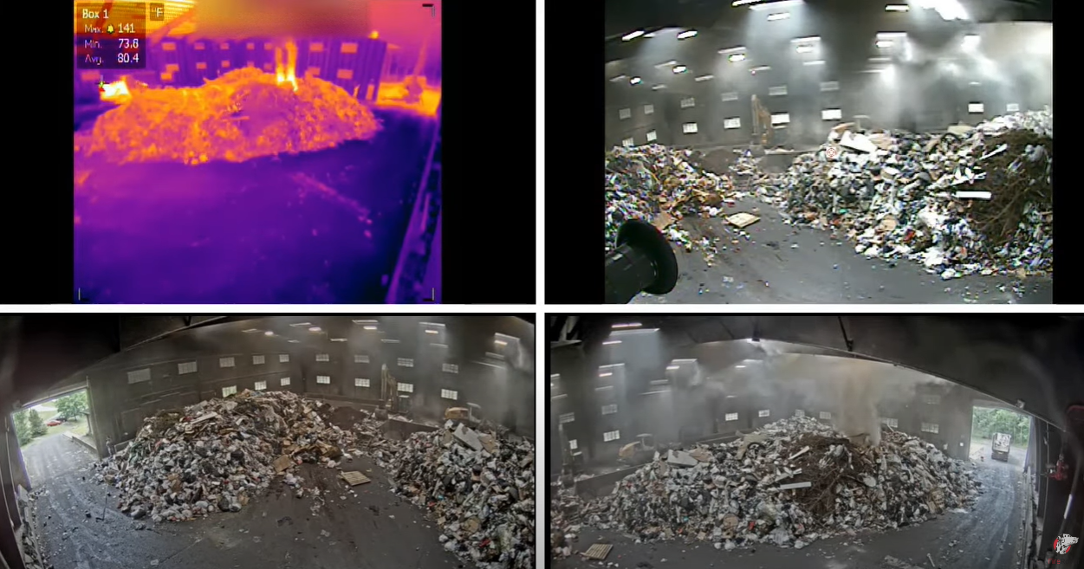
Fire Rover
AI-driven fire monitoring and suppression
Thermal cameras monitor and detect elevated temperatures on tip floor
Remote / Centrally monitored 24/7
Enables early warning, action, and suppression

Slide 16
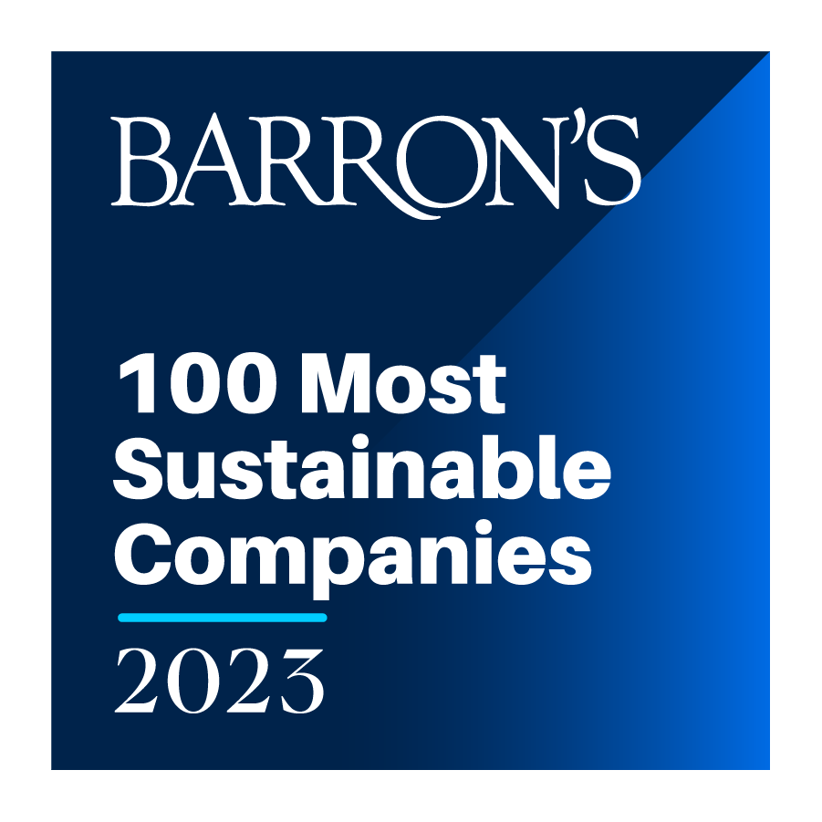
RICHARD COUPLAND Vice President, Municipal Services e: RCoupland@RepublicServices.com o: 480.718.0384
c: 480.225.0481

