Slide 1
Enhancing Climate and Disaster Resilience in Your Community: Exploring AI Tools and Applications for Local Government Managers
Chris Miller, AICP Director – Local Government Services
Patrick Howell, Program Manager – Community Resilience

Slide 2
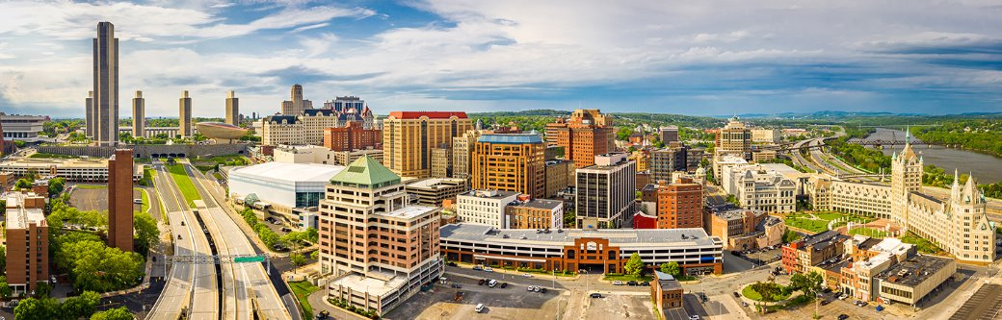
Our Values and Ideals
Empowering People to Serve Communities
^{Delivering Expertise}
Implementing enduring solutions that strengthen community
Strengthening trust and confidence in governance
Accelerating progress through innovation and trusted partnerships

Slide 3






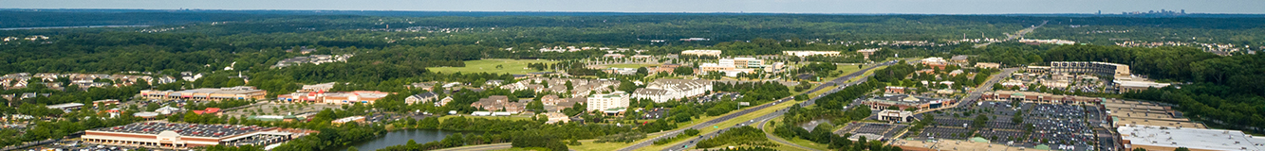
Our Board of Directors
3

Slide 4
Addressing Climate and Disaster Risk at the Local Level
Increasing frequency and severity of events
Rising costs from extreme weather and disaster events
Local Government Responses
Barriers to Building Resilience

Slide 5
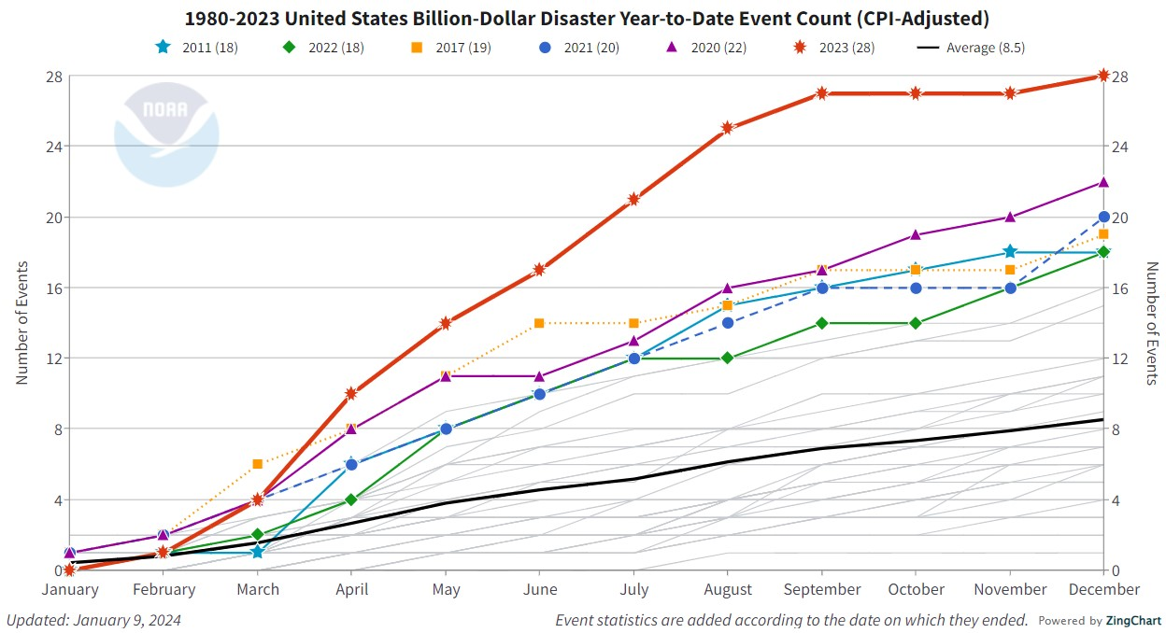
Increasing Climate and Disaster Risk
Source: NOAA National Centers for Environmental Information (NCEI) U.S. Billion-Dollar Weather and Climate Disasters (2024). https://www.ncei.noaa.gov/access/billions/, DOI: 10.25921/stkw-7w73

Slide 6
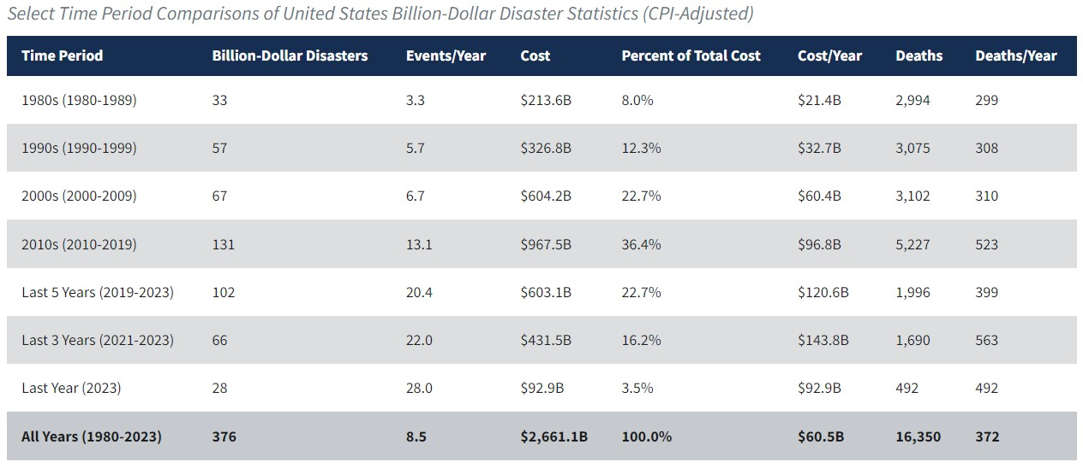
Increasing Climate and Disaster Risk
Source: NOAA National Centers for Environmental Information (NCEI) U.S. Billion-Dollar Weather and Climate Disasters (2024). https://www.ncei.noaa.gov/access/billions/, DOI: 10.25921/stkw-7w73

Slide 7
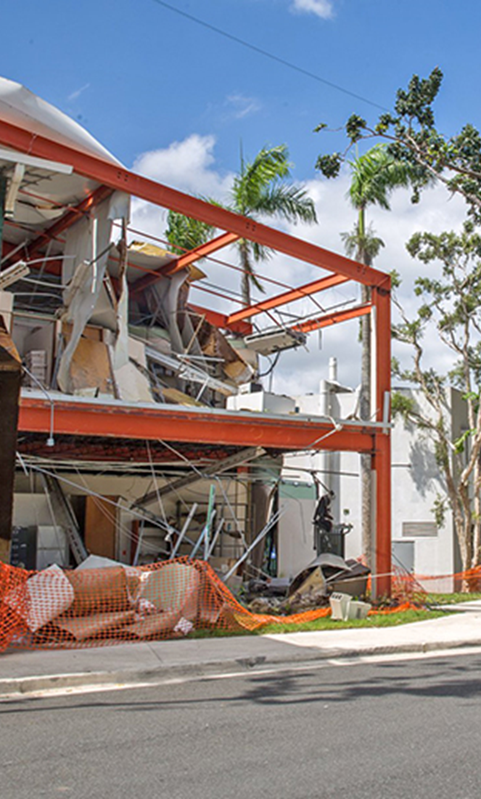
Costs of Inaction to Climate and Disaster Risk
Negative Fiscal Impact for Local Government
  Reduced Property, Sales, and Income Tax Revenue
    Major hurricanes shown to reduce local government revenues by 7% over the ensuing 10 years after an event
Economic Losses for Businesses After Disaster
  The U.S. Chamber of Commerce Foundation estimates losses for:
    Small Businesses (< 500 employees): $3,000/day
    Midsize Business: (501–999 employees): $23,000/day
    Large Businesses: (> 1,000 employees): $84,000/hour
Majority of small business will not survive a major disaster
  40-60% of small businesses will never reopen following a disaster.
  90% of small companies fail within a year unless they can resume operations within 5 days.
Sources:

Slide 8
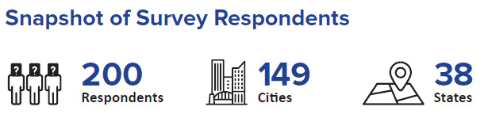
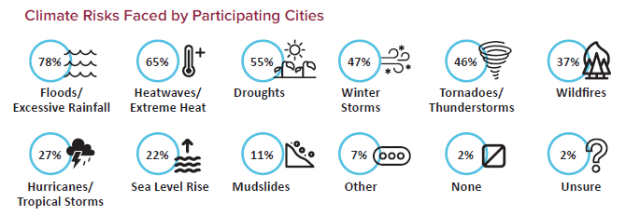
Local Government Response to Climate and Disaster Risk
Source: NOAA National Centers for Environmental Information (NCEI) U.S. Billion-Dollar Weather and Climate Disasters (2024). https://www.ncei.noaa.gov/access/billions/, DOI: 10.25921/stkw-7w73

Slide 9
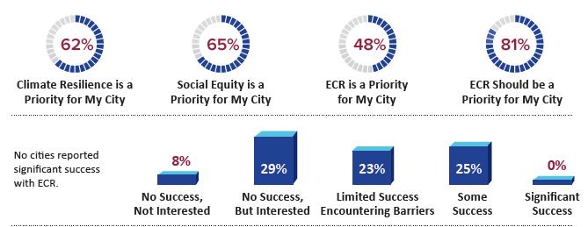
Local Government Response to Climate and Disaster Risk
Source: NOAA National Centers for Environmental Information (NCEI) U.S. Billion-Dollar Weather and Climate Disasters (2024). https://www.ncei.noaa.gov/access/billions/, DOI: 10.25921/stkw-7w73

Slide 10
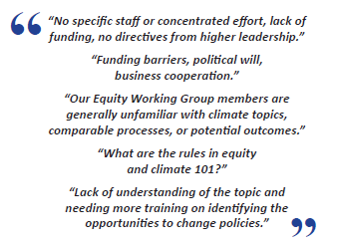
Local Government Barriers to Building Resilience to Climate and Disaster Risk
Constrained Financial Resources and Funding
Limited Staff Capacity
Limited Technical Resources, Tools, and Data
Lack of Political Will

Slide 11
Using AI for Risk Assessment and Modeling

Slide 12
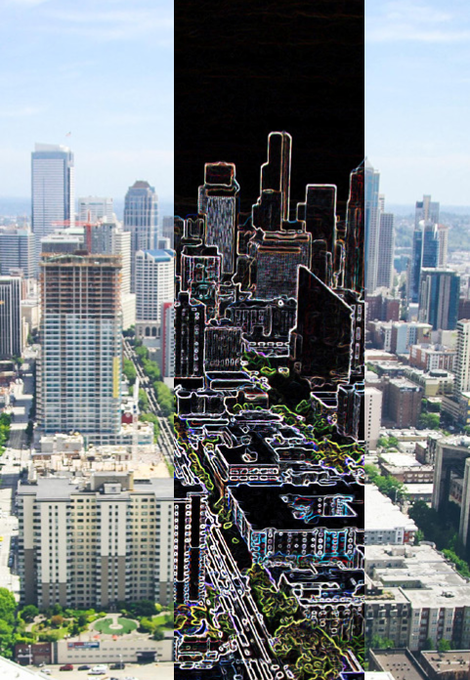
AI for Predictive Risk Assessments –
“Digital Twins”
A digital twin is the combination of a computational model and a real-world system, designed to monito, control and optimize its functionality.
Through data a feedback, both simulated and real, a digital twin can develop capacities for autonomy and to learn from and reason about its environment.
Source: ARUP. Digital Twin: Towards a Meaningful Framework; Arup: London, UK, 2019

Slide 13
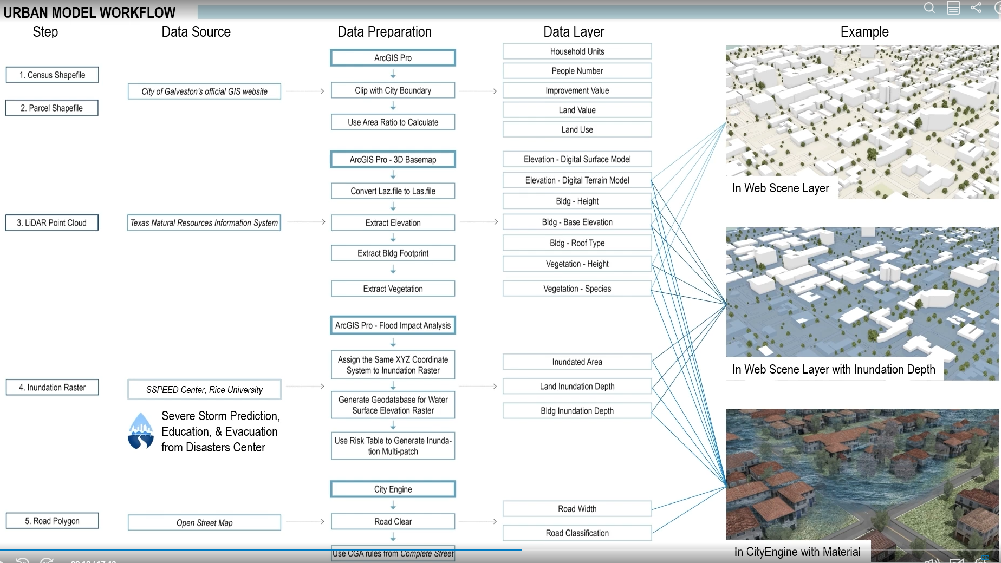
Digital Twin Case Study – Galveston, TX
Source: ARUP. Digital Twin: Towards a Meaningful Framework; Arup: London, UK, 2019

Slide 14
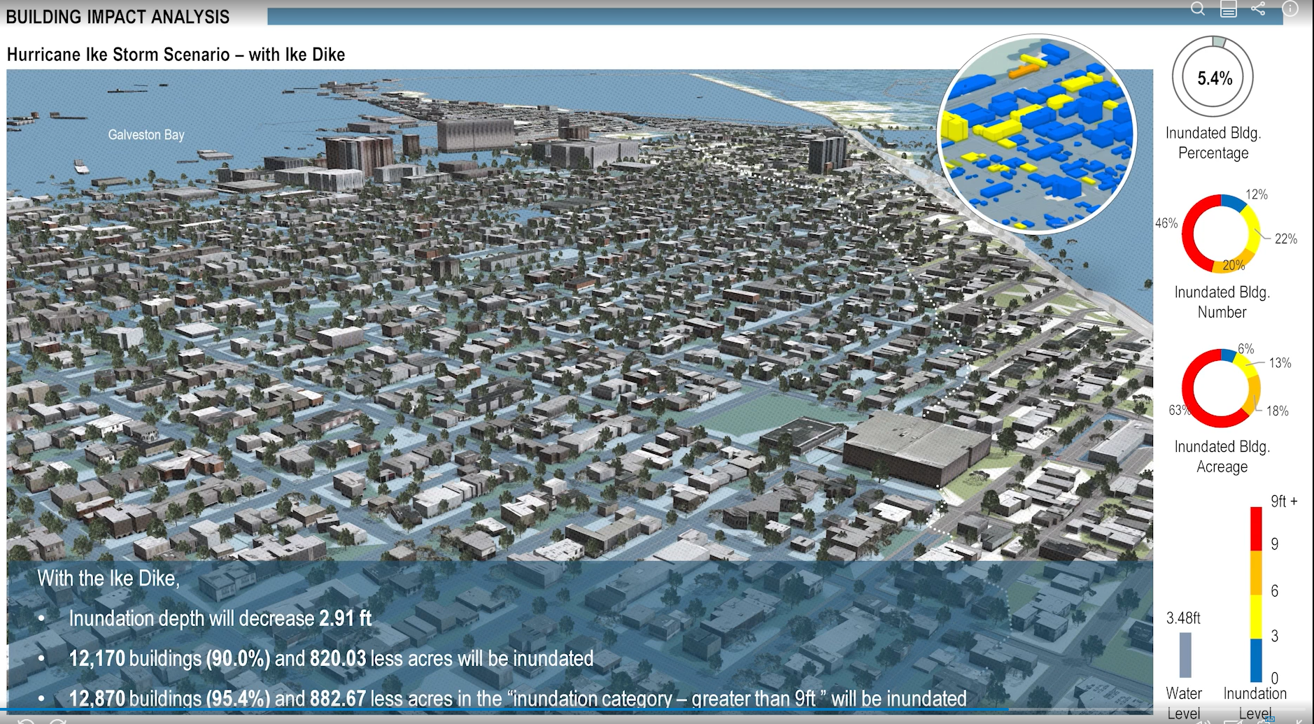
Digital Twin Case Study – Galveston, TX
Source: Galen Newman, Zhenhang Cai: Combining Digital Twin Models with Landscape Performance and Urban Analytics, ESRI (2022).

Slide 15
Using AI for Public Engagement
Chris Miller

Slide 16

Whole Community Resilience Planning (WCRP) Program Overview
Purpose: Increase community resilience in Puerto Rico by providing tools, funds, and support to create resilience plans.
Eligible Participants: Nonprofit organizations and municipalities. Communities can collaborate with nonprofits or municipalities.
Focus Areas: Education, health, economic development, housing, infrastructure, and environment.
Interactive Tools: Social Capital Maps and Vulnerability and Risk Maps for community planning.

Slide 17
AI Applications
Potential Tools
AI Application | Description | Column 3
Data Analysis | Interactive Tools: Social Capital Maps and Vulnerability and Risk Maps for community planning. | BigQuery, IBM Watson
Predictive Modeling | Interactive Tools: Social Capital Maps and Vulnerability and Risk Maps for community planning. | TensorFlow, PyTorch

Slide 18
AI Applications
Potential Tools
AI Application | Description | Column 3
Community Engagement | Interactive Tools: Social Capital Maps and Vulnerability and Risk Maps for community planning. | ChatGPT, Microsoft Bot Framework
Resource Allocation | Interactive Tools: Social Capital Maps and Vulnerability and Risk Maps for community planning. | Interactive Tools: Social Capital Maps and Vulnerability and Risk Maps for community planning.
Monitoring and Evaluation | Interactive Tools: Social Capital Maps and Vulnerability and Risk Maps for community planning. | Interactive Tools: Social Capital Maps and Vulnerability and Risk Maps for community planning.

Slide 19

ChatGPT
Information Dissemination:
  Automated responses to FAQs about community programs, events, and services.
  24/7 availability to ensure accessible information at all times.
Feedback Collection:
  Conduct interactive surveys and polls to gather community feedback.
  Real-time analysis of feedback to identify trends and common concerns.

Slide 20
ChatGPT
Virtual Assistance:
  Personalized guidance and support for navigating local resources and services.
  Event participation support, including registration and updates.
Community Forums
  Facilitation and moderation of online community forums and discussion groups.
  Suggesting relevant discussion topics based on community interests.

Slide 21
Using AI for Resilience Planning and Capacity Building

Slide 22
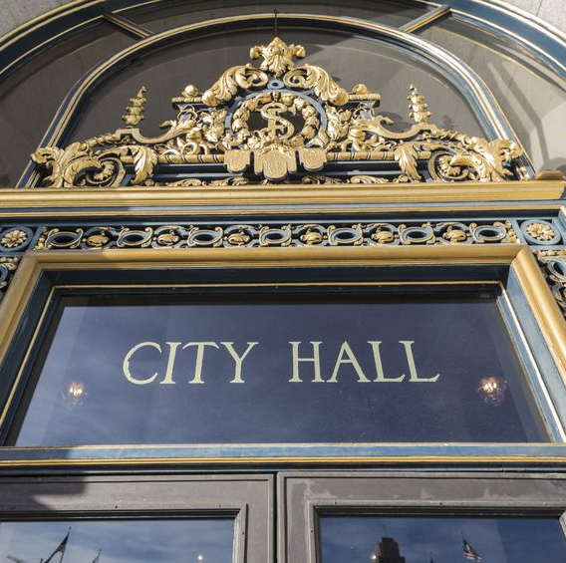
AI for Resilience Planning & Capacity Building
Perform comprehensive review and analysis of resilience related barriers and enablers
Identify programs, projects, and budgets to leverage across departments to enhance resilience impacts
Understand opportunities to enhance organizational capacity for resilience implementation

Slide 23
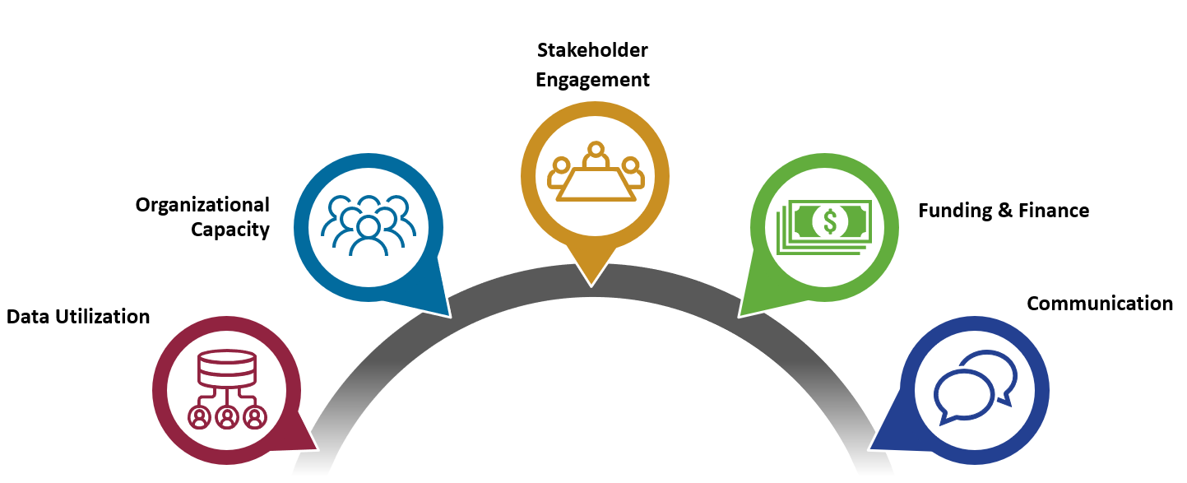
Community Resilience Assessment Framework & Tools
(CRAFT)

Slide 24
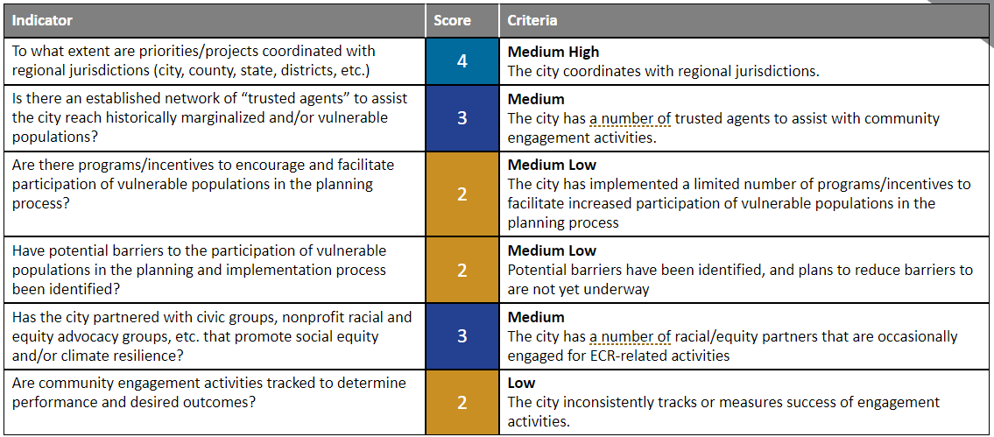
CRAFT FINDINGS
Traditional assessment = 40 hours of desk research, 20 hours of stakeholder engagement
Automated assessment = 10 minutes for desk research. Stakeholder Engagement still required.

Slide 25
AI for Resilience Planning and Capacity Building
Benefits
  Reduces staff burden
  Objective analysis based on available data
  Lower cost
Limitations
  Requires human review and analysis
  Does not capture nuance (political will, transitional initiatives, etc.)

Slide 26
DISCUSSION
Successes, Challenges, and Opportunities

Slide 27
Enhancing Climate and Disaster Resilience in Your Community
Patrick Howell | Community Resilience Program Manager
C: 571.926.0945 | phowell@ibts.org
Ashburn, VA 20147
www.ibts.org

