Slide 1
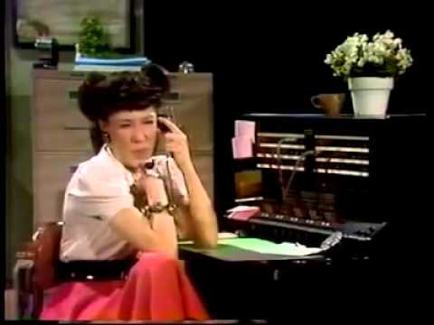
Can AI Answer the call?
Thomas J. Wieczorek, Director
Center for Public Safety Management

Slide 2
Is there a problem?
The workforce crisis is occurring at a time when 9-1-1 telecommunicators are fielding more calls each year. Among the findings:
36% of call centers reported having fewer positions filled in 2022 than in 2019.
Nearly one-third reported stunning vacancy rates in 2022: 13 reported that 70% or more of positions were unfilled; 92 reported a vacancy rate between 50-69%; and 166 reported rates of 30% to 49%.
Nearly 4,000 staff departures were recorded in one year collectively among the centers. Departing staff with at least one year of experience cited pay, work hours, and stress as reasons for leaving.
Only 27% of centers reported no change in actual staffing levels over the most recent 4-year period.
IAED (International Academics of Emergency Dispatch) June 20, 2023
POLICE OFFICER HIRING IN US INCREASES IN 2023 AFTER YEARS OF DECLINE
The survey shows that while small and medium departments had more sworn officers than they did in January 2020, large departments are still more than 5% below their staffing levels from that time, even with a year-over-year increase from 2022 to 2023.
Associated Press, April 28, 2024
Fire departments struggling to recruit as job’s stresses outweigh rewards
Baltimore Banner 3/3/2024
EMS in critical condition
A national survey reveals EMS economic and operations redesigns that would have been considered heresy just years ago
Matt Zavadsky, CPSM, MS-HSA, EMT April 17, 2023
EMS1

Slide 3
Time for your question
Are you experiencing challenges with hiring and retention?
Police?
Fire?
Dispatch
EMS?
Have you asked “why?” And the answer is -----

Slide 4
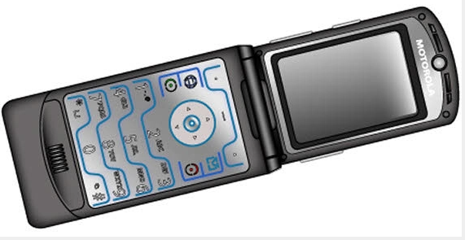
Is there a common problem?
Pay scales which have resulted in many communities giving double digit wage increases – outside of contract expiration
Pay raises have exacerbated budgets and led to further chaos
EMS in crisis
Pension changes
Burn out; lack of clear mission and vision or community support

Slide 5
And the number one answer is:
Toxic Work
Environment
(PERF, US Fire Admin, NVFC, NENA, NAEMT)

Slide 6
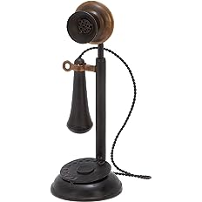
Dispatch

Slide 7
9-1-1 and dispatch
First 9-1-1 call was made in 1968. On February 19, 1968 in Haleyville, Alabama by Rankin Fite, the Speaker of the House of Alabama to Congressman Tom Bevill just weeks after Congress declared 9-1-1- the National Emergency Number
Last year there were 240 MILLION calls handled by 9-1-1 centers.
U.S. has 5748 Primary and secondary PSAP’s and 3135 counties, parishes, independent cities, boroughs and census areas.
80% of the calls today are WIRELESS

Slide 9
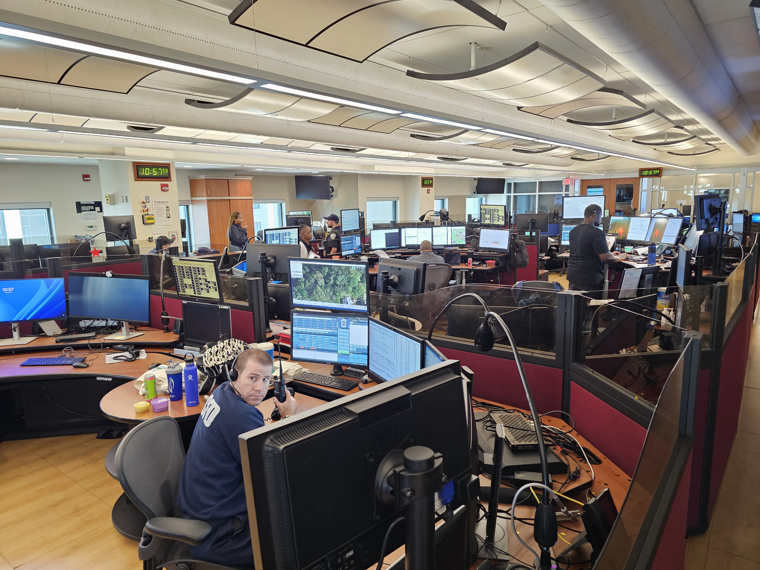
Arlington, VA
Emergency Communications Center answers approximately 400,000 calls from citizens each year and dispatches over 300,000 of those to police; 45,000 to fire; and 55,000 to emergency medical services.

Slide 10
Data is Critical – All disciplines
Category | Winter |  |  | Summer
 | Dispatch | Travel | Response | Dispatch | Travel | Response
Accident | 12.0 | 14.5 | 24.3 | 12.0 | 15.0 | 27.9
Alarm | 3.6 | 10.4 | 13.9 | 5.1 | 9.8 | 13.3
Animal | 24.9 | 21.6 | 47.6 | 29.8 | 22.8 | 40.1
Assist other agency | 33.0 | 12.2 | 39.4 | 12.4 | 12.0 | 21.6
Check | 31.9 | 10.4 | 50.7 | 33.1 | 17.4 | 44.4
Citizen contact | 10.4 | 20.7 | 24.0 | 15.9 | 9.9 | 23.9
Civil problem | 19.2 | 19.2 | 34.5 | 25.4 | 20.6 | 36.7
Crime against persons | 14.1 | 13.6 | 27.7 | 17.6 | 12.5 | 35.2
Crime against property | 24.9 | 20.5 | 41.2 | 24.6 | 14.6 | 35.8
Crime against society | 10.7 | 15.0 | 26.5 | 16.7 | 13.7 | 28.8
Disturbance | 7.4 | 12.9 | 19.1 | 12.2 | 9.3 | 24.2
Investigation | 26.0 | 21.9 | 49.9 | 31.3 | 19.6 | 47.1
Mental health | 24.3 | 26.6 | 33.5 | 34.0 | 21.9 | 48.1
Miscellaneous | 31.9 | 16.9 | 50.1 | 28.1 | 19.2 | 44.0
Suspicious incident | 15.7 | 15.4 | 30.5 | 13.5 | 13.1 | 28.5
Traffic enforcement | 14.9 | 21.3 | 32.6 | 25.7 | 17.5 | 47.5
Violation | 25.1 | 15.8 | 40.7 | 39.6 | 20.7 | 49.4
Total Average | 18.8 | 16.2 | 33.9 | 19.2 | 14.6 | 34.3
What are the processes that you have at your dispatch center?
What are the non-emergency processes?
Map out the processes.
Arlington removed 180,000 administrative calls going into center
Worked with Amazon (AWS)
Notes:
Thank Jacob Saur and Timothy Kane of Arlington. Goal was to remove 40,000 calls into 9-1-1. Towing calls used to come through; fire alarms and maintenance used to come through. Set up flow process and calls no longer come through dispatch (where is my car, where did the car go, etc). Now 180,000 admin calls off the floor. AWS captures info and “learns” where to send calls from voice recognition and script. But you have to start with the call, map the process, identify where calls should go. AI says “I know what you are asking, what is the reason for this call?” Expanded to storm damage calls, frequent calls (why are the sirens going off?) Marine Marathon (100 calls) As you build the workflows, AI recognizes and links to pages where people can get info. The calls never hit the floor. Other examples: snow storms, heavy rains, etc. As you develop, AI begins to recognize more and more and builds on the process.

Slide 11
Problems
As you use AI and it recognizes – is there a review process?
Are you checking data to make sure calls don’t go into the cloud?
In Arlington – “Does Amazon do EVERYTHING!?!”
Early in process for admin, after 30 seconds and no answer, it dropped the call. Adjusted and rings until answered.
Learning with amazon; early adapter.
User group
Silos – learning how to bridge the gaps

Slide 12
Next up
Chat bots – questions and answers when reporting incidents.
Identify minor incidents and those can be reported on-line (property damage accidents, non-serious calls for insurance, credit cards, etc.)
Alexandria, VA identified 14 types and people can fill out reports.
San Diego was first, user groups growing. Don’t re-invent the wheel (design and publish work flows)

Slide 13
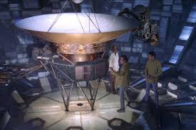
Learning – all Emergency Services
AI has listening skills
AI does not YET have empathy for callers
Once AI learns, it can handle more but there will always still need to be a human preceptor
Force multiplier

Slide 14
Policing

Slide 16
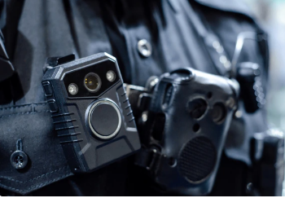
Artificial intelligence
Axon – have you ever read police reports?
Tied into body camera footage; transcripts of all body cam footage.
Crime prediction (UK)
DNA data searches (people upload DNA results – scanning and matching)
Facial recognition
Silos – learning how to bridge the gaps

Slide 17
Police

Slide 18
Where is it working?
Alexandria, VA that now has 14 categories of reports that tie through dispatch and avoid having police dispatched
Police were created to deal with failure – education, social issues, Axon – have you ever read police reports?
Crime prediction, accident prediction, live crime reporting, camera footage when crime occurs.
On July 13, 2020, the New Yorker published an article by Jill Lepore titled, The Invention of the Police; Why did American policing get so big, so fast? The answer, mainly, is slavery. In the article, Ms. Lepore might best sum up the challenge cities, city managers, police chiefs, and elected officials face: "The crisis in policing is the culmination of a thousand other failures — failures of education, social services, public health, gun regulation, criminal justice, and economic development.“
Jill Lepore, “The Invention of the Police; Why did American policing get so big, so fast? The answer, mainly, is slavery.” https://www.newyorker.com/magazine/2020/07/20/the-invention-of-the-police. The New Yorker, July 13, 2020.
.

Slide 19
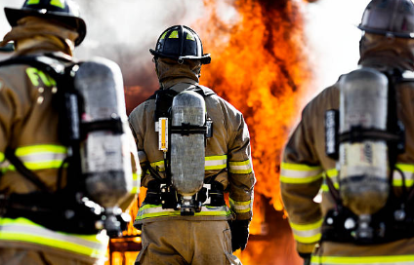
Fire

Slide 21
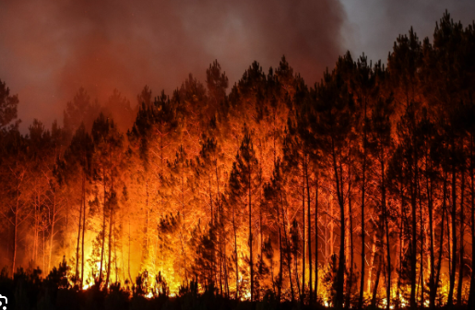
Fire intelligence
UK (as mentioned) re-wrote how it deployed. Instead of viewing a fire and extinguishment as “success,” it was viewed as a failure.
What caused the fire? Fire in bedroom. Fire in bedding. Fire started by smoking. Smoking cessation program with local community non-profits to eliminate smoking and fire reductions.
60% + reduction in fires, property losses, injuries and deaths, improved firefighter safety
Wildfires – can identify before humans can
Are you mining the data to get to the root causes?
Risk management (all hazards, all risks) GFOA!!!

Slide 22
EMS

Slide 23
EMS Unit Hour Utilization and Getting it Right
AI predicts where incidents are likely to occur – Unit Hour Utilization
Moving units increases the amount of billable hours your service has versus standby
More UHU, more billing, less costs to make up through billing, special charges, millage, etc.
Sending the right unit to the right location at the right time
Shorting response times to incidents
Billing

Slide 24
EMS

Slide 26
Future

Slide 27
What about the future?
If you haven’t started to look at it, you are behind
Do not recreate the wheel – look at user groups and templates to make it easier for your team – it’s okay to steal!
Criminals are already up on AI, substituting voices, videos, and other “doctored” information to throw off investigators
Remote or work from home dispatch
Make sure the software works

Slide 28
Questions?
Thomas J. Wieczorek
Director, CPSM
616-813-3782
twieczorek@cpsm.us

