Slide 1
THE PERFECT STORM
Mental Health, depression, and suicide prevention

Slide 2
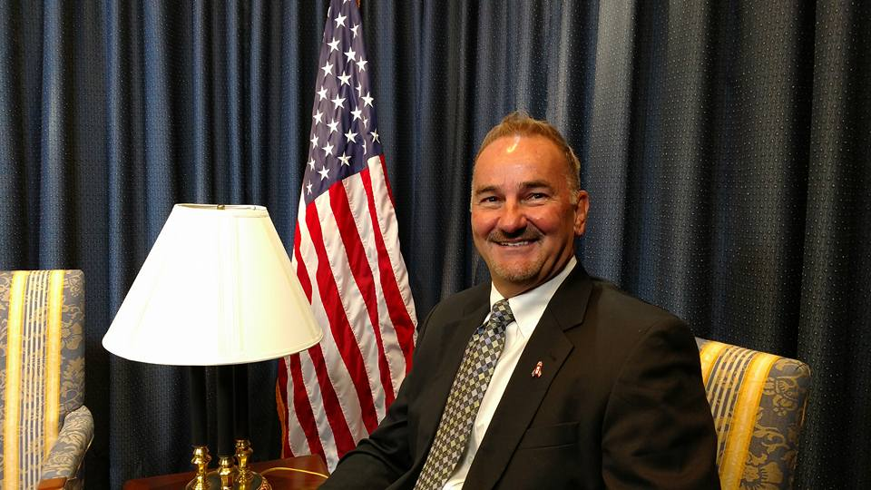
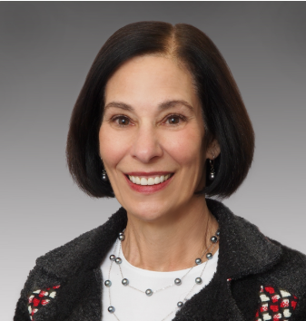
Thomas Wieczorek
Helaine Zack
Today’s Presenters

Slide 3
Center for public safety management
CPSM has conducted over 388 public safety studies, in 250 jurisdictions, in 46 states and Canada
CREATED FOR MANAGERS
Master and Strategic Plans – Police, Fire and EMS
Risk Assessments
Public Safety Training
Dispatch, EMS, Police & Fire Technical Assistance
Chief Selection Advantage
Standards of Response Coverage
Representation at national level for ICMA
Exclusive provider of public safety technical assistance to ICMA

Slide 4
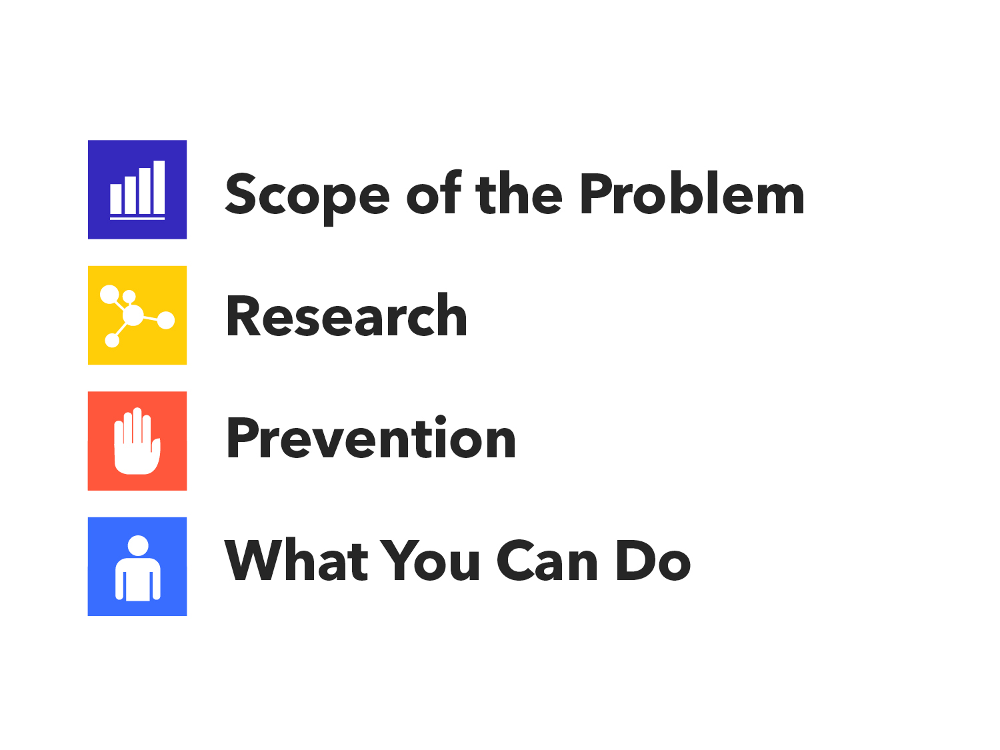
Notes:
The purpose of Talk Saves Lives is to provide community members with a general overview of what suicide is, who it affects, what we know about it and what can be done to prevent it.
This presentation will cover some statistics to give you an idea of the scope of the problem of suicide.
We will review some key research findings, including the risk and protective factors that relate to suicide.
And we’ll talk about what works and what we can all do to prevent this leading cause of death.

Slide 5
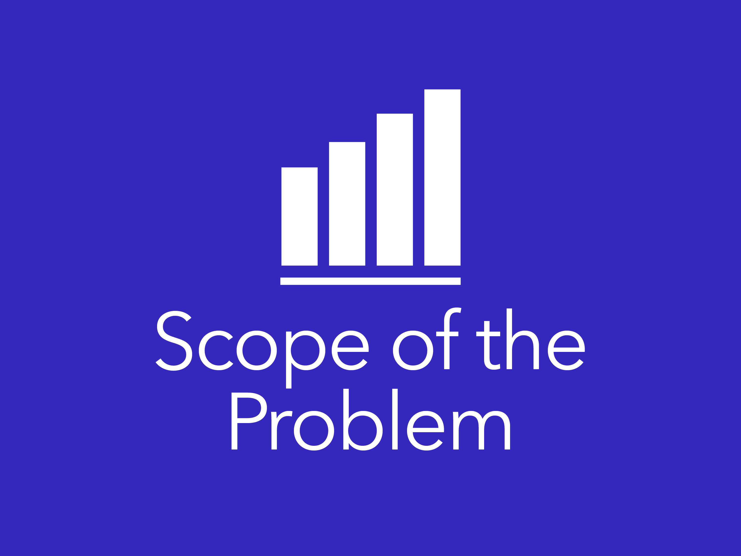
Notes:
Suicide is a significant issue that affects individuals, families and communities worldwide.
So let’s start with some statistics that demonstrate the scope of the problem.

Slide 6
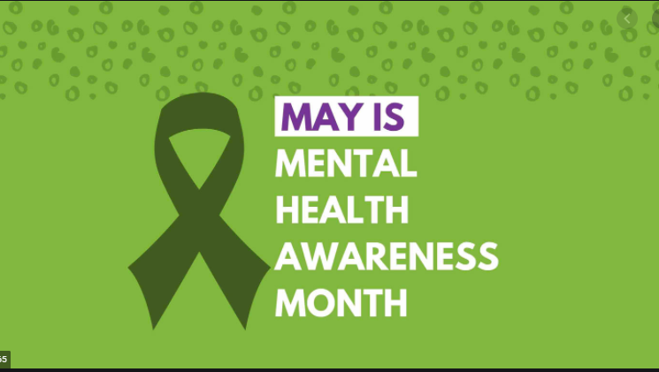
May is mental health awareness month
You Are Not Alone
For 2021’s Mental Health Awareness Month NAMI will continue to amplify the message of “You Are Not Alone.” We will use this time to focus on the healing value of connecting in safe ways, prioritizing mental health and acknowledging that it’s okay to not be okay through NAMI’s blog, personal stories, videos, digital toolkits, social media engagements and national events.
Together, we can realize our shared vision of a nation where anyone affected by mental illness can get the appropriate support and quality of care to live healthy, fulfilling lives — a nation where no one feels alone in their struggle.

Slide 7
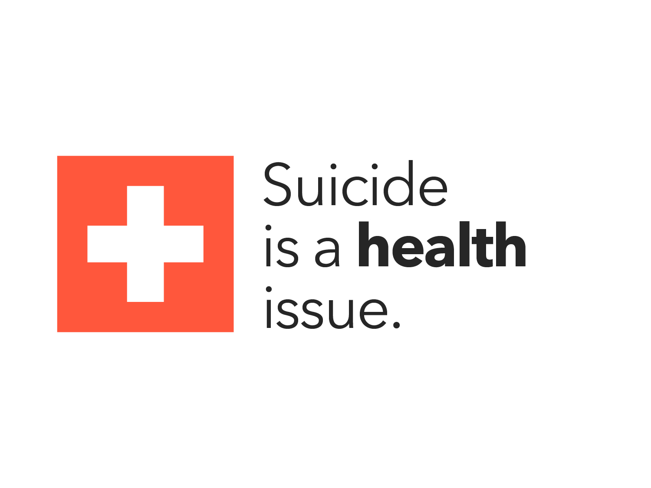
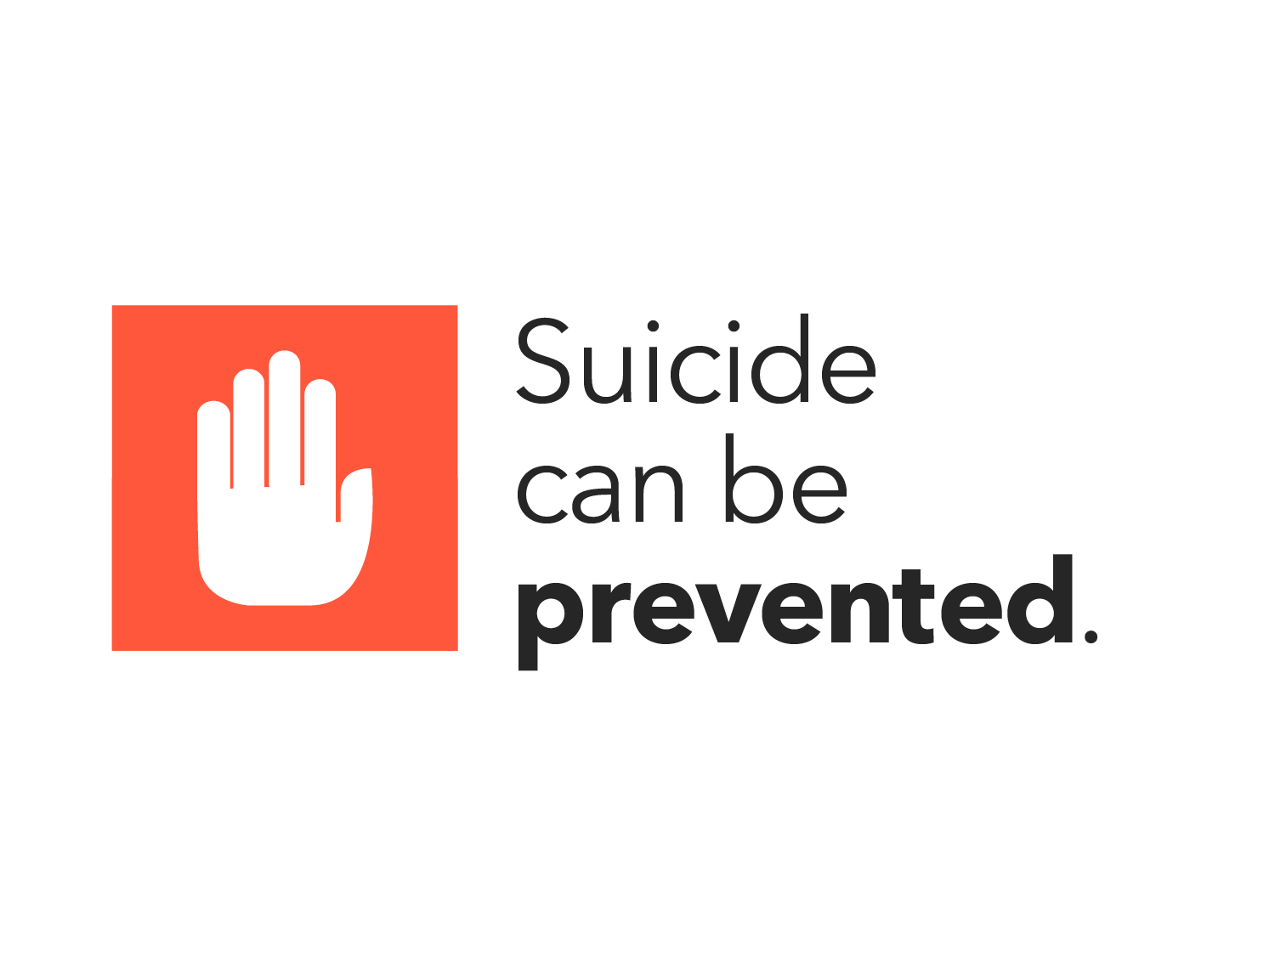
Notes:
Despite its complexity, suicide can be prevented.
Just like there are warning signs and risk factors for other health crises like cardiac arrest, we can learn the warning signs and risk factors that can help us to prevent people from dying by suicide.
As with other health issues, time can be a critical and life saving measure. Typically, a life can be saved if you allow time for the person’s suicide risk to subside or to get through that period of distress, and to get mental health help. To prevent suicide, we need to identify persons who may be suicidal as well as take an active role in connecting them to help before they take action to end their lives.

Slide 8
How we talk about suicide and mental health matters
Notes:
So let’s establish a baseline of shared language on this topic.
We avoid using the phrase “committed suicide” as it can have a negative connotation. Instead, we encourage the phrases “died by suicide”, “ended his/her life” or “killed himself/herself.”
When talking about suicide and suicide attempts, we avoid referring to suicide attempts as “failed” or “successful.” Not only is it unnecessary, these words imply judgment. Instead, we encourage the use of phrases such as “suicide attempt” “suicide” “death by suicide.”
Educating the public about suicide is critical for encouraging help-seeking, raising awareness of risk in vulnerable populations, and advocating for new interventions and prevention strategies for those at risk. When suicide is talked about safely and accurately, we can help reduce the likelihood of its occurrence.
We want to change how society understands mental health and suicide – because when we open up and connect, talk saves lives.

Slide 9
Scope of the Problem
Worldwide: More than 800,000 people die by suicide each year
Someone dies by suicide EVERY 40 SECONDS
In the U.S., suicide is the 10th LEADING CAUSE OF DEATH (In 2016: 44,965 people died
by suicide)
For every suicide – 25 OTHERS ATTEMPT
Suicide impacts INDIVIDUALS and COMMUNITIES
Suicide has an economic impact. $69 billion per year in the United States
Notes:
Suicide is a global problem.
According to the World Health Organization, each year, over 800,000 people die by suicide worldwide.
While this is the most accurate data available, we estimate the numbers to be higher – as it is likely that suicide is underreported in many countries.
Suicide is highly prevalent.
Suicide presents a major challenge to public health in the United States and worldwide. It contributes to premature death, morbidity, lost productivity, and health care costs.
In 2015 (the most recent year of available death data), suicide was responsible for 44,193 deaths in the U.S., which is approximately one suicide every 12 minutes.
In 2015, suicide ranked as the 10th leading cause of death and has been among the top 12 leading causes of death since 1975 in the U.S.
Overall suicide rates increased 28% from 2000 to 2015.
Suicide is a problem throughout the life span; it is the third leading cause of death for youth 10–14 years of age, the second leading cause of death among people 15–24 and 25–34 years of age; the fourth leading cause among people 35 to 44 years of age, the fifth leading cause among people ages 45–54 and eighth leading cause among people 55–64 years of age.6

Slide 10
While the exact number of officers who die by suicide each year is not known, research suggests that more officers die by suicide each year than in the line of duty.
The non-profit organization BLUE H.E.L.P. has estimated that these deaths increased from 143 to 228, from 2016 to 2019.
However, these numbers are likely to represent an undercount, as they are derived from Internet searches and volunteer reports made by family members, friends, colleagues, and others.
Moreover, suicide deaths are often unreported or misreported due to stigma and other reasons
POLICE

Slide 11
Resources from COPS office

Slide 12
CONCLUSION
Law enforcement agencies should implement comprehensive suicide prevention programs that combine multiple strategies and practices addressing areas such as:
Leadership and culture n Access to culturally competent mental health services
Peer support
Suicide prevention training and awareness
Event response
Family support
Limiting access to means of suicide
Safe and effective messaging
Notes:
Officers transitioning to retirement or to another career. Among these officers, the separation from peer networks could potentially increase the risk of social isolation and suicide. Efforts that support the development of social connections—such as allowing officers to make use of departmental peer support programs post retirement—may potentially help protect these officers from suicide risk.16 More research is needed on the effectiveness of these approaches and on other ways to engage these officers, such as opportunities to volunteer with the department. n Military service members and veterans. Studies suggest that suicide rates are high among veterans and military service members.102, 103 Experts have also noted that some law enforcement officers who are former service members may have experienced more trauma than their peers who come from different backgrounds.104 n Female officers. Existing research suggests that female officers may be more likely than their male peers to experience depression, a risk factor for suicide.14, 39, 46 Social stressors may also differ. For example, day shifts may increase concerns with childcare and other family obligations. Some female officers may also experience a culture of sexism and bullying that provides limited support for women.23 More research is needed to understand the unique needs of female officers and how to best address those needs

Slide 13
FIRE
USA Today reported that 103 firefighters and 140 police officers died by suicide in 2017, compared to 93 firefighter and 129 officer line-of-duty deaths, according to the Ruderman Family Foundation, a philanthropic organization that fights for the rights of people with disabilities.
Study: More firefighters died by suicide than in the line of duty in 2017
A study found that 103 firefighters and 140 police officers died by suicide in 2017, compared to 93 firefighter and 129 officer line-of-duty deaths
The study also found that little has been done to address PTSD and depression in responders, even though they are five times more likely than civilians to suffer from symptoms.

Slide 14
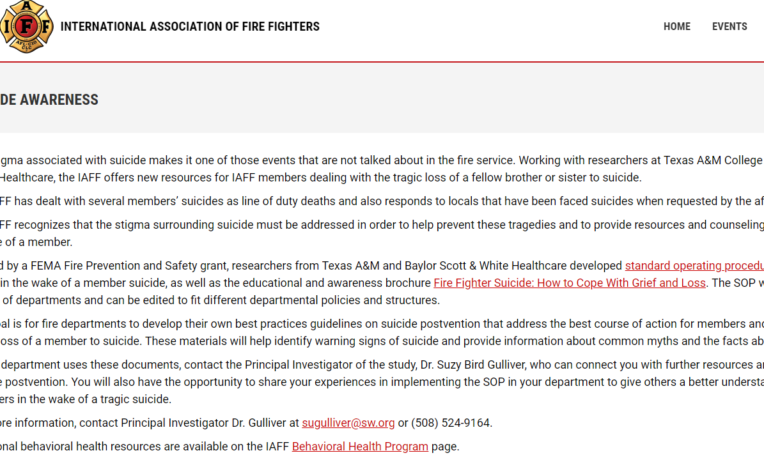
CONCLUSION

Slide 15
VETERANS
Veteran suicide rates are still higher than the rest of the population, particularly among women.
In both reports, the VA said an average of 20 veterans succumbed to suicide every day.
The VA's 2012 report stated 22 veterans sucumbbed to suicide every day – a number that’s still often cited incorrectly. That number also included active-duty troops, Guard and Reserve
VA officials determine the statistic by analyzing state death certificates and calculating the percentage of veterans out of all suicides. The death certificates include a field designating whether the deceased ever served in the U.S. military.

Slide 17
LGBTQ+
Suicide is the 2nd leading cause of death among young people ages 10 to 24.
LGB youth seriously contemplate suicide at almost three times the rate of heterosexual youth.
LGB youth are almost five times as likely to have attempted suicide compared to heterosexual youth.
Of all the suicide attempts made by youth, LGB youth suicide attempts were almost five times as likely to require medical treatment than those of heterosexual youth.
Suicide attempts by LGB youth and questioning youth are 4 to 6 times more likely to result in injury, poisoning, or overdose that requires treatment from a doctor or nurse, compared to their straight peers.
In a national study, 40% of transgender adults reported having made a suicide attempt. 92% of these individuals reported having attempted suicide before the age of 25.
LGB youth who come from highly rejecting families are 8.4 times as likely to have attempted suicide as LGB peers who reported no or low levels of family rejection.
1 out of 6 students nationwide (grades 9–12) seriously considered suicide in the past year.
Each episode of LGBT victimization, such as physical or verbal harassment or abuse, increases the likelihood of self-harming behavior by 2.5 times on average.
Notes:
Also, recent population-based studies suggest that the reported rates of suicide attempts for high school students who identify as LGBT are two to seven times higher than rates among high school students who describe themselves as heterosexual.⁸ LGBT youth are also twice as likely to have thoughts about suicide.⁹ The 2009 Youth Risk Behavior Surveillance System found that during the 12 months before the survey was administered, across the sites evaluated,
the percentage of students who reported having felt sad or hopeless ranged from 19.3 percent to 29.0 percent among heterosexual students, from 28.8 percent to 52.8 percent among lesbian and gay students, and from 47.2 percent to 62.9 percent among bisexual students;
the percentage of students who seriously considered attempting suicide ranged from 9.9 percent to 13.2 percent for heterosexual students, but from 18.8 percent to 43.4 percent among lesbian and gay students; and
the percentage of students who attempted suicide one or more times ranged from 3.8 percent to 9.6 percent among heterosexual students, but from 15.1 percent to 34.3 percent among lesbian and gay students.¹⁰

Slide 18
Covid-19 Every Worker Protection Act – HR 6559 (In Senate)
This bill requires the Department of Labor to promulgate both an emergency temporary occupational safety or health standard and a permanent standard to protect certain employees from occupational exposure to the coronavirus (i.e., the virus that causes COVID-19). These standards apply to health care sector employees, paramedic and emergency medical services employees, and other employees identified as having an elevated risk for exposure. Further, the Centers for Disease Control and Prevention must collect and make public information regarding employee exposure in these occupations and provide guidance to further protect such employees.
National Suicide Hotline Designation Act of 2019 – HR 4194
9-8-8

Slide 19
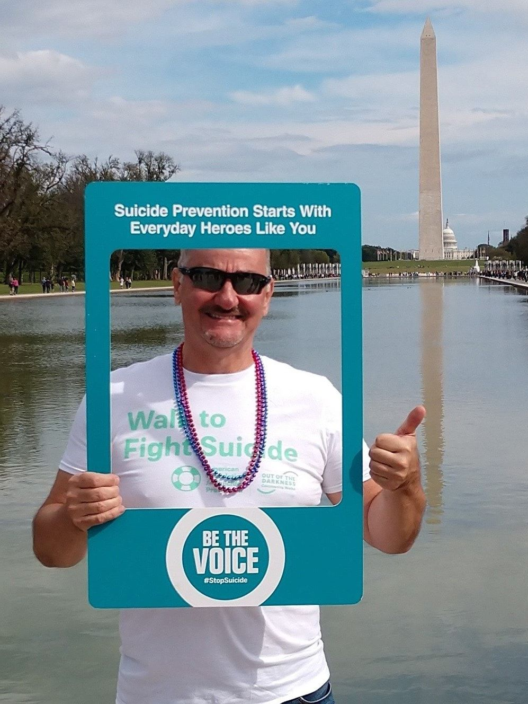
It can affect anyone

Slide 20
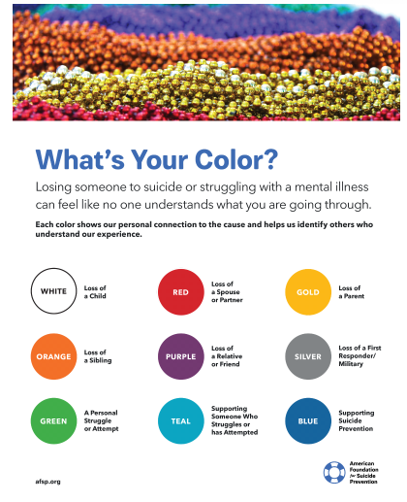

Slide 21
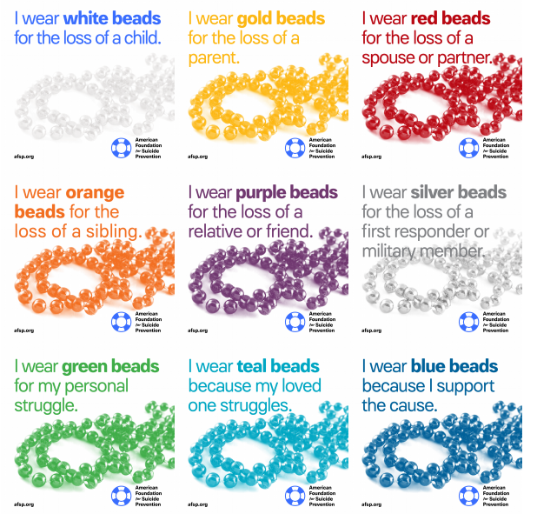

Slide 22
Helaine Zack

Slide 23
MME Reaching Out With Help

Slide 24
Notes:
So let’s move on to research.
Only in the past several decades have scientists been studying suicide. Research is shedding light on many critical areas, and we still have more to learn.
This section provides and overview of suicide prevention research, key research findings, and future goals in the field.

Slide 25
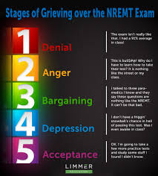

Slide 26
Suicide, like other human behaviors, has no single determining cause.
Instead, suicide occurs in response to multiple biological, psychological, interpersonal, environmental and societal influences that interact with one another, often over time.
The social ecological model—encompassing multiple levels of focus from the individual, relationship, community, and societal—is a useful framework for viewing and understanding suicide risk and protective factors identified in the literature.
Risk factors include:
Individual level: history of depression and other mental illnesses, hopelessness, substance abuse, certain health conditions, previous suicide attempt, violence victimization and perpetration, and genetic and biological determinants
Relationship level: high conflict or violent relationships, sense of isolation and lack of social support, family/ loved one’s history of suicide, financial and work stress
Community level: inadequate community connectedness, barriers to health care (e.g., lack of access to providers and medications)
Societal level: availability of lethal means of suicide, unsafe media portrayals of suicide, stigma associated with help-seeking and mental illness.
It is important to recognize that the vast majority of individuals who are depressed, attempt suicide, or have other risk factors, do not die by suicide.
Suicide is associated with several risk and protective factors.

Slide 27
Survivors
In an early study, Crosby and Sacks estimated that 7% of the U.S. adult population, or 13.2 million adults, knew someone in the prior 12 months who had died by suicide.
They also estimated that for each suicide, 425 adults were exposed, or knew about the death.
In a more recent study, in one state, Cerel et al found that 48% of the population knew at least one person who died by suicide in their lifetime. Research indicates that the impact of knowing someone who died by suicide and/or having lived experience (i.e., personally have attempted suicide, have had suicidal thoughts, or have been impacted by suicidal loss) is much more extensive than injury and death.
People with lived experience may suffer long-term health and mental health consequences ranging from anger, guilt, and physical impairment, depending on the means and severity of the attempt.
Similarly, survivors of a loved one’s suicide may experience ongoing pain and suffering including complicated grief, stigma, depression, anxiety, posttraumatic stress disorder, and increased risk of suicidal ideation and suicide.
Less discussed but no less important, are the financial and occupational effects on those left behind.

Slide 28
Who is at risk?
Notes:
Risk factors are defined as characteristics or conditions that increase the chance a person may take their life.
Risk factors are important to know to understand the big picture of someone who is considering suicide.
Just like someone who is at risk for heart disease because of high blood pressure, or a history of heart disease in the family, some people are at higher risk for suicide than others.
The main risk factors, shown here, can be grouped into three categories: health factors, historical factors, and environmental factors.
These risk factors can converge at different times in life and increase a person’s risk for suicidal behavior at particular points in time.
Let’s look a little closer…

Slide 29
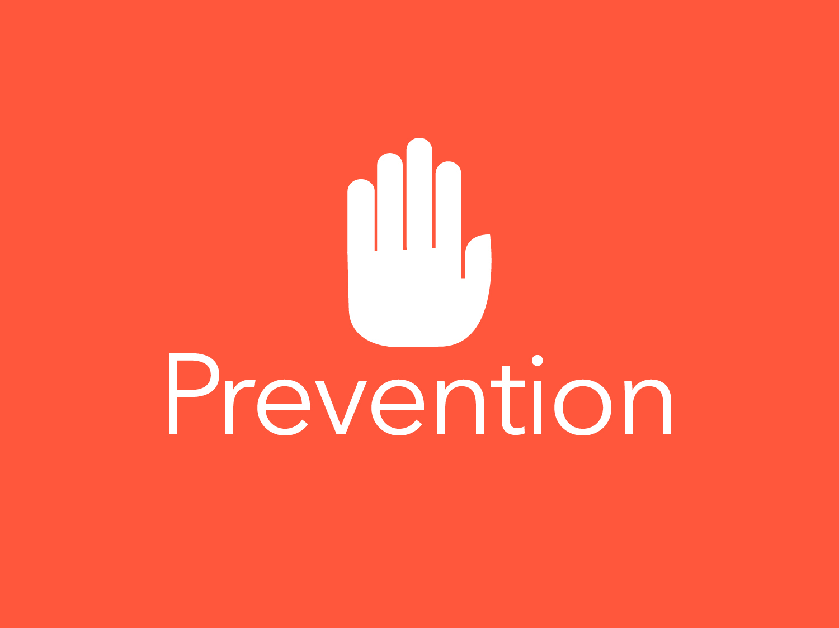
Notes:
Now that we have a better understanding of the scope of the problem of suicide and the key research findings, including risk factors, this next section will focus on prevention.
We will discuss:
The different types of protective factors, with a focus on mental health;
The importance of engaging in self-care;
The need to provide support for suicide loss survivors and those with lived experience; and
The critical prevention strategy of limiting access to lethal means.

Slide 30
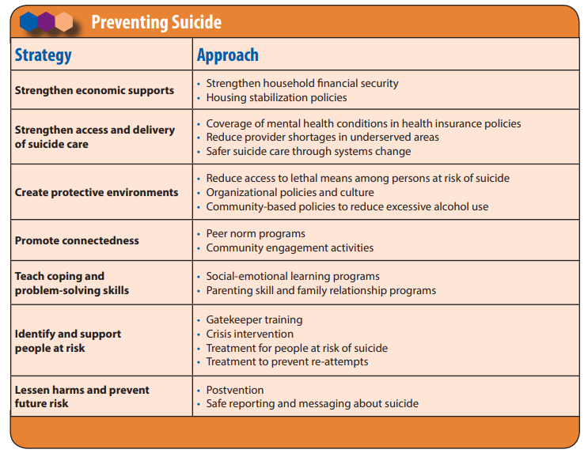

Slide 31
Notes:
Just like there are risk factors that increase a person’s risk for suicide, are also protective factors that lower a person’s risk.
If you are proactive about mental health, and make an effort to get healthier, you protect yourself. More on this in a moment.
Feeling connected to family and community support can protect against suicide. When someone is struggling with depression, anxiety, psychosis or substance abuse, these protective factors that may normally be strong can erode and temporarily weaken. When that happens, having friends and family to remind us our strengths can be a tremendous protective factor.
Problem-solving skills also help. Life can get really tough, but being able see a way through problems can be a protective factor.
Cultural and religious beliefs that encourage connecting and help-seeking, discourage suicidal behavior or create a strong sense of purpose can also be a protective factor.

Slide 32
Notes:
Because mental health care is so important for preventing suicide, we are going to focus on this topic for the next few minutes.
Getting effective treatment for mental health conditions like depression or anxiety can prevent suicide.

Slide 33
Notes:
Critical to suicide prevention is getting people connected to mental health treatment. One of the biggest challenges in fighting suicide is getting people to address their mental health in the same way they would for physical health. In fact, of those suffering from a mental health condition, less than half seek treatment.
One way to encourage individuals to seek help for their mental health conditions is to treat mental health like any other aspect of our health; there are certain times when a person becomes ill and it’s critical to seek a trained professional.
We need a culture where everyone knows it’s smart to take care of our mental health.

Slide 34
Notes:
Taking care of our mental health is just as important as taking care of physical health.
Seeing a mental health professional is a sign of strength and many are taking that step.
The person seeking help should request a thorough evaluation to figure out if there is a mental health condition affecting their life.
There are many types of treatment available, like various kinds of psychotherapy and medications.
Research has shown that for many people the combination of psychotherapy and medications tend to be the most helpful.
But the most important thing is to find the treatment that works best for the individual.

Slide 35
Notes:
The good news is that advocacy efforts are improving access to mental health services so that more people can get the treatment they need. The law now requires insurance plans to cover mental health services on par with physical health services. If we need mental health services, and one out of four of us will at some point, we should get treated and get our health back on track faster.

Slide 36
Notes:
Just like people can find strategies that optimize their physical health, people can do the same for their mental health.
In addition to professional mental health care, proactive self care strategies like good sleep habits, exercise, nutrition, and stress management can also play a critical role in protecting mental health and promoting resilience.

Slide 37
Notes:
Prevention efforts also include support for those touched by suicide. The loss of one person to suicide profoundly impacts many. It’s important that survivors have the support they need, both to heal and to reduce their own suicide risk.
And since those with lived experience — those who have attempted suicide or who experience suicidal thinking — are at increased risk, we need to make sure they have the support they need too.

Slide 38
Notes:
The most important thing you can put between a suicidal person and their way of ending their life is TIME.
Research shows that by temporarily reducing a suicidal person’s access to lethal means, we give suicidal individuals time – time for the intense suicidal risk to diminish and time for someone to intervene with mental health support and resources.
For the majority of people who experience a suicidal crisis, if unable to access their chosen method even temporarily, they are unlikely to engage in another action to end their lives.

Slide 39
Notes:
Now that we have reviewed key suicide prevention efforts, let’s talk about what we all can do to help prevent suicide.

Slide 40
Notes:
It’s important to have a caring, supportive conversation with someone you might be worried about to allow them to share what they are experiencing. A conversation is a way to show you care, and allows you to gain more information about their level of distress.

Slide 41
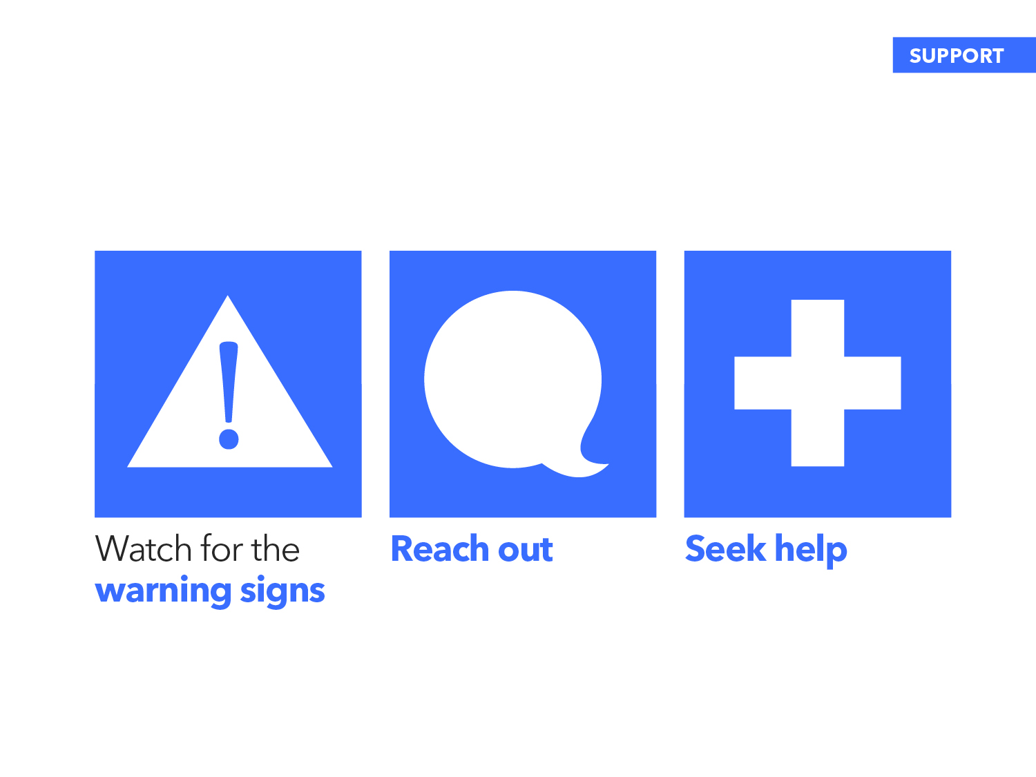
Notes:
Let’s start by talking about suicide warning signs. Watch for the warning signs, in yourself and others.
While many of the suicide risk factors we discussed endure over a longer period of time, warning signs are observable signs that signal suicidal risk in the near future.
It is important to pay attention to both the risk factors discussed earlier and the warning signs we are talking about now.
If you see warning signs, reach out to individuals in your life you’re concerned about, and reach out to others if you’re struggling.
Seek mental health services if you are depressed or if your anxiety regularly interferes with your daily life, and encourage others to do the same.

Slide 42
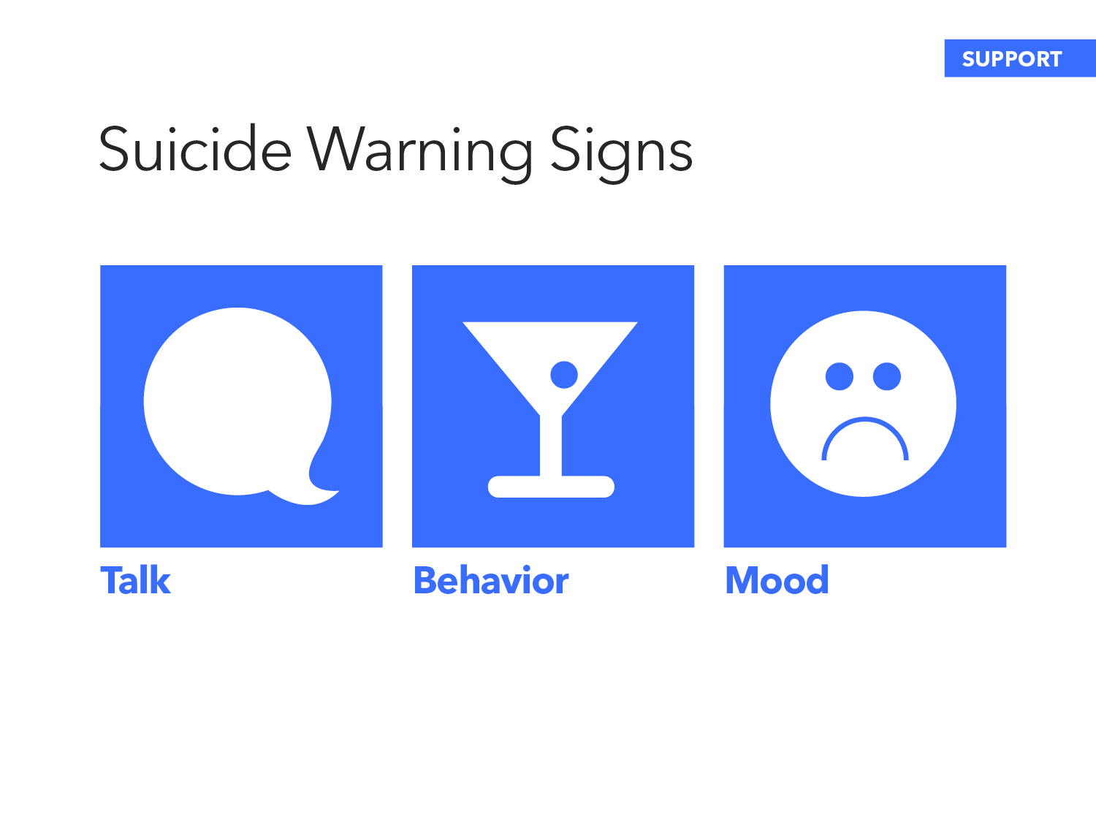
Notes:
Suicide warning signs are typically displayed in three main ways that we can detect: Talk, Behavior, and Mood.
We will discuss each one of these ways in more detail.

Slide 43
Notes:
Many people who are suicidal talk about ending their lives. This may be directly or indirectly. A person might say it outright, or they might joke about it. Take it seriously.
Some people say they have no reason to live.
Others say things that let you know they may feel trapped, or that they are a burden to others.
Or they might talk about feeling overwhelmed or being in unbearable pain.

Slide 44
Notes:
Behaviors that are atypical for an individual should also encourage you to speak to the person about what you are noticing.
People thinking about suicide can display certain behaviors.
There may be an increased use of alcohol or drugs.
They may have trouble sleeping – either experiencing insomnia or sleeping too much.
They may start acting more recklessly.
They might withdraw from activities, especially from activities they normally enjoy.
They might isolate themselves from family and friends.
They also might look for a way to kill themselves, such as searching online for methods, or shopping for a firearm.
They may also give away their possessions or show a related behavior – reckless spending.

Slide 45
Notes:
People at risk for suicide can display — often quite subtly — any of the following moods.
Depression, apathy, rage, irritability, impulsivity, humiliation, anxiety. Moods one would expect of someone who feels overwhelmed and desperate.
We all have ups and downs in our mood, but when you notice a change that seems uncharacteristic or concerning, it is important to speak to the person about what you are noticing.
For example, sudden, unexplained happiness can indicate the individual has decided on a plan and is relieved they will no longer be in pain.

Slide 46
Notes:
That’s a lot of things to look for, so to sum it up: look for changes in behavior and trust your instincts.
Assume you are the only one who is going to reach out. In too many instances, people talked about their concern for someone amongst themselves, but hesitate to reach out to the person directly.
So here’s a rule of thumb: if you are wondering if someone is depressed, or overly anxious: that’s a sure sign you should reach out.
Same goes for you. If you are having suicidal thoughts, that’s a sure sign you need to seek help.
If you have reached out before, reach out again. The first time the person may not be receptive – keep trying. Try talking to someone else or with a professional.
And even if suicide turns out not be a concern, they may still be in distress, and they may feel comforted and supported just by knowing you care and are taking the time to listen.

Slide 47
Notes:
So how do you reach out to someone?
Talk to them in private.
Listen to their story.
Express concern and caring.
Ask directly about suicidal thoughts. Don’t be afraid to ask the question: “Are you thinking about suicide?”
Encourage them to seek mental health services.
If in crisis, take them to help.

Slide 48
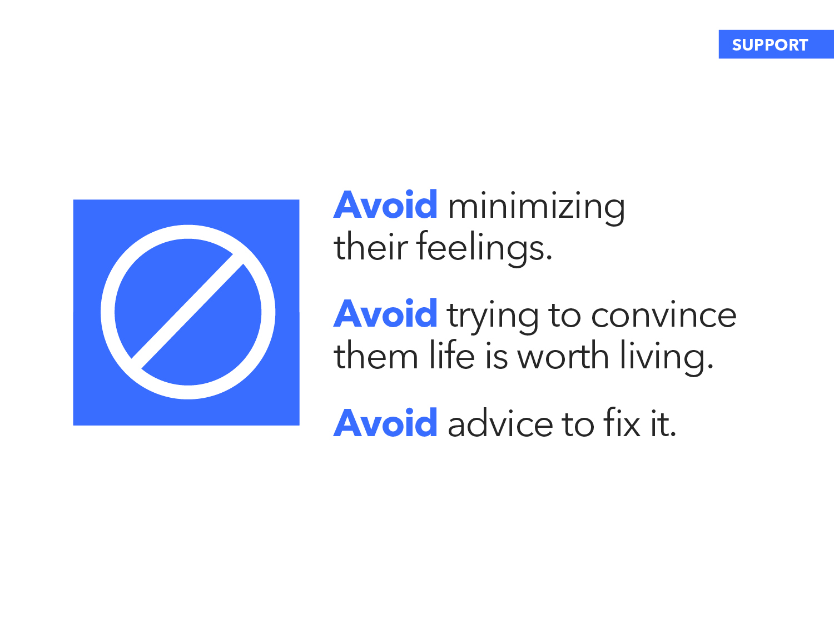
Notes:
There are some things to avoid when talking with someone who may be suffering from depression or anxiety.
Avoid minimizing their feelings. Those of us who have never experienced major depression literally cannot imagine what it feels like.
Avoid trying to convince them life is worth living. If a person is nearing a crisis point, they are not thinking clearly. Philosophical debates about life being worth living tend not to be helpful.
Avoid advice to fix it. If the person is having a heart attack, you wouldn’t tell them to start exercising or to eat a healthier diet.
If they are in crisis, what they need is to be heard and then led to help. Listen to their story, and offer to help them find a health professional. Help them take active steps toward keeping their environment safe.

Slide 49
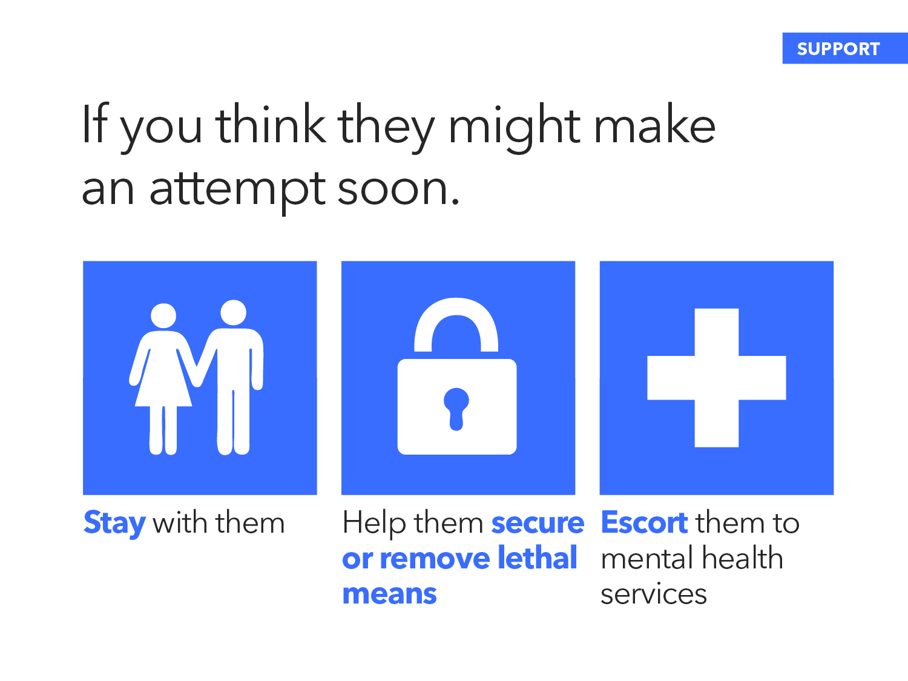
Notes:
If you think they might make an attempt on their life soon:
Stay with them. Do not leave them alone. However, if the situation puts your own safety at-risk, leave the area immediately and call 911.
Help them remove lethal means, or remove themselves from the potentially dangerous area.
Escort them to mental health services or an emergency room.

Slide 50
Notes:
Help them to call the Lifeline, or call the Lifeline yourself and a trained counselor will tell you what you should do to help the person in distress. If they don’t feel comfortable speaking to a counselor on the phone, they can also text TALK to the Crisis Text Line at 741741.
[ASK AUDIENCE TO TAKE OUT THEIR PHONES]
Now would be a great time to take out your phones, and add both the Lifeline and Crisis Text Line as contacts. Even if you never use these resources for yourself, you may need them to help a friend. They’re both open. 24/7, 365.

Slide 51
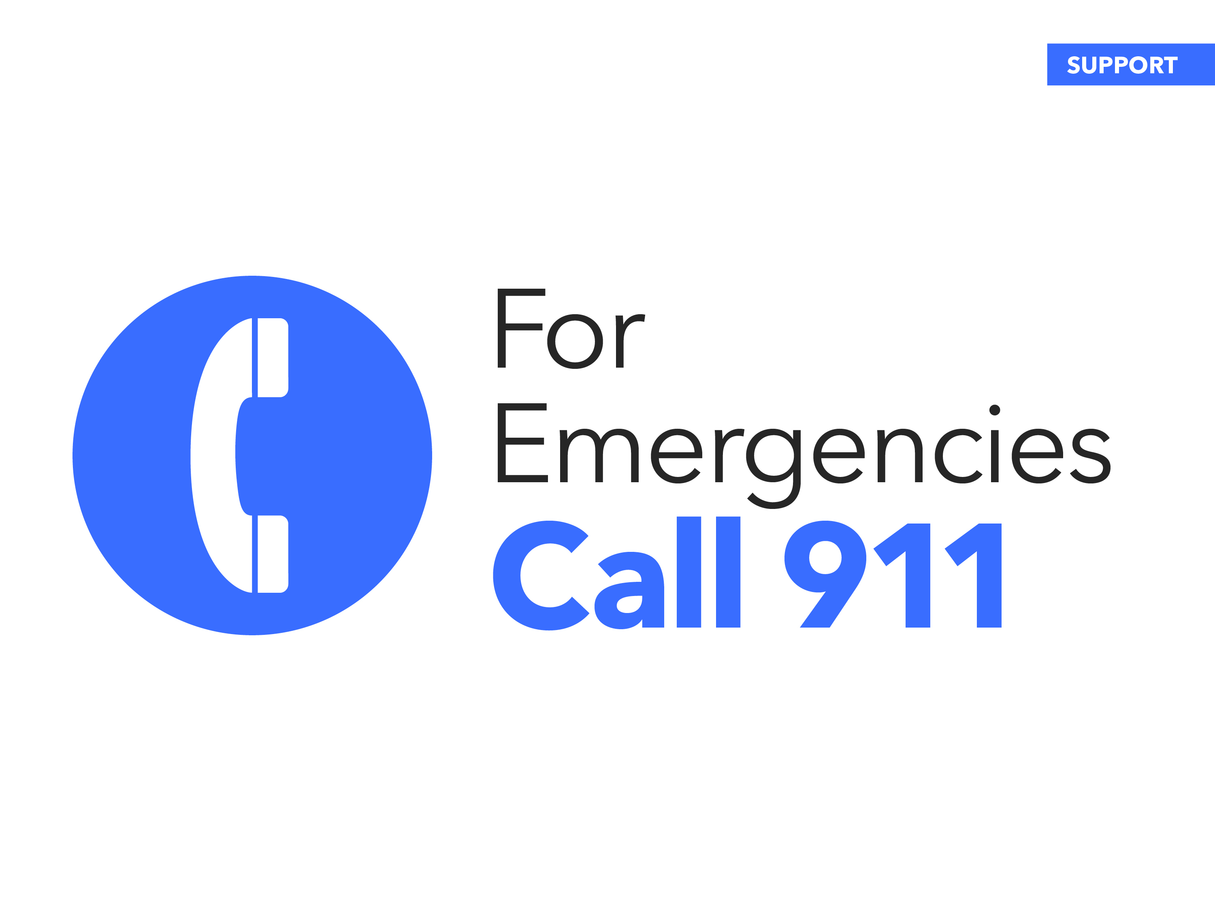
Notes:
If it’s an emergency, such as a suicide attempt in progress, call 911.

Slide 52
Notes:
Together we can create a culture that’s smart about mental health. We’ll save lives, and vastly improve the lives of many more.

Slide 53
RESOURCES

Slide 55
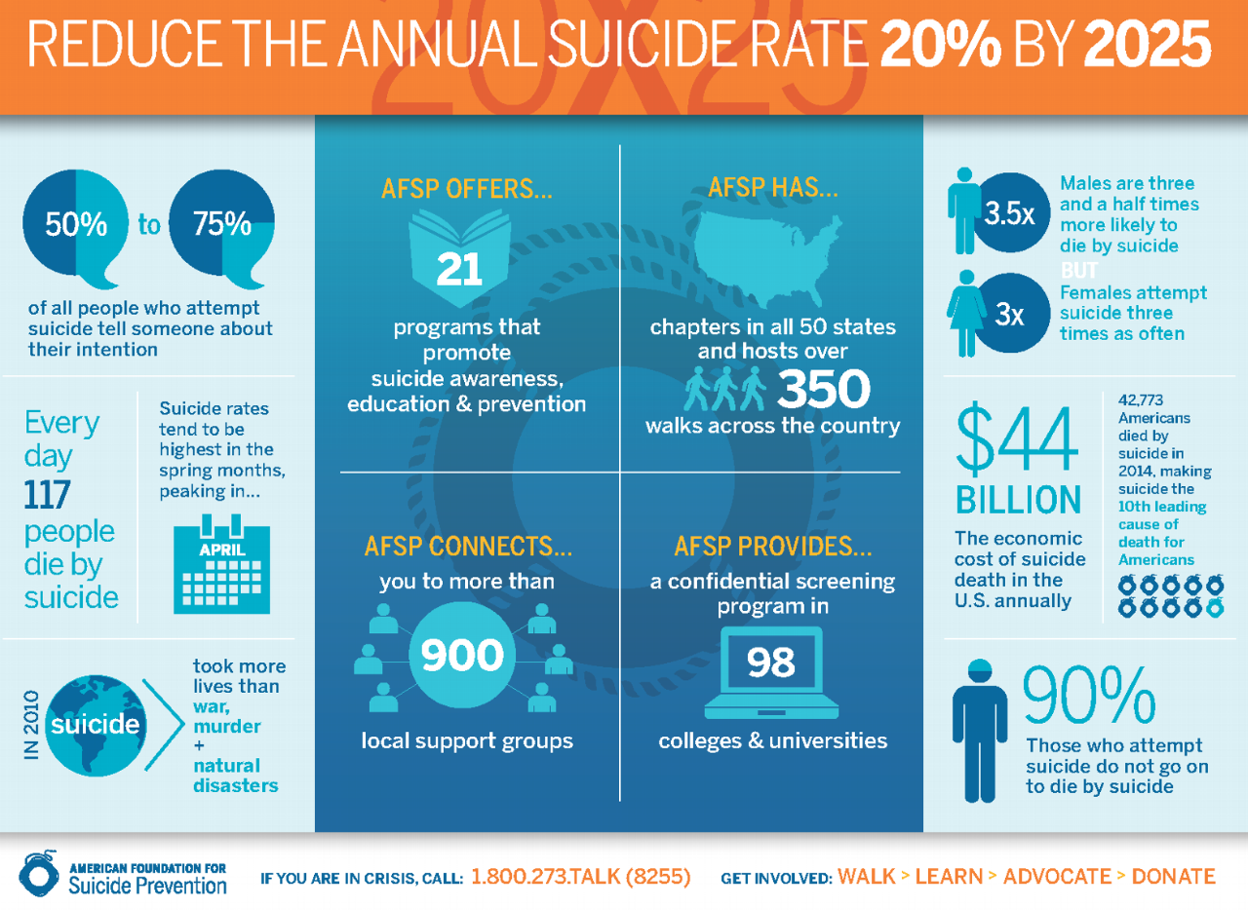

Slide 56
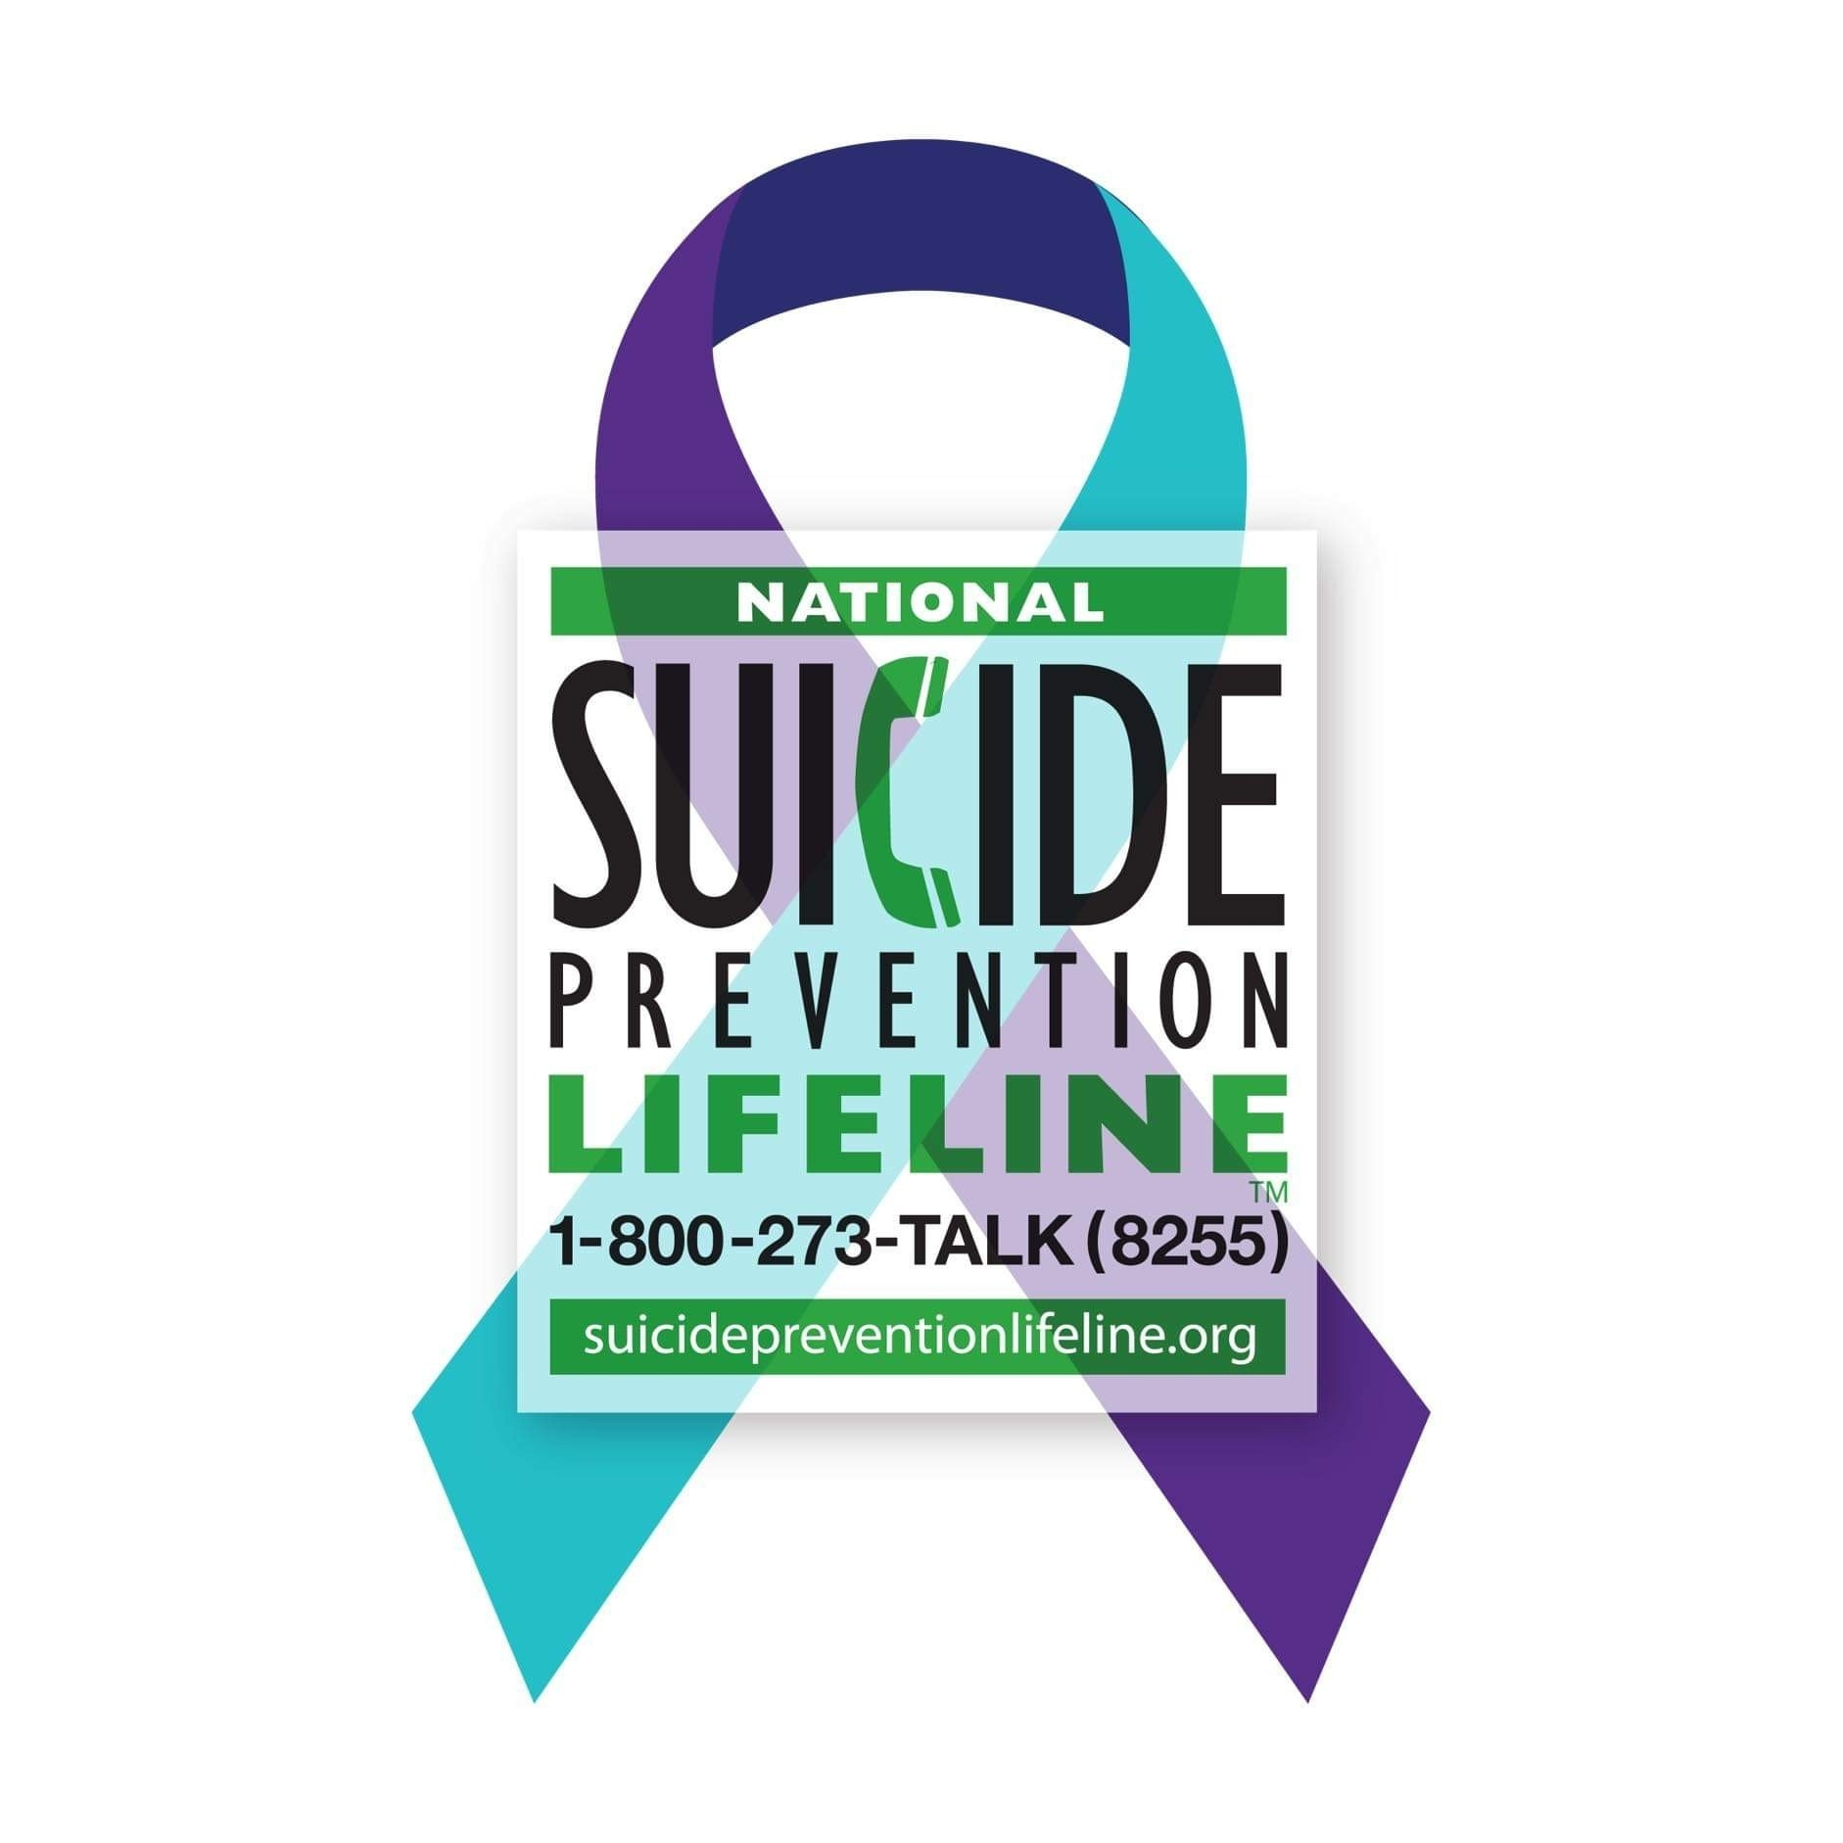

Slide 57
@afspnational
Notes:
You can learn more at afsp.org, or by following us on Facebook, Twitter, and Instagram using the handle @afspnational.
[If you have a personal connection to suicide, you have the option of taking no more than two minutes to share your story here. Please review AFSP’s “Speaking Out About Suicide” resource.]
Thank you for listening.
If you have any questions about our local chapter, our current initiatives, and how you can get involved, please see me after the presentation concludes. Again, thank you for being here today. Together we can save lives.

Slide 59
Notes:
In addition to mental health conditions, there are many other factors that increase risk as well.
We’ve learned that the brains of people who die by suicide differ from those who die from other causes in terms of structure and function, specifically in the areas related to stress response and impulse-control.

Slide 60
Notes:
One of the many important things we have learned from research is about the perspective of a suicidal person.
That a crisis point has been reached.
For a suicidal person, the pain seems unbearable, whether it’s emotional pain, physical pain or sometimes both.
For a moment, I’d like you to think back to the most physically painful experience of your life. At that moment, would you have been able to give someone clear and accurate directions to your house? Probably not.
The pain makes ordinary thinking nearly impossible.
For a suicidal person, thinking becomes constricted at that moment of crisis — a state of intense tunnel vision where other options seem unavailable. Someone who considers suicide cannot foresee a time when that unbearable pain will end.
Understanding the perspective of the suicidal person has also helped us to learn that suicidal feelings are often temporary. They can come on intensely and can sometimes pass in minutes or hours. Keeping people safe and helping them feel supported can get them through those critical moments.
There is evidence that putting time and distance between an individual who is suicidal and the means to take their life can be a life saving action. This is why it is so important that we take steps when we know someone is struggling to help keep them safe.

Slide 61
Notes:
One of the main questions research explores is: why do people take their own lives?
Through research we have learned that there is no single cause for suicide. Suicide most often occurs when several stressors and health issues converge to create an experience of hopelessness and despair.

Slide 62
Notes:
Research has consistently shown that the large majority of people who die by suicide have a mental health condition at the time of their death.
It may or may not have been diagnosed or adequately treated.

Slide 63
Notes:
That said, research has also made clear that mental health conditions cannot be the whole story.
Mental health conditions are common, and the vast majority of people who suffer from these illnesses do not die by suicide.

Slide 64
Notes:
We’ve also learned that most people who are suicidal are ambivalent about taking their life: part of them wants to live, part of them wants to die.
This research has informed key strategies in suicide prevention that involve engaging the part of the person that wants to stay alive and helping to create distance from the part of them that wants to die.
One way we do that is to help the person connect with reasons for living while at the same time, decreasing the visibility and presence of things around them that may facilitate their desire to die.

Slide 65
Notes:
The first type of risk factors include health factors, such as biological and psychological medical conditions, the most significant of which are mental health conditions.
As we said before, most people who die by suicide have an active mental health problem at the time of their death.
Depression is the most common mental health condition and the one that is most associated with suicide.
Bipolar disorder is also shown to be high risk, although the disorder is less common than depression.
Because these conditions put a person at greater risk for suicide, detecting the presence of a mental health condition is critically important.
The best way to be sure, when you feel concerned or detect a possible change in you or your loved one’s mental health, is for the person at risk to seek a professional evaluation and effective treatment.
Many people may not realize that their distress has actually become a health problem. Providing information such as a crisis number or mental health resource to someone who is struggling can be a solid step in helping them connect to the help they need.
We will talk more about this later in the discussion when we directly address prevention.

Slide 66
Notes:
Mental health conditions are not the only health factors that are associated with suicide risk.
Serious or chronic health conditions can increase risk, especially when the person also has mental health issues.
Chronic pain and serious head injuries have also been found to increase suicide risk.

Slide 67
Notes:
The second type of risk factors include historical factors such as a family history of suicide, a family history of mental health conditions, or past trauma such as sexual abuse or combat stress.
Research has also found that a history of childhood abuse can contribute to suicide risk.
And while most people who attempt suicide do not go on to die by suicide, previous suicide attempts are also considered historical risk factors for suicide and also put a person at increased risk.

Slide 68
Notes:
The third type of risk factors are environmental factors that involve the circumstances of a person’s life.
Often, there are aspects of a person’s environment that can contribute to their overall level of risk. Let’s look at a few of the most common:
Having access to a way of killing oneself is referred to as access to lethal means. This includes having access to a variety of things, such as firearms, drugs, a bridge, a car, etc.
Research has shown that contagion – the exposure to another person’s suicide, or to graphic or sensationalized accounts of suicide – especially among those with other risk factors, can increase a person’s risk of suicide.
Prolonged stress may include harassment, bullying, relationship problems, legal problems, and unemployment.
Stressful life events, which vary across the lifespan, include experiences like divorce, legal problems or job loss.

Slide 69
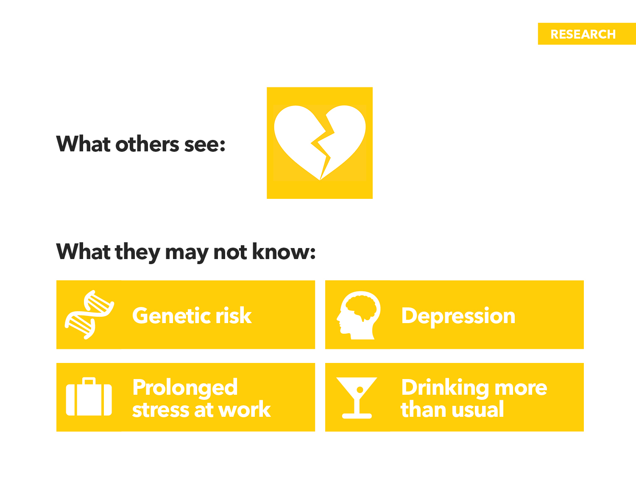
Notes:
To better understand suicide risk, here is an example of a set of risk factors that could converge in a person who is suicidal.
This example shows what is often the public perception of suicide. When someone dies by suicide, often the story only talks about the environmental factors. People see a life event, like a breakup, or bullying, or a job loss, and then they see the person die by suicide, so they might assume the person killed themselves because of that stressful life event.
But that’s never the full story. What others don’t know is that the person who died may have had genetic risks for suicide. Maybe they were suffering from depression and anxiety disorders, and their work life had become increasingly stressful. Their underlying depression and anxiety could have made the situation at work even worse, or the work stress could have made their depression worse. Perhaps they’d also been drinking more than normal.
The key is that the combination of risk factors could have contributed to the suicide death.
Therefore, while a life event can play a precipitating role for suicidal behavior, without other underlying risk factors, life events alone aren’t thought to cause suicide.

Slide 70
Notes:
Looking to the future, research will help us find the best ways to fight suicide.
Research is looking for biomarkers — for example, something testable in a blood sample — that would help us to identify those at risk.
A number of clinical treatments, like particular types of therapy, are effective for suicidal people and more need to be developed and studied. The good news is that, through research, we are learning more and more about what helps those who are in a suicidal crisis.
Research can also help us to identify the most effective interventions to reduce suicide rates and to reduce risk in those suffering from mental health conditions.

Slide 71
Notes:
In most cases, when a suicidal person doesn’t have current access to the means that has been on their mind, they don’t substitute with another method.
Therefore, a clear way to prevent suicide is to limit access to lethal means.

Slide 72
Notes:
During a period of high risk, the safer their environment is, the better chance a suicidal person has of living through that crisis period. Suicide prevention research has looked at a number of ways to create safer environments.
Installing an inexpensive carbon monoxide sensor that would automatically shut cars off if carbon monoxide levels reach unsafe levels, would save lives.
We’ve learned through research that installing barriers on bridges deters suicides and in many cases, bridge barriers actually lowered the suicide rate for the entire region.
Restricting access to potentially lethal medications reduces suicides and can be as simple as requiring lethal drugs to be sold in blister packaging.
Firearm safety is critical to reducing suicide rates. In the United States, firearms are used in roughly half of all suicides, making suicide prevention an important part of gun safety education.
As noted already and contrary to what you may think, when access to lethal means are limited, most people who are suicidal do not find other means; therefore, the suicide death does not occur in that moment, allowing more time for the person in crisis to get connected to help.

Slide 73
