Slide 1
Knead Dough? Performance Measurement Can Leaven Your Budget
Joshua A. Smith
Village Administrator
Howard, Wisconsin

Slide 2
Howard’s Performance Management Process – Quick Overview
Note: Howard’s fiscal year is January 1 to December 31
Strategic Planning
Village Board & Executive Leadership Team (ELT) hold Annual Strategic Planning Session to Affirm or Modify Strategic Prioritized Goals (April)
ELT & Large Management Team hold Strategy Action Plan Review Session (May)
Village Board formally approves Strategy/Action Plan Review Session (June)
Operating & Capital Budgets
Village Board reviews first 6 month Expenditure/Revenue data; amends existing budget policies; distribute capital project summary sheets (July)
Capital project tour with Village Board and ELT (August)
Hold 2 all-day budget meetings (October/November)
Have budget public hearing (November)
Performance Measurement
Provide monthly VillageTrack updates to Village Board (includes CPM & customer performance measurment information)
Incorporate performance measures that illustrate strategic goals progress

Slide 3
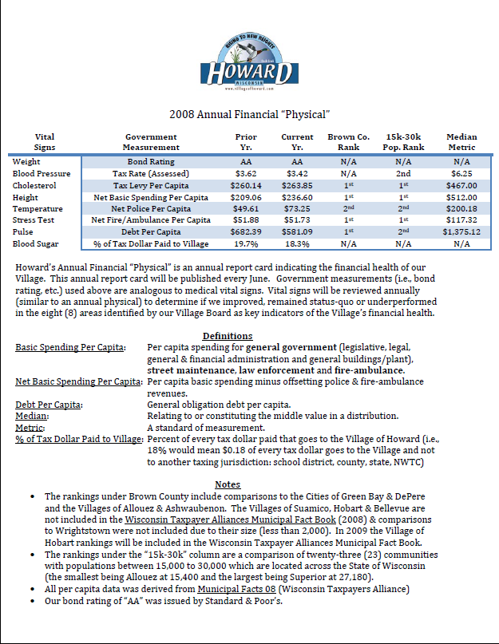
Howard, WI – “VillageTrack”
The Village’s Performance
Measurement initiative
(VillageTrack) implemented in
2007, prior to joining the ICMA
Center for Performance
Measurement (CPM) in
January 2008. The Village
tracks other performance
measures that ICMA CPM may
not and prepares an Annual
Financial Physical for
financial benchmarking
purposes.
Handout #1

Slide 4
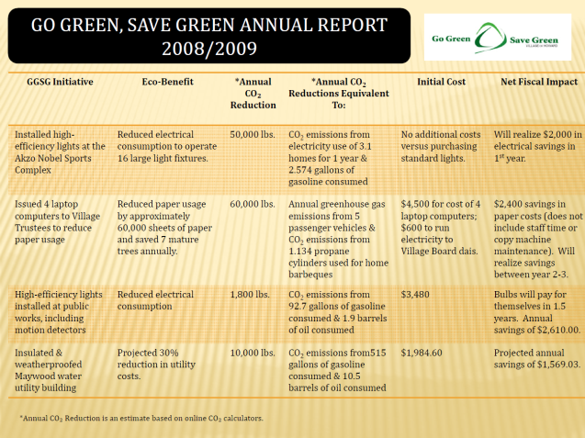
VillageTrack & G²SG
The Village Board created the Go Green, Save Green Task Force. The mission of this task force is:
Make policy recommendations which provide a sustainable benefit and recognizes cost-savings to our community
The first annual report was released on Earth Day (June 2009)
Handout #2

Slide 5
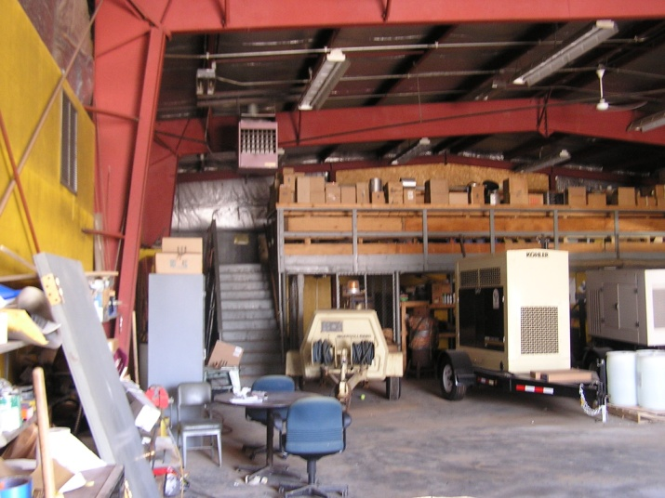
VillageTrack & G²SG
The first recommendation from the G²SG Task Force was to conduct energy audits of all Village buildings.
Buildings with high utility costs per square foot should be retrofitted with energy efficient upgrades (insulation, light bulbs, etc).

Slide 6
VillageTrack & G²SG
After conducting energy
Audits, the Village
completed building
efficiency retrofits in
February, the Village has
recognized a total utility
cost saving of $17,012
over a period of six
months. Annualized, this
would mean a savings of
$34,024 in FY 2009.

Slide 7
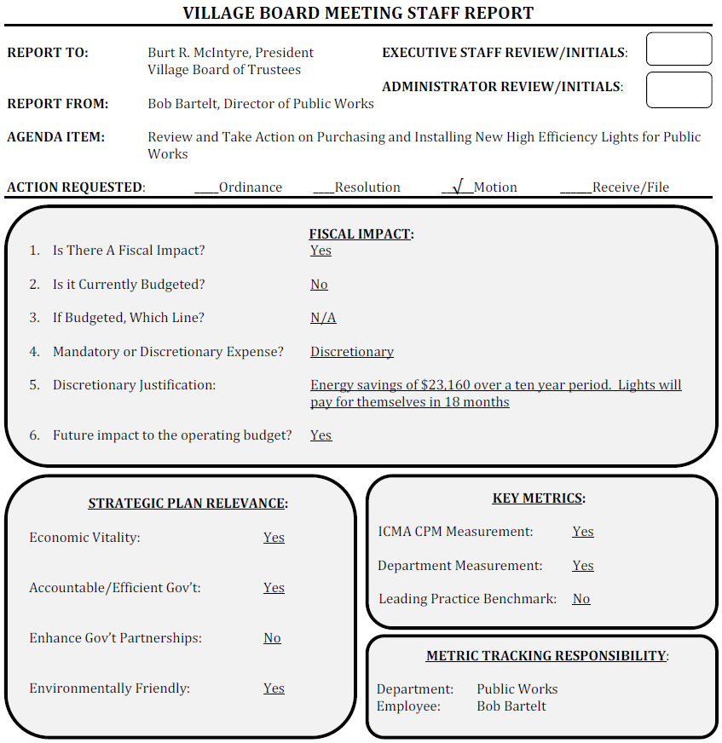
VillageTrack & G²SG
In 2008 the Village Board approved the purchase of energy efficient fluorescent light bulbs at a cost of $3,480.
Energy expenditure data collected in 2008 allowed staff to project monthly savings ($193.33) from the new lights & helped the Board make its decision.

Slide 8
VillageTrack & G²SG
GGSG Initiative | Eco-Benefit | *Annual CO₂ Reduction | *Annual CO₂ Reductions Equivalent To: | Initial Cost | Net Fiscal Impact
Installed high-efficiency lights at the Akzo Nobel Sports Complex | Reduced electrical consumption to operate 16 large light fixtures. | 50,000 lbs. | CO₂ emissions from electricity use of 3.1 homes for 1 year & 2.574 gallons of gasoline consumed | No additional costs versus purchasing standard lights. | Will realize $2,000 in electrical savings in 1st year.
Regulated Village Hall & park shelter temperatures at 68° during the day and 55° at night. Also reduced Public Works temperature | Reduced heating & cooling costs by 5%. | 3,100 lbs. at each building. | CO₂ emissions from 319 gallons of gasoline consumed & annual gas emissions from .52 passenger vehicles | No additional costs. | Varies by location. Projected annual heating/cooling cost savings of $2,631.23 at Village Hall and $2,033.18 at Public Works.
High-efficiency lights installed at public works, including motion detectors | Reduced electrical consumption | 1,800 lbs. | CO₂ emissions from 92.7 gallons of gasoline consumed & 1.9 barrels of oil consumed | $3,480 | Bulbs will pay for themselves in 1.5 years. Annual savings of $2,610.00.
Insulated & weatherproofed Maywood water utility building | Projected 30% reduction in utility costs. | 10,000 lbs. | CO₂ emissions from515 gallons of gasoline consumed & 10.5 barrels of oil consumed | $1,984.60 | Projected annual savings of $1,569.03.

Slide 9
VillageTrack & G²SG
Questions?
Further Village of Howard resources may be found at:
www.villageofhoward.com
More Questions? Call Joshua @
920/434-4673

